Slide 1
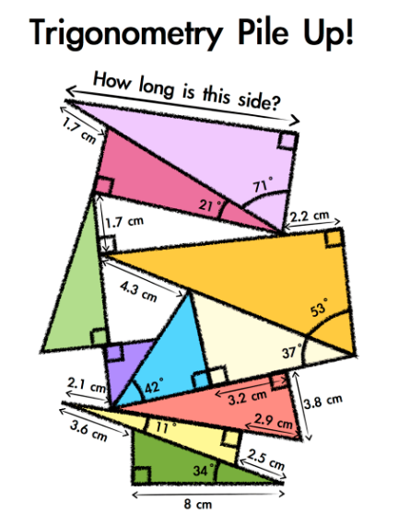
Notes:
Uses Cosine and Pythagoras…
Answer 12.07cm
Acknowledgemets: GreatMathsTeachingIdeas.com

Slide 2
Notes:
Acknowledgements: William Emeny @greatmathsteachingideas.com

