Slide 1
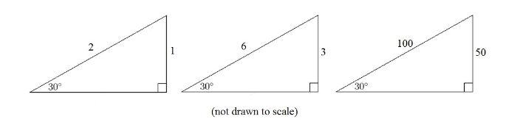



$$60°$$
$$60°$$
$$60°$$
Discuss: What do these triangles have in common?
Try to include these key words in your discussion:
Angle
Similar
Ratio
Hypotenuse
Adjacent
Notes:
Opposite : Hypotenuse
Need rulers, protractors, calculators (non scientific preferred)

Slide 2



On your whiteboards: What is the missing length?
$$60°$$
$$?$$
$$32 cm$$
Notes:
64 cm

Slide 3



On your whiteboards: What is the missing length?
$$6.5 cm$$
$$?$$
$$60°$$
Notes:
13cm

Slide 4



On your whiteboards: What is the missing length?
$$?$$
$$60°$$
$$22 cm$$
Notes:
11cm

Slide 5
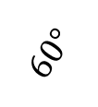

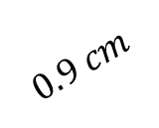
On your whiteboards: What is the missing length?
$$0.9 cm$$
$$60°$$
$$?$$
Notes:
0.45 cm or 4.5mm

Slide 6


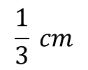
On your whiteboards: What is the missing length?
$$?$$
$$60°$$
$$\frac{1}{3} cm$$
Notes:
64 cm

Slide 7

Geogebra Demo
The ratio of the adjacent side to the hypotenuse in any right-angled with an angle of 60 degrees is 1:2
$$60°$$
hypotenuse
adjacent
Notes:
https://www.geogebra.org/m/QgTmeaA8#material/ET5MMAVn – alter angle 60 degrees.

Slide 8
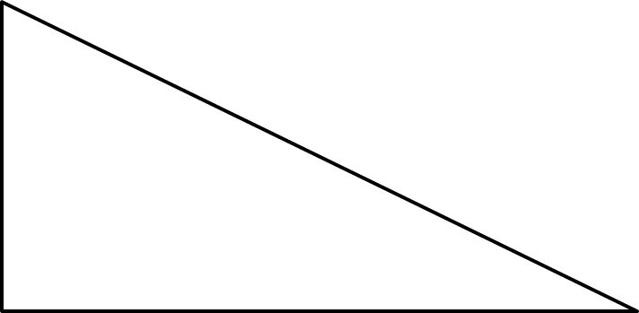
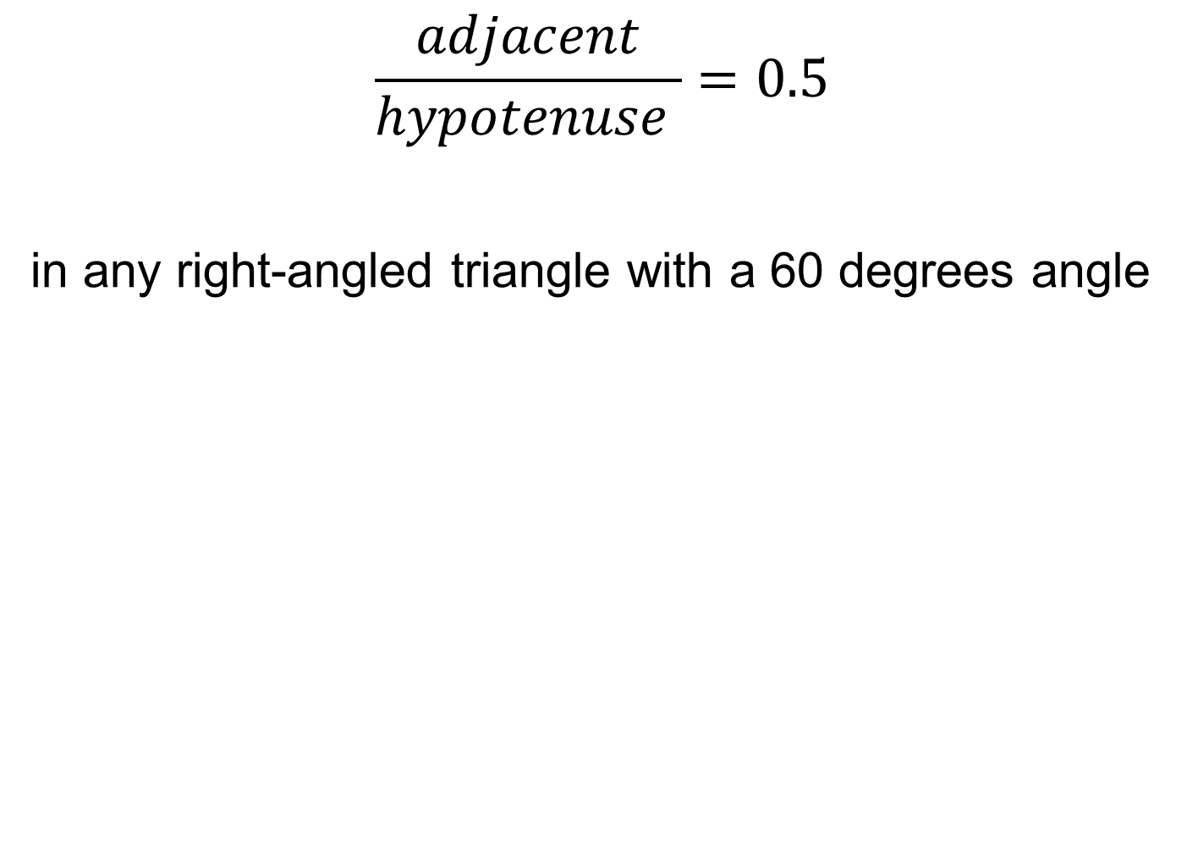


$$\frac{adjacent}{hypotenuse }=0.5$$
in any right-angled triangle with a 60 degrees angle
adjacent
$$60°$$
$$60°$$
hypotenuse
hypotenuse
adjacent
Notes:
https://www.geogebra.org/m/QgTmeaA8

Slide 9
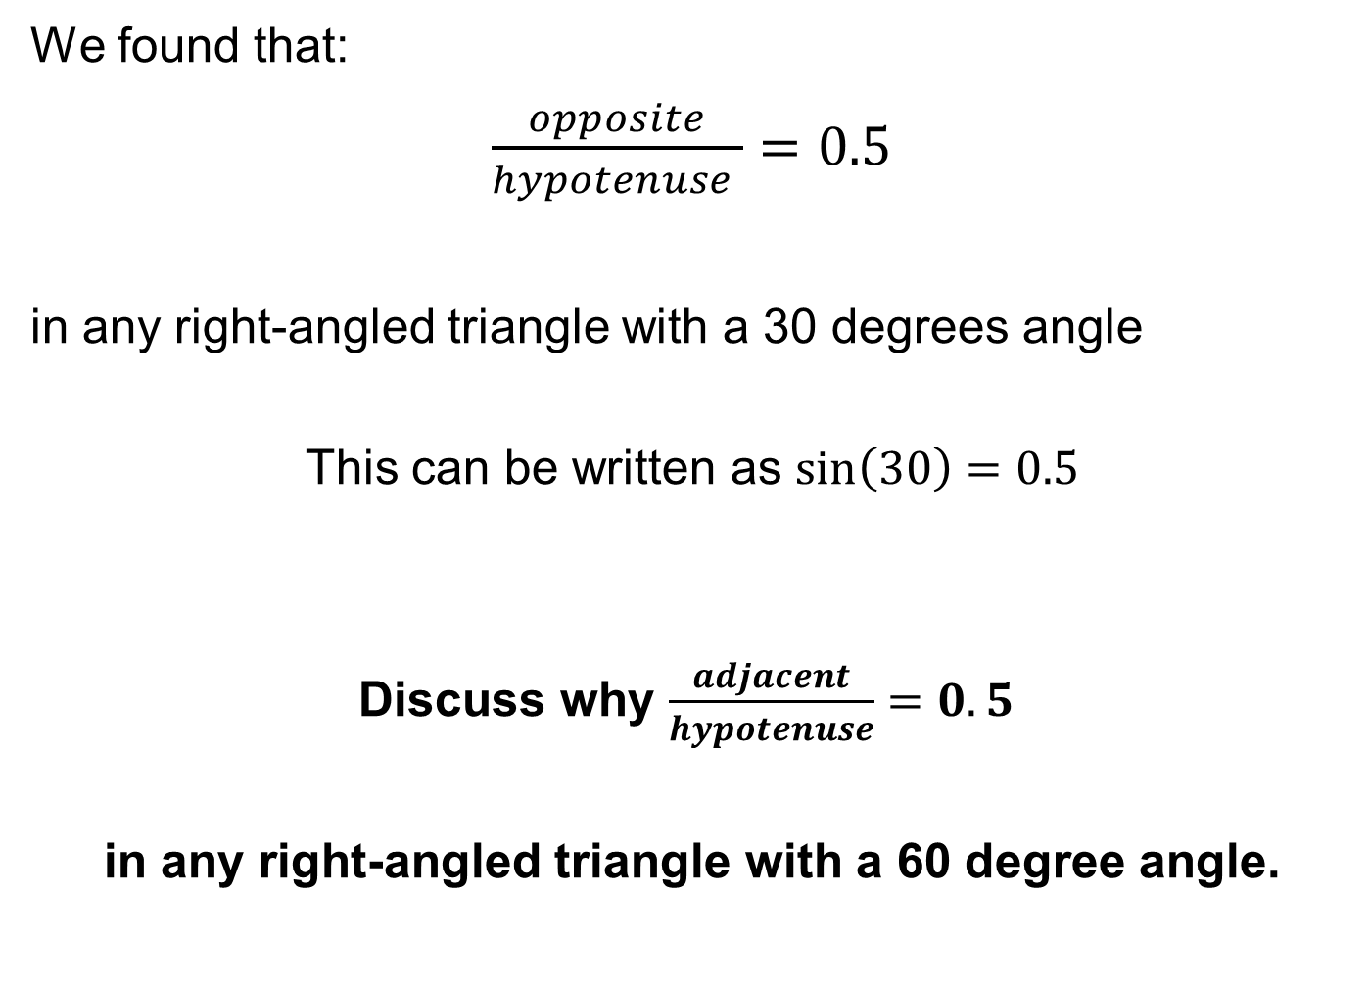
We found that:
$\frac{opposite}{hypotenuse }=0.5$
in any right-angled triangle with a 30 degrees angle
This can be written as $\sin\left(30\right)=0.5$
Discuss why $\frac{adjacent}{hypotenuse}=0.5$
in any right-angled triangle with a 60 degree angle.
Notes:
https://www.geogebra.org/m/QgTmeaA8

Slide 10
The ratio of the adjacent side to the hypotenuse in any right-angled triangle is called the COSINE ratio.
COSINE = SINE of the COMPLEMENT
Notes:
Complementary angles add up to 90 degrees, therefore the acute angles in a right-angled triangle are complementary.

Slide 11
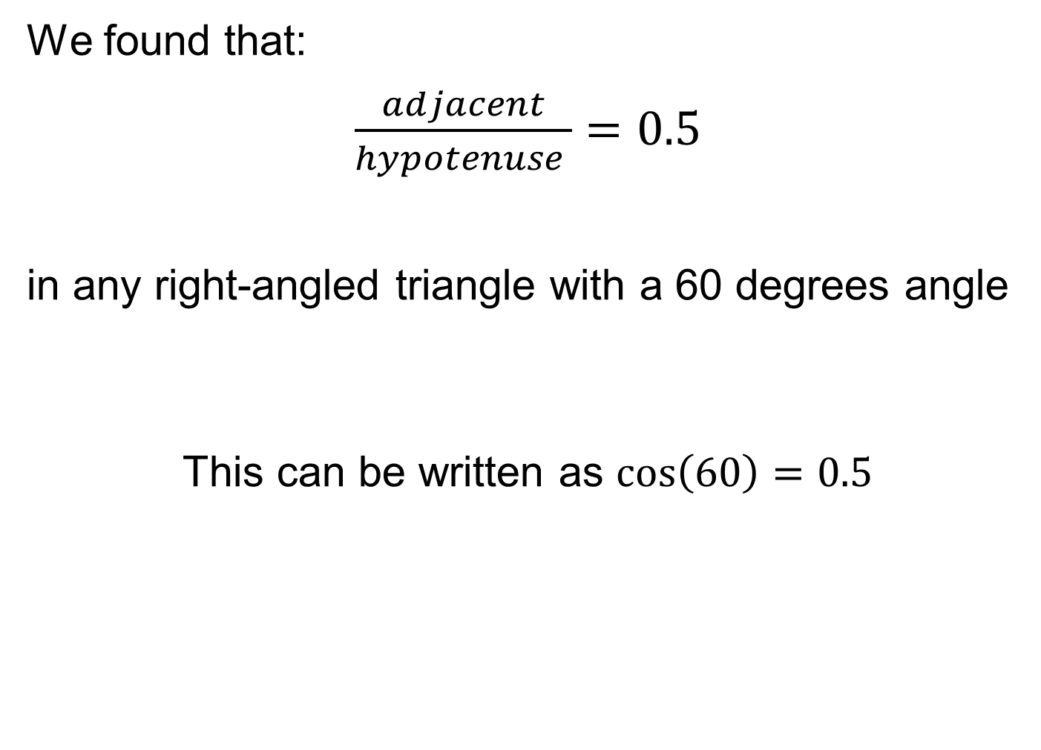
We found that:
$\frac{adjacent}{hypotenuse }=0.5$
in any right-angled triangle with a 60 degrees angle
This can be written as $\cos\left(60\right)=0.5$
Notes:
https://www.geogebra.org/m/QgTmeaA8

Slide 12
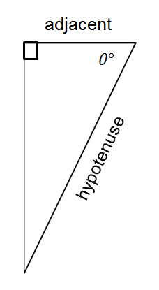
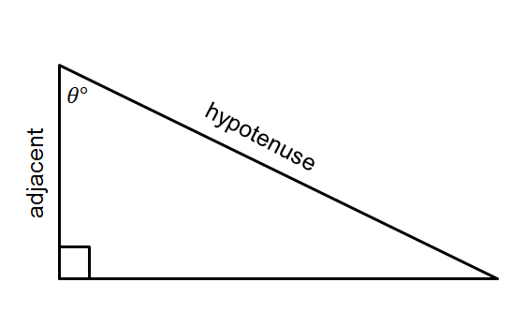
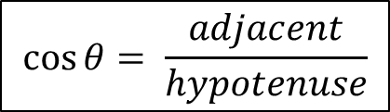
In your book…
Title: The COSINE Ratio
The ratio of the adjacent side to the hypotenuse in any right-angled triangle is called the COSINE ratio.
$$\cos{θ= \frac{adjacent}{hypotenuse}}$$
Remember the hypotenuse is the longest side of a right angled triangle and is always opposite the right angle.
The adjacent side is the side next to the acute angle given.
Notes:
Encourage students to make useful notes in their Maths book. Some students may benefit from formal notes and examples being written in a different colour to the exercises they complete.

Slide 13



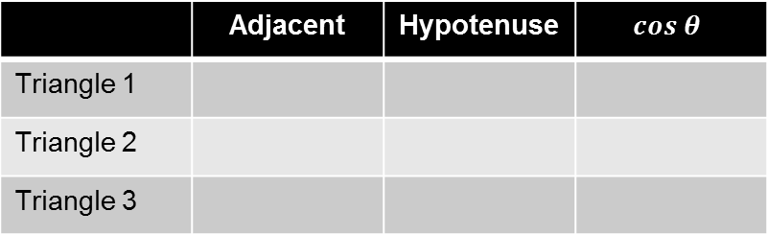






Copy and complete the table below using the three triangles you previously constructed in your book:
 | Adjacent | Hypotenuse | $$cos θ$$
Triangle 1
Triangle 2
Triangle 3
$$5cm$$
$$3.5cm$$
3
1
$$2.3cm$$
2
$$35°$$
$$45°$$
$$25°$$
$$5cm$$
$$5cm$$
$$5cm$$
Notes:
Students may check with their calculator..

Slide 14
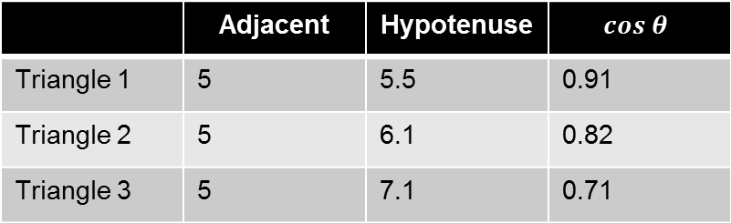
Mark your table…
 | Adjacent | Hypotenuse | $$cos θ$$
Triangle 1 | 5 | 5.5 | 0.91
Triangle 2 | 5 | 6.1 | 0.82
Triangle 3 | 5 | 7.1 | 0.71
Notes:
Acknowledgements:
Jo Morgan – http://www.resourceaholic.com
TeachItMaths - https://www.teachitmaths.co.uk/resources/ks4/trigonometry-sohcahtoa/trigonometry-introduction-booklet/16136
GeoGebra Institute of Hong Kong – Geogebra.org

Slide 15


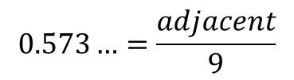







Worked Example
SUBTITLE: Using the Cosine ratio to find the adjacent length
Your Turn
$$14cm$$
$$?$$
$$62°$$
$$55°$$
$$?$$
$$9 cm$$
$$\cos\left(55\right)=0.573…$$
$$0.573…=\frac{adjacent}{9}$$
$$adjacent=0.573…×9$$
$$The opposite side is 5.16 cm$$
Notes:
Explicit Instruction
Try modelling the worked example in silence, without talking it through. This reduces “cognitive overload”.
Then ask students to describe each step or explain each step yourself after your silent demonstration
Students can use whiteboards to attempt “their turn” first, ask students to model their working out as you have.
Students to then record at least one of the examples in their Maths books.

Slide 16
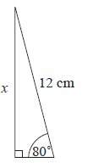
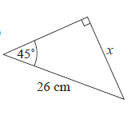
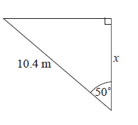
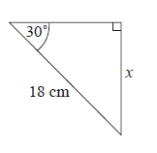







In your book…
Copy the questions and calculate the missing lengths to 2 decimal places.
$$c$$
$$a$$
$$d$$
$$b$$

Slide 17
Mark your work:
Copy the questions and calculate the missing lengths to 2 decimal places.
2.08
15.6
18.4
7.97
$$c$$
$$a$$
$$d$$
$$b$$

Slide 18
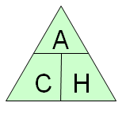
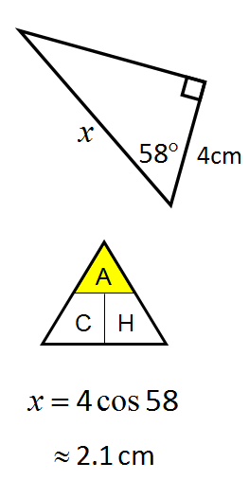
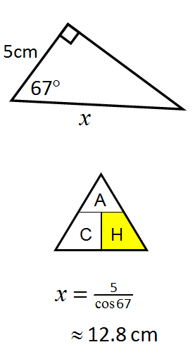
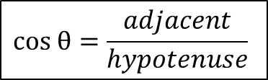
Some people find calculation triangles, like those used in Science, useful to know whether to multiply or divide
$$cos θ=\frac{adjacent}{hypotenuse}$$
Finding the adjacent
Finding the hypotenuse

Slide 19
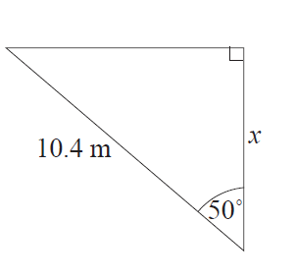
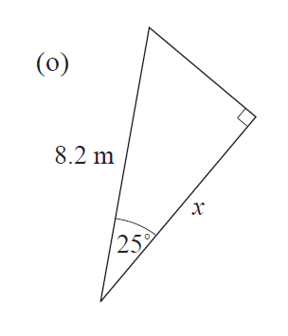
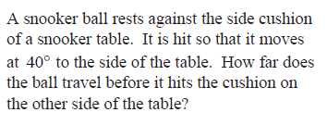
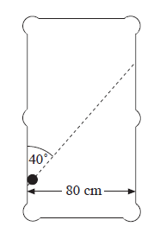
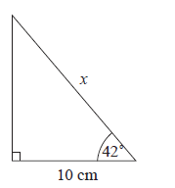



In your book…
Copy the questions and calculate the missing lengths to 2 decimal places.
d)
$$a$$
$$c$$
$$b$$

Slide 20
Mark your work..
a) 6.68m
b) 13.46m
c) 7.43m
d) 124.46cm

Slide 21
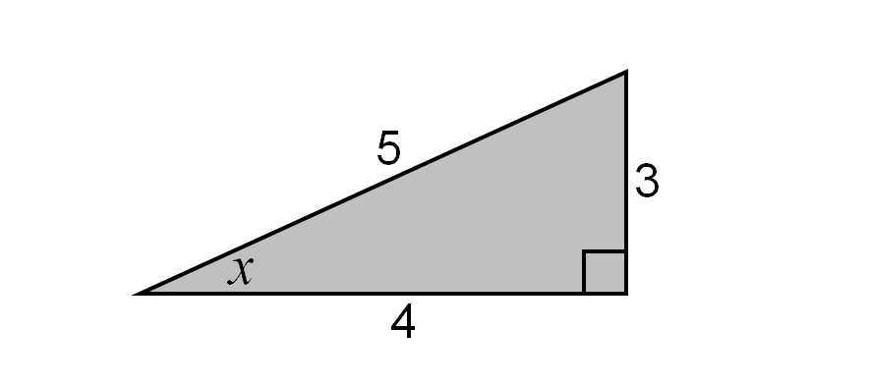
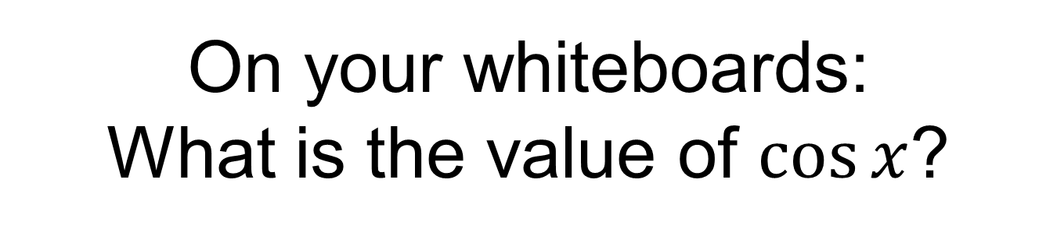
On your whiteboards:
What is the value of $cos⁡x$?

Slide 22
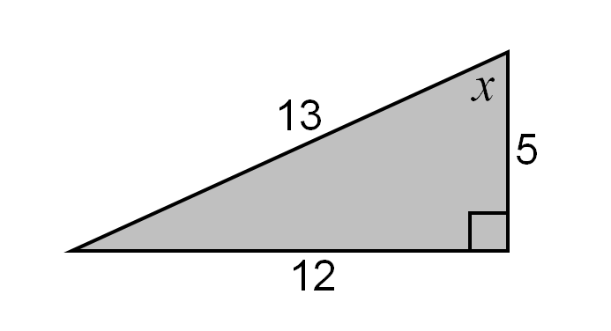
On your whiteboards:
What is the value of $cos⁡x$?

Slide 23
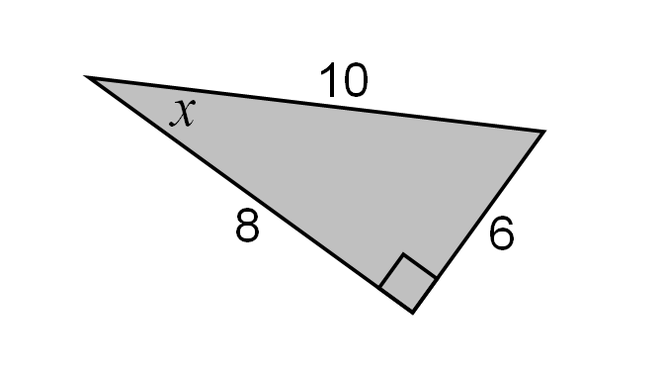
On your whiteboards:
What is the value of $cos⁡x$?

Slide 24
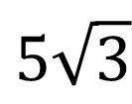
On your whiteboards:
What is the value of $cos⁡x$?
10
$$5\sqrt{3}$$

Slide 25
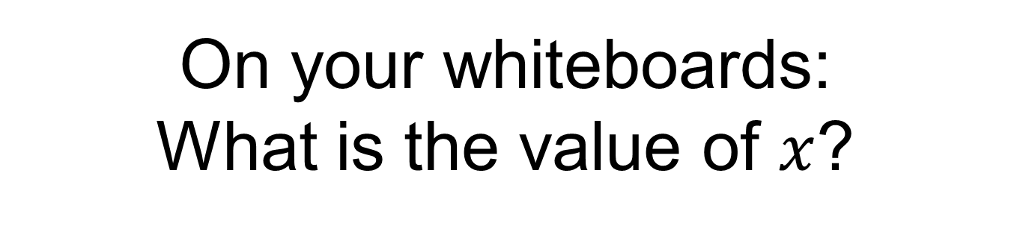
On your whiteboards:
What is the value of $x$?
10
$$5\sqrt{3}$$

Slide 26
The ratio of the adjacent side to the hypotenuse in any right-angled with an angle of 60 degrees is 1:2
$$60°$$
hypotenuse
adjacent

Slide 27
$$\frac{adjacent}{hypotenuse }=0.5$$
in any right-angled triangle with a 60 degrees angle
adjacent
$$60°$$
$$60°$$
hypotenuse
hypotenuse
adjacent
Notes:
https://www.geogebra.org/m/QgTmeaA8

Slide 28
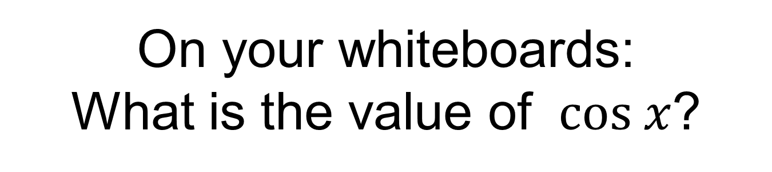
On your whiteboards:
What is the value of $cos x$?
11

Slide 29
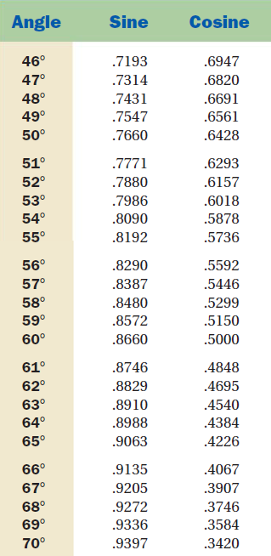
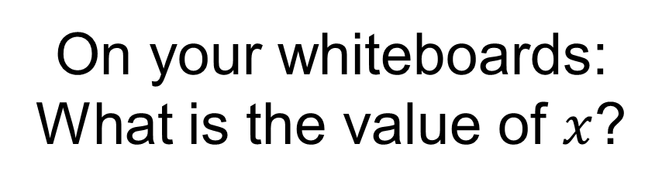
On your whiteboards:
What is the value of $x$?
11

Slide 30
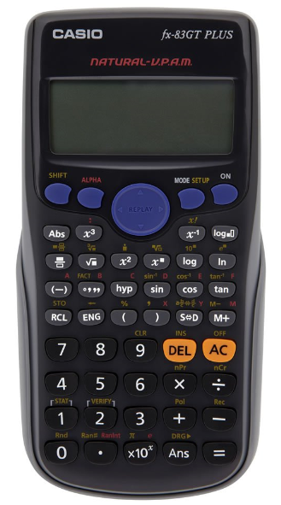



11
$$2\sqrt{3}$$
What is the value of $x$?
Press shift
Press cos
Enter $5÷11$
Close the bracket
Press =
$$x=62.96 (2 dp)$$

Slide 31
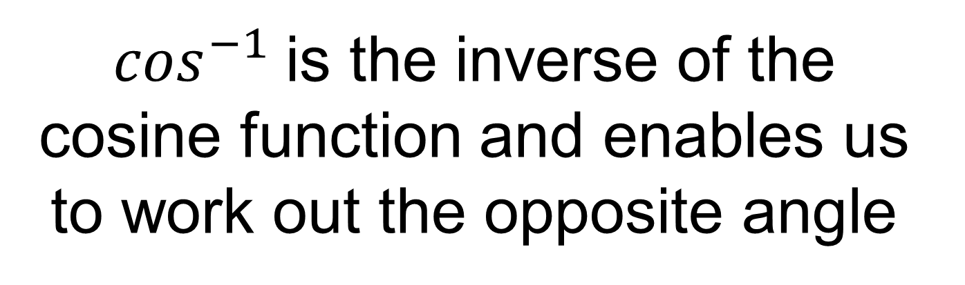
$\cos^{−1}$is the inverse of the cosine function and enables us to work out the opposite angle

Slide 32


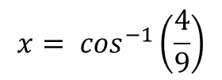
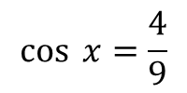

Worked Example
TITLE: Using inverse cosine to find the adjacent angle
Your Turn
$$14 cm$$
$$4 cm$$
$$x$$
$$x$$
$$11 cm$$
$$9 cm$$
$$\cos{ x=\frac{4}{9}}$$
$$x= \cos^{−1}\left(\frac{4}{9}\right)$$
$$x=63.6 (1dp)$$
Notes:
Explicit Instruction
Your Turn x = 38.2

Slide 33
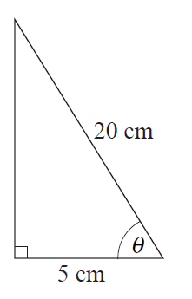
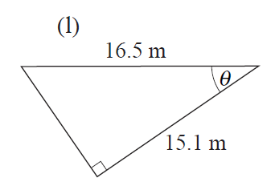
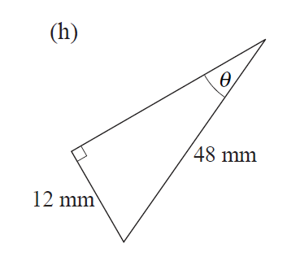
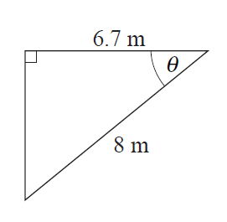




In your book…
Copy the questions and calculate the missing lengths to 2 decimal places.
$$c$$
$$a$$
$$d$$
$$b$$
Notes:
d) Students can now use sine or Pythagoras to find adjacent side or calculate unmarked angle to calculate theta

Slide 34
Mark your work…
75.52
b) 33.12
c) 23.77
d) 14.48

