Slide 1
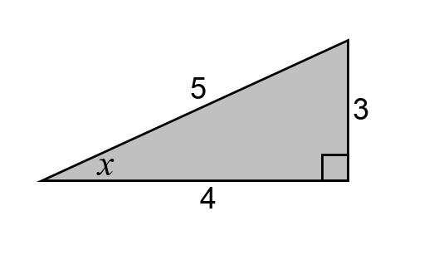

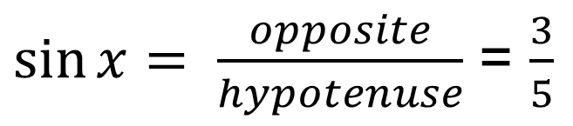
hypotenuse
opposite
What is the value of $sin⁡x$?
$\sin{x= \frac{opposite}{hypotenuse}}$ = $\frac{3}{5}$

Slide 2

What is the value of $sin⁡x$?

Slide 3
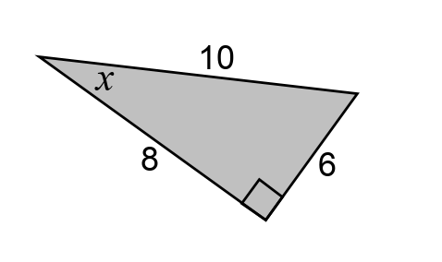
What is the value of $sin⁡x$?

Slide 4
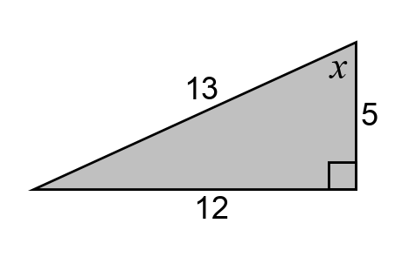
What is the value of $sin⁡x$?

Slide 5

4
2
$$2\sqrt{3}$$
What is the value of $sin⁡x$?

Slide 6
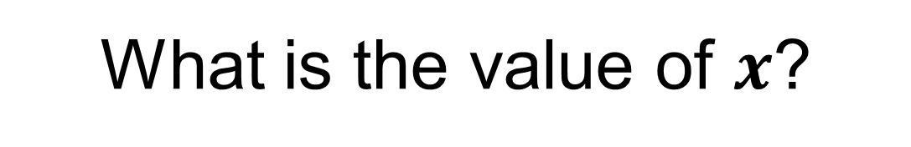
4
2
$$2\sqrt{3}$$
What is the value of $x$?

Slide 7


$$x=30°$$
because he ratio of the opposite side to the hypotenuse in any right-angled with an angle of 30 degrees is 1:2
hypotenuse
opposite
$$30°$$

Slide 8
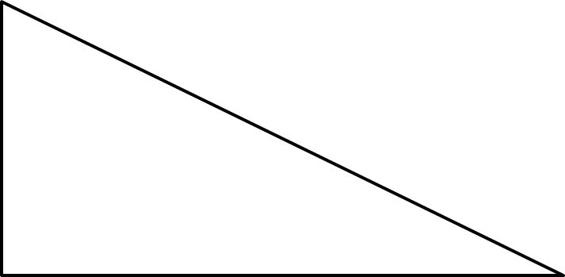
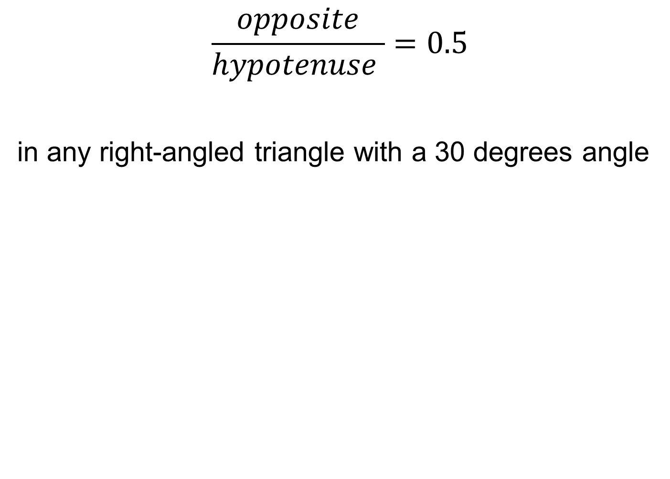

$$\frac{opposite}{hypotenuse }=0.5$$
in any right-angled triangle with a 30 degrees angle
opposite
hypotenuse
hypotenuse
opposite
$$30°$$
$$30°$$

Slide 9
4
1
$$2\sqrt{3}$$
What is the value of $sin⁡x$?

Slide 10
4
1
$$2\sqrt{3}$$
What is the value of $x$?

Slide 11
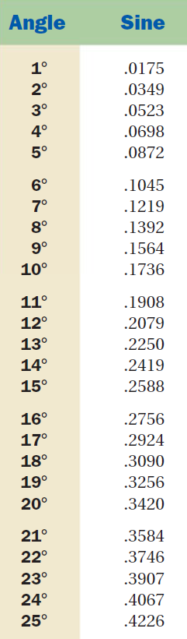

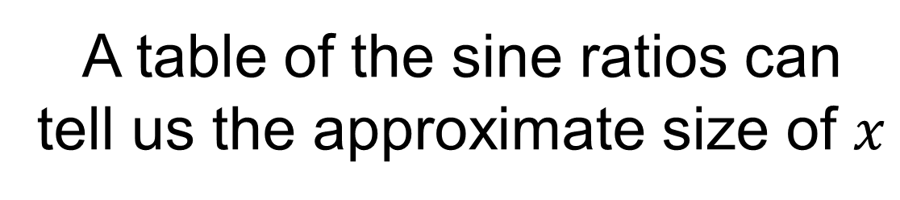
4
1
$$2\sqrt{3}$$
A table of the sine ratios can tell us the approximate size of $x$
$$x is between 14° and 15°$$

Slide 12

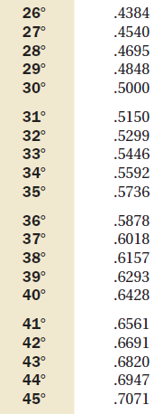
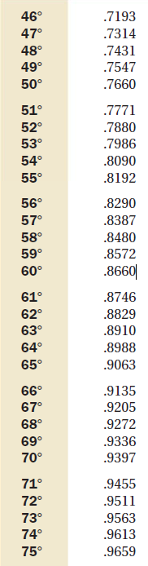
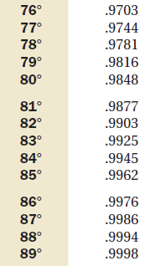
Notes:
Print off for students to refer to

Slide 13
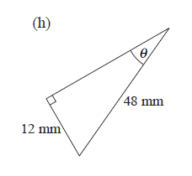
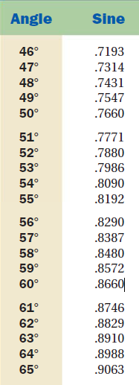
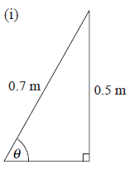
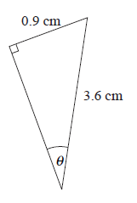
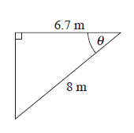
Find the approximate size of the angles using the table of sine ratios
1.
3.
2.
4.
Notes:
Question 4 – students may need prompting to calculate unmarked angle or use Pythagoras to work out missing length. Do not introduce cosine yet,

Slide 14
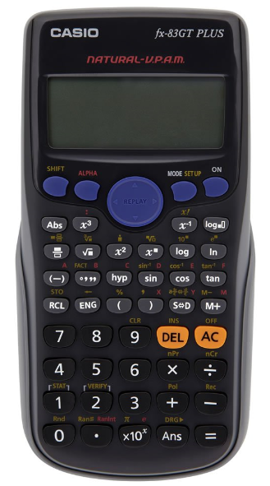



A calculator can be used to help us work out the missing angle more precisely.
4
1
$$2\sqrt{3}$$
What is the value of $x$?
Press shift
Press sin
Enter 0.25 or ¼
Close the bracket
Press =
$$x=14.48 (2 dp)$$

Slide 15
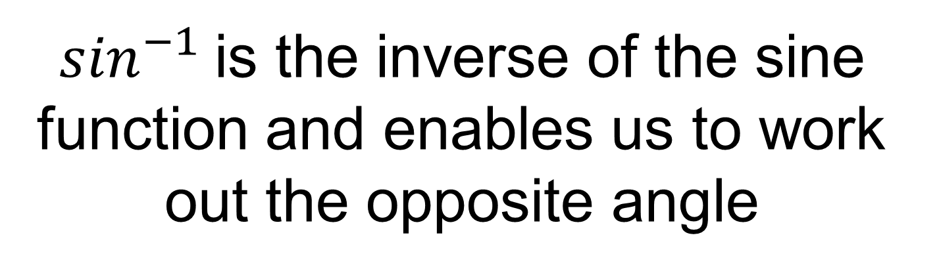
$\sin^{−1}$is the inverse of the sine function and enables us to work out the opposite angle

Slide 16


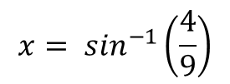
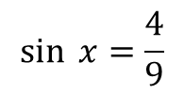





Worked Example
TITLE: Using inverse sine to find the opposite angle
Your Turn
$$14 cm$$
$$4 cm$$
$$x$$
$$x$$
$$11 cm$$
$$9 cm$$
$$\sin{ x=\frac{4}{9}}$$
$$x= \sin^{−1}\left(\frac{4}{9}\right)$$
$$x=26.4 (1dp)$$
Notes:
Explicit Instruction x = 51.8

Slide 17
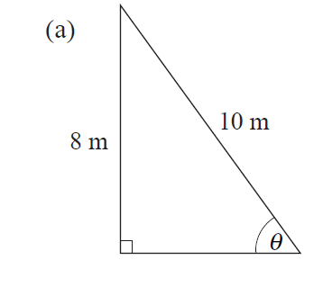
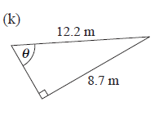
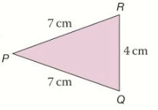
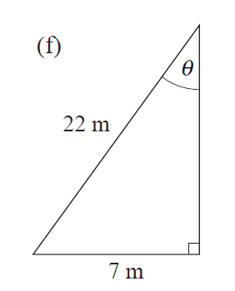







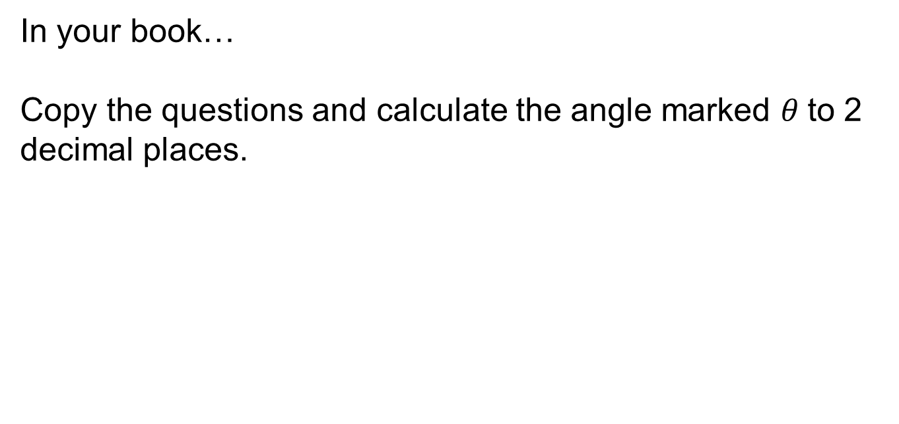
In your book…
Copy the questions and calculate the angle marked $θ$to 2 decimal places.
$$a$$
$$c$$
$$e) Work out angle RPQ$$
$$d$$
$$b$$
Notes:
Question a, b, c– standard questions
Question d – non-standard.
Question e – non – standard. Some students may need encouraging to draw a relevant right-angled triangle first.
Question f – non – standard. As above.

Slide 18
Mark your work…
a) 51.13
18.55
45.49
75.52
33.20

Slide 19
1. A ladder leans against a wall. The length of the ladder is 4 metres and the base is 2 metres from the wall.
Find the angle between the ladder and the wall.
2. As cars drive up a ramp at a multi-storey carpark, they go up 2 metres. The length of the ramp is 10 metres.
Find the angle between the ramp and the horizontal..
3. An isosceles triangle has side lengths 10cm, 13cm and 13cm. Work out all of the missing angles in the triangle.
Worded Questions
Notes:
If needed..

Slide 20
Mark your work…
30
11.54
45.24, 67.38, 67.38
Notes:
Acknowledgements:
CMIT
Dan Walker

