Slide 1



On your whiteboards:
What is the missing length?
$$10cm$$
$$?$$
$$30°$$
Notes:
Finding the hypotenuse given the opposite
Scientific Calculators needed for this lesson.
Includes rounding to 3 significant figures

Slide 2



On your whiteboards:
What is the missing length?
$$30°$$
$$?$$
Show your calculation
And another…
And another…
$$9cm$$
Notes:
Would like to see 9 x 2 = 9 / 0.5 = 9 / sin 30 etc..

Slide 3



On your whiteboards:
What is the missing length?
$$30°$$
$$14cm$$
$$?$$
Show your calculation
And another…
And another…

Slide 4



On your whiteboards:
What is the missing length to 3 significant figures?
$$50°$$
$$?$$
$$11cm$$
14.4

Slide 5



On your whiteboards:
What is the missing length to 3 significant figures?
$$50°$$
13.1
$$?$$
$$10cm$$

Slide 6



On your whiteboards:
What is the missing length to 3 significant figures?
15.7cm
$$?$$
$$40°$$
$$10.1cm$$
Show your calculation
And another…
And another…

Slide 7
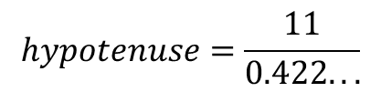

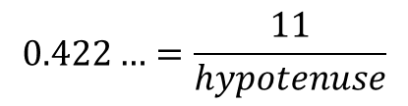







Worked Example
TITLE: Using the Sine ratio to find the hypotenuse
Your Turn
$$?$$
$$11 cm$$
$$42°$$
$$14cm$$
$$25°$$
$$?$$
$$\sin\left(25\right)=0.422…$$
$$0.422…=\frac{11}{hypotenuse}$$
$$hypotenuse=\frac{11}{0.422...}$$
$$The hypotenuse is 26.1 cm (3 sf)$$
Notes:
Explicit Instruction
Try modelling the worked example in silence, without talking it through. This reduces “cognitive overload”.
Then ask students to describe each step or explain each step yourself after your silent demonstration
Students can use whiteboards to attempt “their turn” first, ask students to model their working out as you have.
Students to then record at least one of the examples in their Maths books.
? = 20.9

Slide 8
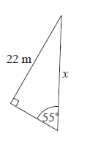
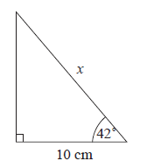
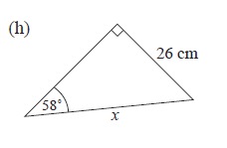
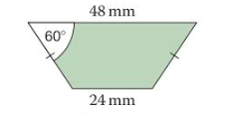







In your book…
Copy the questions and calculate the missing lengths to 3 significant figures.
$$c$$
$$a$$
$$d) Find perimeter of this isosceles trapezium$$
$$b$$
Notes:
Question a, b – standard questions
Question c – non-standard. Some students may need the hint to calculate and use the “missing” angle.
Question d – non – standard. Some students may need encouraging to draw a relevant right-angled triangle first and use the 30 degrees to calculate the hypotenuse.

Slide 9
Mark your work…
26.9
30.7
13.5
120
Notes:
Acknowledgements:
GeoGebra Institute of Hong Kong, Alex CHIK
Craig Barton = How I wish I taught Maths, Chapter 6

Slide 10
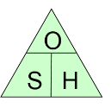
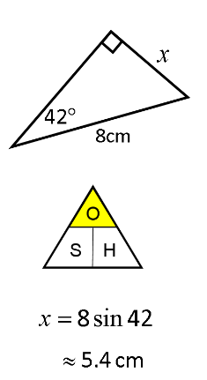
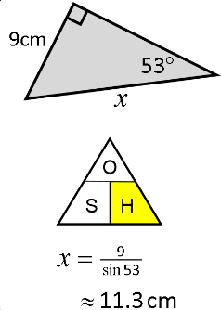
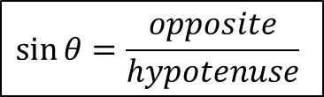
Some people find calculation triangles, like those used in Science, useful to know whether to multiply or divide
$$\sin{θ}=\frac{opposite}{hypotenuse}$$
Finding the opposite
Finding the hypotenuse

Slide 11

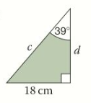

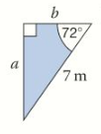
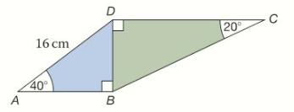




In your book…
Copy the questions and calculate the missing lengths to 3 significant figures.
$$a$$
$$c$$
$d) Find$ BC
$$b$$
Notes:
Question a, b – finding opposite
Question c – finding hypotenuse
Question d – both

Slide 12
Mark your work…
7.55
6.66
28.6
30.1
Notes:
Acknowledgements:
Dan Walker
Craig Barton – How I wish I Taught Maths Chapter 6

Slide 13
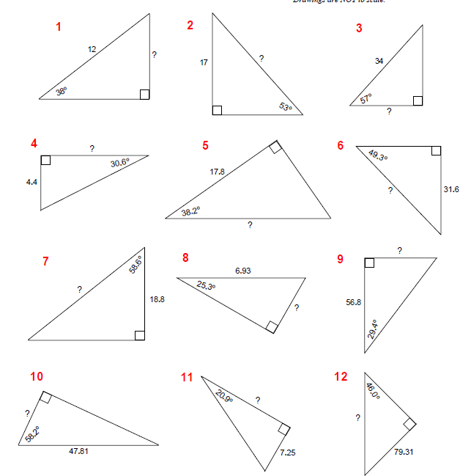
More Practise
Notes:
If needed..

Slide 14
Mark your work…
7.39 9) 21.1
21.3 10) 19.0
18.5 11) 110
22.7 12)110
41.7
36.1
2.96
2.96
Notes:
Acknowledgements:
Dan Walker
Craig Barton – How I wish I Taught Maths Chapter 6

