Slide 1
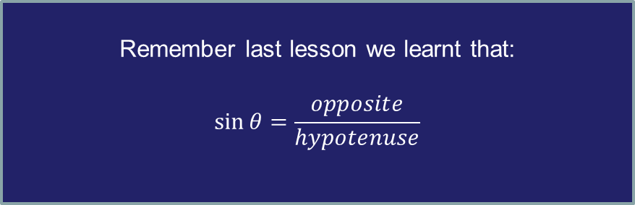
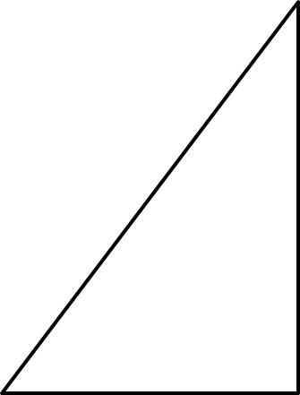




What is sin (60)?
$$2$$
$$\sqrt{3}$$
$$60°$$
$$1$$
Remember last lesson we learnt that:
$$\sin{θ}=\frac{opposite}{hypotenuse}$$
Notes:
Finding the opposite given the hypotenuse
Scientific Calculators needed for this lesson.

Slide 2
A scientific calculator can also be used to tell us the ratio of the opposite side to the hypotenuse in a right-angled triangle.

Slide 3
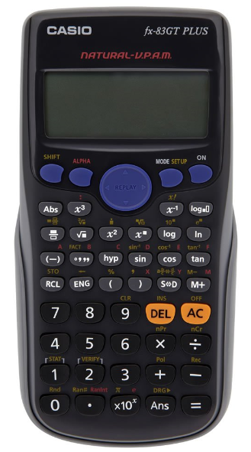

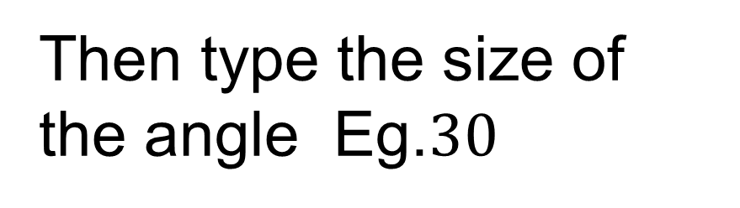
What is sin (60)?
Find and press
Then type the size of the angle Eg.$30$
Press to close the bracket
Then press
To convert this fraction to a decimal use
Notes:
Mention how we need to see Deg or D at the top of their calculator display

Slide 4
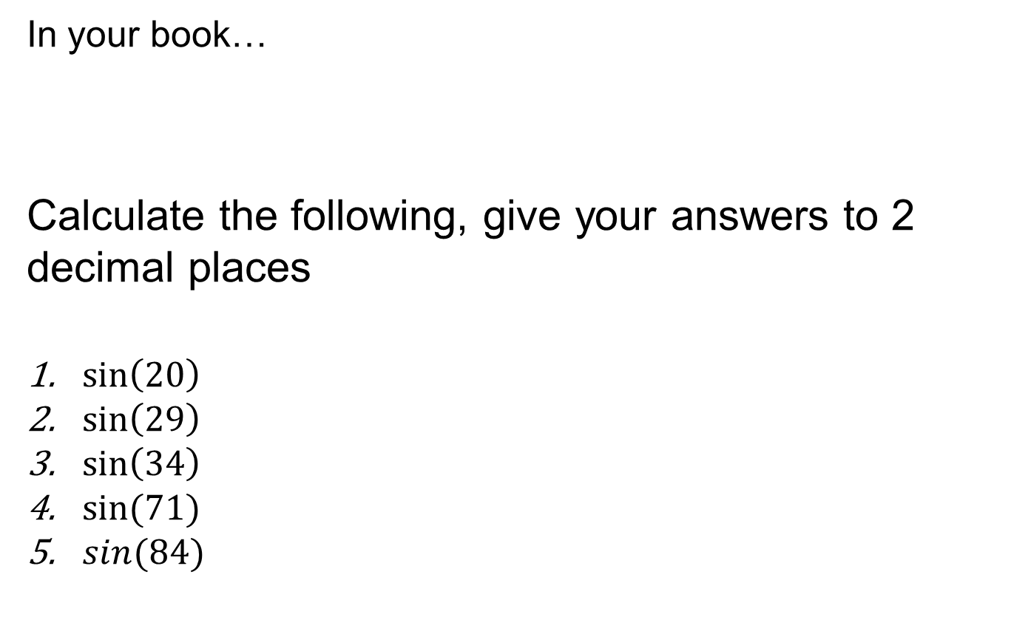
In your book…
Calculate the following, give your answers to 2 decimal places
$\sin\left(20\right)$
$\sin\left(29\right)$
$\sin\left(34\right)$
$sin⁡(71)$
$sin(84)$

Slide 5
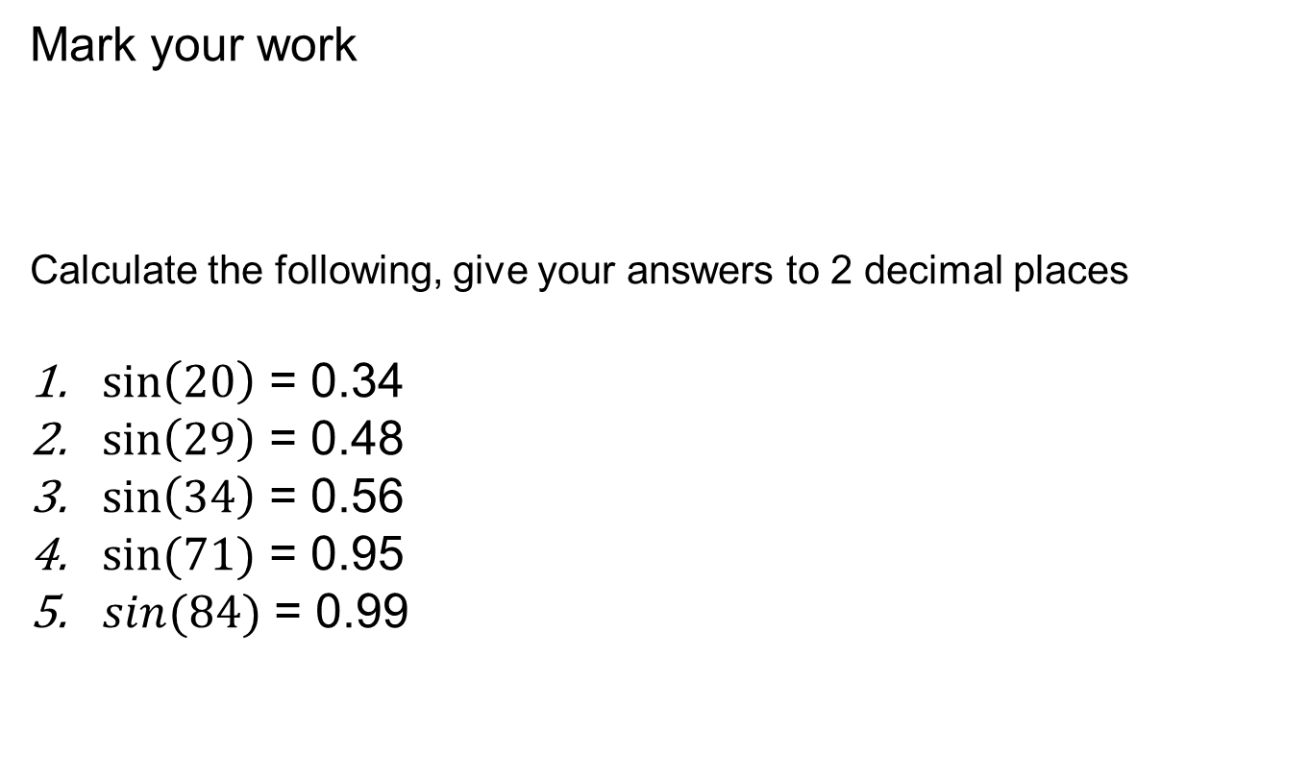
Mark your work
Calculate the following, give your answers to 2 decimal places
$\sin\left(20\right)$ = 0.34
$\sin\left(29\right)$ = 0.48
$\sin\left(34\right)$ = 0.56
$sin⁡(71)$ = 0.95
$sin(84)$ = 0.99

Slide 6
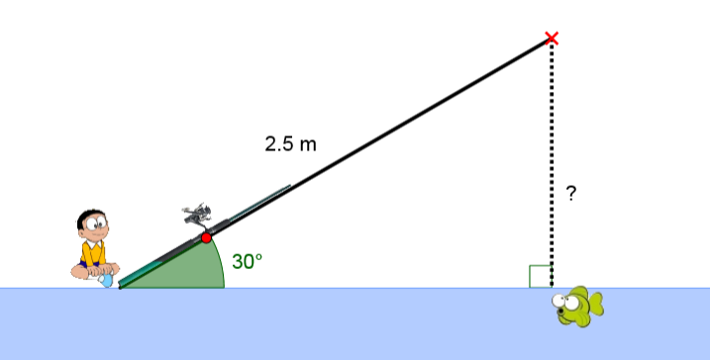
We know sin(30) = 0.5
On your whiteboards work out the missing length.
1.25

Slide 7
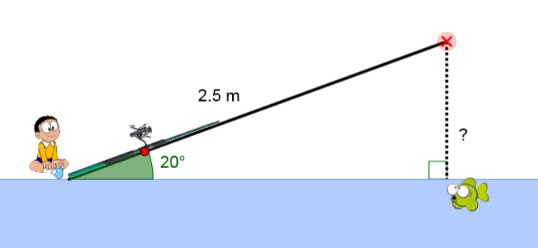
We know sin(20) = 0.34
On your whiteboards work out the missing length
0.85

Slide 8
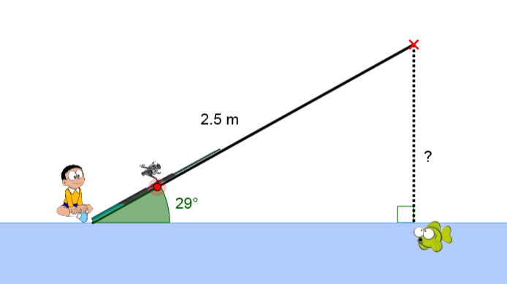
We know sin(29) = 0.48
On your whiteboards work out the missing length
1.2

Slide 9










Worked Example
TITLE: Using the Sine ratio to find the opposite length
Your Turn
$$14cm$$
$$?$$
$$62°$$
$$35°$$
$$?$$
$$9 cm$$
$$\sin\left(35\right)=0.573…$$
$$0.573…=\frac{opposite}{9}$$
$$opposite=0.573…×9$$
$$The opposite side is 5.16 cm$$
Notes:
Explicit Instruction
Try modelling the worked example in silence, without talking it through. This reduces “cognitive overload”.
Then ask students to describe each step or explain each step yourself after your silent demonstration
Students can use whiteboards to attempt “their turn” first, ask students to model their working out as you have.
Students to then record at least one of the examples in their Maths books.
? = 12.36 (2 dp)

Slide 10
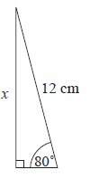
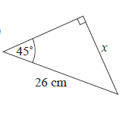
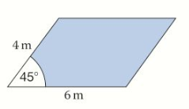
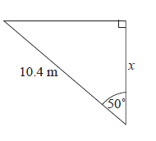
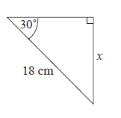
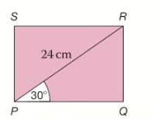
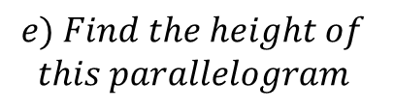



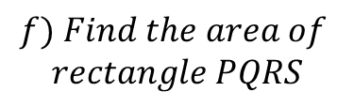


In your book…
Copy the questions and calculate the missing lengths to 2 decimal places.
$$e) Find the height of$$
$$this parallelogram$$
$$c$$
$$a$$
$$f) Find the area of$$
$$rectangle PQRS$$
$$b$$
$$d$$
Notes:
Question a, b, c– standard questions
Question d – non-standard. Some students may need the hint to calculate and use the “missing” angle.
Question e – non – standard. Some students may need encouraging to draw a relevant right-angled triangle first.
Question f – non – standard. Do not introduce cosine yet. Encourage students to use angle PQR to find the other dimension using sine ratio.

Slide 11
Mark your work…
11.82
9.00
18.38
6.68
2.83
249.42
Notes:
Acknowledgements:
GeoGebra Institute of Hong Kong, Alex CHIK
CMIT
Craig Barton = How I wish I taught Maths, Chapter 6

Slide 12
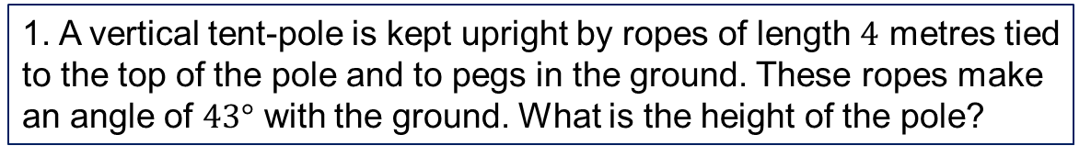
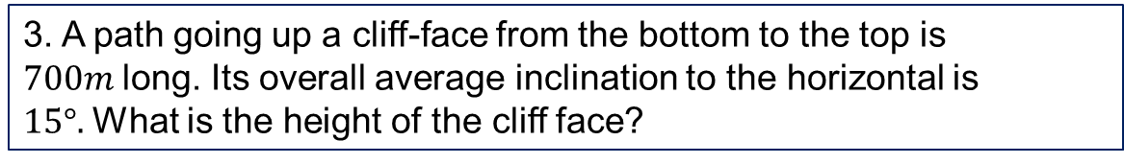
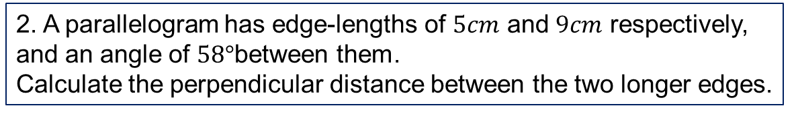
1. A vertical tent-pole is kept upright by ropes of length $4$ metres tied to the top of the pole and to pegs in the ground. These ropes make an angle of $43°$ with the ground. What is the height of the pole?
2. A parallelogram has edge-lengths of $5cm$ and $9cm$ respectively, and an angle of $58°$between them.
Calculate the perpendicular distance between the two longer edges.
3. A path going up a cliff-face from the bottom to the top is $700m$long. Its overall average inclination to the horizontal is $15°.$What is the height of the cliff face?
Worded Questions
Notes:
If needed..

Slide 13
Mark your work…
2.73
4.24
181.17
Notes:
Acknowledgements:
GeoGebra Institute of Hong Kong, Alex CHIK
CMIT
Craig Barton = How I wish I taught Maths, Chapter 6

