Slide 1


What is the missing length? How do you know?
$$x$$
$$30°$$
20 cm
Notes:
Need rulers, protactors and pairs of compasses for this lesson

Slide 2
The angle is not 90 degrees
$$x$$
$$30°$$
20 cm
$$∴ x≠10 cm$$
Therefore x is not equal to 10 cm

Slide 3
Labelling a non right angled triangle
c
A
B
b
a
C
Angles are marked with capital letters
Opposite sides with lower case letters

Slide 4



Draw this triangle with a ruler and pair of compasses
$$72°$$
6.1 cm
5.8 cm
$$56°$$
$$52°$$
7 cm
Now measure all of the angles with a protractor

Slide 5
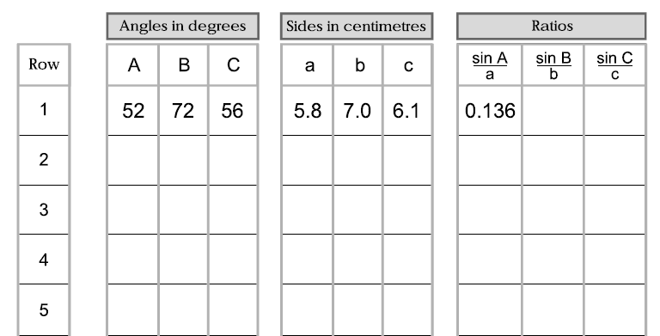
Complete the first row of the table
Now draw a different triangles of your choice
and complete each row
Notes:
This activity consolidates the labelling of angles and lengths of a non-right angled triangle

Slide 6
What do you notice?
Notes:
Complete the table with triangles from the class

Slide 7
You can cut any triangle into two right angled triangles

Slide 8
You can cut any triangle into two right angled triangles
another way

Slide 9
You can cut any triangle into two right angled triangles a third way

Slide 10
Even if it has an obtuse angle
You can cut any triangle into two right angled triangles

Slide 11
h
c
looking at both of the right angled triangles
sin B =
c sin B = h
h
b
sin C =
b
c
h
b sin C = h
B
C
c sin B =
b sin C
sin B
b
sin C
c
=

Slide 12
k
b
looking at both of the right angled triangles
sin A =
b sin A = k
A
k
a
b
sin B =
a sin B = k
k
B
a
b sin A =
a sin B
sin A
a
sin B
b
sin C
c
=
=

Slide 13
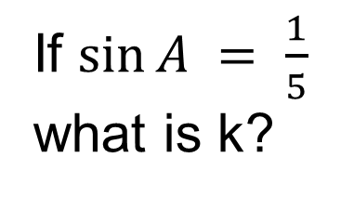
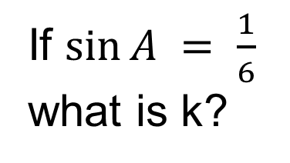
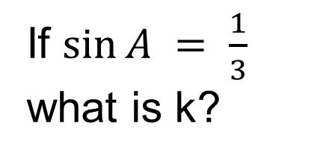
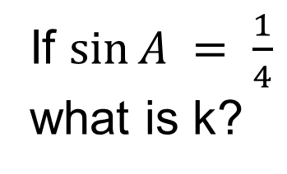
Challenge
If $sin⁡A = \frac{1}{4}$
what is k?
If $sin⁡A = \frac{1}{5}$
what is k?
k
4
150º
A
If $sin⁡A = \frac{1}{3}$
what is k?
If $sin⁡A = \frac{1}{6}$
what is k?
Notes:
Acknowledgements: SMILE Mathematics, Don Steward and Jo Frost

