Slide 1
In pairs: Using an equilateral triangle whose sides are 2 units in length, work out values for the sine, cosine and tangent of 60º and 30º.
30º
2
2
?
√3
60º
?
1
2
?
1

Slide 2
30º
2
2
√3
60º
1
1
√3
1
Cos 60º
√3
=
Tan 60º
Sin 60º
=
=
2
2
1
√3
1
Cos 30º
=
Tan 30º
Sin 30º
=
=
2
2
√3

Slide 3
In pairs: Using a right angled isosceles triangle whose equal sides are 1 unit in length, work out the values for the sine, cosine and tangent of 45º.
45º
√2
1
45º
1

Slide 4
45º
√2
1
45º
1
1
1
Cos 45º
Sin 45º
=
=
√2
√2
Tan 45º
1
=

Slide 5
Cos 0º
= 1
Tan 0º
0
Sin 0º
= 0
=
Sin 90º
= 1
Cos 90º
= 0
We will look at why these ratios are true when we look at graphs later this half term.

Slide 6
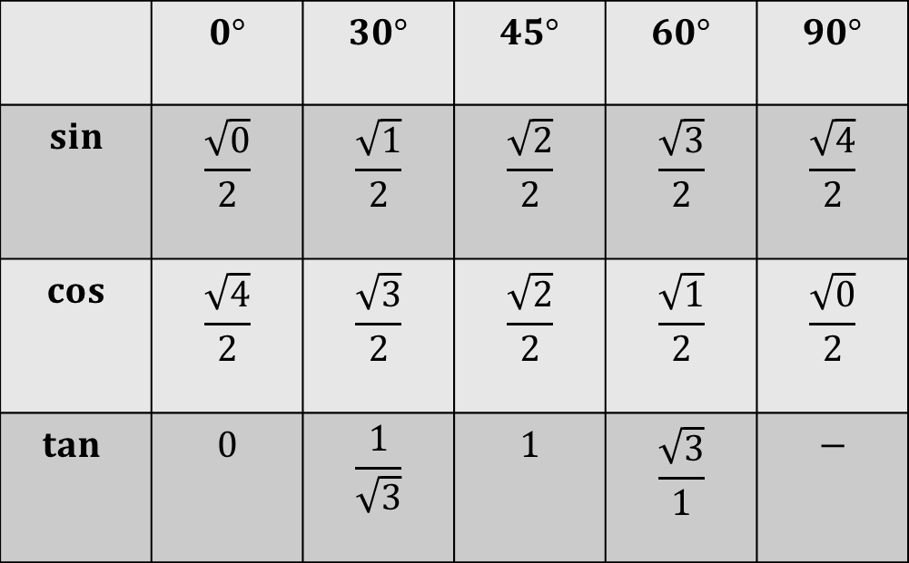
We need to be able to work out and memorise the values of sine, cosine and tangent for 0⁰, 30⁰, 45⁰, 60⁰, and 90⁰. Some people find the following pattern helpful:
 | $$0°$$ | $$30°$$ | $$45°$$ | $$60°$$ | $$90°$$
$$sin$$ | $$\frac{\sqrt{0}}{2}$$ | $$\frac{\sqrt{1}}{2}$$ | $$\frac{\sqrt{2}}{2}$$ | $$\frac{\sqrt{3}}{2}$$ | $$\frac{\sqrt{4}}{2}$$
$$cos$$ | $$\frac{\sqrt{4}}{2}$$ | $$\frac{\sqrt{3}}{2}$$ | $$\frac{\sqrt{2}}{2}$$ | $$\frac{\sqrt{1}}{2}$$ | $$\frac{\sqrt{0}}{2}$$
$$tan⁡$$ | $$0$$ | $$\frac{1}{\sqrt{3}}$$ | $$1$$ | $$\frac{\sqrt{3}}{1}$$ | $$−$$
Notes:
Print out for students to refer to during the lesson

Slide 7

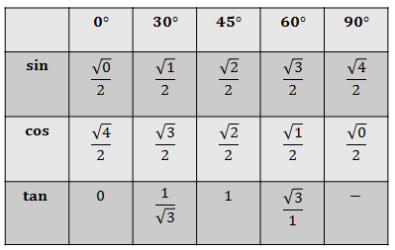

Explain how $\frac{\sqrt{0}}{2}=0$

Slide 8


Explain how $\frac{\sqrt{4}}{2}=1$

Slide 9
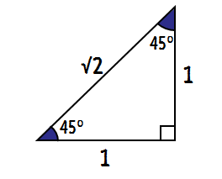
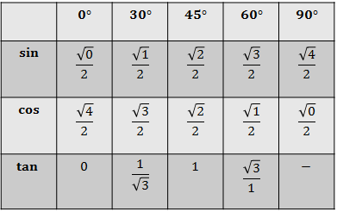

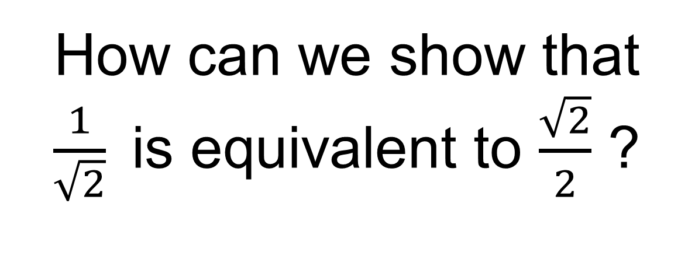
How can we show that $\frac{1}{\sqrt{2}}$is equivalent to $\frac{\sqrt{2}}{2}$ ?

Slide 10
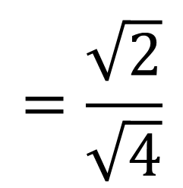
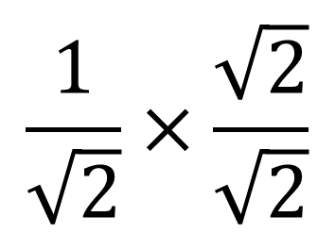
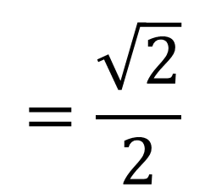
$$\frac{1}{\sqrt{2}}×\frac{\sqrt{2}}{\sqrt{2}}$$
$$=\frac{\sqrt{2}}{\sqrt{4}}$$
$$=\frac{\sqrt{2}}{2}$$
This is called
“rationalising the denominator”
There is now no irrational number in the denominator

Slide 11
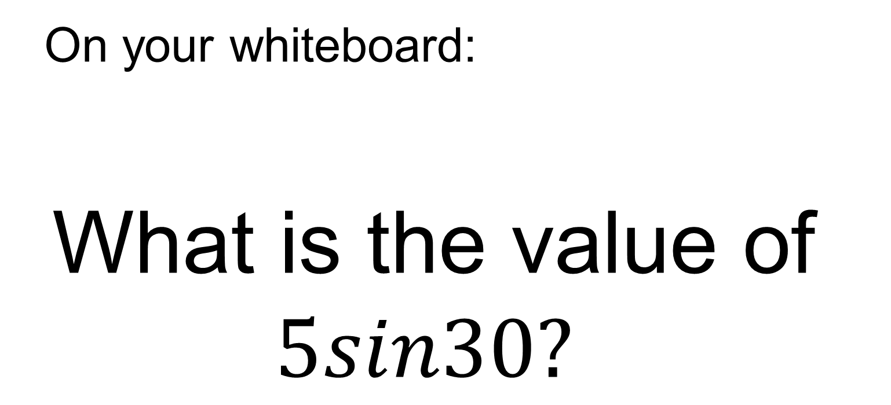
On your whiteboard:
What is the value of $5sin30?$
Notes:
Allow students to refer to their special triangles and their table of values.

Slide 12
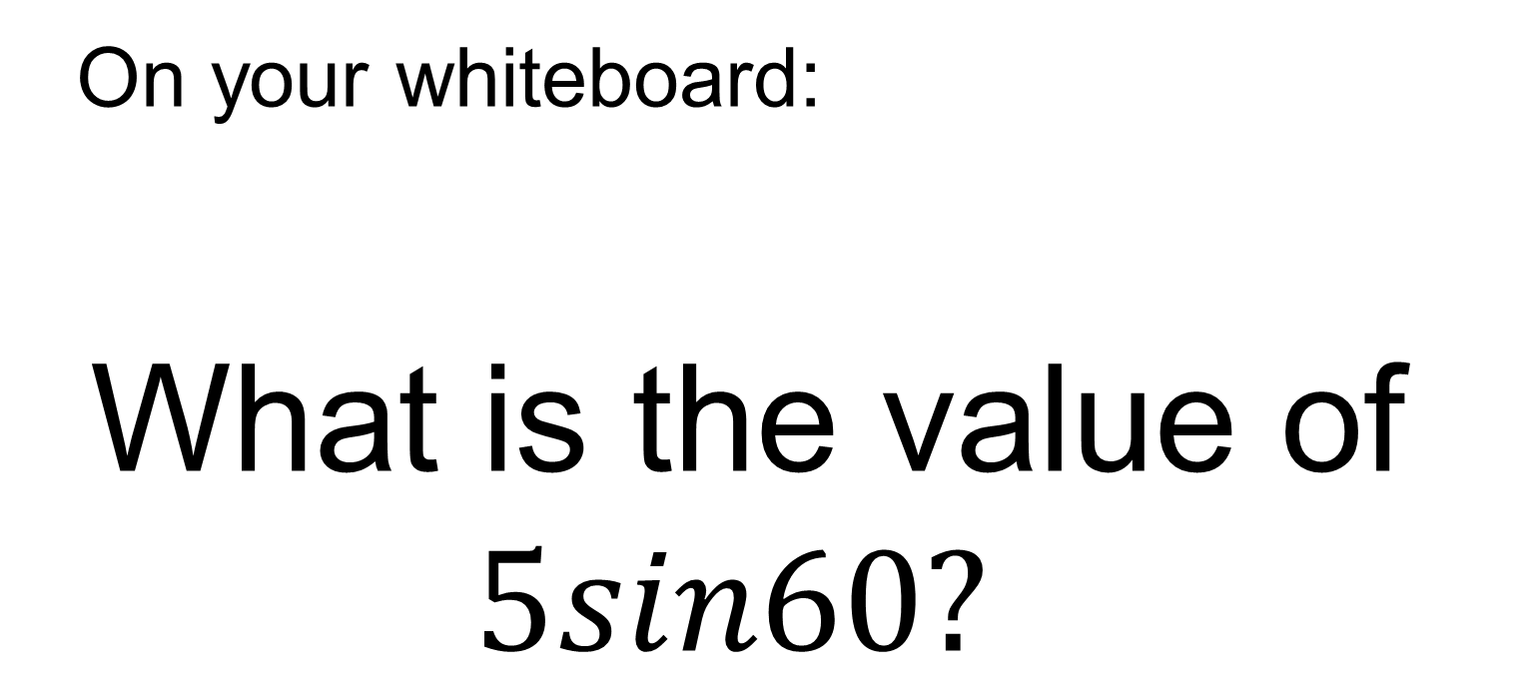
On your whiteboard:
What is the value of $5sin60?$

Slide 13
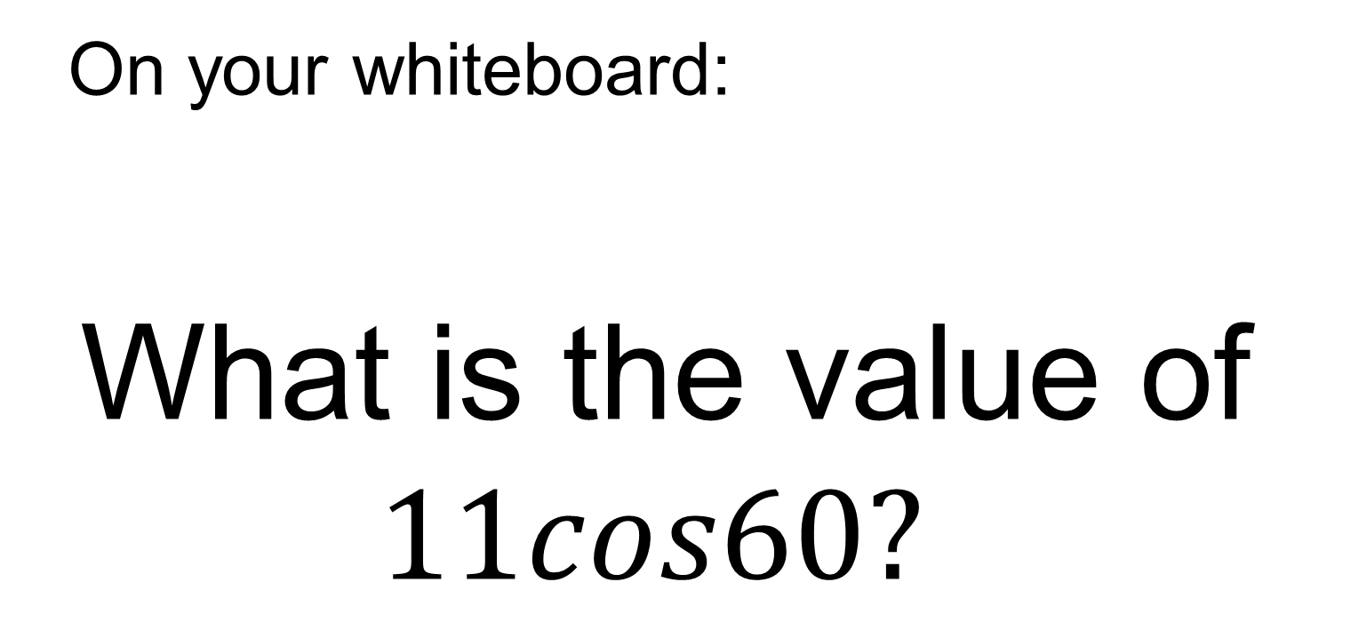
On your whiteboard:
What is the value of $11cos60?$

Slide 14
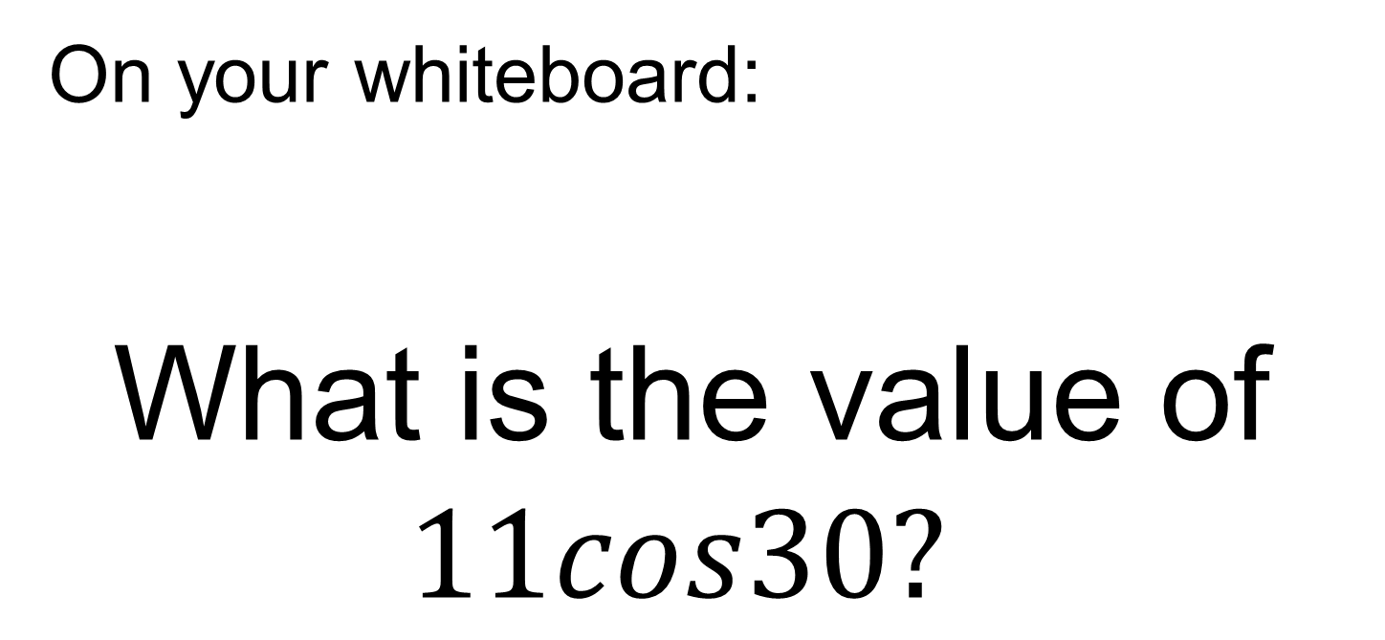
On your whiteboard:
What is the value of $11cos30?$

Slide 15
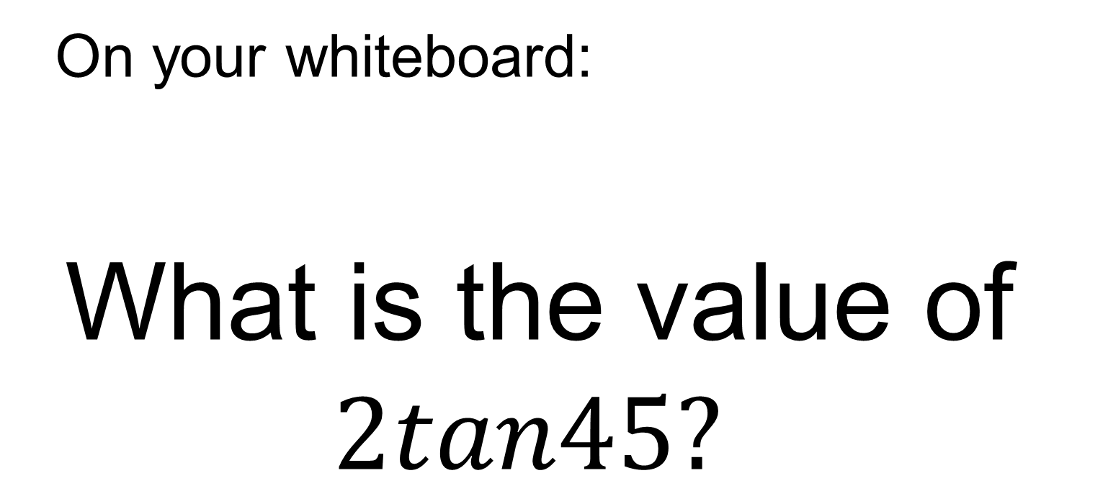
On your whiteboard:
What is the value of $2tan45?$

Slide 16
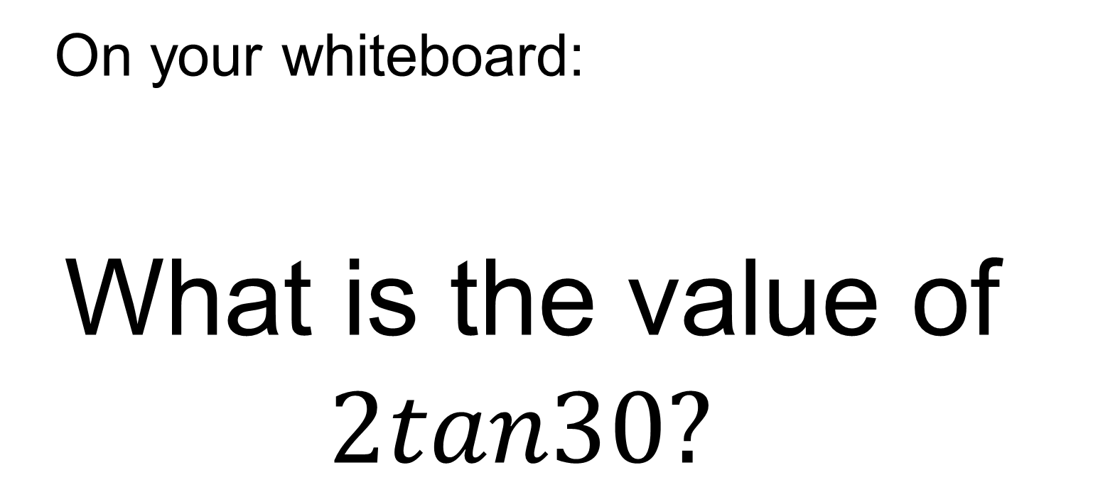
On your whiteboard:
What is the value of $2tan30?$

Slide 17
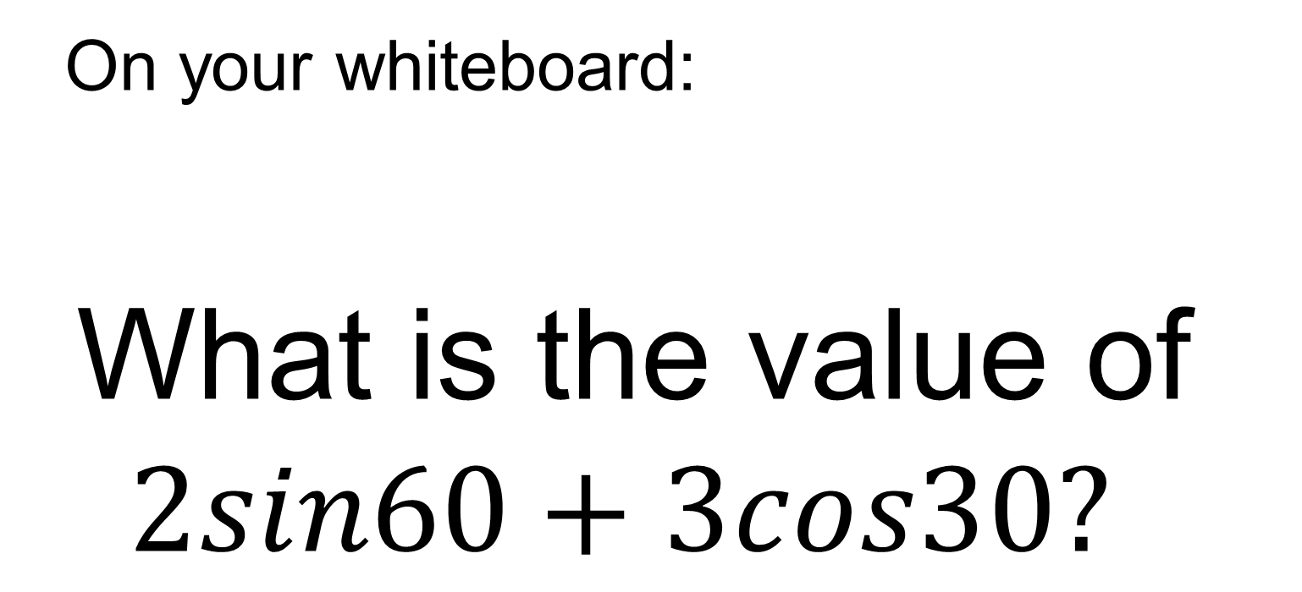
On your whiteboard:
What is the value of $2sin60+3cos30?$

Slide 18
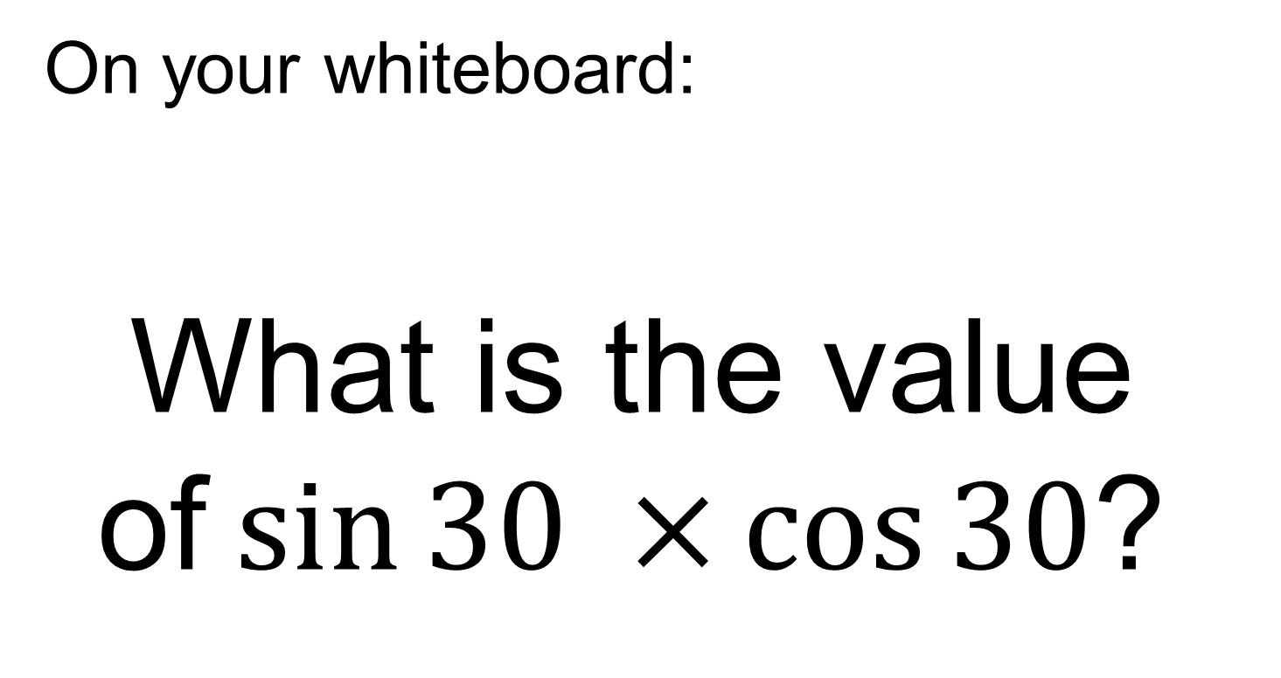
On your whiteboard:
What is the value of$\sin{30 ×}\cos{30}$?

Slide 19
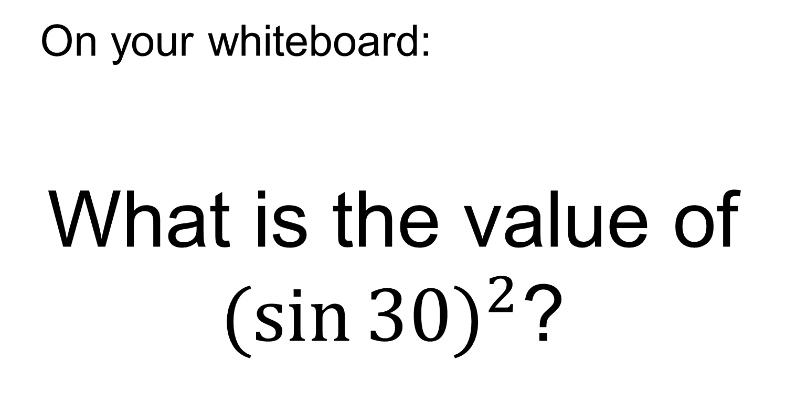
On your whiteboard:
What is the value of $({\sin{30)}}^{2}$?

Slide 20
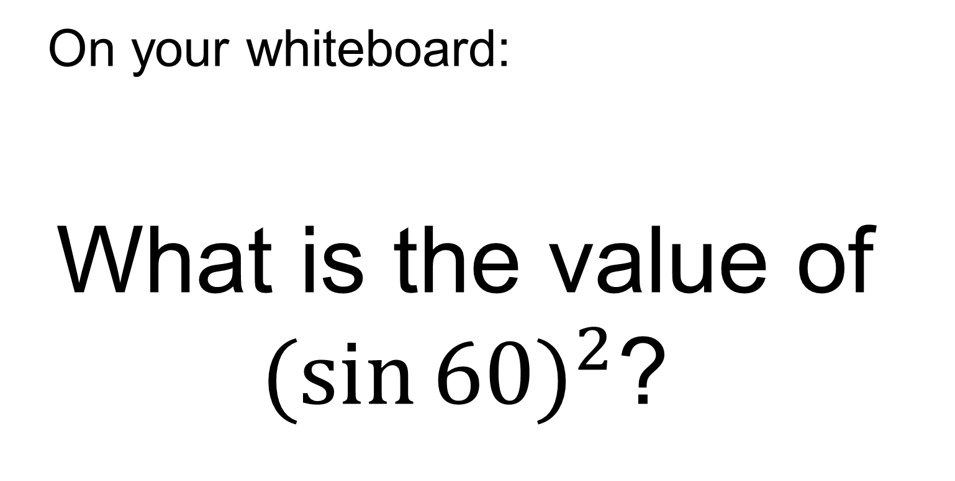
On your whiteboard:
What is the value of $({\sin{60)}}^{2}$?

Slide 21
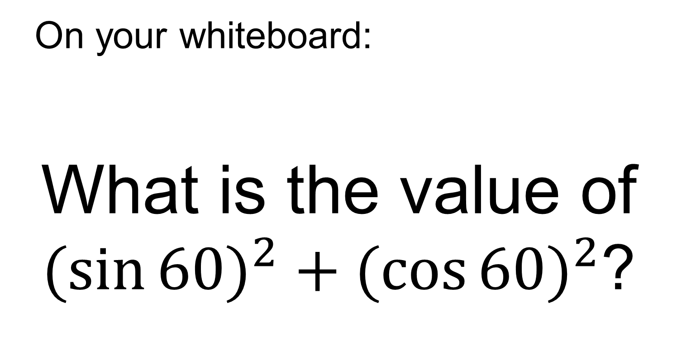
On your whiteboard:
What is the value of $({\sin{60)}}^{2}+{(\cos{60)}}^{2}$?

Slide 22
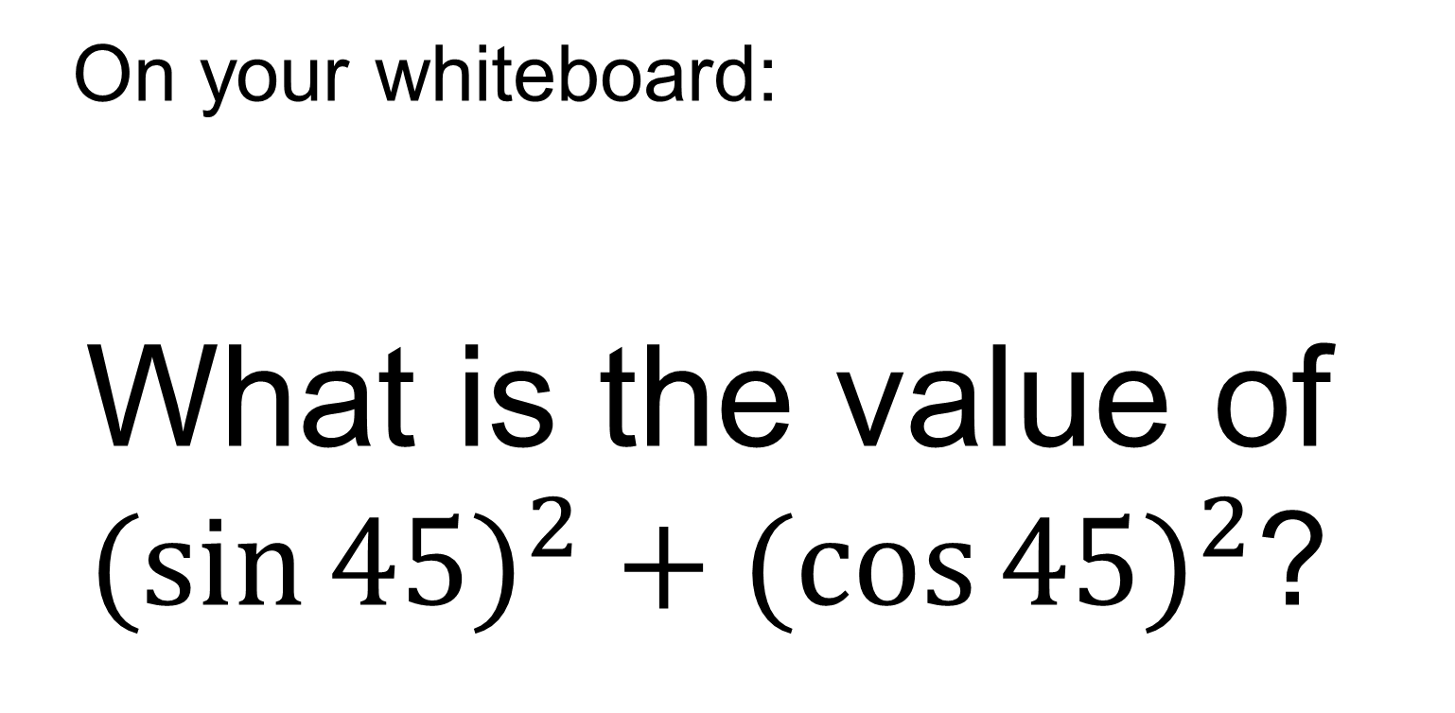
On your whiteboard:
What is the value of $({\sin{45)}}^{2}+{(\cos{45)}}^{2}$?

Slide 23
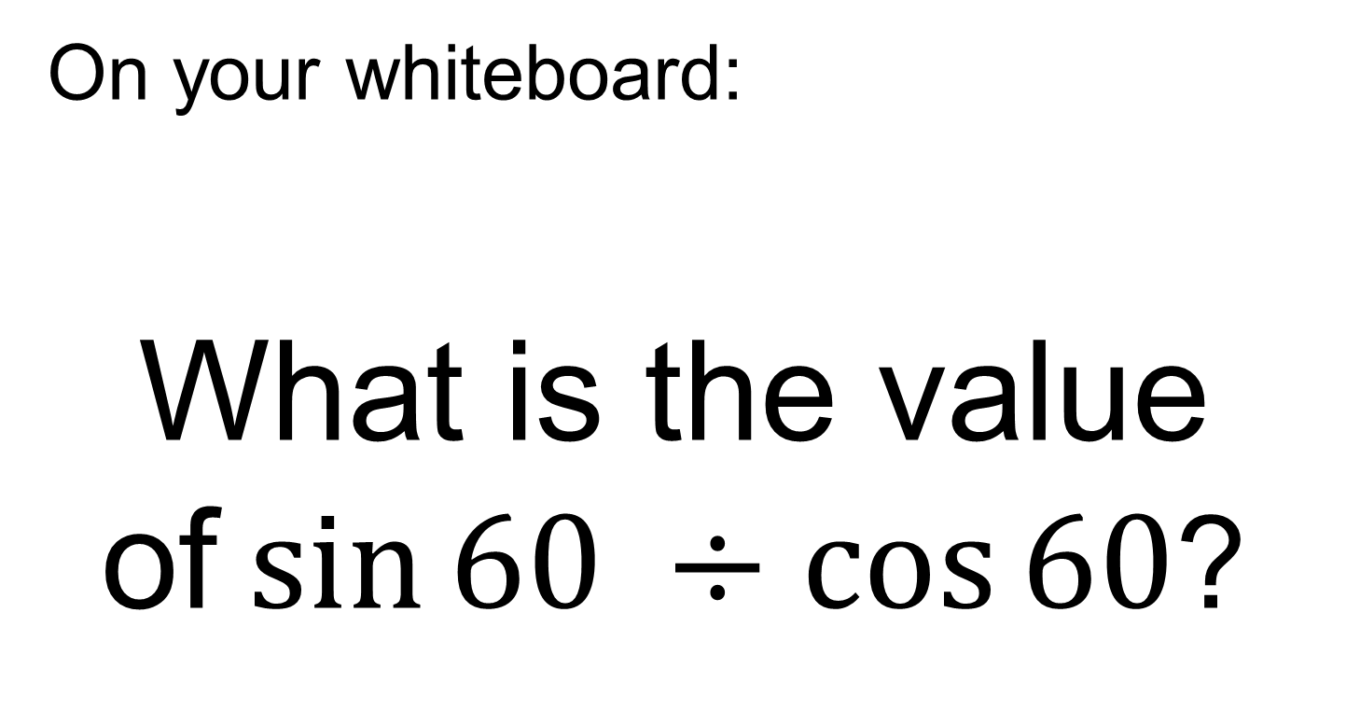
On your whiteboard:
What is the value of$\sin{60 ÷\cos{60}}$?

Slide 24
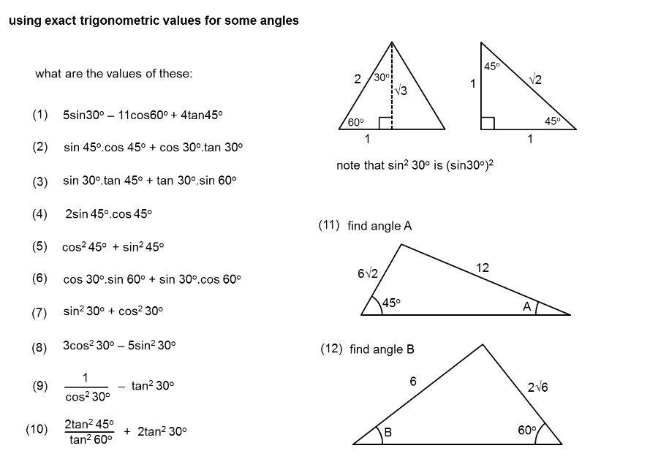
TITLE: Trigonometry without a Calculator
In your books use the special triangles and your table of values to work out the following:

Slide 25
Mark your work:
1
1
1
1
1
1
1
1
1
4/3

Slide 26
TITLE : Using the trigonometric ratios to find missing lengths and angles without a calculator.
Example
8
30º
x

Slide 27
Example
Your Turn
45º
8
30º
x
x
5
x
Cos 30º
=
8
√3
x
=
2
8
8√3
x
=
2
x
4√3
=
Notes:
Use silent teacher approach

Slide 28
Example 2
Your Turn
45º
x
30º
8
x
5
Notes:
Use silent teacher approach

Slide 29
In your books:
30º
30º
b
10
a
x
x
4
c
d
45º
45º
x
x
10
10

Slide 30
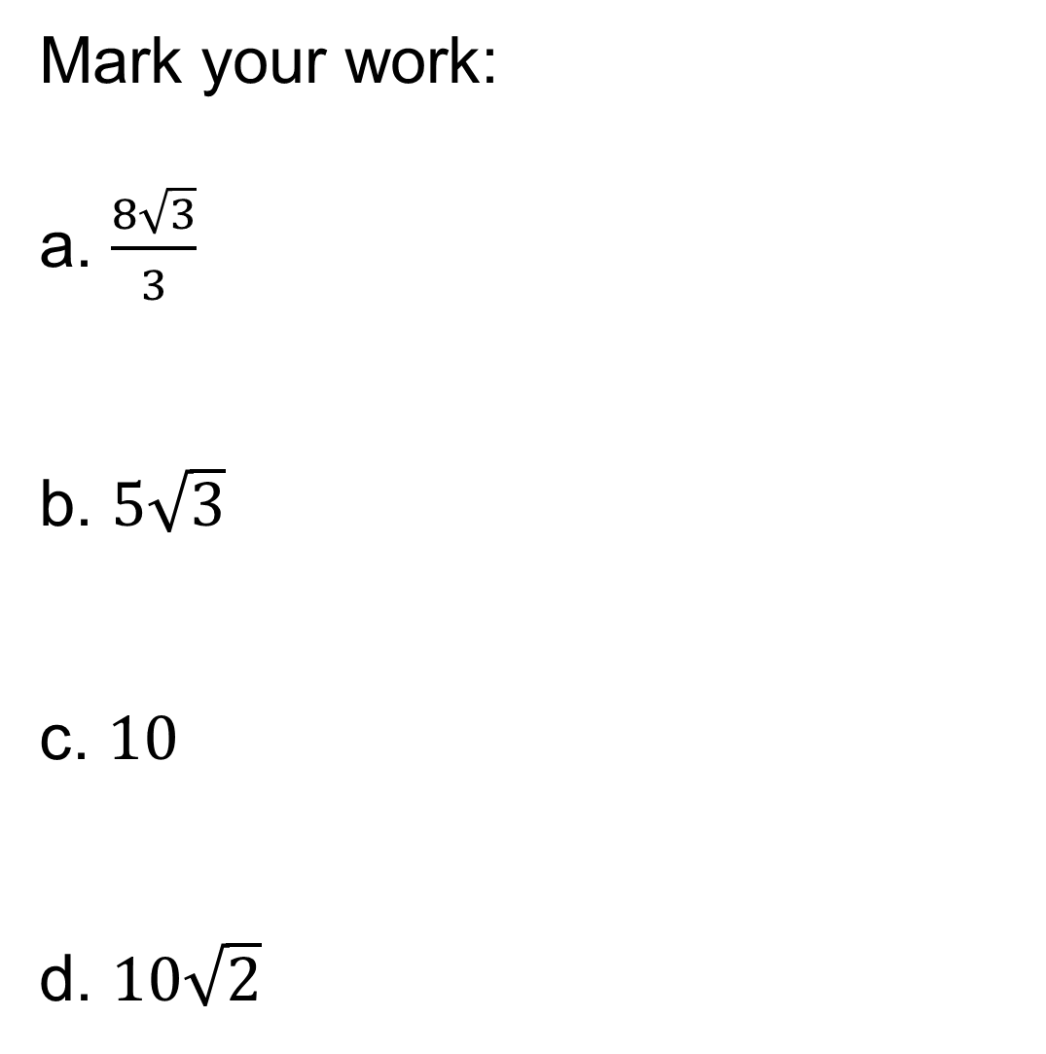
Mark your work:
a. $\frac{8\sqrt{3}}{3}$
b. $5\sqrt{3}$
c. $10$
d. $10\sqrt{2}$

Slide 31
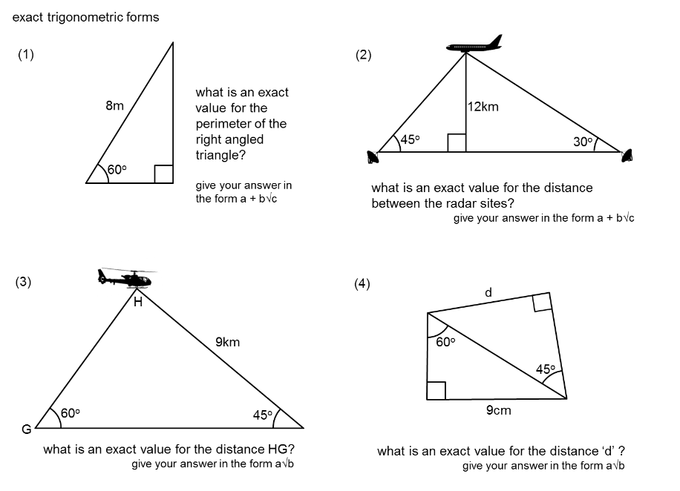
Worded Problems:

Slide 32
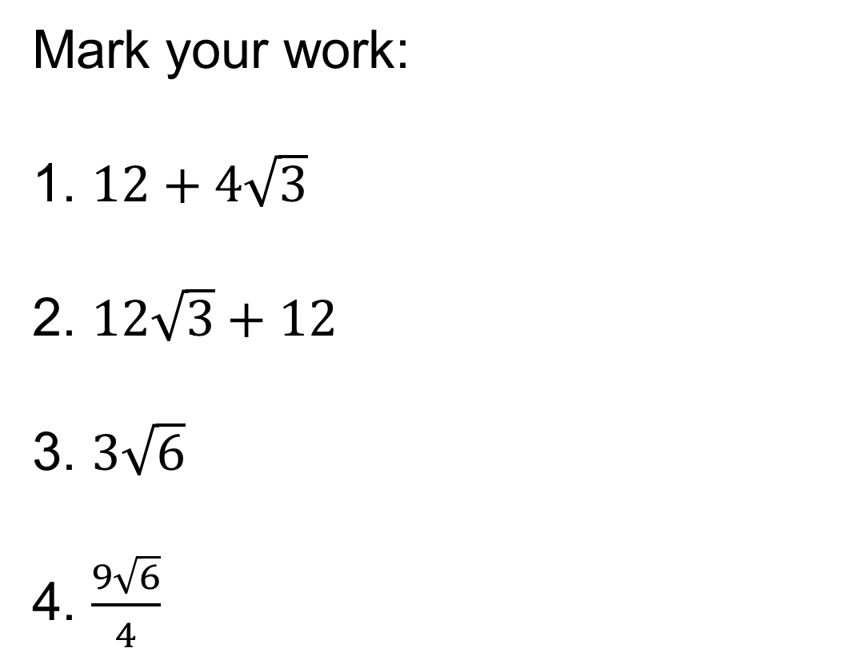
Mark your work:
1. $12+4\sqrt{3}$
2. $12\sqrt{3}+12$
3. $3\sqrt{6}$
4. $\frac{9\sqrt{6}}{4}$

Slide 33
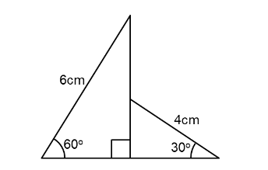
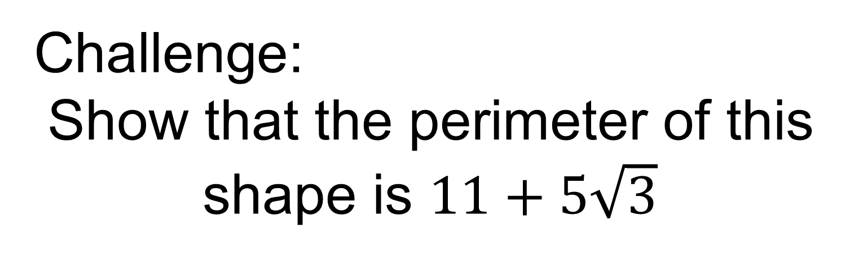
Challenge:
Show that the perimeter of this shape is $11+5\sqrt{3}$
Notes:
Acknowledgements: Don Steward again!

