Slide 1

Discuss: Which ratio would we use to find the missing angle? How do you know?
8.5 cm
$$θ$$
10 cm

Slide 2
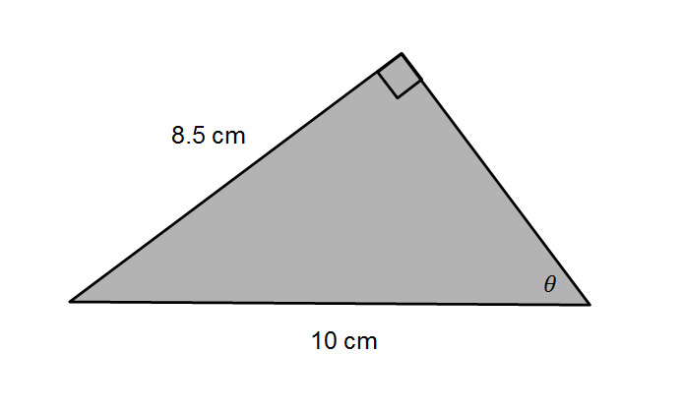
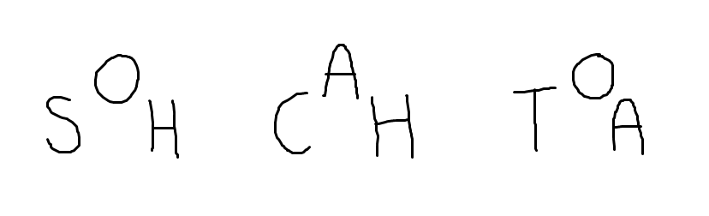

Which ratio would we use to find the missing angle? How do you know?
opp
Hypotenuse known
adj
Opposite known
Angle required
hyp

Slide 3
In your book…
Title: Using Trigonometry to calculate a missing angle in a right-angled triangle.

Slide 4




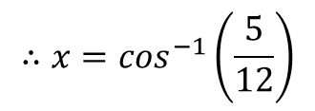



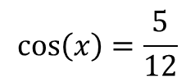

Worked Example
Your Turn
adj
opp
$$y$$
$$5 cm$$
$$14 cm$$
$$x°$$
$$12 cm$$
hyp
$$15 cm$$
$$\cos\left(x\right)=\frac{5}{12}$$
$$∴x=\cos^{−1}\left(\frac{5}{12}\right)$$
$$x=65.4° (3 sf)$$
Notes:
Explicit Instruction – Silent Teacher

Slide 5
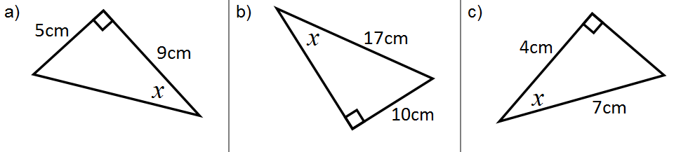
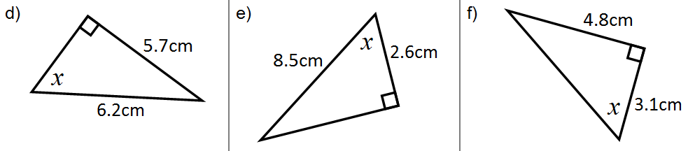
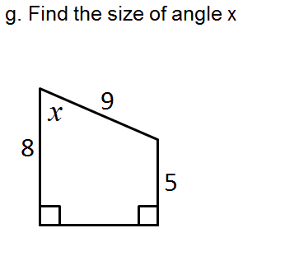
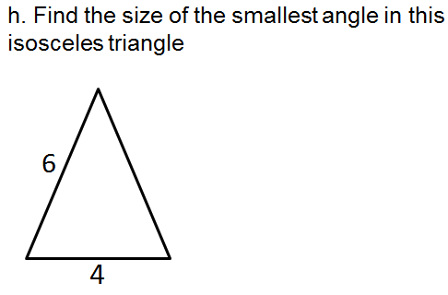
Calculate the missing angles to three significant figures.

Slide 6
Mark your work
29.1
36.0
55.2
66.8
72.2
57.1
70.5
38.9

Slide 7
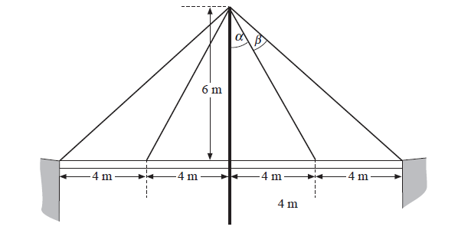
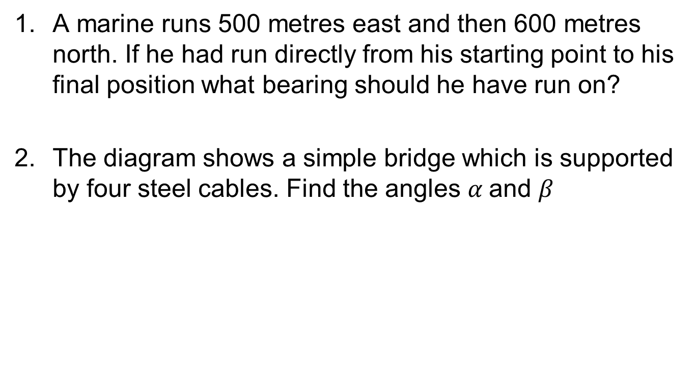
Further Problems
A marine runs 500 metres east and then 600 metres north. If he had run directly from his starting point to his final position what bearing should he have run on?
The diagram shows a simple bridge which is supported by four steel cables. Find the angles $α$and $β$

Slide 8
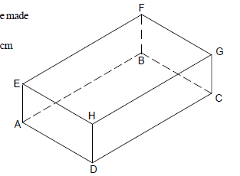
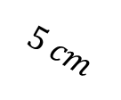

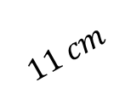
Further Problems
3. Calculate angle GDC
4. Calculate angle EDA
5. Calculate angle EFH
$$2 cm$$
$$11 cm$$
$$5 cm$$

Slide 9
Mark your work
39.8
33.7, 19.4
10.5
23.6
27.0

Slide 10
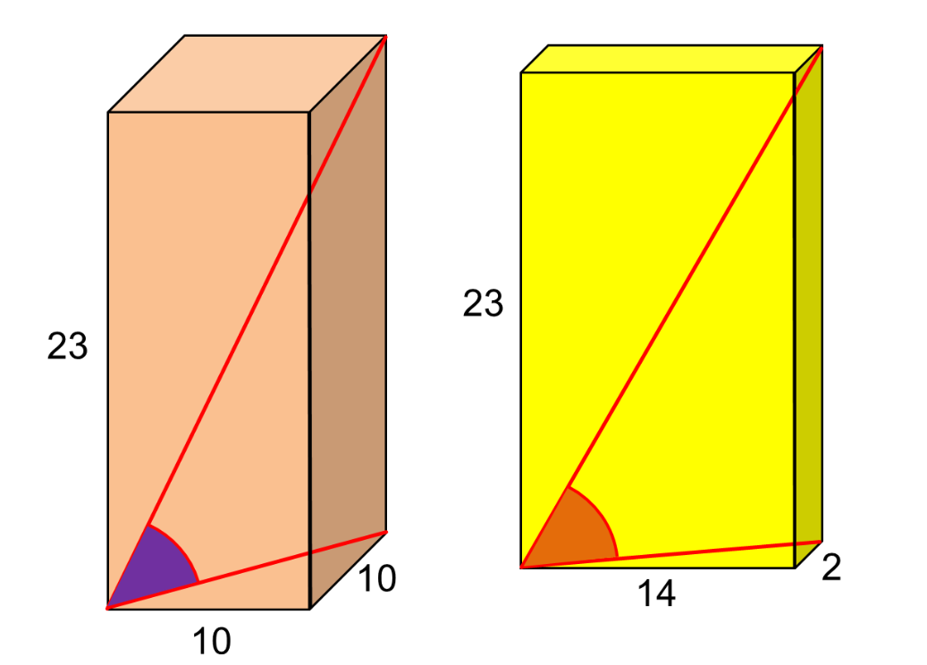
Challenge
Which space diagonal is at a larger angle to the base?
Notes:
Acknowledgements: Don Steward and CMIT

