Slide 1
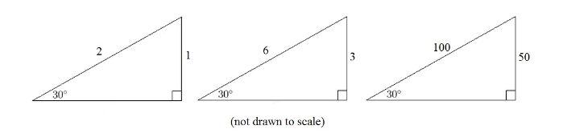
Discuss: What do these triangles have in common?
Try to include these key words in your discussion:
Angle
Similar
Ratio
Hypotenuse
Opposite
Notes:
Opposite : Hypotenuse
Need rulers, protractors, calculators (non scientific preferred)

Slide 2



On your whiteboards: What is the missing length?
$$?$$
$$32 cm$$
$$30°$$
Notes:
64 cm

Slide 3



On your whiteboards: What is the missing length?
$$30°$$
$$6.5 cm$$
$$?$$
Notes:
13cm

Slide 4



On your whiteboards: What is the missing length?
$$?$$
$$30°$$
$$22 cm$$
Notes:
11cm

Slide 5
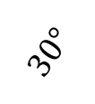

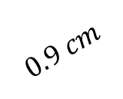
On your whiteboards: What is the missing length?
$$30°$$
$$0.9 cm$$
$$?$$
Notes:
0.45 cm or 4.5mm

Slide 6


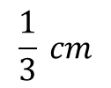
On your whiteboards: What is the missing length?
$$30°$$
$$?$$
$$\frac{1}{3} cm$$
Notes:
64 cm

Slide 7

Geogebra Demo
The ratio of the opposite side to the hypotenuse in any right-angled with an angle of 30 degrees is 1:2
hypotenuse
opposite
$$30°$$
Notes:
https://www.geogebra.org/m/QgTmeaA8 – don’t alter the angle yet.

Slide 8
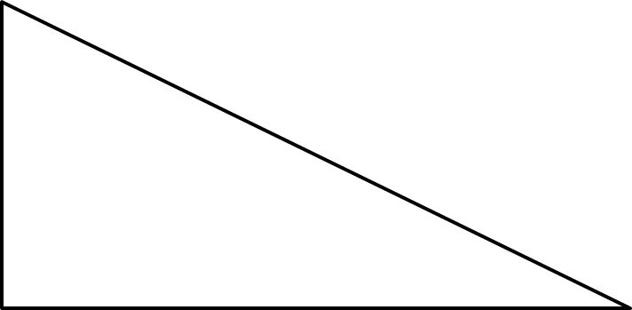
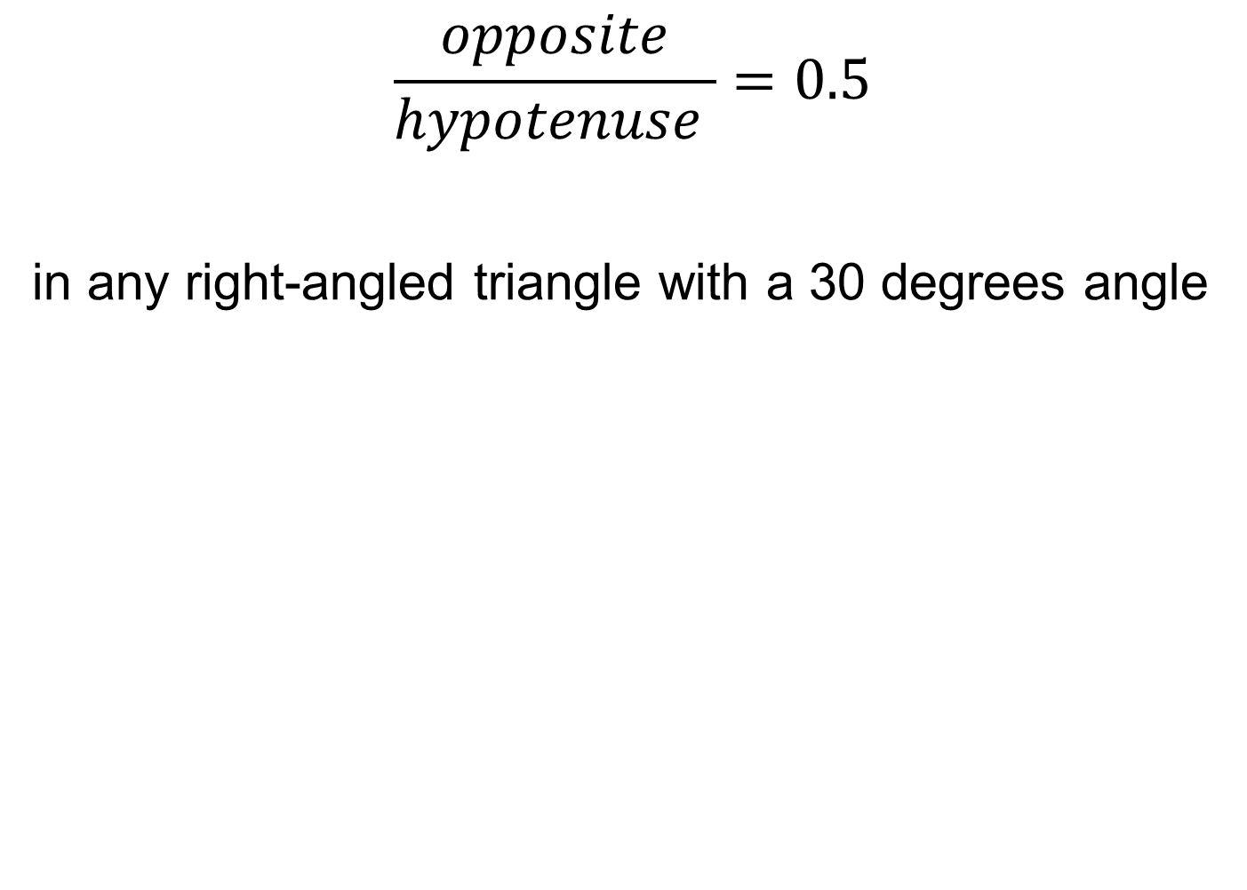

$$\frac{opposite}{hypotenuse }=0.5$$
in any right-angled triangle with a 30 degrees angle
opposite
hypotenuse
hypotenuse
opposite
$$30°$$
$$30°$$
Notes:
https://www.geogebra.org/m/QgTmeaA8

Slide 9









Discuss: What do these triangles have in common?
$$3$$
$$2$$
$$2.598$$
$$1$$
$$1.732$$
$$0.866$$
$$60°$$
$$60°$$
$$60°$$
Try to include these key words in your discussion:
Angle
Similar
Ratio
Hypotenuse
Opposite

Slide 10

Geogebra Demo
The ratio of the opposite side to the hypotenuse in any right-angled with an angle of 60 degrees is 0.866:1
$$60°$$
hypotenuse
opposite
Notes:
https://www.geogebra.org/m/QgTmeaA8 – alter angle to 60

Slide 11
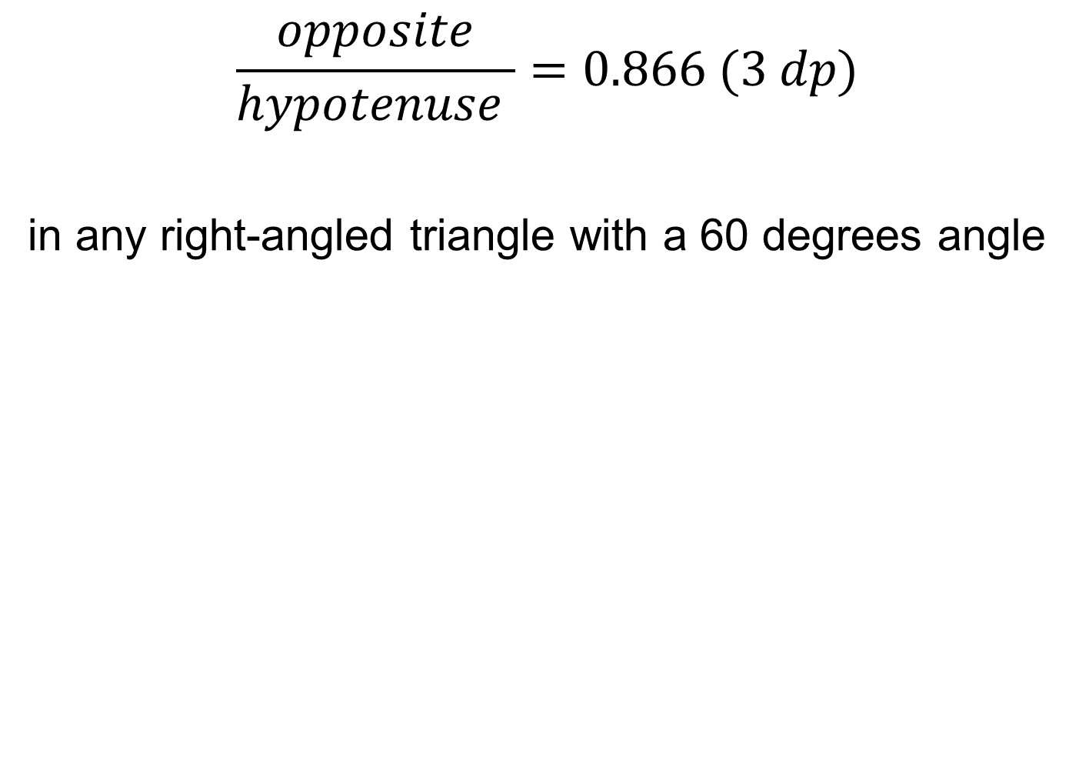


$$\frac{opposite}{hypotenuse }=0.866 (3 dp)$$
in any right-angled triangle with a 60 degrees angle
$$60°$$
$$60°$$
hypotenuse
opposite
hypotenuse
opposite
Notes:
https://www.geogebra.org/m/QgTmeaA8

Slide 12
The ratio of the opposite side to the hypotenuse in any right-angled triangle is called the SINE ratio.
The ratio of the opposite side to the hypotenuse in any-right angled triangle for any angle can be found using a table or your calculator.
Notes:
https://www.geogebra.org/m/QgTmeaA8 – alter angle to 60

Slide 13
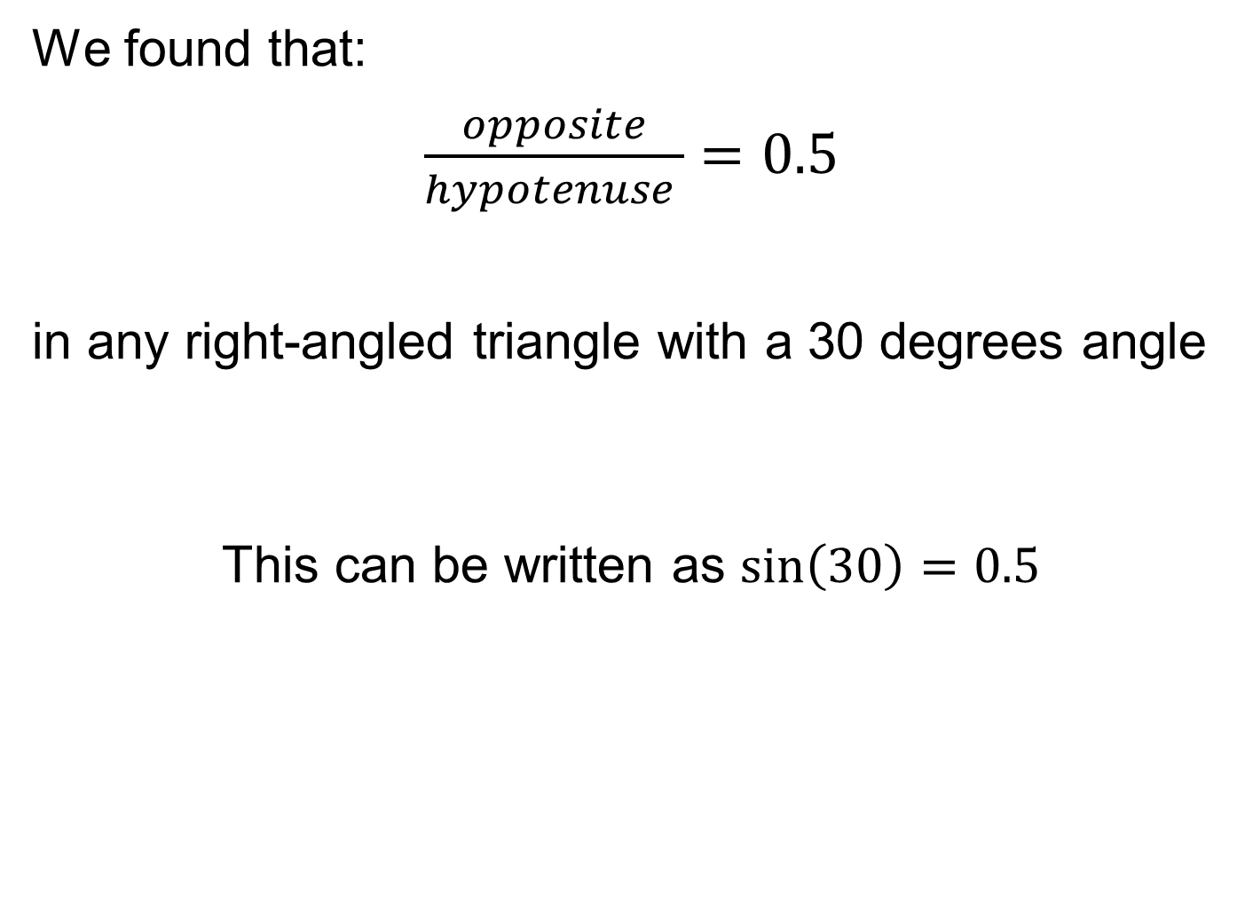
We found that:
$\frac{opposite}{hypotenuse }=0.5$
in any right-angled triangle with a 30 degrees angle
This can be written as $\sin\left(30\right)=0.5$
Notes:
https://www.geogebra.org/m/QgTmeaA8

Slide 14
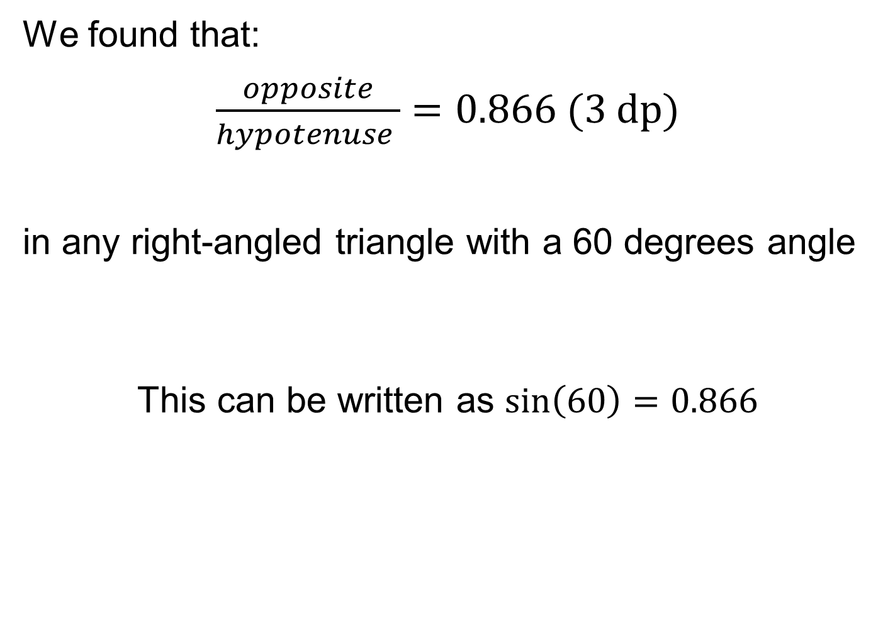
We found that:
$\frac{opposite}{hypotenuse }=0.866 (3 dp)$
in any right-angled triangle with a 60 degrees angle
This can be written as $\sin\left(60\right)=0.866$
Notes:
https://www.geogebra.org/m/QgTmeaA8

Slide 15
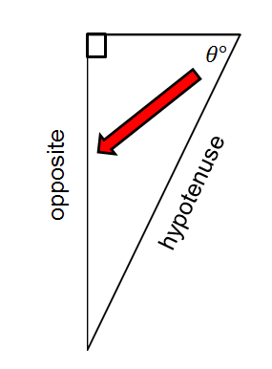
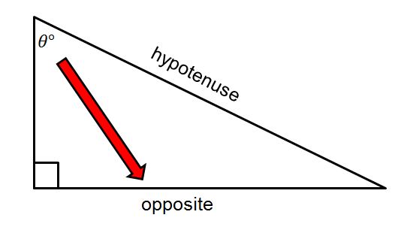
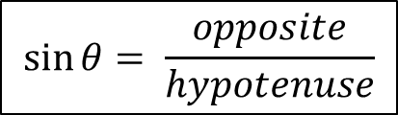
In your book…
Title: The SINE Ratio
The ratio of the opposite side to the hypotenuse in any right-angled triangle is called the SINE ratio.
$$\sin{θ= \frac{opposite}{hypotenuse}}$$
Remember the hypotenuse is the longest side of a right angled triangle and is always opposite the right angle.
The opposite side is the side opposite the other angle given.
Notes:
Encourage students to make useful notes in their Maths book. Some students may benefit from formal notes and examples being written in a different colour to the exercises they complete.

Slide 16



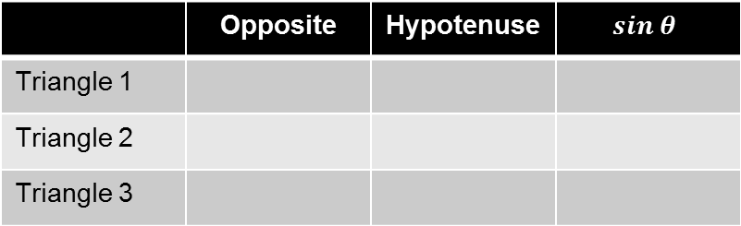






In your books...
With a ruler and protractor construct the following triangles and use your triangles to complete the table.
$$5cm$$
$$3.5cm$$
3
1
$$2.3cm$$
2
$$25°$$
$$35°$$
$$45°$$
$$5cm$$
$$5cm$$
$$5cm$$
 | Opposite | Hypotenuse | $$sin θ$$
Triangle 1
Triangle 2
Triangle 3
Notes:
Do not point out function on calculator just yet. Encourage students to work it out by measuring the hypotenuse and calculating the opposite divided by the hypotenuse.

Slide 17
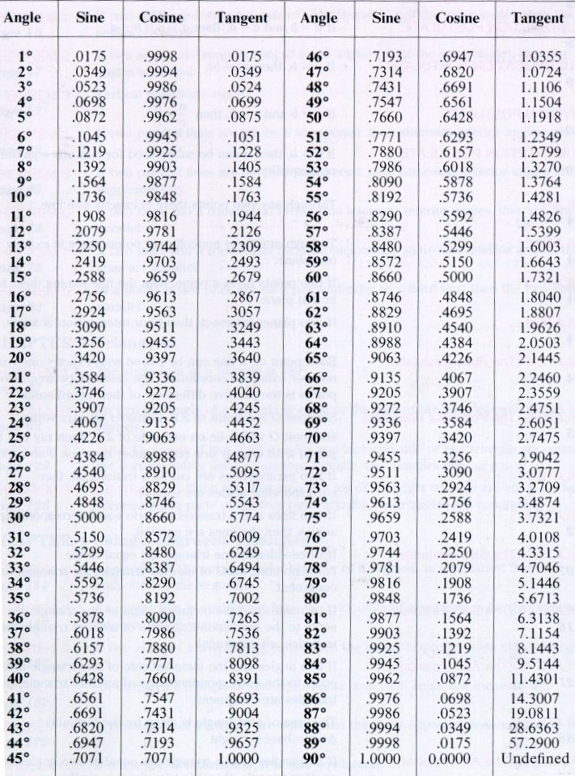
The ratio of the opposite side to the hypotenuse in any right-angled triangle used to be found using a table like this.
Mark your work using the table of values here.
Notes:
Acknowledgements:
Jo Morgan – http://www.resourceaholic.com
TeachItMaths - https://www.teachitmaths.co.uk/resources/ks4/trigonometry-sohcahtoa/trigonometry-introduction-booklet/16136
GeoGebra Institute of Hong Kong – Geogebra.org

