Slide 1
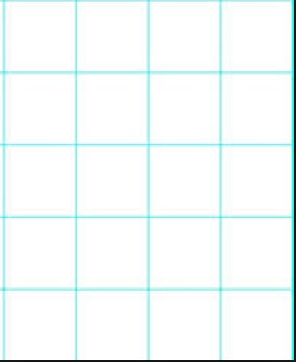
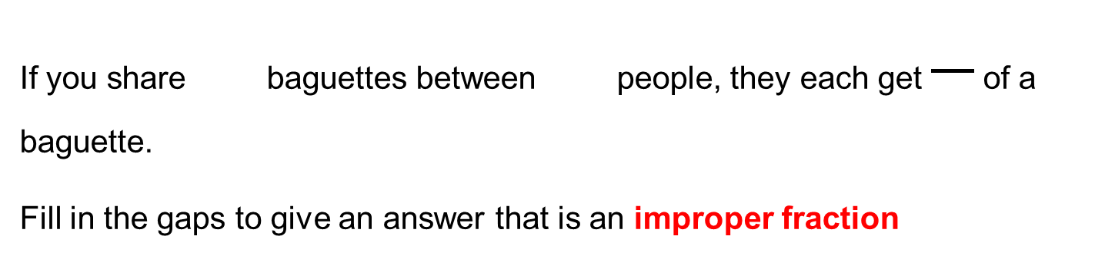
Sharing ideas from last lesson
If you share baguettes between people, they each get of a baguette.
Fill in the gaps to give an answer that is an improper fraction
Show this by using diagrams below.

Slide 2
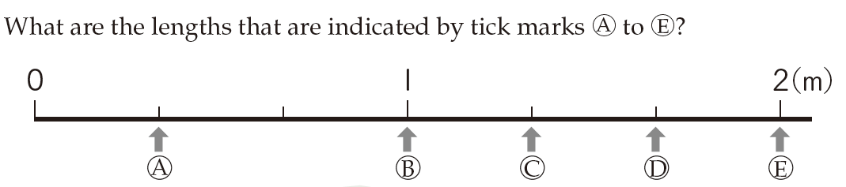
A different representation.

Slide 3
How else could we write C and D?

Slide 4
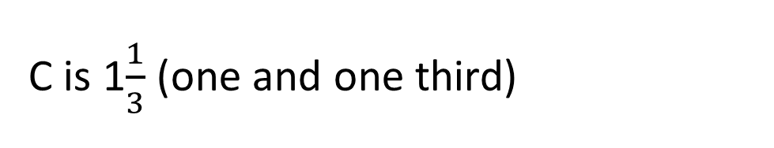
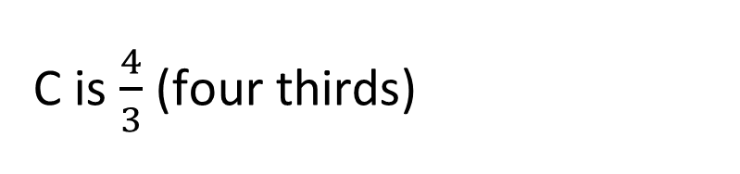
How else could we write C and D?
C is $\frac{4}{3}$ (four thirds)
This is as an improper fraction
C is 1$\frac{1}{3}$ (one and one third)
This is as a
mixed number

Slide 5
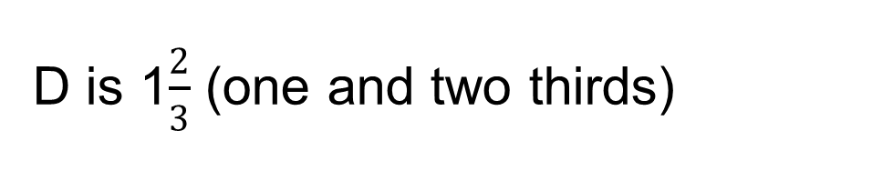
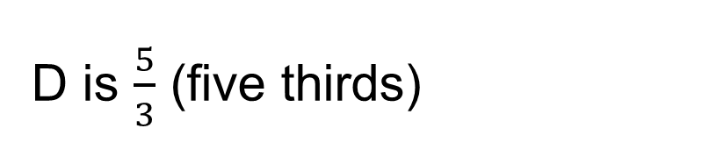
How else could we write C and D?
D is $\frac{5}{3}$ (five thirds)
This is as an improper fraction
D is 1$\frac{2}{3}$ (one and two thirds)
This is as a
mixed number

Slide 6
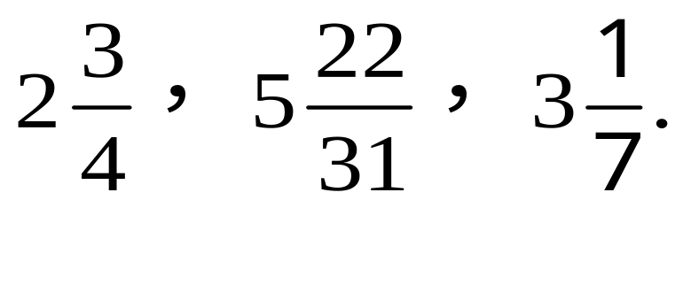
Summary
A mixed number is the sum of an integer and a proper fraction.
What are the integers and the proper fraction of each of the following mixed number fractions.

Slide 7
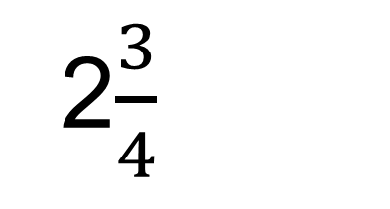
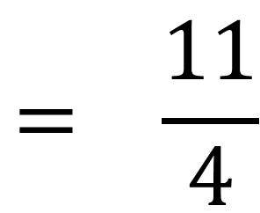
How would we write this mixed number as an improper fraction?
$$= \frac{11}{4}$$
2$\frac{3}{4}$
Let’s use a representation to help
0
1
2
How many quarters in total? How would we write this?

Slide 8
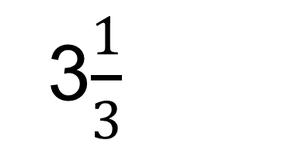
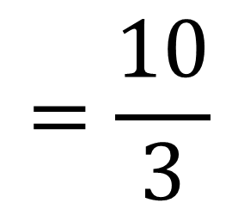
How would we write this mixed number as an improper fraction?
$$=\frac{10}{3}$$
3$\frac{1}{3}$
Let’s use a representation to help
0
1
2
3
How many thirds in total? How would we write this?

Slide 9
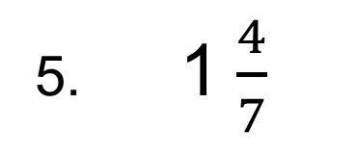
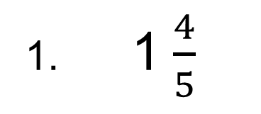
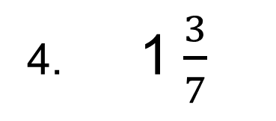
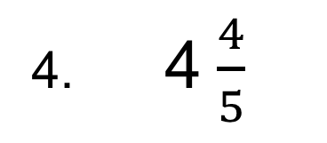
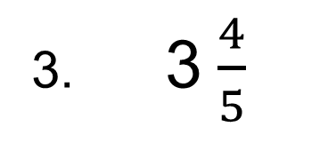
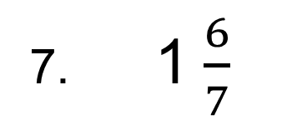
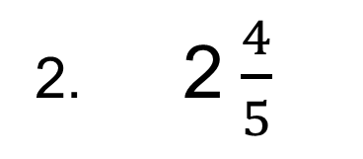
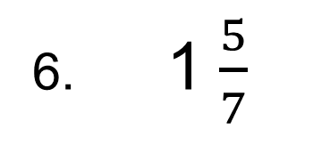
Your turn…
Write the following mixed numbers as improper fractions
1. 1$\frac{4}{5}$
4. 1$\frac{3}{7}$
2. 2$\frac{4}{5}$
5. 1$\frac{4}{7}$
3. 3$\frac{4}{5}$
6. 1$\frac{5}{7}$
4. 4$\frac{4}{5}$
7. 1$\frac{6}{7}$
What do you notice about the answers in each column?
Can you explain why the patterns occur in this way?

Slide 10
Challenge:
9. Write four similar questions where the numerators in the answers increase by 6 each time, but the denominators remain the same.
10. Write four similar questions where the numerators in the answers decrease by 2 each time, but the denominators remain the same.

Slide 11
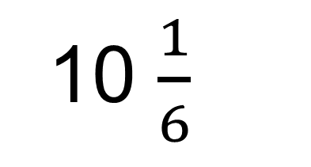
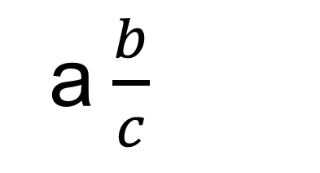
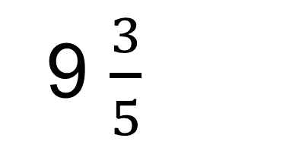
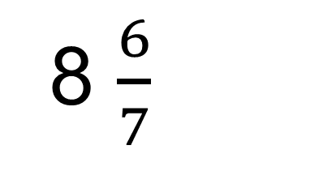
On your whiteboards…
10 $\frac{1}{6}$
Challenge:
What about this one?
8 $\frac{6}{7}$
a$\frac{b}{c}$
9 $\frac{3}{5}$

Slide 12
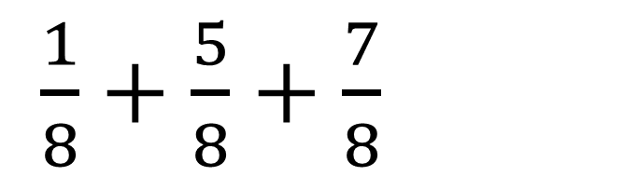
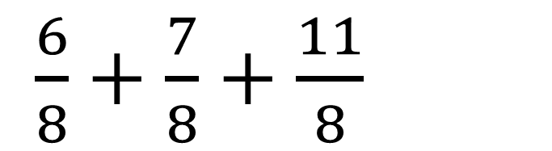
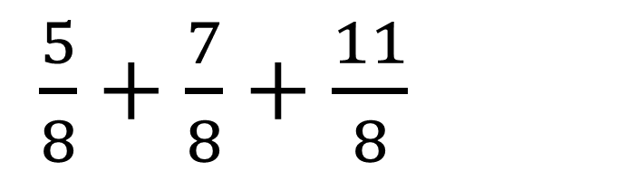
Write these sums as mixed numbers:
$\frac{1}{8}+\frac{5}{8}+\frac{7}{8}$
$\frac{5}{8}+\frac{7}{8}+\frac{11}{8}$
$\frac{6}{8}+\frac{7}{8}+\frac{11}{8}$
Write similar sums that would have the answer $4\frac{1}{8}$

Slide 13
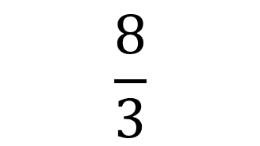
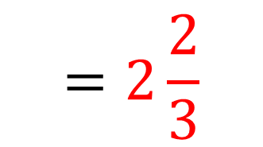
Now can we covert the other way, from an improper fraction to a mixed number?
$$\frac{8}{3}$$
$$=2\frac{2}{3}$$
0
1
2
Where would 1 go? How do you know?
What about 2? Why?
How would we write this as a mixed number?

Slide 14
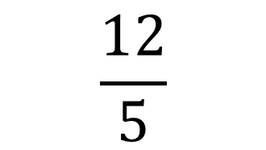
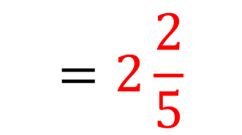
Now can we covert the other way, from an improper fraction to a mixed number?
$$\frac{12}{5}$$
$$=2\frac{2}{5}$$
0
1
2
Where would 1 go? How do you know?
What about 2? Why?
How would we write this as a mixed number?

Slide 15
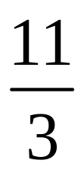
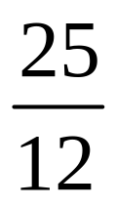
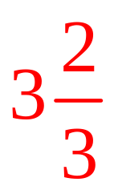
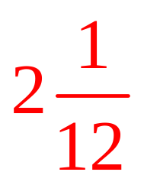
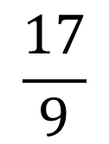
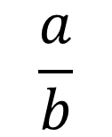
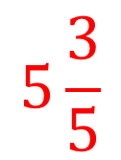
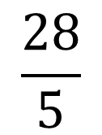
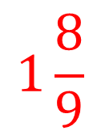
You try these:
$$\frac{17}{9}$$
$$\frac{28}{5}$$
$$1\frac{8}{9}$$
$$5\frac{3}{5}$$
Challenge where a > b
$$\frac{a}{b}$$

Slide 16
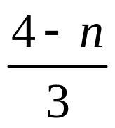
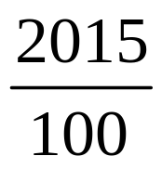
Challenge:
1. If is an improper fraction and n is a positive whole number, what value could n be ?
1
2. The value of the fraction is between which two positive whole numbers?
20 and 21

Slide 17
True or false?
Give reasons for your answers
1. Improper fractions are always greater than proper fractions.
T
2. There are five proper fractions with the denominator five.
F
3. A fraction can be classified into three groups：proper fractions, improper fractions and mixed number fractions.
T

