Slide 1
Today we will be using negative numbers in context

Slide 2
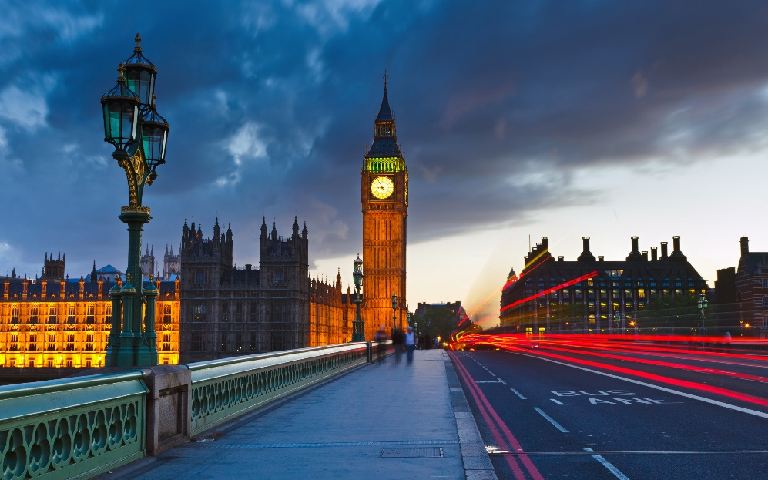
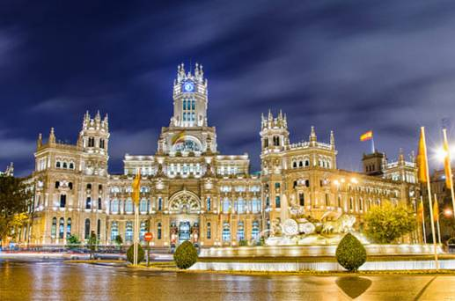


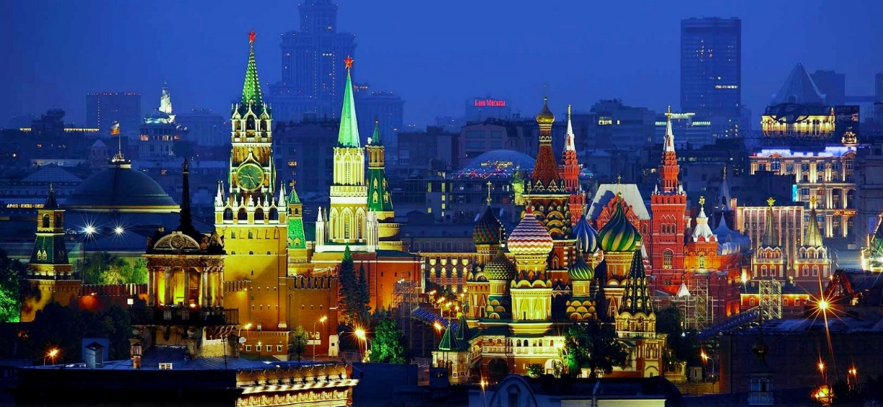
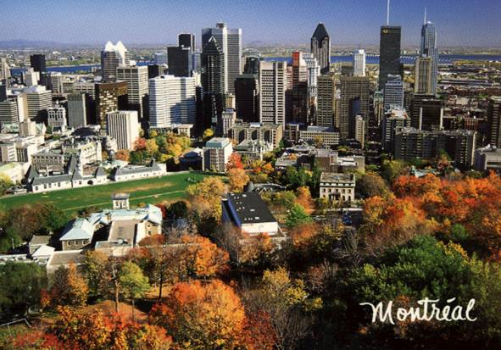

Order the cities from coldest to hottest

Slide 3

City Line Up in Order of Temperature
Coldest to Hottest
If I travel instantly from London to Madrid
Does the temperature rise or fall? By how much?
Madrid to Moscow?
Moscow to Montreal?
Cairo is 30° warmer than Montreal
What is the temperature in Cairo?

Slide 4
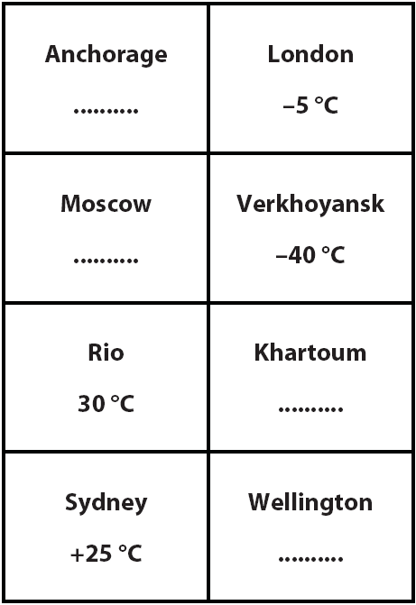
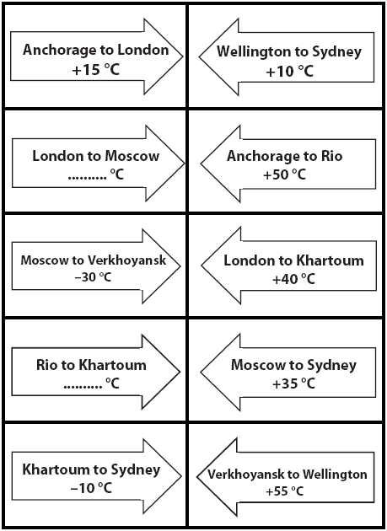
Cut out the cards
+40

Slide 5
In Pairs
Arrange the City cards beside the Temperature Change cards.
‘City’ cards
‘Temperature Change’ cards
You can then write in the correct temperature at Moscow
Work out all the missing temperatures in this way.

Slide 7
Where else are negative numbers used?
Bank accounts
£400
Pay in £150.
£200
Pay in another £100.
Spend £200.
£0
Spend another £200.
How much money do you have in your bank account now?
-£200
-£400
What does this actually mean?
So why don’t you hear people say they have negative £150?
With money, we say ‘overdrawn’ rather than ‘negative’, but it means the same thing!

Slide 8
London
13ºC

Slide 9
Moscow
-8ºC

Slide 10
Montreal
-11ºC

Slide 11
Madrid
20ºC

