Slide 1
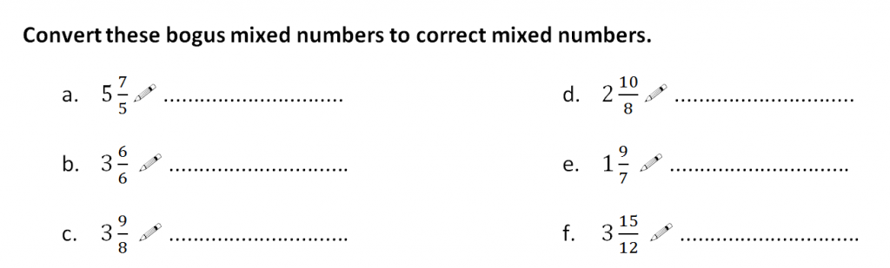
In your books…
What makes them ‘bogus’?

Slide 2
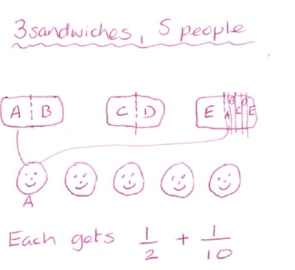
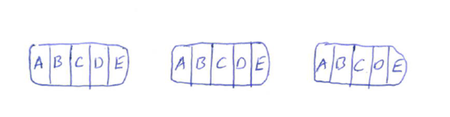

Recap:
Here are two strategies for sharing 3 baguettes equally between 5 people:
$\frac{1}{2}+\frac{1}{10}=\frac{3}{5}$
Why?

Slide 3
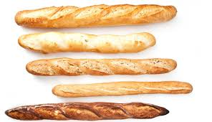
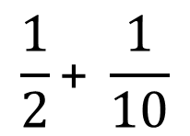
$$\frac{\text{1}}{\text{2}}\text{+ }\frac{\text{1}}{\text{10}}$$
To find the exact total, it is necessary to split the pieces into the same size. Why?
In this case, we could split them into tenths.
Why tenths?

Slide 4
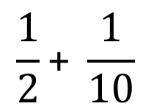
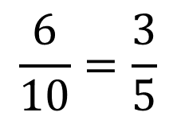
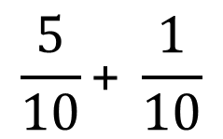
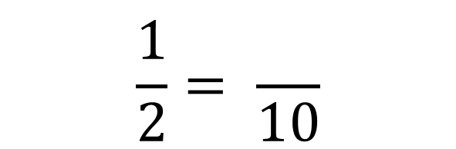
×5
$$\frac{1}{2}= \frac{}{10}$$
$$\frac{\text{1}}{\text{2}}\text{+ }\frac{\text{1}}{\text{10}}$$
5
$$\frac{\text{5}}{\text{10}}\text{+ }\frac{\text{1}}{\text{10}}$$
×5
$$\frac{\text{6}}{\text{10}}=\frac{\text{3}}{\text{5}}$$

Slide 5
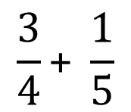


$$\frac{\text{3}}{\text{4}}\text{+ }\frac{\text{1}}{\text{5}}$$
$$\frac{\text{3}}{\text{4}}$$
$$\frac{\text{1}}{\text{5}}$$

Slide 6

$$\frac{\text{3}}{\text{4}}\text{+ }\frac{\text{1}}{\text{5}}$$
$$\frac{\text{3}}{\text{4}}$$
$$\frac{\text{1}}{\text{5}}$$
$$\frac{\text{1}}{\text{5}}$$
What fraction of a whole baguette is there?
We can’t add quarters to fifths.
Which common denominator could we use instead? Why?

Slide 7
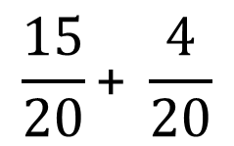

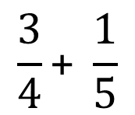

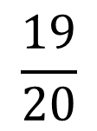
$$\frac{\text{3}}{\text{4}}\text{+ }\frac{\text{1}}{\text{5}}$$
$$\frac{\text{3}}{\text{4}}$$
$$\frac{\text{1}}{\text{5}}$$
×5
$$\frac{\text{3}}{\text{4}}\text{+ }\frac{\text{1}}{\text{5}}$$
15
$$\frac{3}{4}= \frac{}{20}$$
×5
$$\frac{\text{15}}{\text{20}}\text{+ }\frac{\text{4}}{\text{20}}$$
×4
4
$$\frac{1}{5}= \frac{}{20}$$
$$\frac{\text{19}}{\text{20}}$$
×4

Slide 8
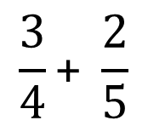

$$\frac{\text{3}}{\text{4}}\text{+ }\frac{\text{2}}{\text{5}}$$
$$\frac{\text{3}}{\text{4}}$$
$$\frac{\text{2}}{\text{5}}$$

Slide 9

$$\frac{\text{3}}{\text{4}}\text{+ }\frac{\text{2}}{\text{5}}$$
$$\frac{\text{3}}{\text{4}}$$
$$\frac{\text{2}}{\text{5}}$$
$$\frac{\text{2}}{\text{5}}$$
What can you say about the answer?

Slide 10
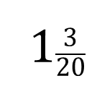

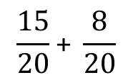
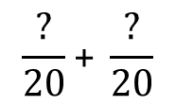
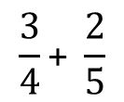
$$\frac{\text{3}}{\text{4}}\text{+ }\frac{\text{2}}{\text{5}}$$
$$\frac{\text{3}}{\text{4}}\text{+ }\frac{\text{2}}{\text{5}}$$
We already know that the lowest common multiple of 4 and 5 is 20.
$$\frac{\text{?}}{\text{20}}\text{+ }\frac{\text{?}}{\text{20}}$$
$$\frac{\text{15}}{\text{20}}\text{+ }\frac{\text{8}}{\text{20}}$$
It is now possible to add the fractions
$$\frac{\text{23}}{\text{20}}$$
How many whole baguettes is this, and how much is left over?
1$\frac{\text{3}}{\text{20}}$

Slide 11

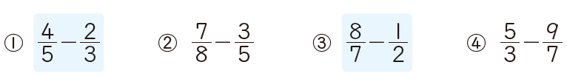

Changing to a mixed number here would give a better idea of size
In your books:
Section 1:
Section 2:
Section 3:

Slide 12












Mark your work
Section 1:
$$\frac{11}{12}$$
$$\frac{13}{14}$$
$$\frac{31}{15}$$
$$\frac{38}{15}$$
Section 2:
$$\frac{2}{15}$$
$$\frac{11}{40}$$
$$\frac{9}{14}$$
$$\frac{8}{21}$$
Section 3:
$$\frac{1}{2}$$
$$\frac{23}{12}$$
$$\frac{1}{2}$$
$$\frac{7}{24}$$

Slide 13

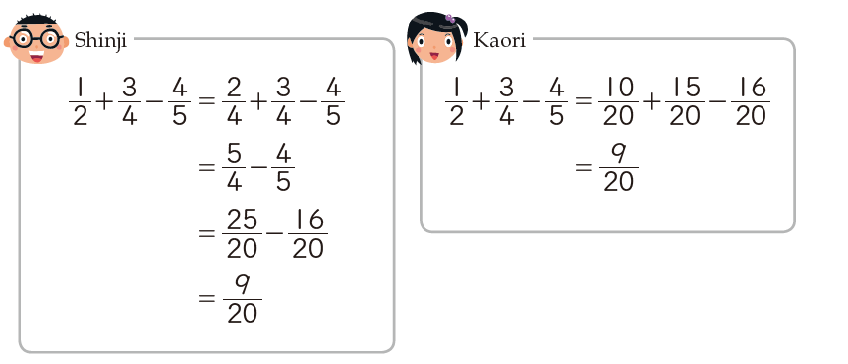
Student 1
Student 2
In your books:
Extra questions: section A

Slide 14

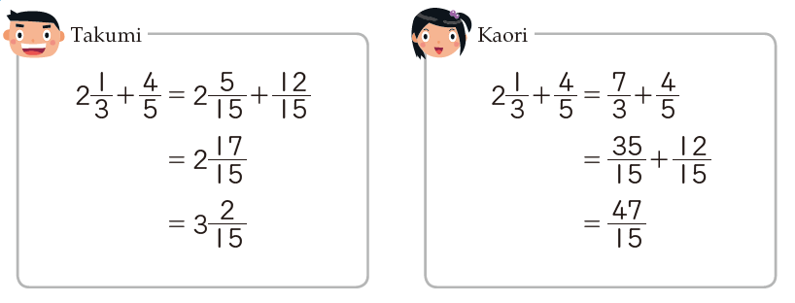

Student 1
Student 2
In your books:
Extra questions: section B

Slide 15

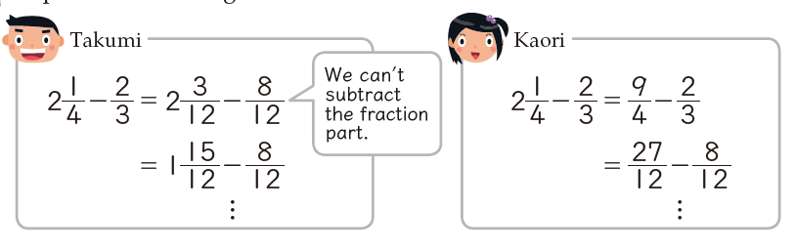
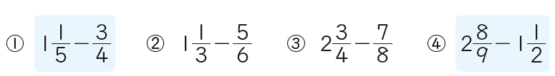
Student 1
Student 2
In your books:
Extra questions: section C

Slide 16
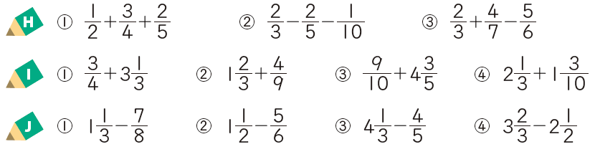
Extra questions:
A
B
C

