Slide 1
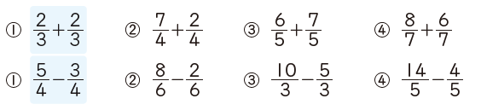

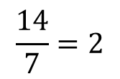
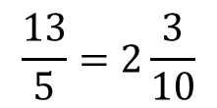
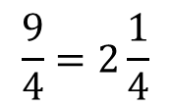
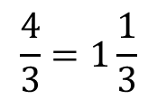
On your whiteboards:
Section 1: Write your answers as mixed numbers
$$\frac{4}{3}=1\frac{1}{3}$$
$$\frac{9}{4}=2\frac{1}{4}$$
$$\frac{13}{5}=2\frac{3}{10}$$
$$\frac{14}{7}=2$$
Describe the error in the calculation below, then find the correct answer.

Slide 2

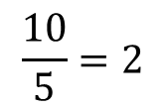
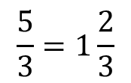
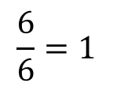

On your whiteboards:
Section 2: Write your answers as mixed numbers
$$\frac{1}{2}$$
$$\frac{6}{6}=1$$
$$\frac{5}{3}=1\frac{2}{3}$$
$$\frac{10}{5}=2$$
Describe the error in the calculation below, then find the correct answer.

Slide 3
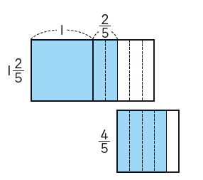

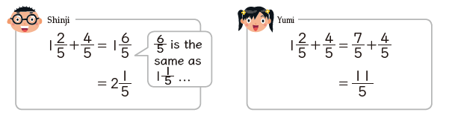
Student 1
Student 2

Slide 4
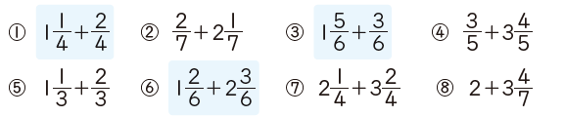

In your books
Title: Adding Mixed numbers and proper fractions.
Section 3:
Write your answers as a mixed number.
Challenge:
Write as many questions as you can that have the answer

Slide 5

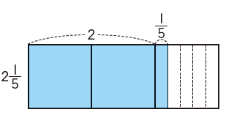
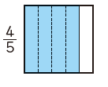
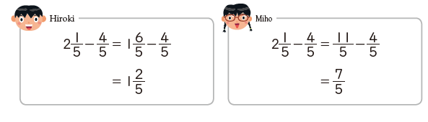
Student 1
Student 2

Slide 6
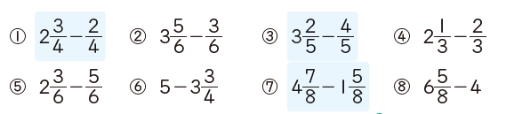
In your books:
Title: Adding Mixed numbers and proper fractions.
Section 4:
Write your answers as a mixed number.

Slide 7
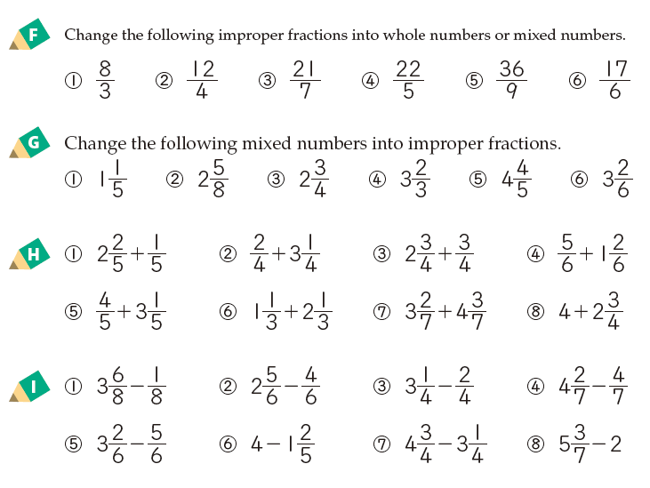
A
B
C
D

