Slide 1
Discuss
Build
Where do we see negative numbers in the real world?
How do we represent negative numbers in mathematics?
Notes:
Students to discuss where maths happens in real life…..debt, lifts, temperature etc
Discuss the idea of a number line to show negatives

Slide 2
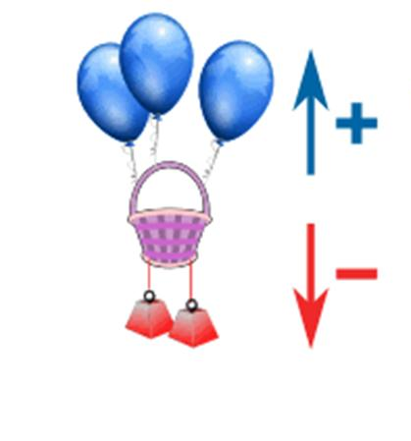
Build
Vertical Number lines
Notes:
Introduce concept of the basket. Discuss the physics. The balloons are positive numbers and the weights negative. What happens when I add a balloon? What happens when I add a weight?

Slide 3
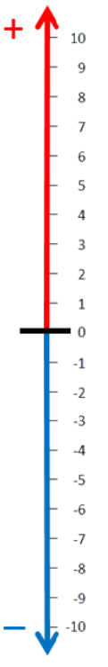
Build
On your whiteboards..
My basket has 3 positives (balloons) and 2 negatives (weights).
What number would my basket be on?
Write a number sentence to describe this.
3

Slide 4
Build
On your whiteboards..
My basket has 6 balloons and I add 3 weights.
At what number does my basket start?
What happens to my basket?
Write a number sentence to describe this.

Slide 5
Build
On your whiteboards..
My basket has 3 weights attached and I add 2 more weights.
At what number does my basket start?
What happens to my basket?
Write a number sentence to describe this.

Slide 6
Build
On your whiteboards..
My basket has 3 balloons attached and I add 7 more balloons.
At what number does my basket start?
What happens to my basket?
Write a number sentence to describe this

Slide 7
Build
On your whiteboards..
My basket has 4 weights attached and I add 3 balloons.
At what number does my basket start?
What happens to my basket?
Write a number sentence to describe this

Slide 8
Develop Understanding
On your whiteboard, work out:
Remember positives are balloons and negatives are weights
7 + -2
12 + -4
5 + -3
3 + -5
8 + -8
-8 + 0
-8 + -1
-8 + -2

Slide 9
Mark it
7 + -2 = 5
12 + -4 = 8
5 + -3 = 2
3 + -5 = -2
8 + -8 = 0
-8 + 0 = -8
-8 + -1 = -9
-8 + -2 = -10

Slide 10
Build
Do you notice any patterns?
15 + -15 = 0
-30 + 30 = 0
5 + -5 = 0
-3 + 3 = 0
The sum of two opposite numbers is 0.

Slide 11
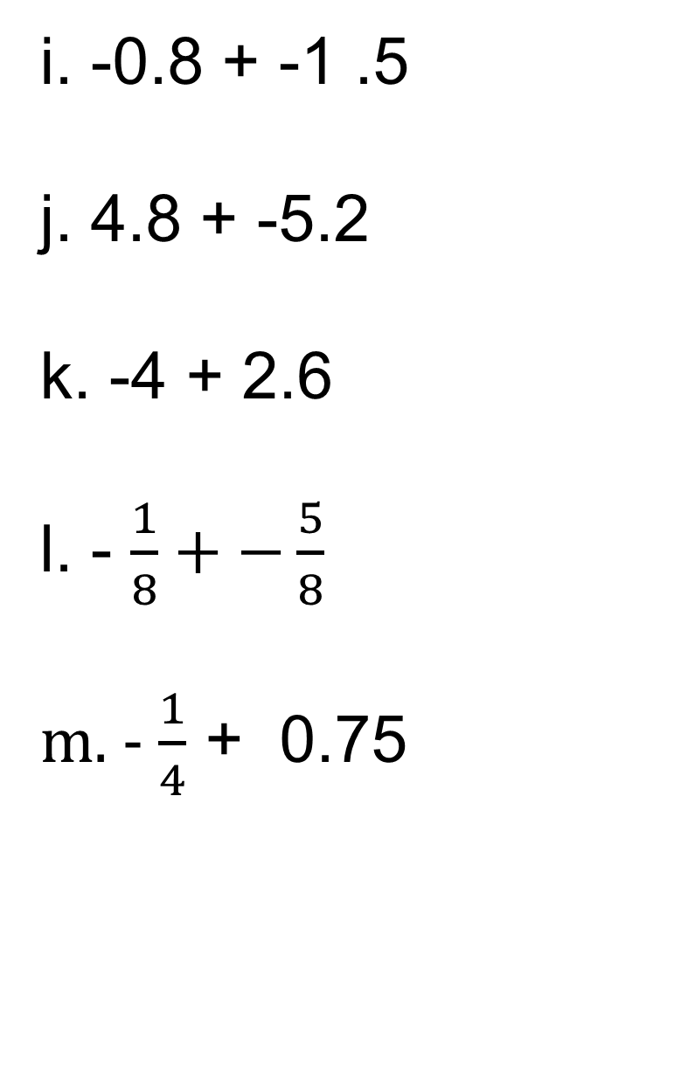
Develop Understanding
In your books…
i. -0.8 + -1 .5
j. 4.8 + -5.2
k. -4 + 2.6
l. - $\frac{1}{8}+−\frac{5}{8}$
m. - $\frac{1}{4}$ + 0.75
-3 + 27
-5 + -7
0 + -2
-4 + 4
-15 + -8
-40 + 12
-19 + -13
24 + -36
Notes:
Ask students to copy and complete these in their Maths books.

Slide 12
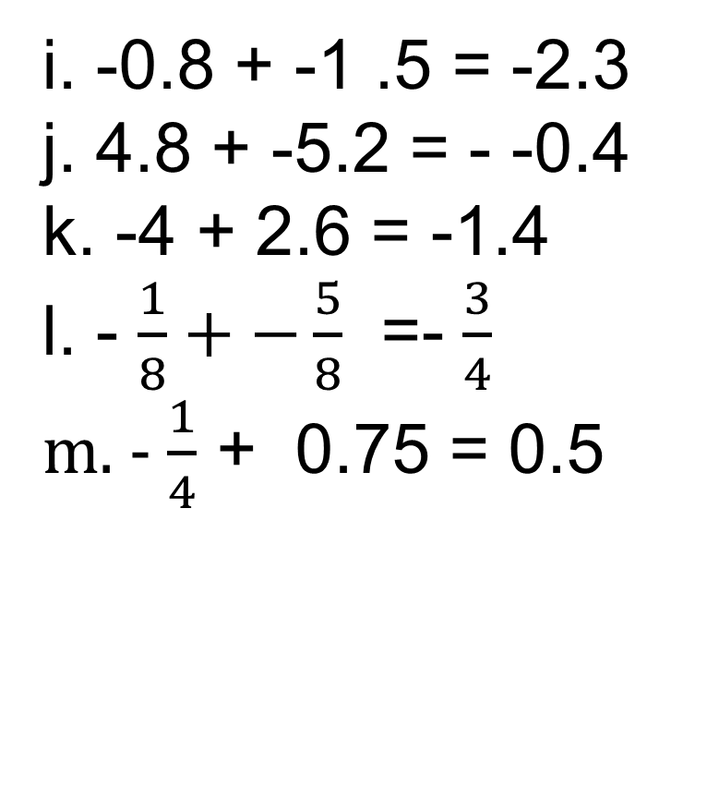
Develop Understanding
Mark it
i. -0.8 + -1 .5 = -2.3
j. 4.8 + -5.2 = - -0.4
k. -4 + 2.6 = -1.4
l. - $\frac{1}{8}+−\frac{5}{8}$ =- $\frac{3}{4}$
m. - $\frac{1}{4}$ + 0.75 = 0.5
-3 + 27 = 24
-5 + -7 = -12
0 + -2 = -2
-4 + 4 = 0
-15 + -8 = -23
-40 + 12 = -28
-19 + -13 = -32
24 + -36 = -12

Slide 13

Transfer
On your whiteboards..
I am overdrawn at the bank by £5. How much money will I have if I add £15 to it?
Can you write a number sentence to represent this information?
-£5 + £15 = £10
-5 + 15 = 10
Notes:
Contextual example to remind students about negative numbers. Reinforce that we don’t always have to put the unit in the calculation.
Use vertical number line representation to illustrate how this calculation work. Suggest student are provided with laminated number line to use throughout this lesson

Slide 14

Transfer
On your whiteboards..
A submarine is 10 m below sea level. If it moves 6 m towards the surface, at what level is it now?
Can you write a number sentence to represent this information?
-10 + 6 = 4
Notes:
Another contextual example

Slide 15

Transfer
On your whiteboard..
Starting at my house I walk 10 km north, then 17 km south.
Can you write a number sentence to represent this information?
Notes:
Again, a contextual example. Here we are adding a negative

Slide 16
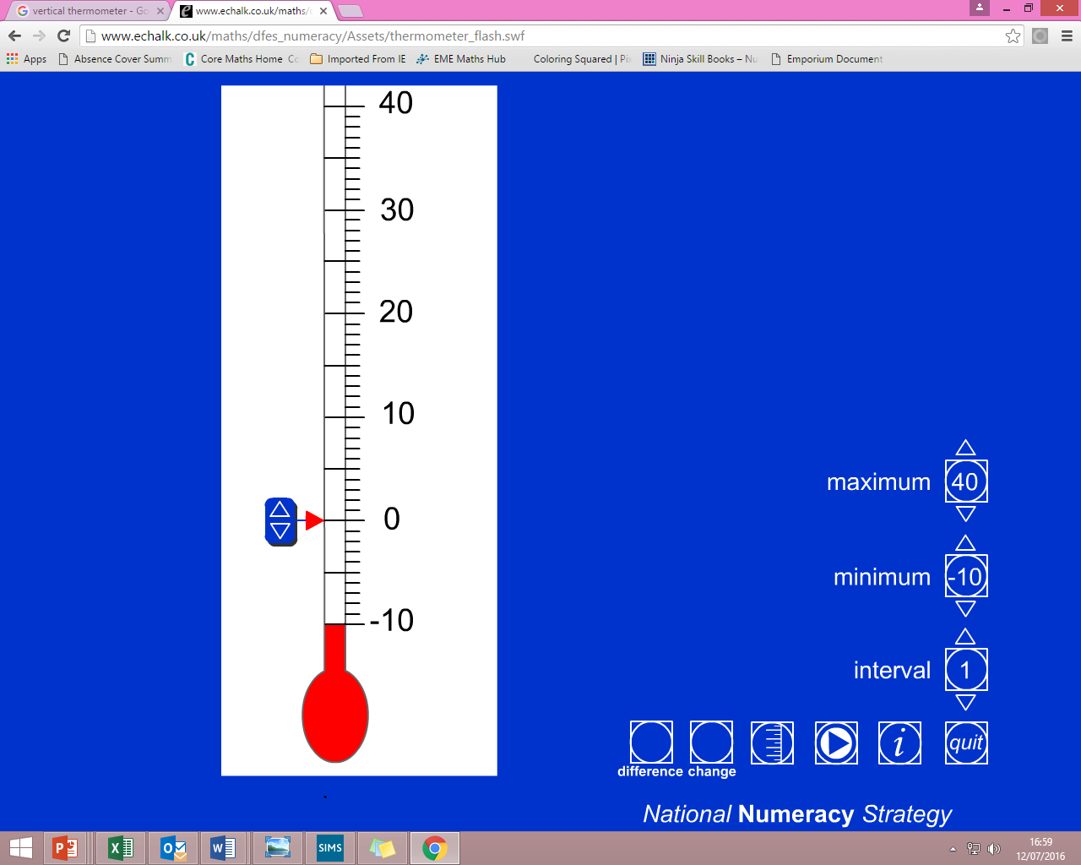
Transfer
On your whiteboard..
The temperature is -4°C and during the night it falls by a further 3°C.
What temperature is it now?
Notes:
Students should first write a number sentence and then calculate.

Slide 17
Transfer
On your whiteboard..
I play a game with my friend. There are 5 rounds in the game. In each round I can either win points if I do well, or lose points if I don’t. At the end of each round I add my points to my score from the previous round. After 5 rounds my scores are as follows:
3,
-2,
5,
-4,
3
Write a number sentence to show how I would find my total score after 5 rounds.
3 + -2 + 5 + -4 + 3
3 – 2 + 5 – 4 + 3
Notes:
Emphasise here that after round 2 we are ADDING a negative i.e 3 + (-2), and that adding a negative is effectively the same as subtracting a positive (the opposite)

Slide 18
3 + -8 + 7 + -5
Transfer
Work out:
Find another way..
And another..

Slide 19
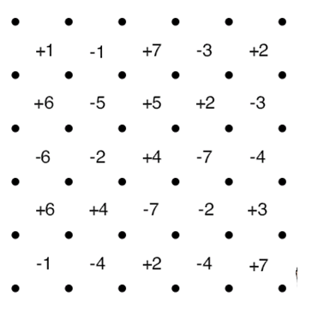
SQUARES
This is a two player game.
Each player takes it in turn to join two dots next to each other, in a straight line – No diagonals allowed.
If a player completes a square they mark the square with their initials and gets the value written inside the square.
They then get another go.
The winner is the player with the highest score when all
boxes are completed/time is up!
Notes:
Ackwowledgements:
East Midlands East Maths Hub
Nottingham Emmanuel School

