Slide 1
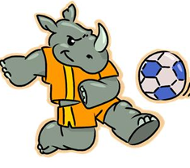
Which Team Will Win?
Think back to this previous lesson where we compared frequency trees with a probability tree diagram:

Slide 2
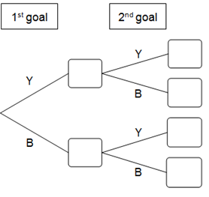






Which Team Will Win?
We can rewrite the frequency tree as a probability tree diagram:
16
$$\frac{16}{24}$$
Y
24
$$\frac{24}{36}$$
Y
8
$$\frac{8}{24}$$
B
8
$$\frac{8}{12}$$
$$\frac{12}{36}$$
Y
12
B
4
$$\frac{4}{12}$$
B

Slide 3
Which Team Will Win?
What are the differences between the two diagrams?
16
$$\frac{16}{24}$$
Y
24
$$\frac{24}{36}$$
Y
8
$$\frac{8}{24}$$
B
8
$$\frac{8}{12}$$
$$\frac{12}{36}$$
Y
12
B
4
$$\frac{4}{12}$$
B

Slide 4
Which Team Will Win?
Where do the fractions come from in the second diagram?
16
$$\frac{16}{24}$$
Y
24
$$\frac{24}{36}$$
Y
8
$$\frac{8}{24}$$
B
8
$$\frac{8}{12}$$
$$\frac{12}{36}$$
Y
12
B
4
$$\frac{4}{12}$$
B

Slide 5






Which Team Will Win?
Notice the fractions haven’t been cancelled down?
What would they be if they were?
How does this relate to the dice we used?
$$\frac{16}{24}$$
16
Y
24
$$\frac{24}{36}$$
Y
8
$$\frac{8}{24}$$
B
8
$$\frac{8}{12}$$
$$\frac{12}{36}$$
Y
12
B
4
$$\frac{4}{12}$$
B

Slide 6





Which Team Will Win?
We can use the tree diagram to find probabilities by multiplying the fractions on the branches.
$$\frac{2}{3}$$
Y
$$\frac{2}{3}$$
Y
$$\frac{1}{3}$$
B
$$\frac{2}{3}$$
$$\frac{1}{3}$$
Y
B
$$\frac{1}{3}$$
B

Slide 7
Which Team Will Win?
On your whiteboards:
What is the probability of the Yellow team scoring twice?
$$\frac{2}{3}$$
Y
$$\frac{2}{3}$$
Y
$$\frac{1}{3}$$
B
$$\frac{2}{3}$$
$$\frac{1}{3}$$
Y
B
$$\frac{1}{3}$$
B

Slide 8
Which Team Will Win?
On your whiteboards:
What is the probability of the Blue team scoring twice?
$$\frac{2}{3}$$
Y
$$\frac{2}{3}$$
Y
$$\frac{1}{3}$$
B
$$\frac{2}{3}$$
$$\frac{1}{3}$$
Y
B
$$\frac{1}{3}$$
B

Slide 9
Which Team Will Win?
On your whiteboards:
What is the probability of the Yellow team scoring once?
Why is this different?
$$\frac{2}{3}$$
Y
$$\frac{2}{3}$$
Y
$$\frac{1}{3}$$
B
$$\frac{2}{3}$$
$$\frac{1}{3}$$
Y
B
$$\frac{1}{3}$$
B

Slide 10
Which Team Will Win?
On your whiteboards:
What is the probability of the Yellow team scoring at least once? Can you answer this in more than one way?
$$\frac{2}{3}$$
Y
$$\frac{2}{3}$$
Y
$$\frac{1}{3}$$
B
$$\frac{2}{3}$$
$$\frac{1}{3}$$
Y
B
$$\frac{1}{3}$$
B

Slide 11
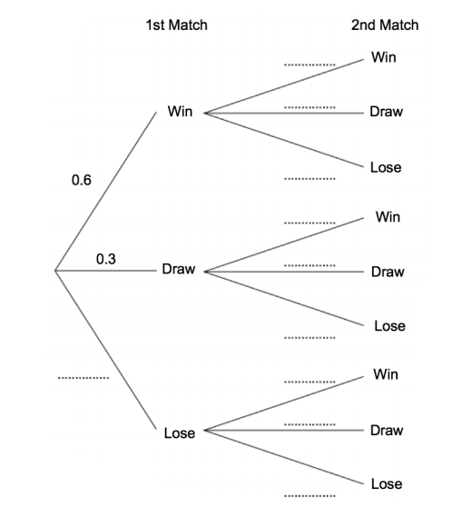
Here is a partially filled tree diagram
What is different about this tree diagram?

Slide 12
Here is a partially filled tree diagram
What do you think this tree diagram is about?

Slide 13
Here is a partially filled tree diagram
What questions could be asked about this tree diagram?
Think of as many as you can and write them on your whiteboards.
Notes:
Choose some questions from around the room and ask students to find the answers on their whiteboards.

Slide 14
