Slide 1
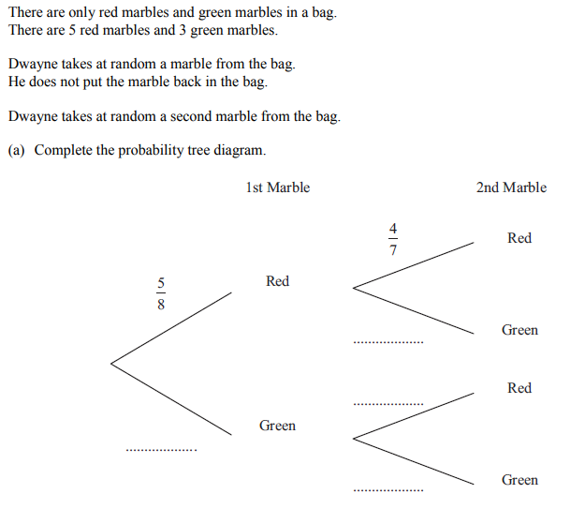
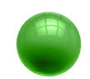

$$\frac{3}{8}$$
What fraction should go here

Slide 2

Why is this fraction $\frac{4}{7}$ ?

Slide 3
A red marble has been removed
$$\frac{3}{8}$$

Slide 4
So now there are 7 marbles, 4 of which are red
$$\frac{3}{8}$$

Slide 5

$$\frac{3}{7}$$
What fraction should go here?
Why?
$$\frac{3}{8}$$

Slide 6
This time, a green marble has been removed and not replaced
$$\frac{3}{7}$$
$$\frac{3}{8}$$

Slide 7
$$\frac{3}{7}$$
What should these two fractions be?
Why?
$$\frac{3}{8}$$

Slide 8


$$\frac{3}{7}$$
What should these two fractions be?
Why?
$$\frac{5}{7}$$
$$\frac{3}{8}$$
$$\frac{2}{7}$$

Slide 9
We can now answer questions using this tree diagram.
$$\frac{3}{7}$$
$$\frac{5}{7}$$
$$\frac{3}{8}$$
$$\frac{2}{7}$$

Slide 10
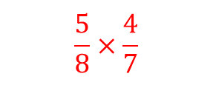
On your whiteboards:
What is the probability of picking two red marbles?
$$\frac{5}{8}×\frac{4}{7}$$
$$\frac{3}{7}$$
$$\frac{5}{7}$$
$$\frac{3}{8}$$
$$\frac{2}{7}$$

Slide 11
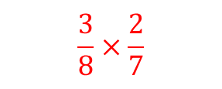
On your whiteboards:
What is the probability of picking two green marbles?
$$\frac{3}{7}$$
$$\frac{5}{7}$$
$$\frac{3}{8}$$
$$\frac{3}{8}×\frac{2}{7}$$
$$\frac{2}{7}$$

Slide 12
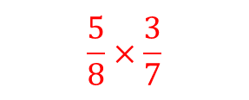
On your whiteboards:
What is the probability of picking marbles of different colours?
$$\frac{3}{7}$$
$$\frac{5}{8}×\frac{3}{7}$$
$$\frac{5}{7}$$
$$\frac{3}{8}$$
$$\frac{2}{7}$$

Slide 13
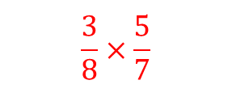
On your whiteboards:
What is the probability of picking marbles of different colours?
But we can also have…
$$\frac{3}{7}$$
$$\frac{5}{8}×\frac{3}{7}$$
$$\frac{5}{7}$$
$$\frac{3}{8}×\frac{5}{7}$$
$$\frac{3}{8}$$
$$\frac{2}{7}$$

