Slide 1
On the next page is a diagram.
What do you think it is about?
What might you be asked?
Think of as many questions as you can.
Answer your own questions
Notes:
Frequency diagrams are reasonably intuitive. Get the students to tell you what they can about the image on the next page.

Slide 2
Bought sweets
Age
56
Yes
80
16 or less
24
No
200
25
Yes
17 or more
120
95
No
Notes:
Collect students ideas and comments.
If they need it, prompts might include:
How many people were surveyed altogether?
What do you think the person was interested in finding out?
Which was most common: buying sweets or not buying sweets?
What is the chance that out of these 200 people, I would randomly select someone 17 or more who bought sweets?
If I choose someone who is 16 or less, what’s the chance the didn’t buy sweets?

Slide 3
There are now some questions on the following slides
Use your answers to answer the questions on your whiteboards.
You might already have the answers in front of you.
Notes:
Frequency diagrams are reasonably intuitive. Get the students to tell you what they can about the image on the next page.

Slide 4
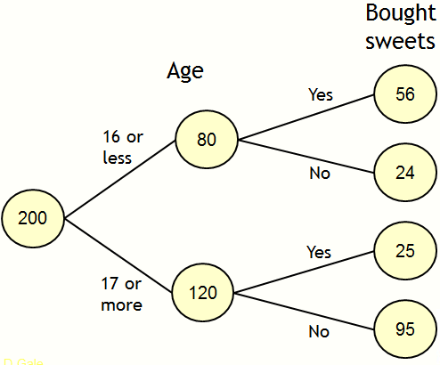

Possible Question 1
How many people were aged 17 or more?
$$120$$
Notes:
Mini whiteboards could be used here.

Slide 5
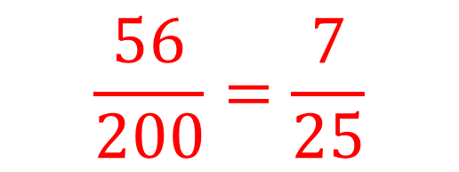
Possible Question 2
What fraction of those asked were 16 or less and bought sweets?
$$\frac{56}{200}=\frac{7}{25}$$
Notes:
Mini whiteboards could be used here.
Up to you whether you want to discuss the simplification of the fraction here.

Slide 6

Possible Question 3
What fraction of the people asked did not buy sweets?
$$\frac{119}{200}$$
Notes:
Mini whiteboards could be used here.
It’s likely you’ll need to clarify that there are two places to be looking for this kind of question.

Slide 7
Share your questions!
Notes:
Ask students for some more questions that they had written. Get other students in the class to answer them.

Slide 8
What is a frequency tree for?
This sort of diagram helps show how information is categorised.
They can be used to help find probabilities.
D.Gale
Notes:
The indication is that these diagrams are likely to lead to a probability question.

Slide 9
Why are they called frequency trees?
The numbers are telling us how often something happened. We call that frequency.
The lines connecting the numbers are called branches. Since it’s a thing made up of branches, it’s called a tree.
D.Gale
Notes:
You may find this phrase helpful:
“No, they do not look like real trees. Deal with it.”

Slide 10
Exam style question
Visit
Gender
Field
Girl
River
Field
Boy
River
90 children went on a Geography field trip.
They either went to a field or a river.
There were 43 boys altogether.
20 girls and 21 boys went to visit the field.
Complete the frequency tree
Use the diagram to find the probability that a child chosen at random would be a girl that visited the river
Notes:
Long term picture. Getting the students familiar with what they might be expected to do.
Students frequently get worried about the amount of writing here. Encourage them to read each line twice.
Ask students to complete on their whiteboards and compare solutions.
(Note that there aren’t many exam questions on this topic yet.)

Slide 11
Challenge – what is the minimum amount of information you need to be given to complete a whole tree like this?
Result
Stall
d
Won
Hoopla
b
e
Lost
a
D.Gale
Won
f
Splat the rat
c
g
Lost
Notes:
How much information is needed? Press students to clearly articulate what they mean.

Slide 12
Challenge – again, what is the minimum amount of information you need to be given to complete a whole tree like this one?
Subject
Gender
Biology
d
b
Chemistry
Male
e
Physics
f
a
Biology
g
Female
c
Chemistry
h
Physics
i
Notes:
How much information is needed?
Press students to clearly articulate what they mean.

Slide 13
Compare and contrast
Colour
Location
45
Dark
 | Dark | Light | Total
Woodland | 45 | 5 | 50
Path | 10 | 20 | 30
Total | 55 | 25 | 80
Woodland
50
5
Light
80
Dark
10
Path
30
Light
20
Woodland
Dark
5
45
10
Dave Gale
20
Notes:
Ask students to compare these diagrams. Again, this is mostly to generate discussion about these types of diagrams.
Since they all contain the same information, are there any particular advantages or disadvantages to each one?
Frequency tree.
Two-way table.
Venn diagram.

Slide 14
Exam style question
Extras
Food
Onions
Burger
Plain
Onions
Hot dog
Plain
In one day, 350 customers visited a burger van.
They chose either a burger or hot dog.
120 customers chose a burger.
30 burgers were served plain.
210 customers wanted onions.
Complete the frequency tree
A customer is selected at random. They chose a hot dog. What is the probability they chose onions?
Notes:
This is a little trickier. You may need to explain why the denominator is 230 due to the conditional nature of the question.
Further practise at getting the students familiar with what they might be expected to do.
(Note that there aren’t many exam questions on this topic yet.)

