Slide 1

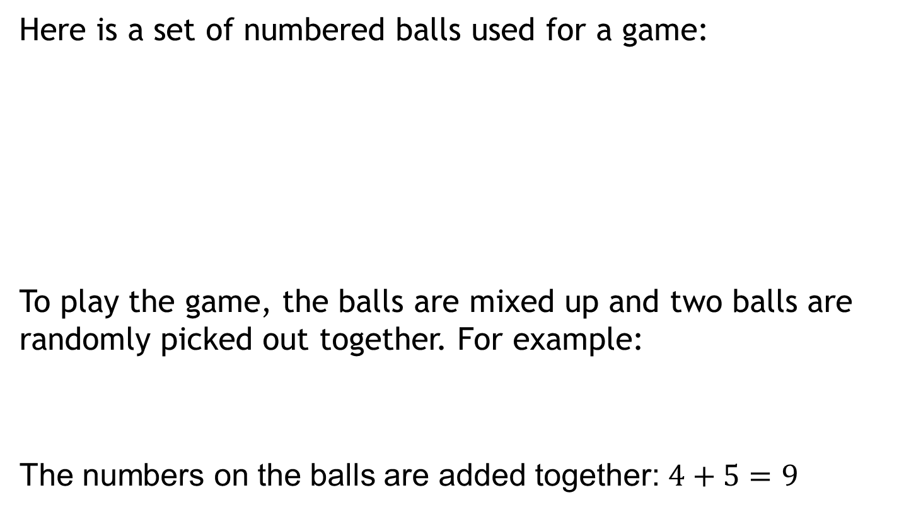
Odds and Evens
Here is a set of numbered balls used for a game:
To play the game, the balls are mixed up and two balls are randomly picked out together. For example:
The numbers on the balls are added together: $4+5=9$
If the total is even, you win.
If the total is odd, you lose.

Slide 2
Odds and Evens
Here is a set of numbered balls used for a game:
How can you decide whether the game is fair?
If the total is even, you win.
If the total is odd, you lose.

Slide 3
Odds and Evens
Here is a set of numbered balls used for a game:
I will now take two discs at random ten times.
Record the outcomes on your whiteboards.
If the total is even, you win.
If the total is odd, you lose.

Slide 4
Odds and Evens
Here is a set of numbered balls used for a game:
Do you think the game is fair?
Can you come up with a convincing argument as to why you think this?
Use your whiteboards for your ideas.
If the total is even, you win.
If the total is odd, you lose.

Slide 5
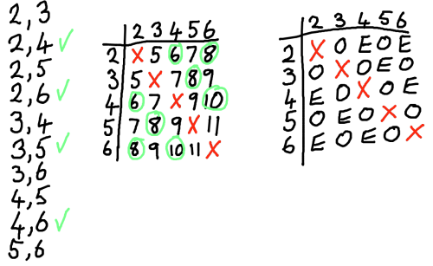
Odds and Evens
Compare these representations to the ones from our class.
Which do you think is the most efficient?

Slide 6
Odds and Evens
Using these diagrams, find what proportion of choices:
result in an even?
result in an odd?

Slide 7
Odds and Evens
Another way of saying this is “What is the probability of getting an even or an odd.”

Slide 8
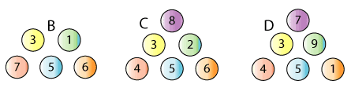
Odds and Evens
Here is a set of numbered balls used for a game:
Which set would you play with to maximise your chances of winning?
You should use a diagram to show all possible outcomes.

Slide 9
Odds and Evens
What if I had these numbered balls?
Work in your pairs to find the probability of winning
with this set.
134
455
1258
622
478
777

Slide 10
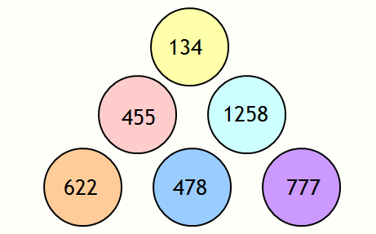
Odds and Evens
You should recognise the probability of winning – it is the same as for Set C.
Why is this?

Slide 11
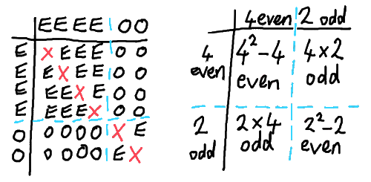
Odds and Evens
You should recognise the probability of winning – it is the same as for Set C.
Why is this?
The actual numbers don’t matter – just whether they
are even or odd.

