Slide 1
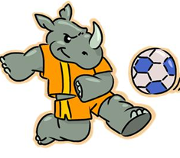
Which Team Will Win?
Every weekend, Team Blue and Team Yellow play each other at 2-Goal Football - they play until two goals have been scored.
Sometimes games last only a minute or two, sometimes they seem to go on for ever.
Over a 36-week season, which team is likely to win more games?

Slide 2
Which Team Will Win?
We will investigate this question through a practical experiment.
We will model this with a die where the numbers 1,2,3 and 4 represent Team Yellow and 5 and 6 represent Team Blue.
What are your initial thoughts?
Why might one team be represented by
more faces on the die?

Slide 3
Which Team Will Win?
Throw your die twice and record your result on your whiteboard.
1,2,3,4 = Y
5,6 = B

Slide 4
Which Team Will Win?
Class Tally:
YY | BB | YB | BY
Who is likely to score more often? Why?
Does this mean they will always win?
Are any of the results in the tally interesting or surprising? Why?
What are the different ways of getting a draw?

Slide 5
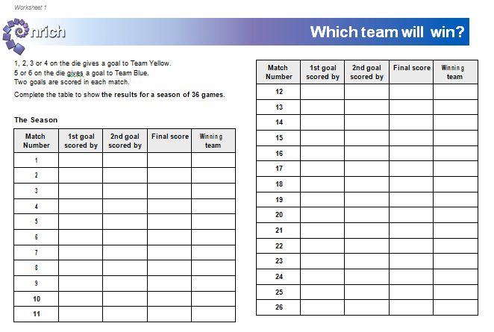
Which Team Will Win?
Now simulate 36 matches
Throw the dice twice for each match and record on the worksheet.

Slide 6
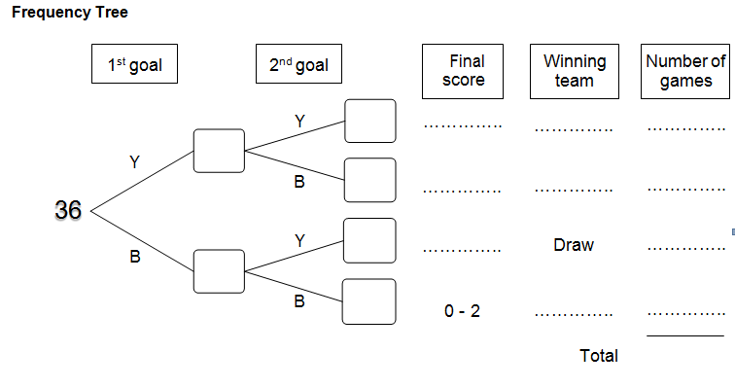
Which Team Will Win?
Transfer your answers to the frequency tree on worksheet 2

Slide 7
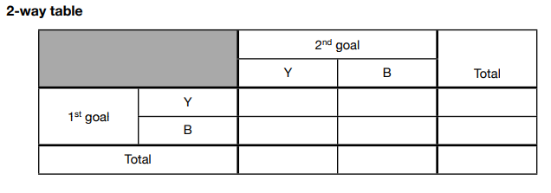
Which Team Will Win?
Now transfer your answers to the 2-way table

Slide 8
What would we expect to happen?
If we didn’t simulate the games with dice, what would we expect the numbers to be? Why?

Slide 9
What would we expect to happen?
If we didn’t simulate the games with dice, what would we expect the numbers to be? Why?

Slide 10
Which Team Will Win?
Use the tables on your sheet to fill in the last page before we share them as a class.

Slide 11
Which Team Will Win?
The expected proportion of games won is also known as the probability of games won.
What is the probability of games won by Team Yellow?
What is the probability of games won by Team Blue?
What is the probability of a draw where Team Yellow score first?
What is the probability of a draw where Team Blue
score first?

Slide 12
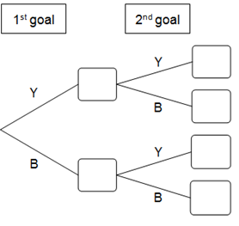






Which Team Will Win?
We can rewrite the frequency tree as a probability tree diagram:
16
$$\frac{16}{24}$$
Y
24
$$\frac{24}{36}$$
Y
8
$$\frac{8}{24}$$
B
8
$$\frac{8}{12}$$
$$\frac{12}{36}$$
Y
12
B
4
$$\frac{4}{12}$$
B

Slide 13
Which Team Will Win?
What are the differences between the two diagrams?
16
$$\frac{16}{24}$$
Y
24
$$\frac{24}{36}$$
Y
8
$$\frac{8}{24}$$
B
8
$$\frac{8}{12}$$
$$\frac{12}{36}$$
Y
12
B
4
$$\frac{4}{12}$$
B

Slide 14
Which Team Will Win?
Where do the fractions come from in the second diagram?
16
$$\frac{16}{24}$$
Y
24
$$\frac{24}{36}$$
Y
8
$$\frac{8}{24}$$
B
8
$$\frac{8}{12}$$
$$\frac{12}{36}$$
Y
12
B
4
$$\frac{4}{12}$$
B

Slide 15






Which Team Will Win?
Notice the fractions haven’t been cancelled down?
What would they be if they were?
How does this relate to the dice we used?
$$\frac{16}{24}$$
16
Y
24
$$\frac{24}{36}$$
Y
8
$$\frac{8}{24}$$
B
8
$$\frac{8}{12}$$
$$\frac{12}{36}$$
Y
12
B
4
$$\frac{4}{12}$$
B

Slide 16
Which Team Will Win?
Challenge:
Draw an expected frequency tree, 2-way table and probability tree diagram if Team Yellow was three times more likely to win than Team Blue.

