Slide 1
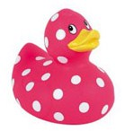
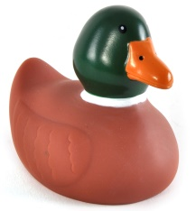
Out of which box do you stand more chance of picking a mallard?
box A
box B

Slide 2
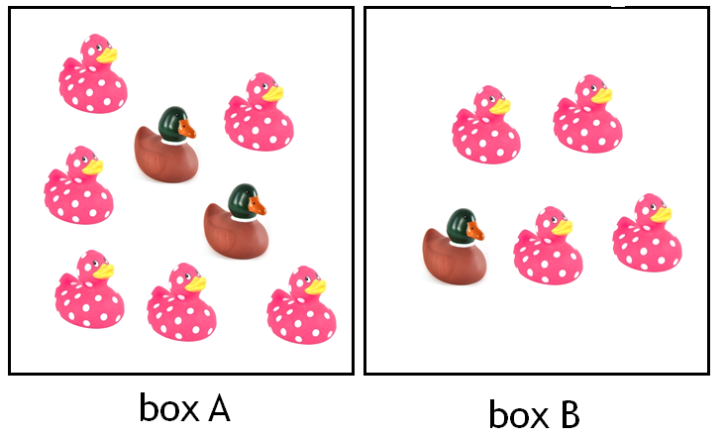
How did you choose?

Slide 3

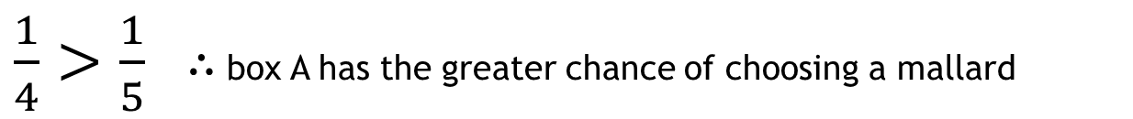

Nick’s method:
Nick compared the size of the fractions by finding a common numerator and comparing the denominators.
Remember:
Smaller denominators mean larger fractions.
Box A: $\frac{2}{8}=\frac{1}{4}$ of the ducks are mallards
Box B: $\frac{1}{5}$of the ducks are mallards
$\frac{1}{4}>\frac{1}{5}$ $∴$ box A has the greater chance of choosing a mallard

Slide 4

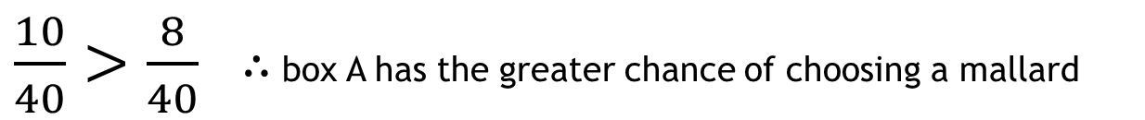

Adam’s method:
Adam compared the size of the fractions by finding a common denominator and comparing the numerators.
Box A: $\frac{2}{8}=\frac{10}{40}$ of the ducks are mallards
Box B: $\frac{1}{5}=\frac{8}{40}$ of the ducks are mallards
$\frac{10}{40}>\frac{8}{40}$ $∴$ box A has the greater chance of choosing a mallard

Slide 5
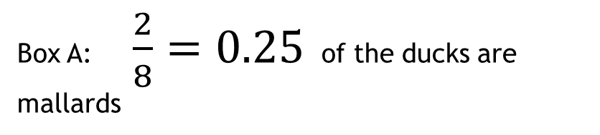

Ruth’s method:
Ruth compared the size of the fractions by converting them to decimals.
Remember:
To convert a fraction to a decimal divide the numerator by the denominator.
Box A: $\frac{2}{8}=0.25$ of the ducks are mallards
Box B: $\frac{1}{5}=0.2$ of the ducks are mallards
$0.25>0.2$ $∴$ box A has the greater chance of choosing a mallard

Slide 6
Use Nick, Gareth and Ruth’s methods to find which box has the greatest chance of choosing a mallard?
box C
box D

Slide 7

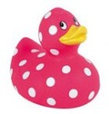

Use Nick, Gareth and Ruth’s methods to find which box has the greatest chance of choosing a mallard?
box E
box F

Slide 8


Out of which box do you stand more chance of picking a blue marble?
Choose any of the methods, or one of your own.
box A
box B

Slide 9


Out of which box do you stand more chance of picking a blue marble?
Choose any of the methods, or one of your own.
box C
box D

Slide 10
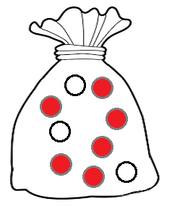
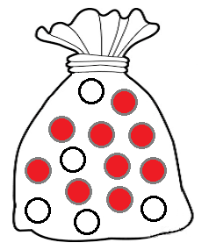
Out of which bag do you stand more chance of picking a red?
bag A
bag B

Slide 11
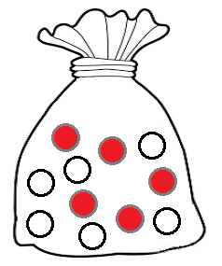
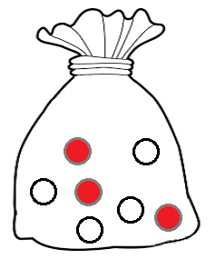
Out of which bag do you stand more chance of picking a red?
bag C
bag D

Slide 12
Which board gives the greatest chance of choosing a quadrilateral?
Which board gives the least chance of choosing a triangle?
Which board gives the greatest chance of choosing a polygon?

Slide 13
Fill the green grid with shapes so that the chance of choosing a quadrilateral is half the chance of choosing a quadrilateral in the blue grid?
Now fill the pink grid with shapes so that the chance of choosing a triangle is twice the chance of choosing a triangle in the blue grid and choosing a quadrilateral is four times the chance of choosing a quadrilateral in your green grid.
What is the chance of choosing a pentagon on your pink grid?

Slide 14
Answer:
Two quadrilaterals drawn and ten other shapes that are not quadrilaterals.
Fill the green grid with shapes so that the chance of choosing a quadrilateral is half the chance of choosing a quadrilateral in the blue grid?
Answer:
Three triangles and six quadrilaterals.
Now fill the pink grid with shapes so that the chance of choosing a triangle is twice the chance of choosing a triangle in the blue grid and choosing a quadrilateral is four times the chance of choosing a quadrilateral in your green grid.
Answer:
There is no room for any pentagons, so there is zero chance of choosing one.
What is the chance of choosing a pentagon on your pink grid?

