Slide 1
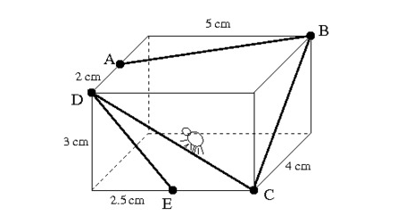
A spider walks on the outside of a box from point A to B to C to D and finally to point E as shown in the picture below.

Slide 2
In your pairs …
Discuss:
What shape is the box?

Slide 3
In your pairs …
Discuss:
What are the dimensions of the box?

Slide 4
In your pairs …
Discuss:
What does the net of a cuboid look like?

Slide 5
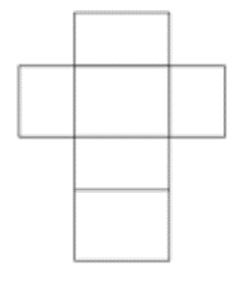
In your pairs …
Discuss:
What does the net of a cuboid look like?

Slide 6
In your pairs …
Draw an accurate net of the box and map out the path of the spider.

Slide 7
In your pairs …
Compare your net with other people – have you got the same?

Slide 8
In your pairs …
Cut out the net and put the box together to see if you are right.

Slide 9
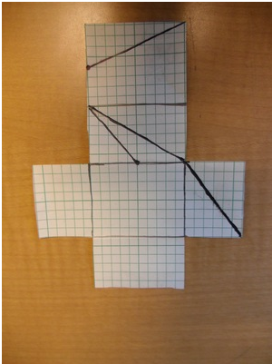
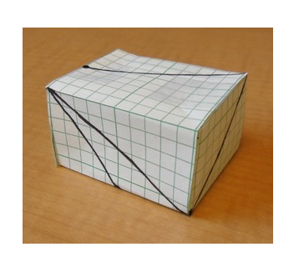
Add in all of the measurements to your box

Slide 10
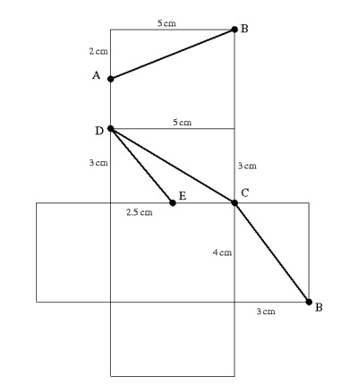
Notes:
GIVE THIS FOR STUDETNS TO USE FOR THE NEXT SECTION OF THE LESSON UNLESS THEY HAVE CREATED A PERFECT VERSION OF THIS NET THEMSELVES …

Slide 11
In your pairs …
What shapes can you see?

Slide 12
In your pairs …
How long is the total path of the spider?
What could we use to keep our answers accurate?

Slide 13
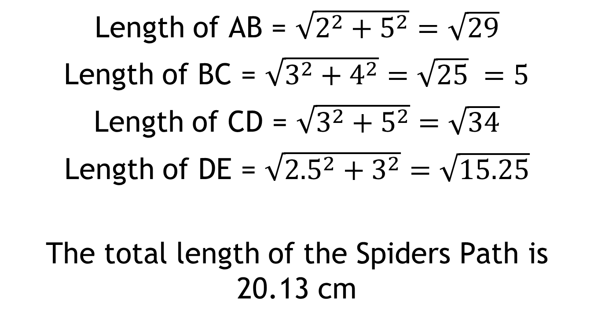
Solutions:
Length of AB = $\sqrt{2^{2}+5^{2}}=\sqrt{29}$
Length of BC = $\sqrt{3^{2}+4^{2}}=\sqrt{25} =5$
Length of CD = $\sqrt{3^{2}+5^{2}}=\sqrt{34}$
Length of DE = $\sqrt{{2.5}^{2}+3^{2}}=\sqrt{15.25}$
The total length of the Spiders Path is 20.13 cm

Slide 14
Notes:
GIVE STUDENTS A COPY OF THIS TO REFFER TO THROUGHOUT THE LESSON

Slide 15
Notes:
GIVE THIS FOR STUDENTS TO USE FOR THE NEXT SECTION OF THE LESSON UNLESS THEY HAVE CREATED A PERFECT VERSION OF THIS NET THEMSELVES …

