Slide 1

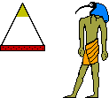
Objective
Make scale models of the Pyramids at Giza
Display them as a 3D poster along with any calculations used in the process
This should be decorated with relevant pictures and diagrams

Slide 2
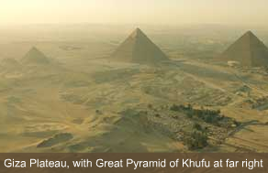

Slide 3
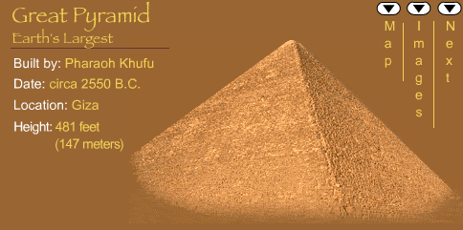
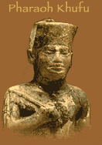
229.8 metres

Slide 4
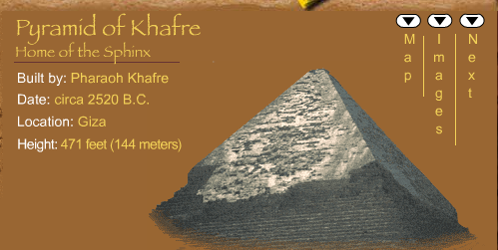
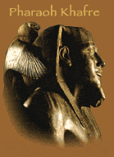
706 feet

Slide 5
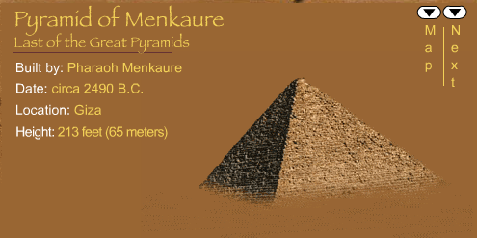
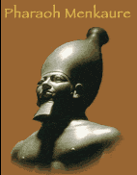
201 cubits

Slide 6
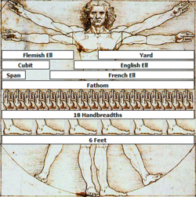
What is a Cubit?
This derivation of the Vitruvian Man by Leonardo da Vinci, depicts nine historical units of measurement:
the Yard,
the Span,
the Cubit,
the Flemish Ell,
the English Ell,
the French Ell,
the Fathom,
the Hand,
the Foot.

Slide 7
What is a Cubit?
The Vitruvian man was drawn to scale, so the units depicted are displayed with their proper historical ratios.

Slide 8
Definition of Cubit
The Cubit is a historic unit of distance frequently mentioned in the Bible.
The word comes from the Latin cubitum, "elbow," because the unit represents the length of a man's forearm from his elbow to the tip of his outstretched middle finger.
This distance tends to be about 18 inches or roughly 45 centimetres.

Slide 9
What will the net look like?
D
C
A
B

Slide 10
What lengths do we know?
D
C
A
B

Slide 11
229.8 metres

Slide 12
What other lengths would we need to make the net easy to draw?
D
C
229.8m
A
B

Slide 13
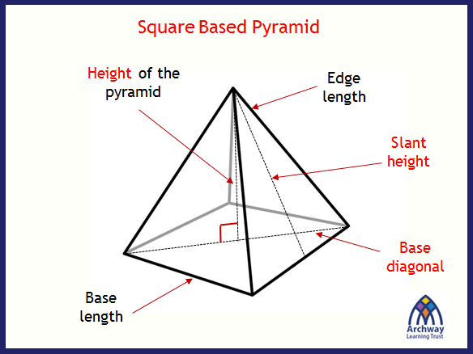
Think back to last lesson …

Slide 14
What is this length called?
D
C
229.8m
A
B

Slide 15
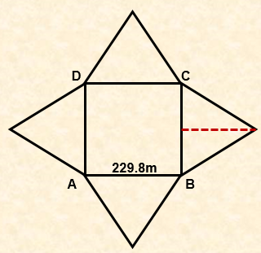
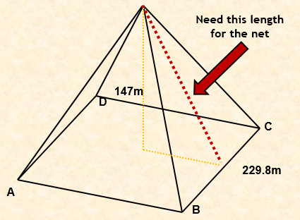
In your pairs … Can you find this length?

Slide 16
186.6m
147m
D
C
229.8m
A
B
Now work it out…

Slide 17
Use this information to draw your net to scale. Let 1square = 1 0m
186.6m

Slide 18
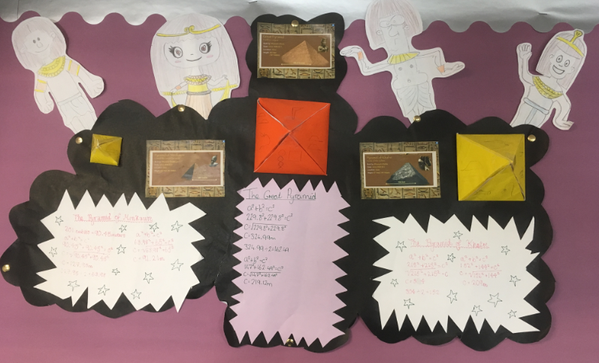

Slide 19
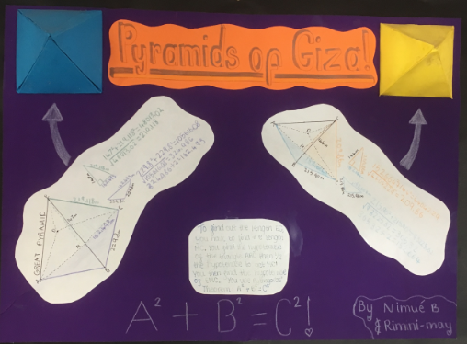

Slide 20
