Slide 1
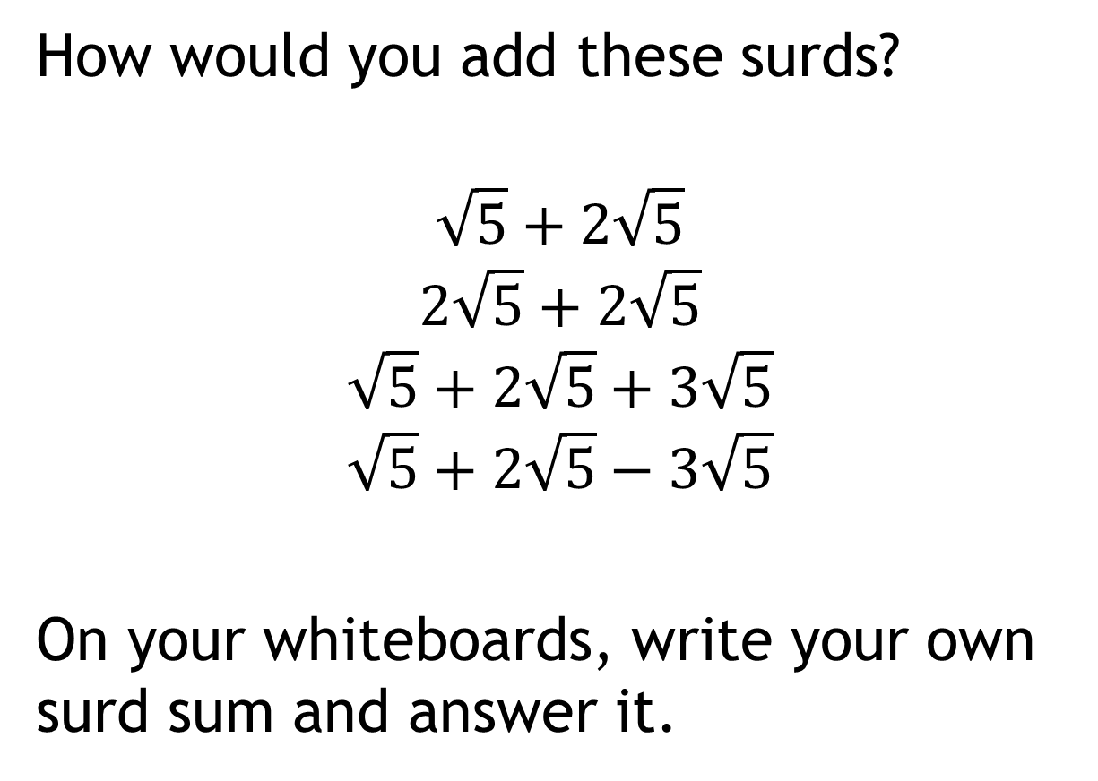
Adding and subtracting surds
How would you add these surds?
$$\sqrt{5}+2\sqrt{5}$$
$$2\sqrt{5}+2\sqrt{5}$$
$$\sqrt{5}+2\sqrt{5}+3\sqrt{5}$$
$$\sqrt{5}+2\sqrt{5}−3\sqrt{5}$$
On your whiteboards, write your own surd sum and answer it.

Slide 2
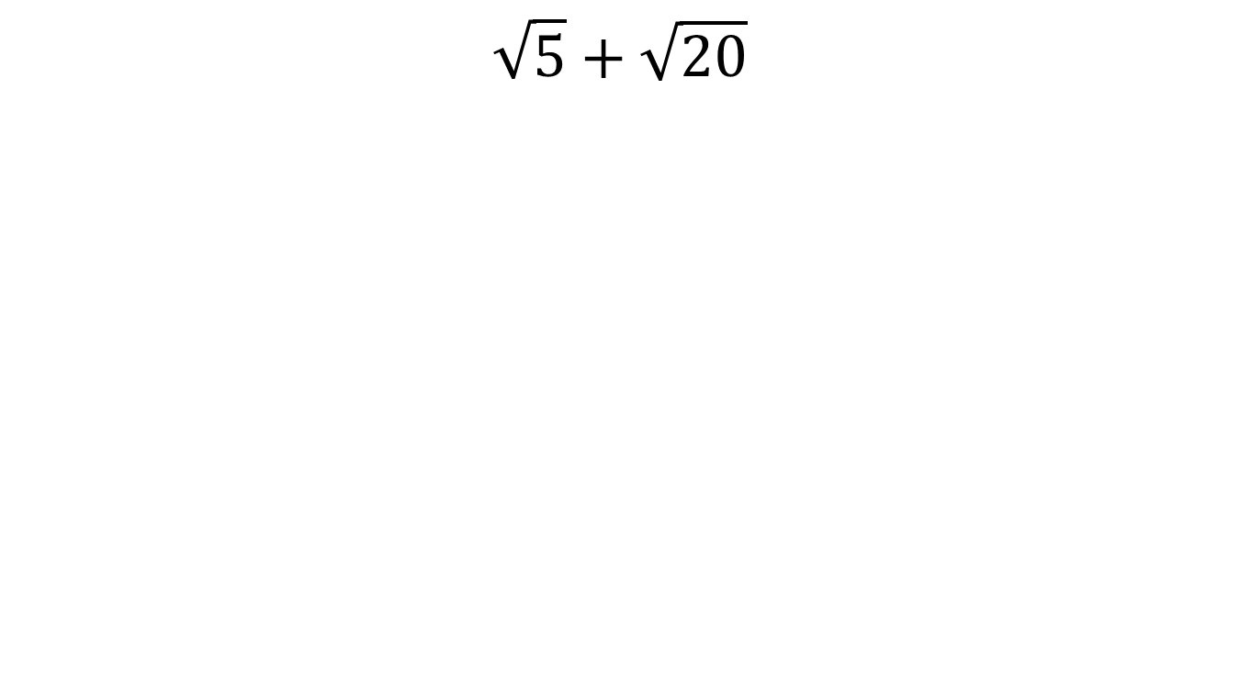
Discuss:
$$\sqrt{5}+\sqrt{20}$$

Slide 3
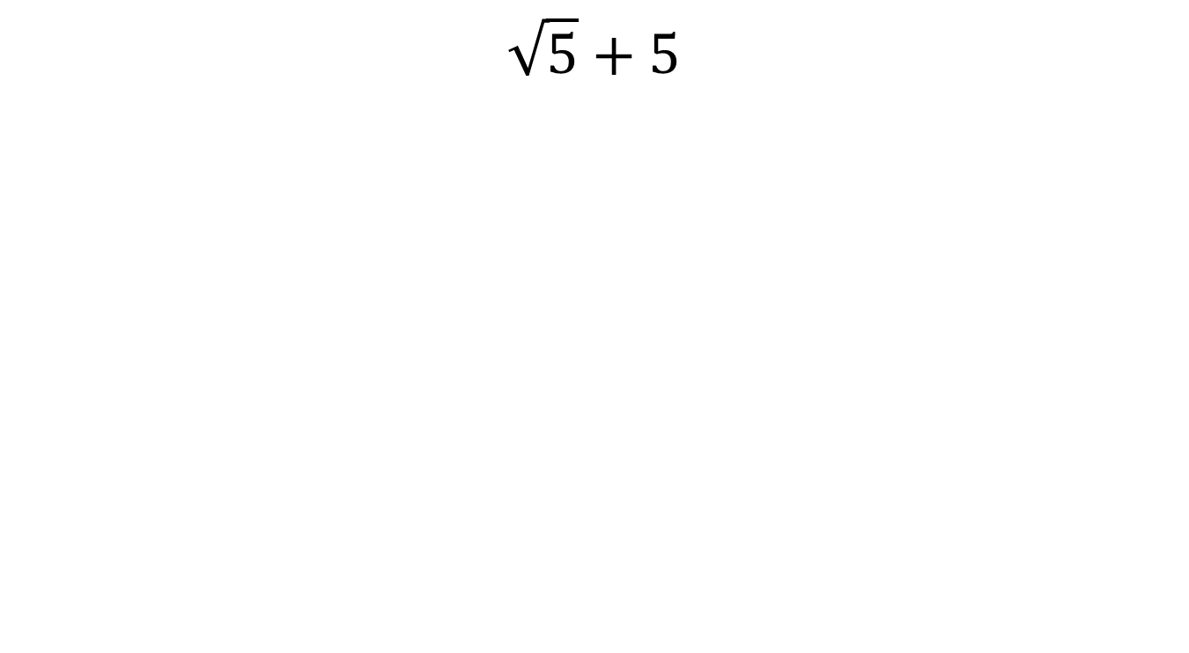
Discuss:
$$\sqrt{5}+5$$

Slide 4
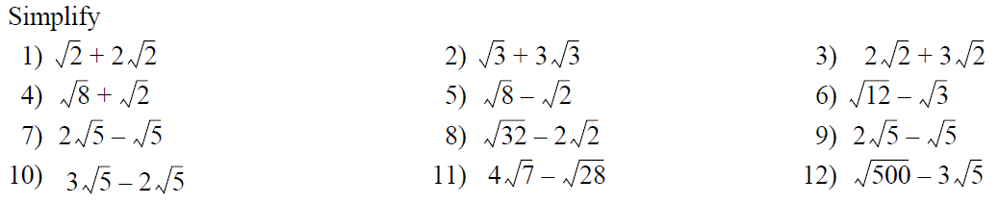
In your books
Title: Adding and subtracting surds

Slide 5
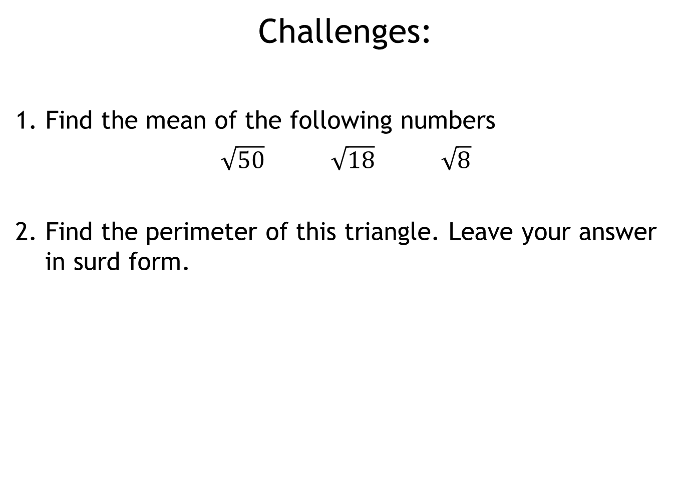
Challenges:
1. Find the mean of the following numbers
$\sqrt{50} \sqrt{18} \sqrt{8}$
2. Find the perimeter of this triangle. Leave your answer in surd form.
8 cm
4 cm

