Slide 1
On your whiteboards …
Write the square numbers up to 15²
1² = 1
2² = 4
3² = 9
4² = 16
5² = 25
6² = 36
7² = 49
8² = 64
9² = 81
10² = 100
11² = 121
12² = 144
13² = 169
14² = 196
15² = 225

Slide 2
The area of the shaded squares is 2cm²
Mohamed says their side lengths are 1.41cm.
Do you agree?
1.41 cm
1.41 cm
1.41 cm
2 cm²
2 cm²
1.41 cm
Notes:
The aim here is for pupils to realise that the rounded answer is not accurate enough (1.41). They may simply square root 2 and come up with a more accurate solution for the length(1.4142 … ect). If so the following slides could be skipped and the principal of leaving it as root 2 instead could be generated from discussion around this point. If they don’t prompt with questioning about the degree of accuracy using the next slides.
Pupils are expected to calculate 1.41 x 1.41 and see that the solution is not 2.
Pythagoras is not encouraged at this stage, though if it is used, don’t shoot it down. They may get a longer decimal ans on their calculator and offer this as a suggestion. If they do, run with it, let them try again with that. Again, if this happens you may not need the next few slides.

Slide 3
The area of these shaded squares is 2cm²
How could these diagrams be made
more accurate?
1.41 cm
1.41 cm
1.41 cm
2 cm²
2 cm²
1.41 cm
Notes:
The aim here is for pupils to realise that the rounded answer is not accurate enough (1.41). They may simply square root 2 and come up with a more accurate solution for the length(1.4142 … ect). If so the following slides could be skipped and the principal of leaving it as root 2 instead could be generated from discussion around this point. If they don’t prompt with questioning about the degree of accuracy using the next slides.
Pupils are expected to calculate 1.41 x 1.41 and see that the solution is not 2.
Pythagoras is not encouraged at this stage, though if it is used, don’t shoot it down. They may get a longer decimal ans on their calculator and offer this as a suggestion. If they do, run with it, let them try again with that. Again, if this happens you may not need the next few slides.

Slide 4
What about now?
Is it more accurate?
1.414213 cm
1.414213 cm
1.414213 cm
2 cm²
2 cm²
1.414213 cm
Notes:
Still not 2 but it is closer
Yes – closer to 2. The longer decimal gives us a more accurate answer but it isn’t perfect

Slide 5
What could we write so that the area is exactly 2cm²?
?
?
?
2 cm²
2 cm²
?
Notes:
Students use Pythagoras to find the exact value of the side length
Alternatively, they may intuitively decide that it’s root 2. This is not a problem and if Pythagoras doesn’t come up and don’t force it

Slide 6
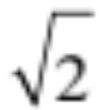
What could we write so that the area is exactly 2cm²?
2 cm²
2 cm²
Notes:
Students use Pythagoras to find the exact value of the side length
Alternatively, they may intuitively decide that it’s root 2.

Slide 7
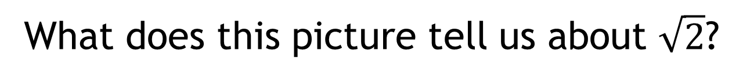
What does this picture tell us about $\sqrt{2}$?
2 cm²
2 cm²
Notes:
Root 2 is a number that carries on forever (has a lot of decimal places) no need to be too explicit here. It is approx. the same value as 1.41 … however root 2 tells us the number EXACTLY

Slide 8

What does this picture tell us about$\sqrt{2} ×\sqrt{2}$ ?
2 cm²
2 cm²
Notes:
Draw the conclusion of multiplying 2 identical surds

Slide 9
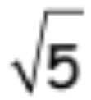
On your whiteboards…
What would the area of this square be?
5 cm²

Slide 10
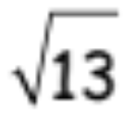
On your whiteboards…
What would the area of this square be?
13 cm²

Slide 11
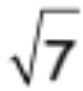
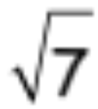
On your whiteboards…
What would the lengths of this square be?
7 cm²

Slide 12
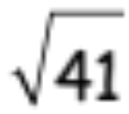
On your whiteboards…
What would the lengths of this square be?
41 cm²

Slide 13
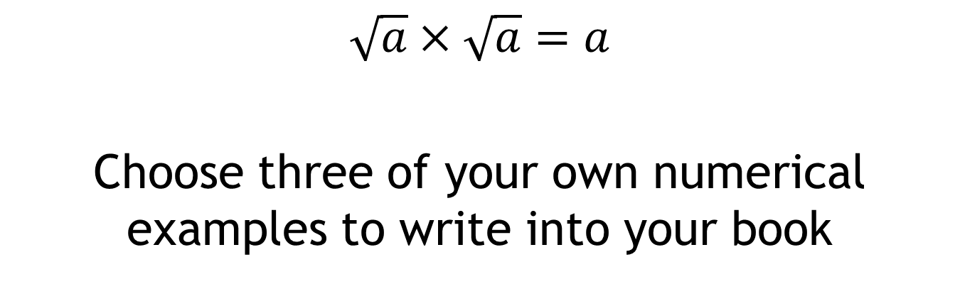
In your books …
$$\sqrt{a}×\sqrt{a}=a$$
Choose three of your own numerical examples to write into your book

Slide 14
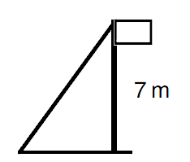
A non-calculator question:
A girl ties a wire to a flag pole to secure it.
The flag pole is 3 metres long and the girl wants to anchor it 3 metres away from the base of the flag pole.
How long must her wire be to do this?
3 m
3 m
Notes:
Emphasise no calc

Slide 15

A non-calculator question:
A girl ties a wire to a flag pole to secure it.
The flag pole is 3 metres long and the girl wants to anchor it 3 metres away from the base of the flag pole.
How long must her wire be to do this?
c² = 3² + 3²
c² = 9 + 9
3 m
c² = 18
3 m
c = $\sqrt{\text{18}}$

Slide 16
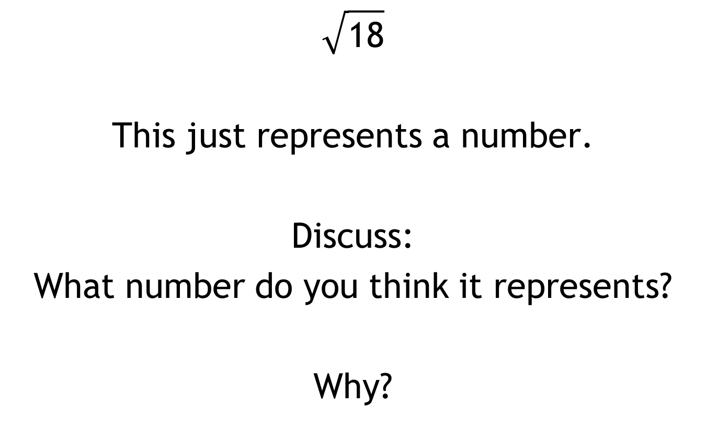
$$\sqrt{\text{18}}$$
This just represents a number.
Discuss:
What number do you think it represents?
Why?

Slide 17
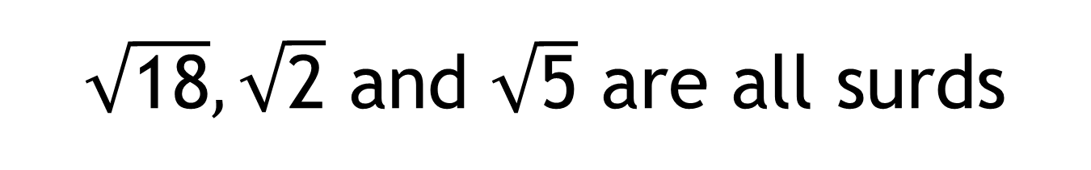
$\sqrt{\text{18}},\sqrt{\text{2}}$ and $\sqrt{\text{5}}$ are all surds
Discuss:
What do you think that means?

Slide 18
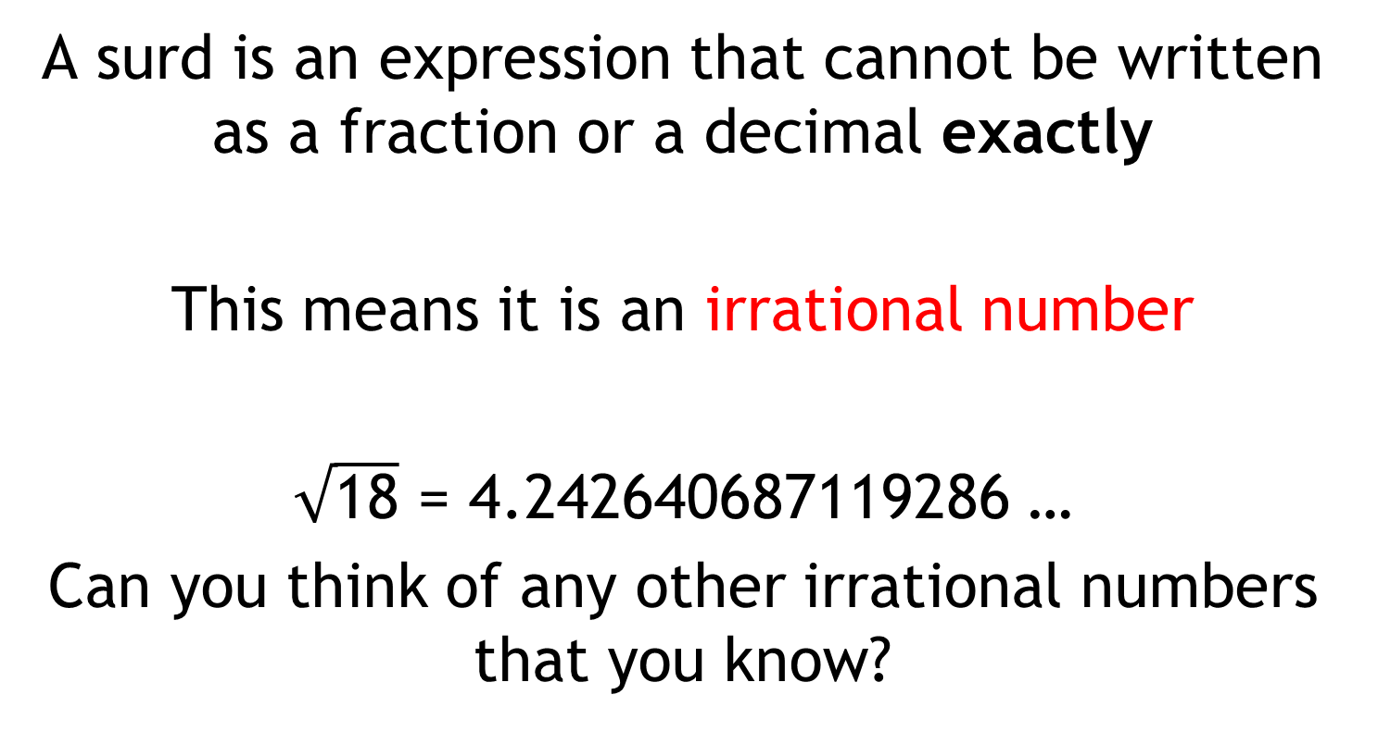
$\sqrt{\text{18}},\sqrt{\text{2}}$ and $\sqrt{\text{5}}$ are all surds
A surd is an expression that cannot be written as a fraction or a decimal exactly
This means it is an irrational number
$\sqrt{\text{18}}$ = 4.242640687119286 …
Can you think of any other irrational numbers that you know?
Notes:
Pupils may think of pi. Some may have seen e.

Slide 19
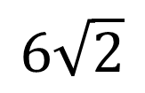
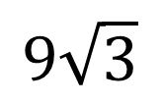


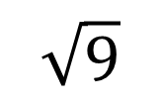
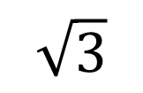
In your pairs …
Which of the following is a surd?
$$9\sqrt{3}$$
$$\sqrt{3}$$
$$\sqrt{9}$$
$$6\sqrt{2}$$
$$9$$
$$3$$

Slide 20
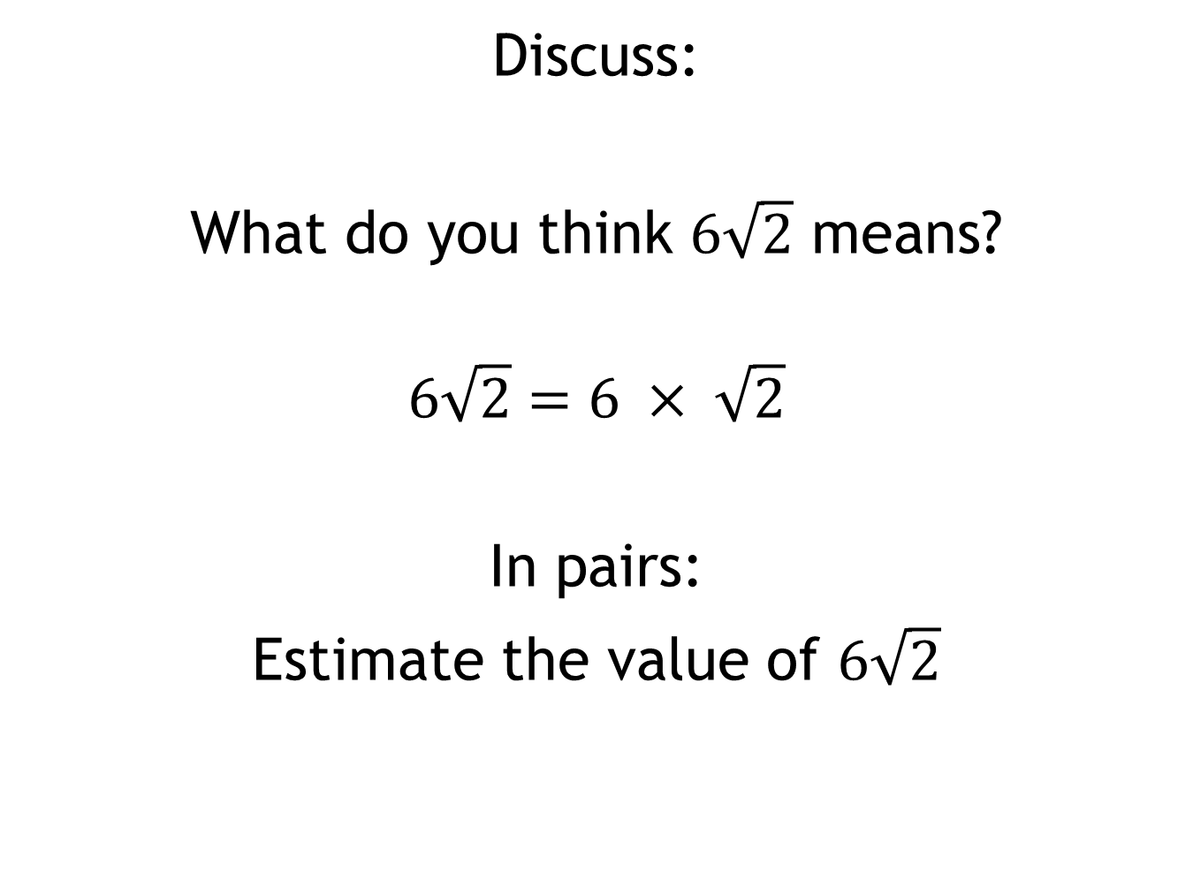
Discuss:
What do you think $6\sqrt{2}$ means?
$$6\sqrt{2}=6 × \sqrt{2}$$
In pairs:
Estimate the value of $6\sqrt{2}$

Slide 21
Think back to the original picture.
What is the perimeter of the tilted square?
2 cm²

Slide 22
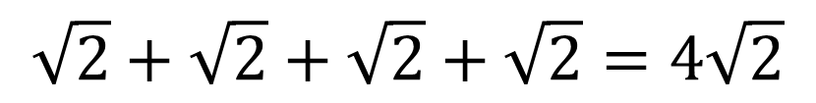
Think back to the original picture.
What is the perimeter of the square?
2 cm²
+
+
+
$$\sqrt{2}+\sqrt{2}+\sqrt{2}+\sqrt{2}=4\sqrt{2}$$

Slide 23
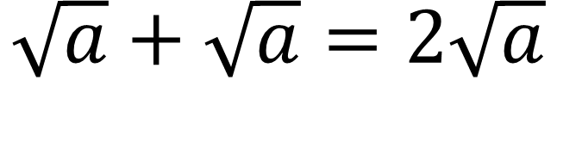
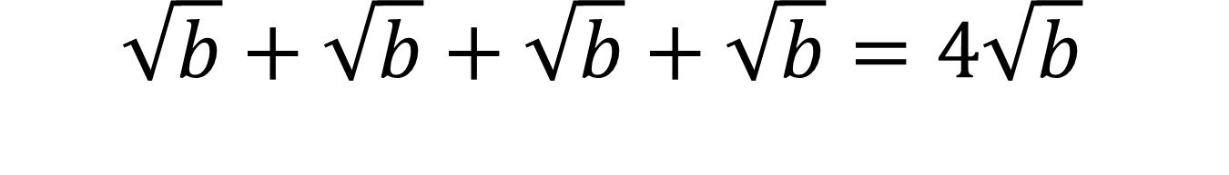
$$\sqrt{a}+\sqrt{a}=2\sqrt{a}$$
In your books …
$$\sqrt{b}+\sqrt{b}+\sqrt{b}+\sqrt{b}=4\sqrt{b}$$
Choose three of your own numerical examples to write into your book

Slide 24
Challenge Problems
Notes:
Most students will not get this far – that is fine!

Slide 25
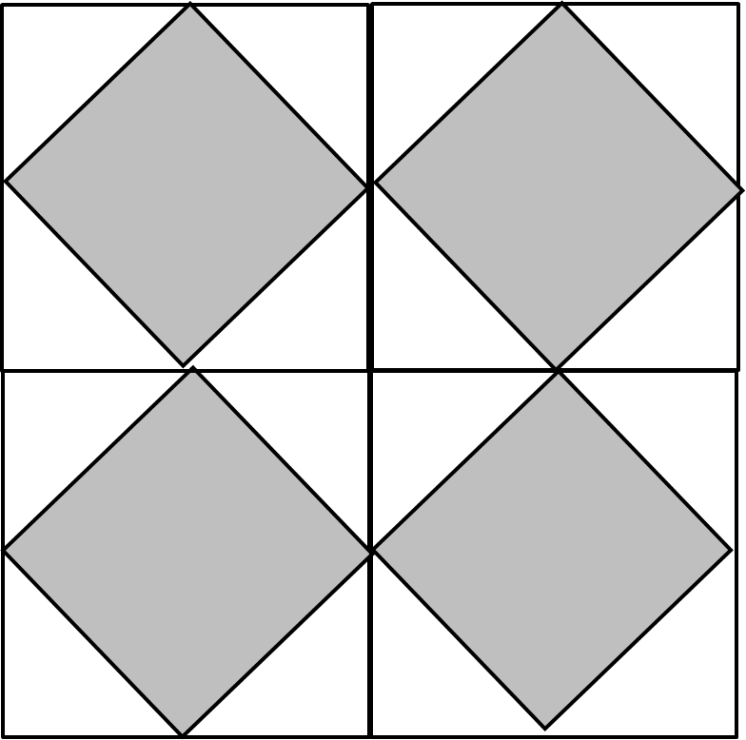
18cm²
18cm²
18cm²
18cm²
What do the little lines mean?

Slide 26
18cm²
18cm²
18cm²
18cm²
What is the side length of the shaded square?

Slide 27
18cm²
18cm²
18cm²
18cm²
What is the perimeter of the centre square?

Slide 28
18cm²
18cm²
18cm²
18cm²
What is total area of the combined white shapes?
Can you find another method?

