Slide 1
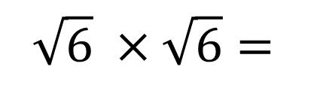
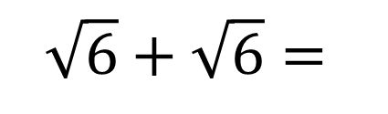
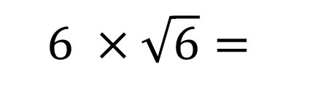
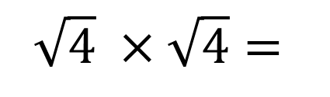
Evaluate the following:
Starter
$$\sqrt{6} ×\sqrt{6}=$$
$$\sqrt{4} ×\sqrt{4}=$$
$$6 ×\sqrt{6}=$$
$$\sqrt{6}+\sqrt{6}=$$

Slide 2
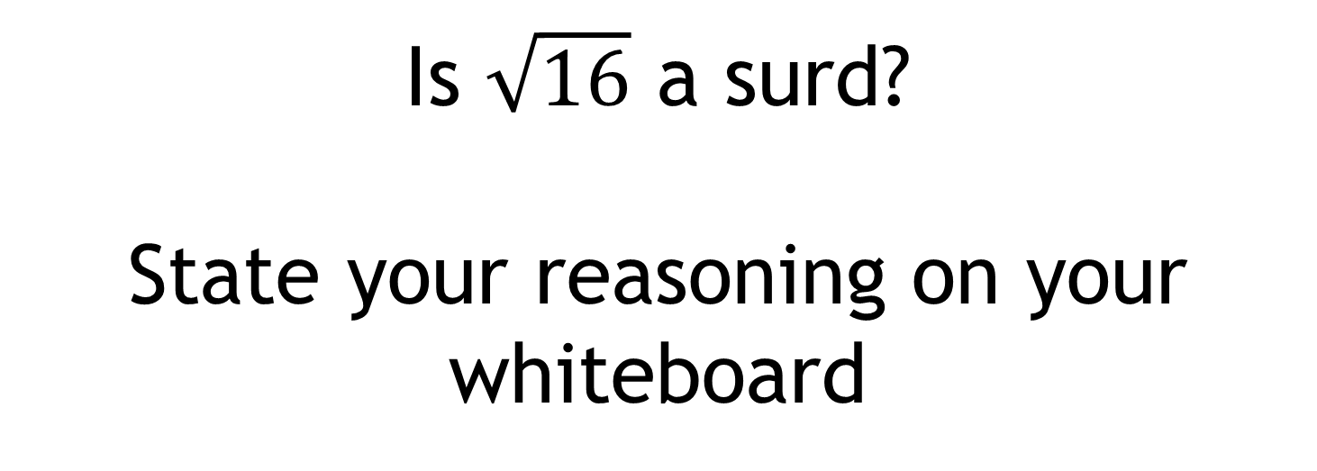
Is $\sqrt{16}$ a surd?
State your reasoning on your whiteboard

Slide 3

Is $\sqrt{16}$ a surd?
When a square numbers appears inside a square root, it is possible to simplify it.

Slide 4

Is $\sqrt{16}$ a surd?
$\sqrt{16}=4$
Write down another square root that can be simplified in this way.
And another…

Slide 5
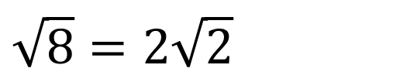
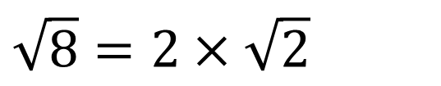
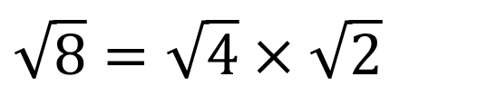
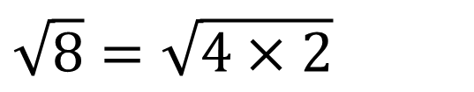
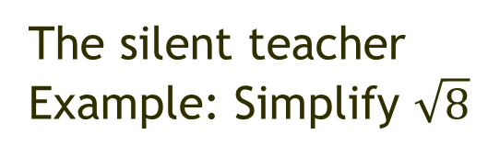
Although $\sqrt{8}$ is a surd, it can still be simplified
The silent teacher
Example: Simplify $\sqrt{8}$
Now let’s talk through it.
Any questions?
$$\sqrt{8}=\sqrt{4×2}$$
$$\sqrt{8}=\sqrt{4}×\sqrt{2}$$
$$\sqrt{8}=2×\sqrt{2}$$
$$\sqrt{8}=2\sqrt{2}$$

Slide 6
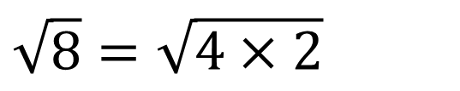
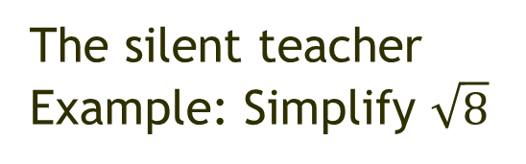
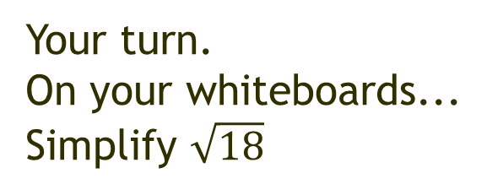
Although $\sqrt{8}$ is a surd, it can still be simplified
Your turn.
On your whiteboards...
Simplify $\sqrt{18}$
The silent teacher
Example: Simplify $\sqrt{8}$
$$\sqrt{8}=\sqrt{4×2}$$
$$\sqrt{8}=\sqrt{4}×\sqrt{2}$$
$$\sqrt{8}=2×\sqrt{2}$$
Now let’s look at some of your work.
$$\sqrt{8}=2\sqrt{2}$$
Notes:
Pick four or five examples to share with the class. Choose correct examples and also examples with errors to discuss.
Show by:
Showing whiteboards
Using the visualiser
Taking photos with your phone and saving to Google Photos which can be shown immediately on the screen.

Slide 7
For the questions on the next slide:
Predict what the answer will be by looking at the previous two examples.
Check by working out.
Were you correct?
Predict. Check. Evaluate

Slide 8
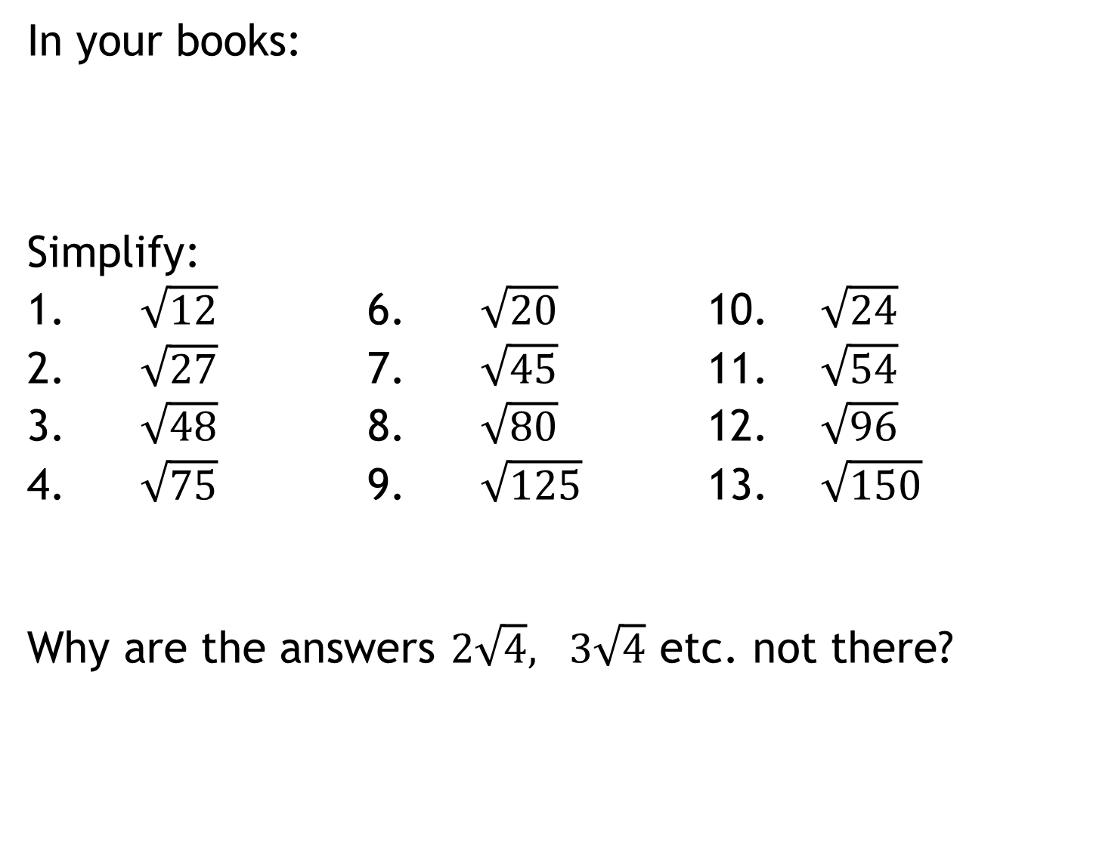
In your books:
Simplify:
1. $\sqrt{12}$ 6. $\sqrt{20}$ 10. $\sqrt{24}$
2. $\sqrt{27}$ 7. $\sqrt{45}$ 11. $\sqrt{54}$
3. $\sqrt{48}$ 8. $\sqrt{80}$ 12. $\sqrt{96}$
4. $\sqrt{75}$ 9. $\sqrt{125}$ 13. $\sqrt{150}$
Why are the answers $2\sqrt{4}, 3\sqrt{4}$ etc. not there?
Predict. Check. Evaluate

Slide 9
What is the key step in simplifying surds?
Find a factor of the surd that is a square number
Write the first 15 numbers on your whiteboards.
1, 4, 9, 16, 15, 36, 49, 64, 81, 100, 121, 169, 196, 225 …
What if the surd doesn’t have a factor that is a square number?

Slide 10
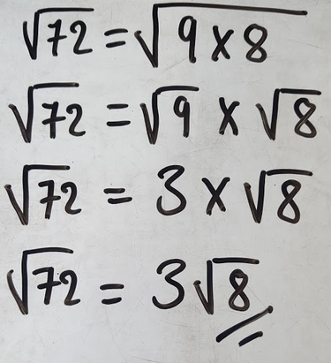
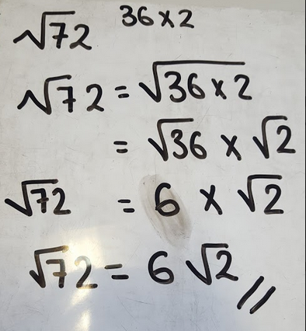
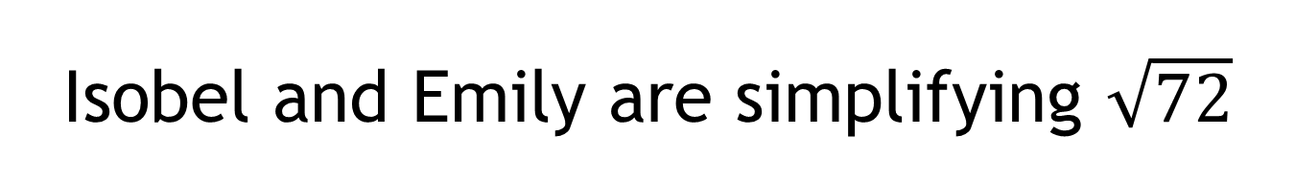
Isobel and Emily are simplifying $\sqrt{72}$
Discuss:
Who has simplified correctly?
Why?

Slide 11
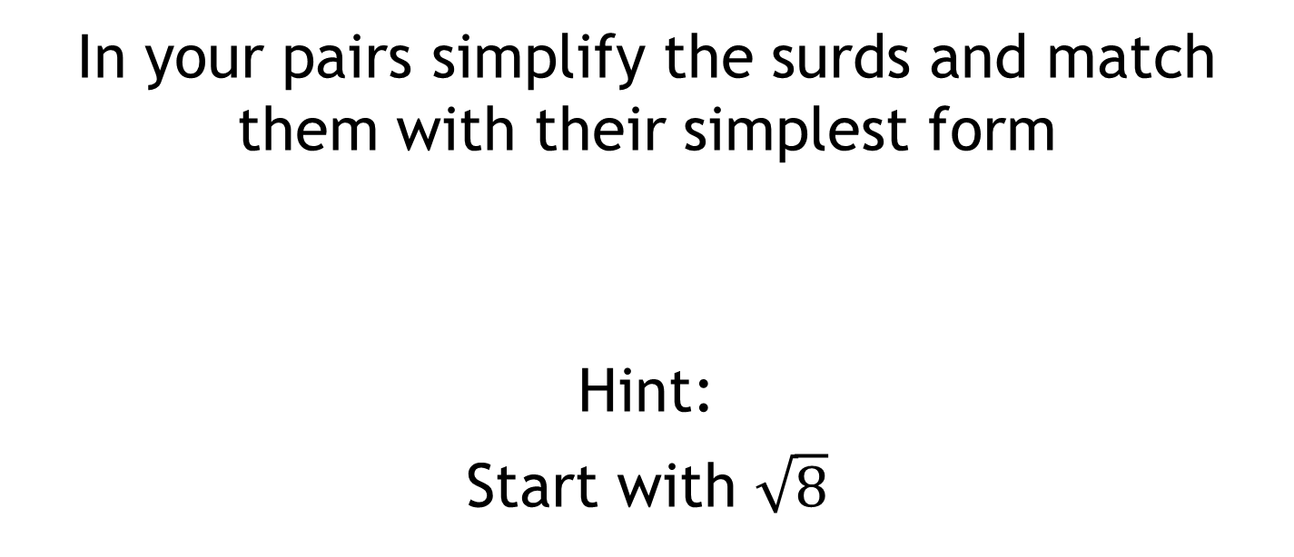
Tarsia Activity
In your pairs simplify the surds and match them with their simplest form
Hint:
Start with $\sqrt{8}$

Slide 12
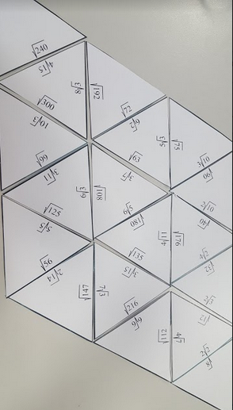
Solutions

Slide 13
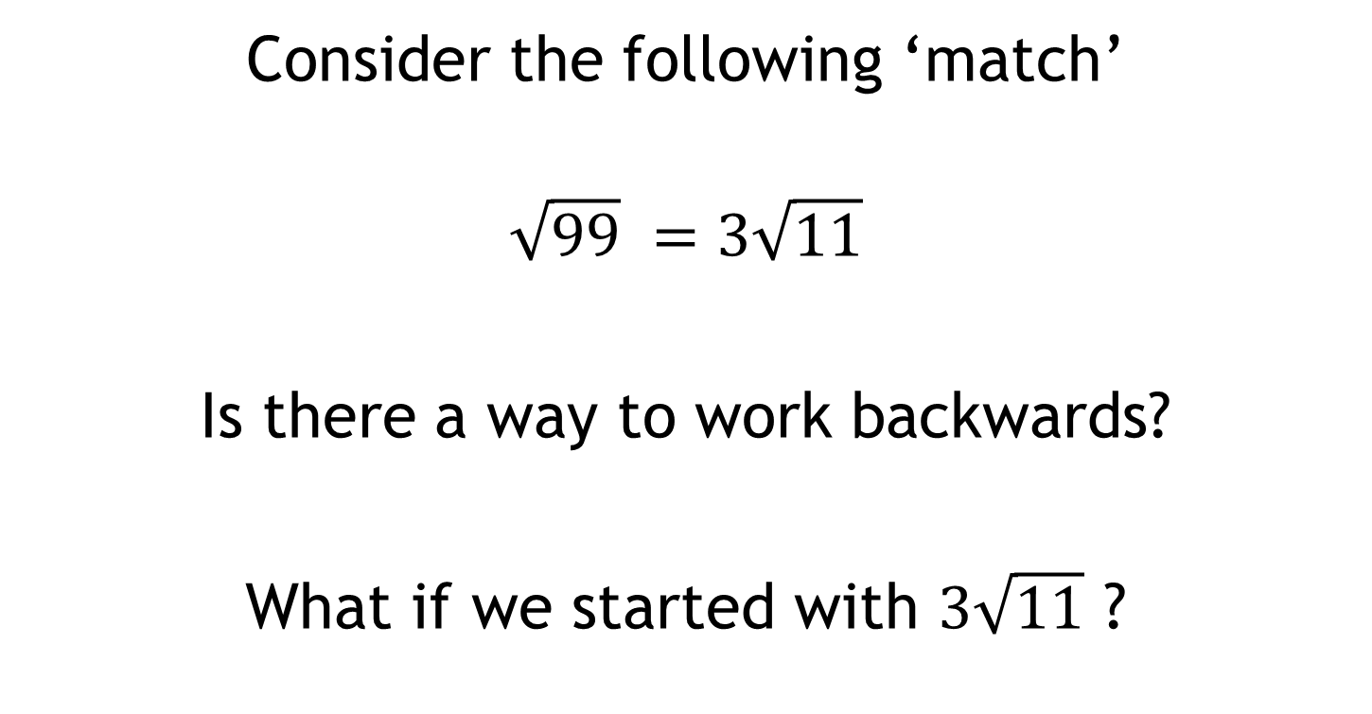
Consider the following ‘match’
$$\sqrt{99} =3\sqrt{11}$$
Is there a way to work backwards?
What if we started with $3\sqrt{11}$ ?

Slide 14
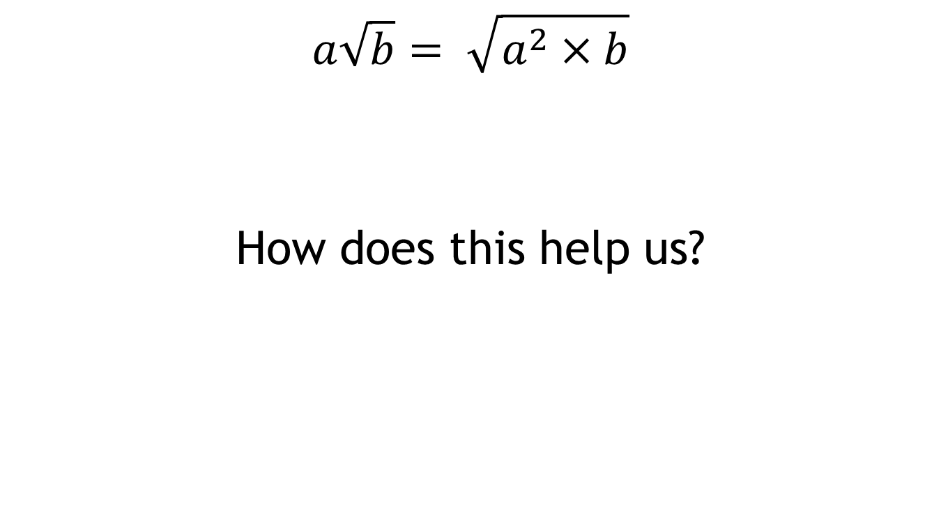
Discuss:
$$a\sqrt{b}= \sqrt{a^{2}×b}$$
How does this help us?

Slide 15
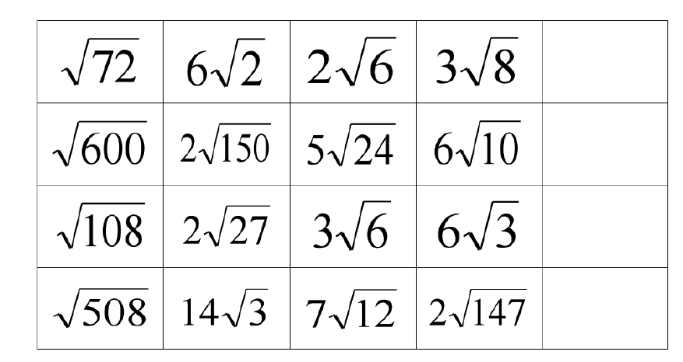
Find the odd one out on each row:
Challenge:
Add another surd, in the empty box, that is equivalent to the odd one out

Slide 16




Find the odd one out on each row:
$$6√2$$
$$10√6$$
$$6√3$$
$$14√3$$
Challenge:
Add another surd, in the empty box, that is equivalent to the odd one out

Slide 17
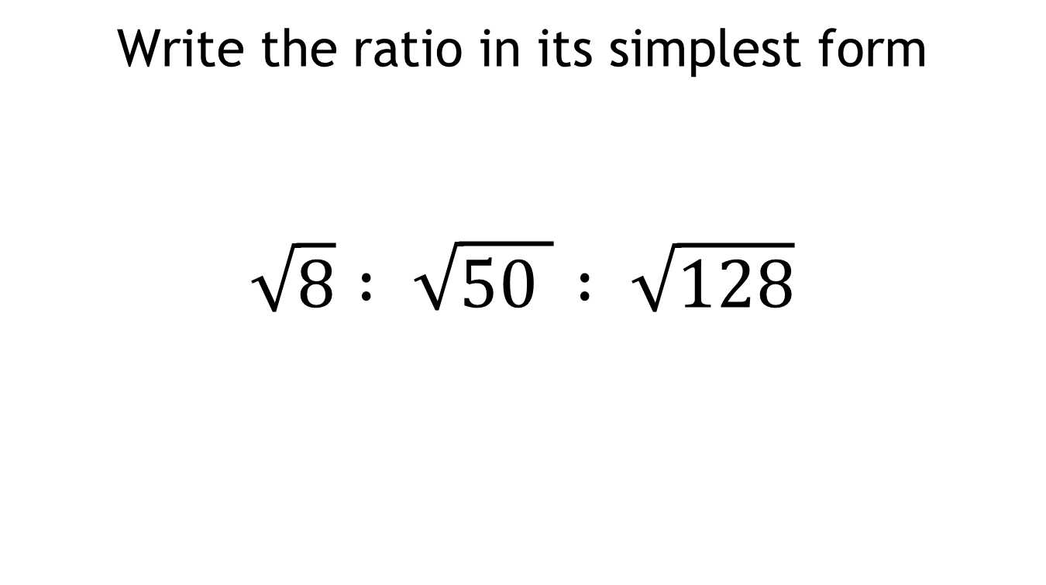
Challenge:
Write the ratio in its simplest form
$$\sqrt{8} : \sqrt{50 } : \sqrt{128}$$

