Slide 1
In pairs:
Discuss how you might answer this question
A triangle has sides of length 23.8 cm, 31.2 cm and 39.6 cm.
Is this a right-angled triangle?
Show how you decide

Slide 2
Pythagoras’ theorem is only true for right angled triangles.
If a triangle satisfies Pythagoras’ theorem then the triangle must be right-angled

Slide 3
The measurements in the table give the lengths of the sides of 9 different triangles.
Triangle 1: 2, 3, 4 | Triangle 2: 24, 45, 51 | Triangle 3: 3.5
Triangle 4: 20, 21, 29 | Triangle 5: 20, 48, 52 | Triangle 6: 12, 12.5
Triangle 7: 6, 13, 14 | Triangle 8: 7, 24, 25, | Triangle 9: 5, 5¼, 7¼

Slide 4
Triangle 1: 2, 3, 4 | Triangle 2: 24, 45, 51 | Triangle 3: 3.5
Triangle 4: 20, 21, 29 | Triangle 5: 20, 48, 52 | Triangle 6: 12, 12.5
Triangle 7: 6, 13, 14 | Triangle 8: 7, 24, 25, | Triangle 9: 5, 5¼, 7¼
Which of the triangles are right-angled?

Slide 5
Triangle 1: 2, 3, 4 | Triangle 2: 24, 45, 51 | Triangle 3: 3.5
Triangle 4: 20, 21, 29 | Triangle 5: 20, 48, 52 | Triangle 6: 12, 12.5
Triangle 7: 6, 13, 14 | Triangle 8: 7, 24, 25, | Triangle 9: 5, 5¼, 7¼
Only the green ones are right angled
Why?

Slide 6
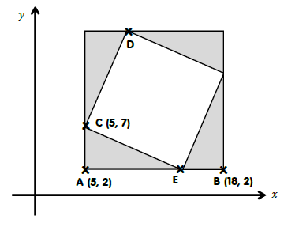
Four congruent triangles are shown below
What is the meaning of the word congruent?

Slide 7
Four congruent triangles are shown below
Use the diagram to find the coordinates of D
Find the length of the line CE

Slide 8
Four congruent triangles are shown below
Challenge:
Find the length of the line from the origin to the centre of the square.

Slide 9
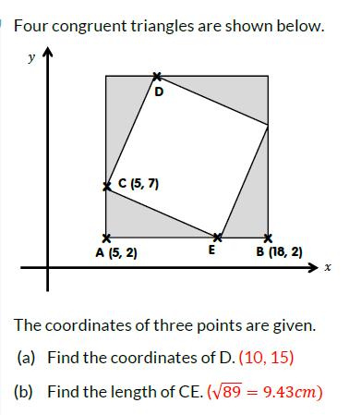

Slide 10

$$(11.5 , 8.5)$$
X
$\sqrt{{8.5}^{2}+{11.5}^{2}}=14.3$

Slide 11
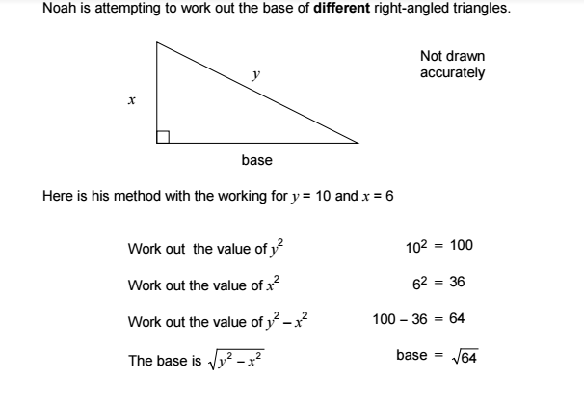
Noah is attempting to work out the length of the base of different right-angled triangles
Do you agree with Noah’s working?

Slide 12
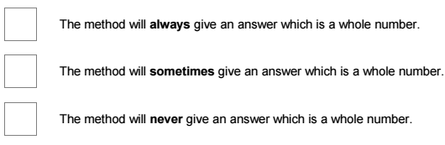
Choose the correct statement
A
B
C
Show some working to support your answer – your pair may be asked to share!

Slide 13
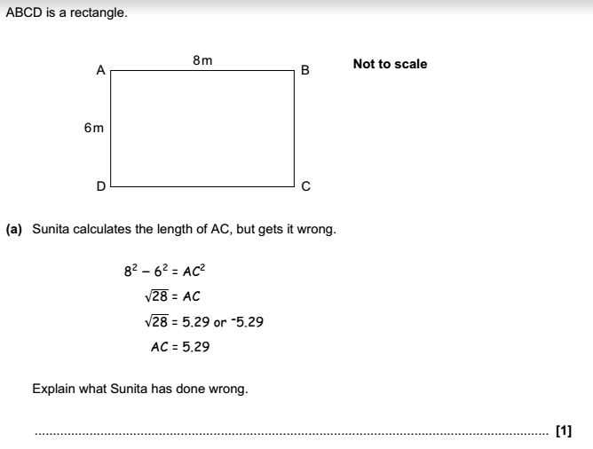
To finish:
ABCD is a rectangle
Sunita calculates the length of AC but has made a mistake.
Can you find the mistake?
Notes:
Use this as an exit ticket

Slide 14

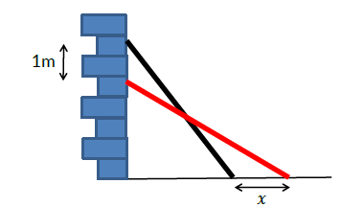
Challenge 1:
A 7m ladder rests against a wall.
The ladder reaches 5.5m up the wall.
The ladder is then moved so that it now reaches 1m lower than last time.
How much further away from the wall is the base of the ladder?

Slide 15
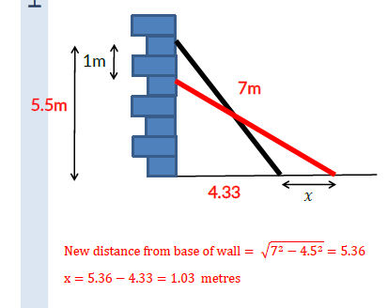

Slide 16
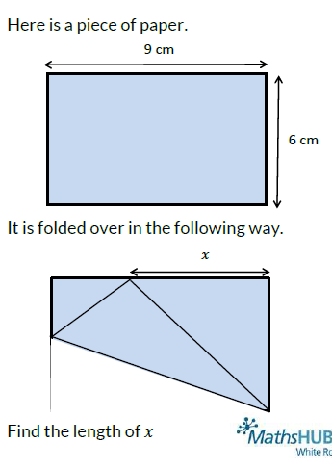
Challenge 2:
Here is a piece of paper.
It is folded over in the following way:
Find the length of x

Slide 17
