Slide 1
On your whiteboards…
Find the length of x.
x
2 cm
7 cm

Slide 2
How is this question different?
7 cm
2 cm
x

Slide 3

Find the length of x.
49 cm²
x² = 7² - 2²
x² = 49 - 4
4 cm²
7 cm
2 cm
x² = 45
x
x = $\sqrt{\text{45}}$
x = 6.7 cm
45 cm²

Slide 4
In your pairs …
T
F
Find the length of x.
x² = 12² - 8²
12cm
x
x² = 144 - 64
x² = 80
8cm
x = √80 = 8.9 cm

Slide 5
In your pairs …
T
F
Find the length of x.
x² = 10² + 6²
10cm
6cm
x² = 100 + 36
x² = 136
x
x = √136
x = 11.7 cm

Slide 6
In your pairs …
T
F
4 m
x
Find the length of x.
11 m
x² = 11² - 4²
x² = 121 - 16
x² = 105
x = √105 = 10.2 cm

Slide 7
In your books…
Find the length of x to 1dp.
x² = 8² - 6²
8 cm
x² = 64 - 36
x
x² = 28
6 cm
x = √28 = 5.3 cm

Slide 8
In your books…
Find the length of x to 1dp.
x² = 6² - 4²
x² = 36 - 16
6 cm
x
x² = 20
x = √20 = 4.5 cm
4 cm

Slide 9
In your pairs…
One of you is student A and one is student B.
Student A: complete the three questions on the left hand side of the sheet,
Student B: complete the three questions on the right hand side of the sheet.
You have 5 minutes in silence…

Slide 10
In your pairs…
Now swap and read each other’s work.
Correct using your green pen.
Discuss any mistakes.
When you have finished answer the question at the bottom of the sheet together.

Slide 11
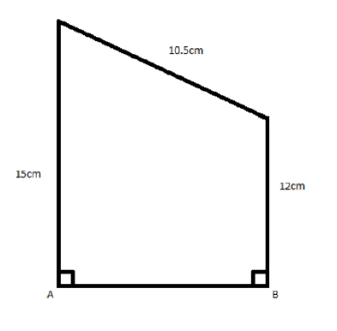
To finish …
In your pairs, find the length of AB

Slide 12
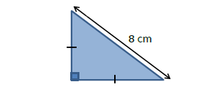
Challenge:
Shown is an isosceles triangle. The hypotenuse is 8cm.
Find the area of the triangle

