Slide 1
From last lesson:
Pythagoras’ Theorem
c² = a² + b²
We can use this formula to find missing lengths in right-angled triangles, where a and b are the sides either side of the right angle, and c is the hypotenuse.
c
a
b

Slide 2
From last lesson:
Pythagoras’ Theorem
c² = a² + b²
a² can be thought of as the area of a square with length a
c
a²
a
b

Slide 3
From last lesson:
Pythagoras’ Theorem
c² = a² + b²
b² can be thought of as the area of a square with length b
c
a
b
b²

Slide 4
From last lesson:
Pythagoras’ Theorem
c² = a² + b²
c² can be thought of as the area of a square with length c
c²
c
a
b

Slide 5
From last lesson:
Pythagoras’ Theorem
c² = a² + b²
So according to Pythagoras’ Theorem, the sum of the areas of the two smaller squares is equal to the square on the hypotenuse.

Slide 6
From last lesson:
Pythagoras’ Theorem
c² = a² + b²
Watch Perigal’s dissection here
Watch another representation of the theorem here
Notes:
The first link is to a Geogebra file. Drag the green slider to animate.
The second link is to a YouTube clip of an episode of QI which uses a gadget to demonstrate Pythagoras’ Theorem. This clip uses the letters in an alternative way, which is a good talking point. It also has the triangle in a different orientation which is also a useful discussion to have.

Slide 7
Before we begin, let’s make sure we know how to identify which side is the hypotenuse.
For the next three slides, identify which side is the hypotenuse.

Slide 8


Slide 9


Slide 10


Slide 11
How can we use it to find the length of the hypotenuse in a right-angled triangle?
c² = a² + b²
Notes:
The first link is to a Geogebra file. Drag the green slider to animate.
The second link is to a YouTube clip of an episode of QI which uses a gadget to demonstrate Pythagoras’ Theorem. This clip uses the letters in an alternative way, which is a good talking point.

Slide 12
The silent teacher
The whole class will watch me very carefully in silence as I silently demonstrate the example. It is important that nobody asks questions during this time.
I will pause at key moments in the process. At these points you should try to think what is going to happen next.
Once I have done this (about 2 minutes) I will talk through the example and take questions.
Notes:
The Example-Problem pair is a method taken from Craig Barton’s book which combines the Silent Teacher with Show Call

Slide 13
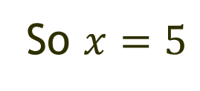
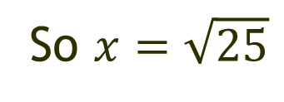


Example:
Now let’s talk through it.
Any questions?
$$c2 = a2 + b2$$
25cm²
9cm²
$$x$$
3cm
4cm
16cm²
So $x=\sqrt{25}$
So $x=5$
Notes:
The diagrams are used initially to ensure all students can access the activity. We will move away from the diagrams most students as the unit progresses, with only those requiring the scaffolding continuing to use them.

Slide 14

Example:
Your turn (on your whiteboards)
$$c2 = a2 + b2$$
25cm²
9cm²
$$x$$
$$x$$
6cm
3cm
4cm
8cm
16cm²
So $x=\sqrt{25}$
So $x=5$
Notes:
Students now answer the next question on their whiteboards. Look around for any errors or particularly good examples.

Slide 15
Example:
Your turn (on your whiteboards)
$$c2 = a2 + b2$$
25cm²
9cm²
$$x$$
$$x$$
6cm
3cm
4cm
8cm
Now let’s look at some of your work.
16cm²
So $x=\sqrt{25}$
So $x=5$
Notes:
Pick four or five examples to share with the class. Choose correct examples and also examples with errors to discuss.
Show by:
Showing whiteboards
Using the visualiser
Taking photos with your phone and saving to Google Photos which can be shown immediately on the screen.

Slide 16



Now try these in your book:
$$x$$
8cm
10cm
Think. Predict. Check
$$x$$
0.8m
1m
40cm
50cm
$$x$$

Slide 17
On your whiteboards …
T
F
Find the length of x.
x
x² = 8² + 6²
6cm
x² = 64 + 36
8cm
x² = 100
x = √100 = 10 cm

Slide 18
On your whiteboards …
T
F
Find the length of x.
9² + 7² = x²
x
9mm
18 + 49 = x²
67 = x²
7mm
x = √67 = 8.2 mm

Slide 19
On your whiteboards …
T
F
9cm
Find the length of x.
x² = 4² + 9²
4cm
x
x² = 16 + 81
x² = 97
x = √97 = 9.8 m

Slide 20
On your whiteboards …
Find the length of x.
x² = 3² + 6²
x
x² = 9 + 36
3cm
x² = 45
6cm
x = √45 = 6.7 cm

Slide 21
On your whiteboards …
You can also do it this way. (Why?)
x² = 6² + 3²
x
x² = 36 + 9
3cm
x² = 45
6cm
x = √45 = 6.7 cm

Slide 22
On your whiteboards …
Find the length of x.
x² = 6² + 8.5²
x
x² = 36 + 72.25
8.5cm
x² = 108.25
6cm
x = √108.25 = 10.4 cm

Slide 23
Find the missing length x for each triangle
6.5 mm
x
11 m
7 m
x
8 cm
x
13.8 mm
15 cm
x = 17 cm
x = 13.04 m
x = 15.25 mm

Slide 24
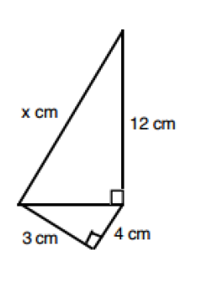
To finish …
How could we find the missing length, x?
In your pairs, find x

Slide 25
Is there a way to make the missing length 17 cm?
?
?
?
Notes:
A challenge question for when students have finished.

