Slide 1
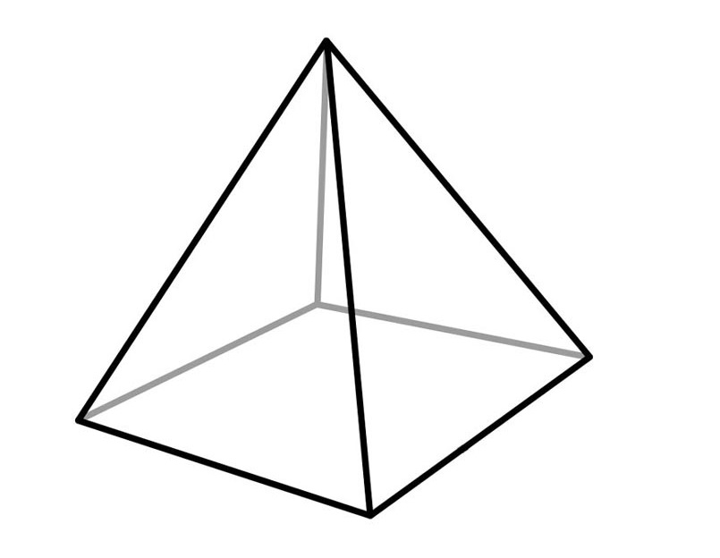
Name the shape …

Slide 2
Square Based Pyramid
?
?
Notes:
Ask students to discuss what they might call these 2 measurements.

Slide 3
Square Based Pyramid
Height of the pyramid
Base
diagonal
These two lines are perpendicular
Notes:
Try to consistently use this terminology – this will make the rest of the lesson much easier

Slide 4
Square Based Pyramid
Height of the pyramid
Base
diagonal
What do you notice about these 2 lines?
Notes:
Right angle – key. Means we can apply Pythagoras

Slide 5
Square Based Pyramid
Height of the pyramid
Base
diagonal
These two lines are perpendicular
Notes:
Right angle – key. Means we can apply Pythagoras

Slide 6
Square Based Pyramid
Height of the pyramid
Base
diagonal
This means we have a right-angled triangle
Notes:
Try to link this back to 3D Pythagoras with the connection to the diagonal in a cuboid

Slide 7
Square Based Pyramid
Height of the pyramid
Edge
length
Slant
height
Base
diagonal
Base
length
Notes:
More terminology – if students haven’t realised we could calculate these lengths, prompt them.

Slide 8
On your wallets …
Label any lengths that you know
What other information do we need to be able to find the edge length?
Base length
= 5 cm
5cm
Notes:
Some students may go straight through and get the base diagonal
Labour the point about half of the base diagonal is the base of triangle 2

Slide 9
On your wallets …
Label any lengths that you know
What other information do we need to be able to find the edge length?
Base diagonal
= 8 cm
8cm
Notes:
Working backwards to find side length
Again – half the base diagonal to find the base of upright triangle

Slide 10
On your wallets …
Label any lengths that you know
What other information do we need to be able to find the edge length?
Height = 10 cm
10cm
Notes:
Is there more than one option?

Slide 11
On your wallets …
Label any lengths that you know
What other information do we need to find the base length ?
10cm
Edge length
= 10 cm

Slide 12
On your wallets …
Label any lengths that you know
What other information do we need?
Slant height
= 10 cm
10cm

Slide 13
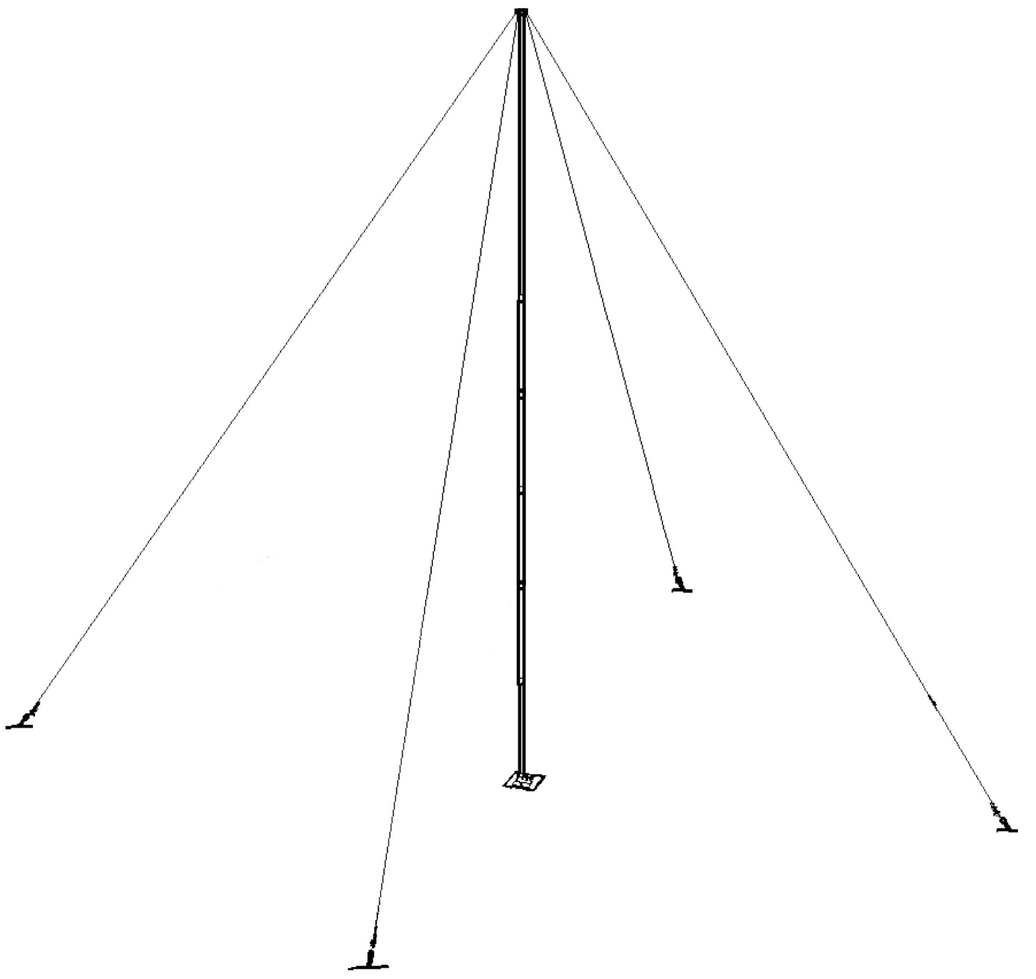
A Guyed Radio Mast
Guys are ropes that hold things sturdy.
A radio mast is held sturdy with wire guys.
How much is guy rope is needed to keep the radio mast in place?
height = 78 feet
56 feet

Slide 14
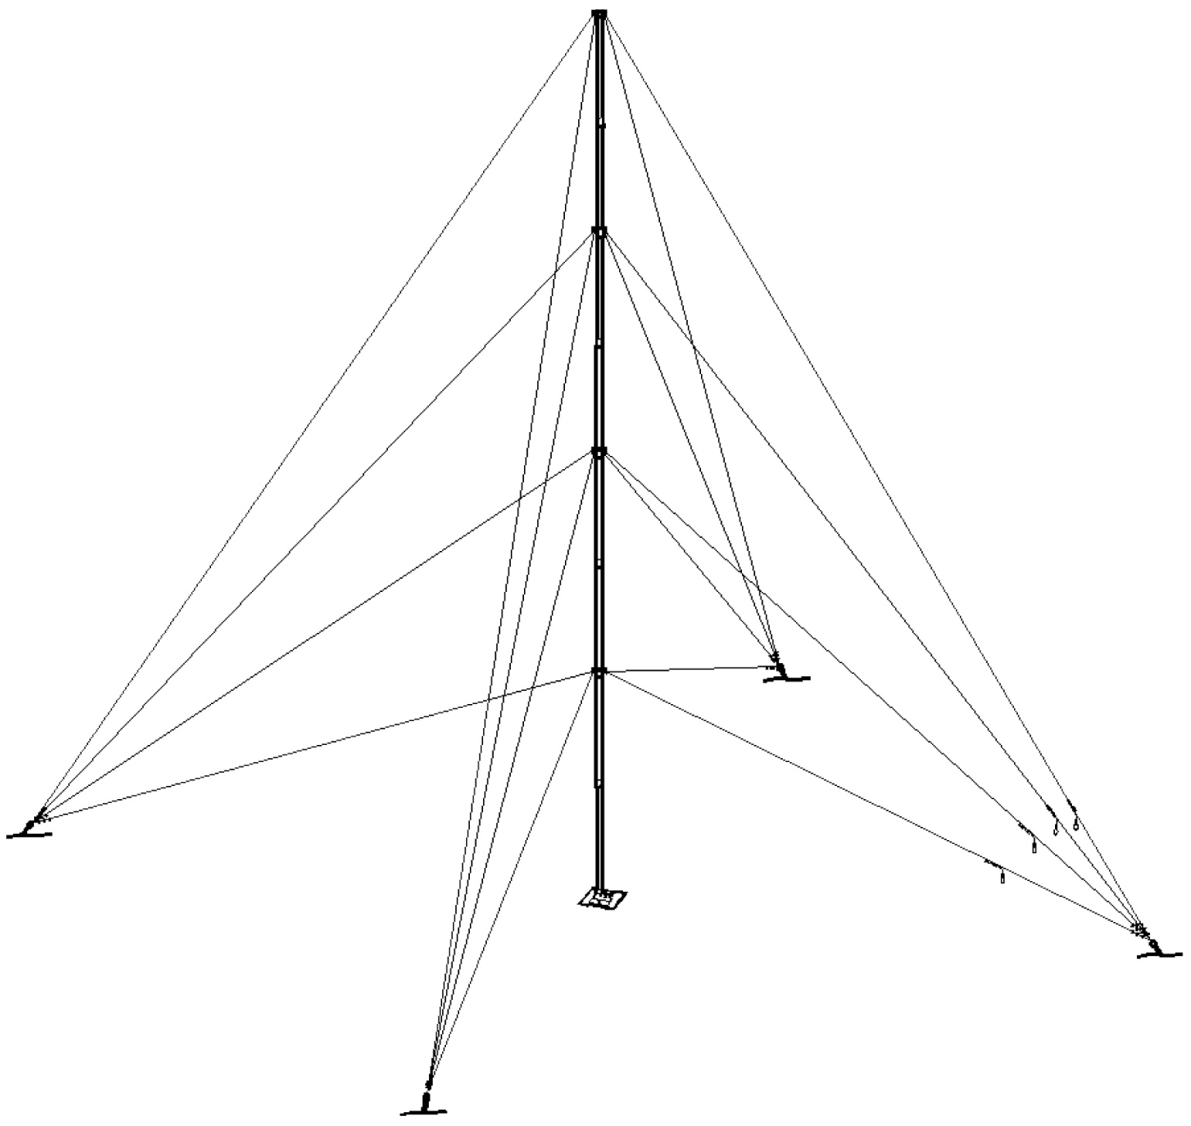
height = 78 feet
In 4 equal sections
A Guyed Radio Mast
It turns out that the radio mast still isn’t sturdy enough so more guy ropes are added.
How much is guy rope is needed to keep the radio mast in place now?
56 feet

Slide 15
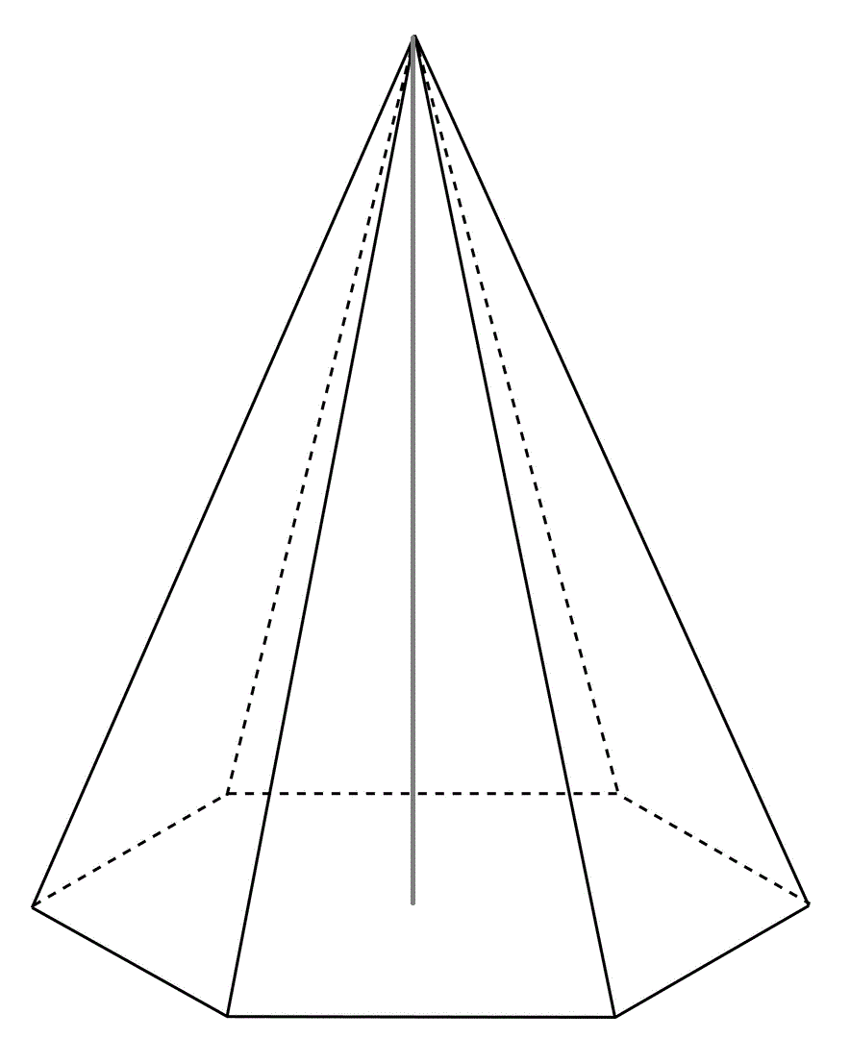
Challenge:
V
A regular hexagon pyramid is shown.
It has an edge length of 6cm and the base width is 2 cm
Calculate the height of the vertex, V , above the hexagon base.
6 cm
2 cm

Slide 16
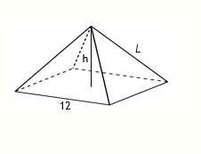
Challenge 2:
Below is a square base pyramid of square base length = 12, height = h, edge length = L
Create a formula for L in terms of h

