Slide 1
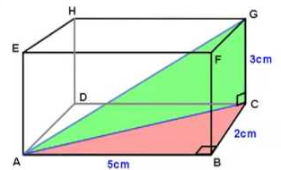
Fill in the blanks …
Find the length of the line AG
____ cm
____ cm
____ cm
____ cm
AC² = ___² + ___²
AG² = ___² + ___²
AC² =
AG² =
AC =
AG =
Notes:
PRINT in colour

Slide 2
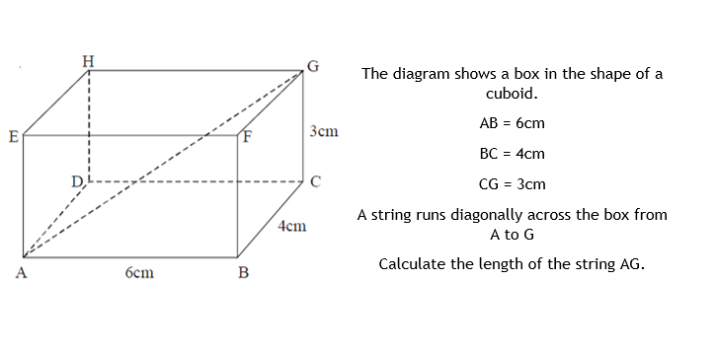

Booklet
AG = $\sqrt{61} cm$

Slide 3
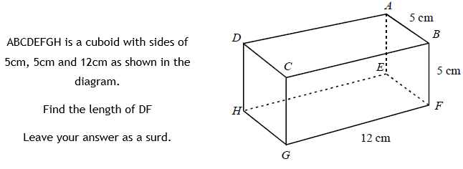

DF = $\sqrt{194} cm$

Slide 4
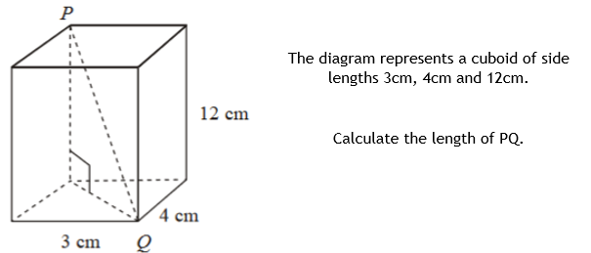
PQ = 13 cm

Slide 5
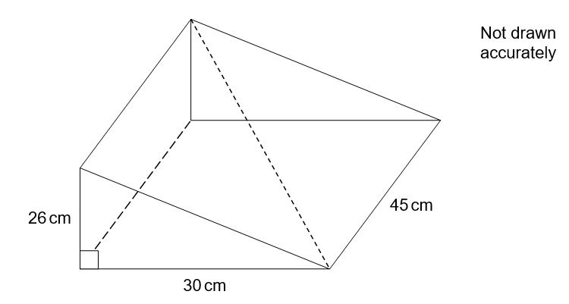
Challenge:
A right angled triangular pyramid is drawn with the dimensions shown.
Calculate the length of the diagonal of the sloping face, shown by the dotted line.
Notes:
Try to at least show students this so that they can see 3D Pythagoras applied to contexts other than a cuboid. With some groups, all students should be attempting this question. (In resources at end)

Slide 6
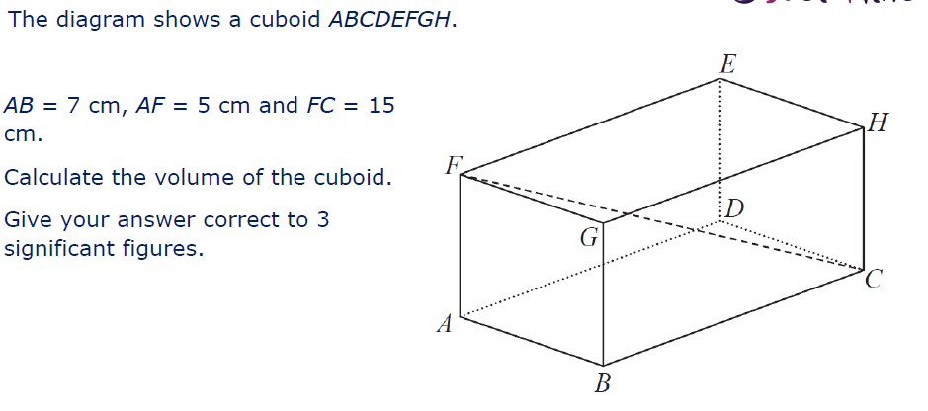
Label the diagram with the information you have been given
AB = 7 cm
AF = 5 cm
FC = 15 cm
15 cm
5 cm
7 cm
Notes:
Students to have a copy of the diagram that is in the resources at the end of the ppt

Slide 7
How is this different to what we have seen so far?
AB = 7 cm
AF = 5 cm
FC = 15 cm
15 cm
5 cm
7 cm
Notes:
We’re given the longest length FC
Try to draw out that AC should be shorter and BC shorter again.

Slide 8
What could the question ask us to find?
AB = 7 cm
AF = 5 cm
FC = 15 cm
15 cm
5 cm
7 cm
Notes:
Use this diagram to talk about what possible lengths you could use the given information to find.
Students may suggest that the length AC could be found. Use this to prompt ‘what other lengths could we find if we know what AC is …’
Here we’re trying to get students to identify that they could in fact find the length BC/AD

Slide 9
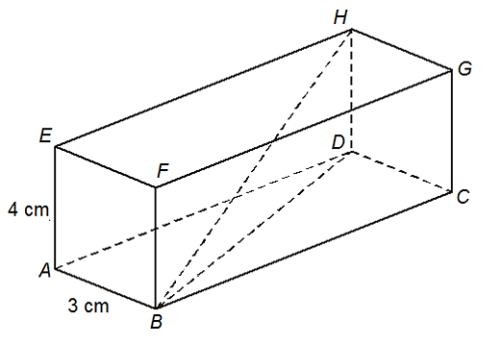
The length of the diagonal BH is 13 cm
What is the length of the cuboid?
Extension: What is the volume of the cuboid?
Notes:
Students work in pairs to try and find the length BC

Slide 10
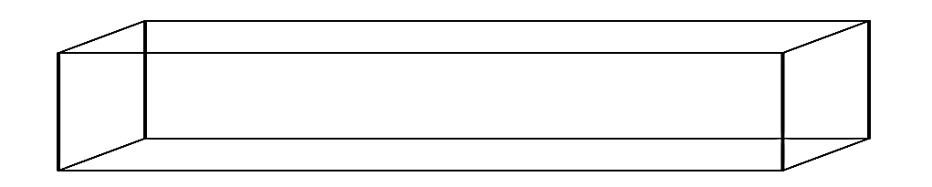
Challenge:
A long thin cuboid magnet has a length of 31 cm and a space diagonal of length 33 cm.
The cuboid has a square cross section
What are the other dimensions of the cuboid?
x = 8 cm

Slide 11
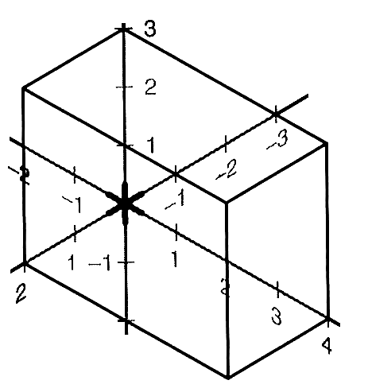
Challenge 2:
What are the distances from the origin to each of the other 7 vertices (corners) of the cuboid?

Slide 12
Resources

Slide 13
Fill in the blanks …
Find the length of the line AG
____ cm
____ cm
____ cm
____ cm
AC² = ___² + ___²
AG² = ___² + ___²
AC² =
AG² =
AC =
AG =
Notes:
PRINT in colour

Slide 14
Challenge:
Calculate the length of the diagonal of the sloping face, shown by the dotted line.

Slide 15
AB = 7 cm AF = 5 cm FC = 15 cm

