Slide 1
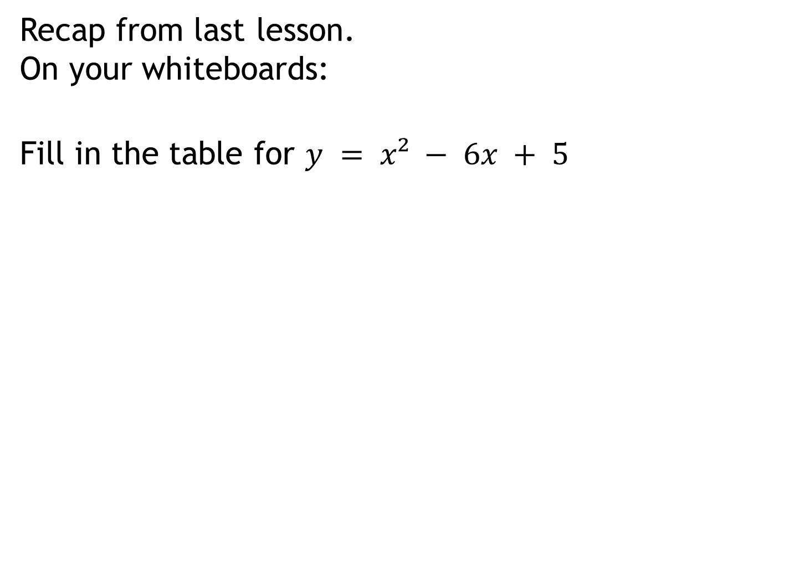
Recap from last lesson.
On your whiteboards:
Fill in the table for $y = x² − 6x + 5$
0 | 1 | 2 | 3 | 4 | 5

Slide 2
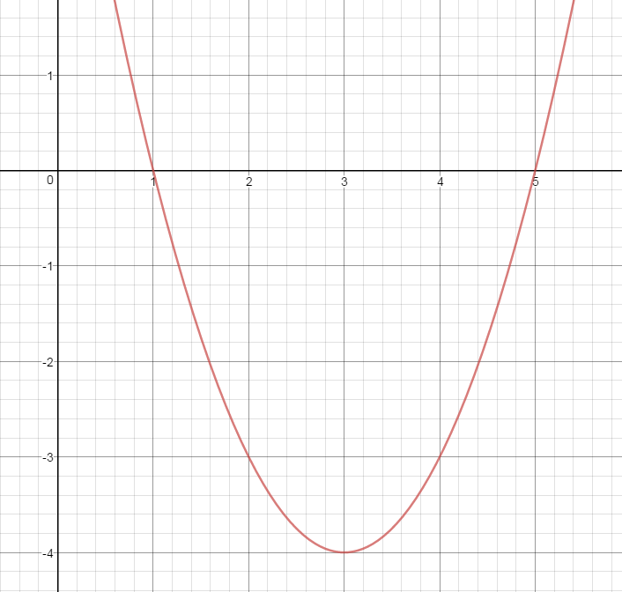
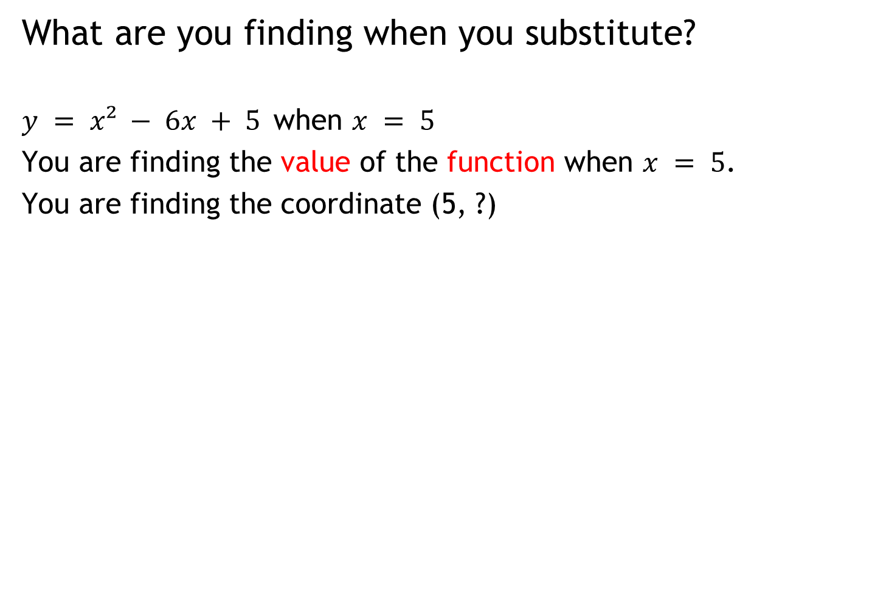
What are you finding when you substitute?
$y = x² − 6x + 5$when $x = 5$
You are finding the value of the function when $x = 5$.
You are finding the coordinate (5, ?)

Slide 3
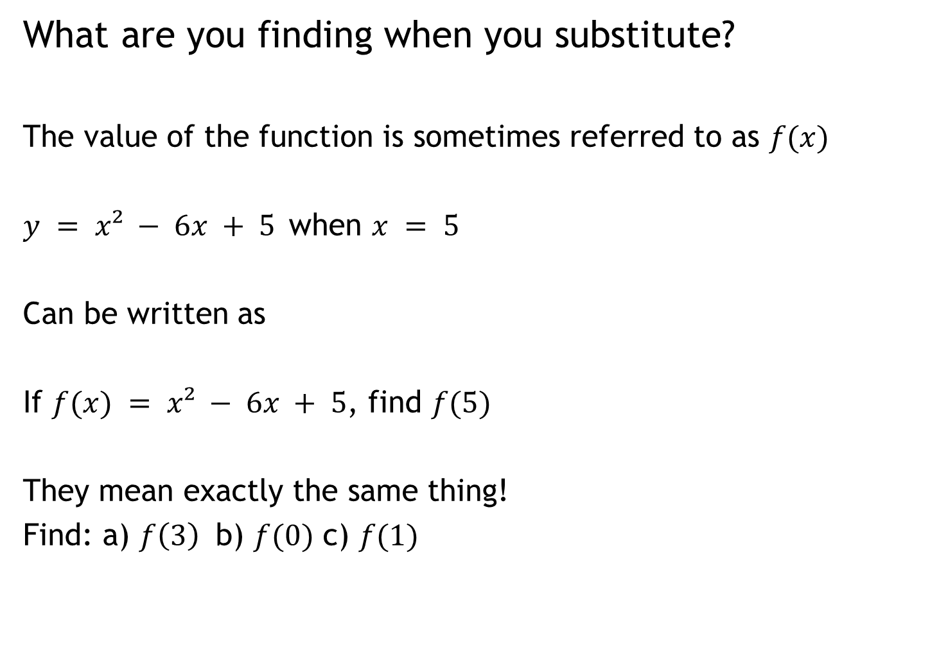
What are you finding when you substitute?
The value of the function is sometimes referred to as $f(x)$
$y = x² − 6x + 5$when $x = 5$
Can be written as
If $f(x) = x² − 6x + 5$, find $f(5)$
They mean exactly the same thing!
Find: a) $f\left(3\right)$ b) $f(0)$ c) $f(1)$

Slide 4
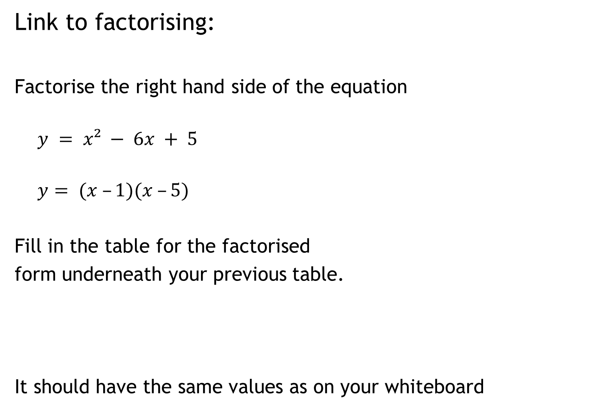
Link to factorising:
Factorise the right hand side of the equation
$$y = x² − 6x + 5$$
$$y= (x –1)(x –5)$$
Fill in the table for the factorised
form underneath your previous table.
It should have the same values as on your whiteboard
0 | 1 | 2 | 3 | 4 | 5

Slide 5
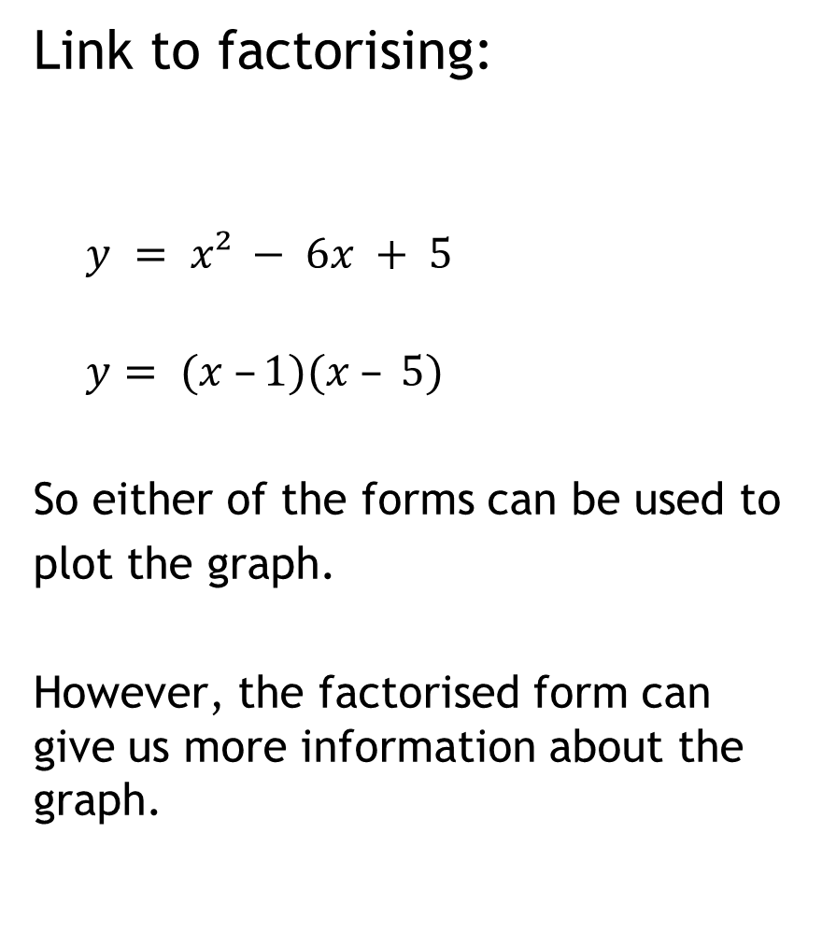
Link to factorising:
$$y = x² − 6x + 5$$
$$y= (x –1)(x – 5)$$
So either of the forms can be used to
plot the graph.
However, the factorised form can give us more information about the graph.

Slide 6
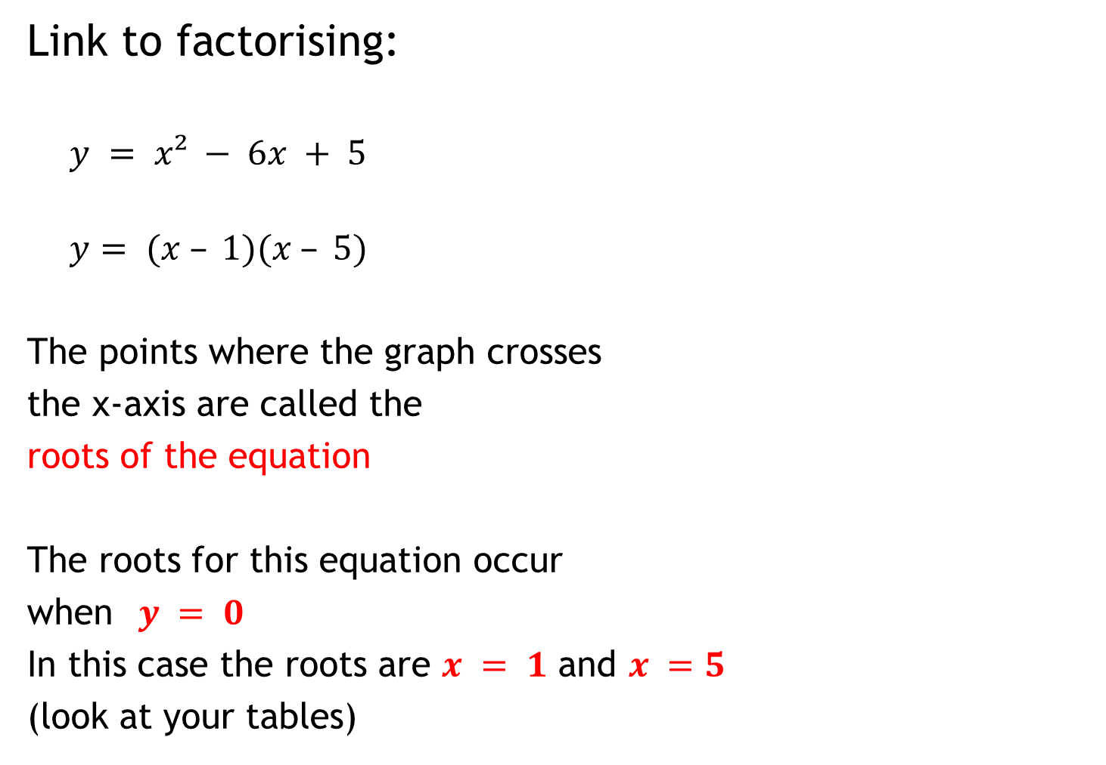
Link to factorising:
$$y = x² − 6x + 5$$
$$y= (x – 1)(x – 5)$$
The points where the graph crosses
the x-axis are called the
roots of the equation
The roots for this equation occur
when$y = 0$
In this case the roots are $x = 1$ and $x =5$
(look at your tables)

Slide 7
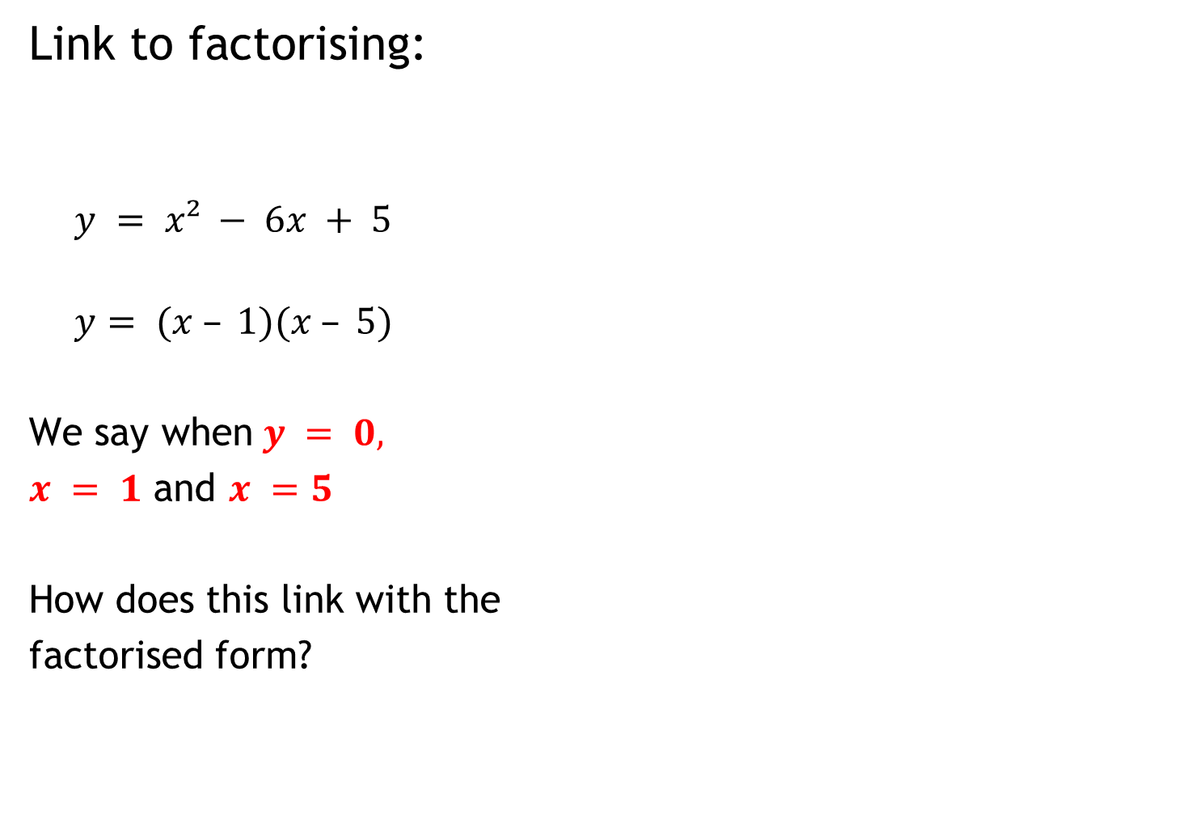
Link to factorising:
$$y = x² − 6x + 5$$
$$y= (x – 1)(x – 5)$$
We say when$y = 0,$
$x = 1$ and $x =5$
How does this link with the
factorised form?

Slide 8
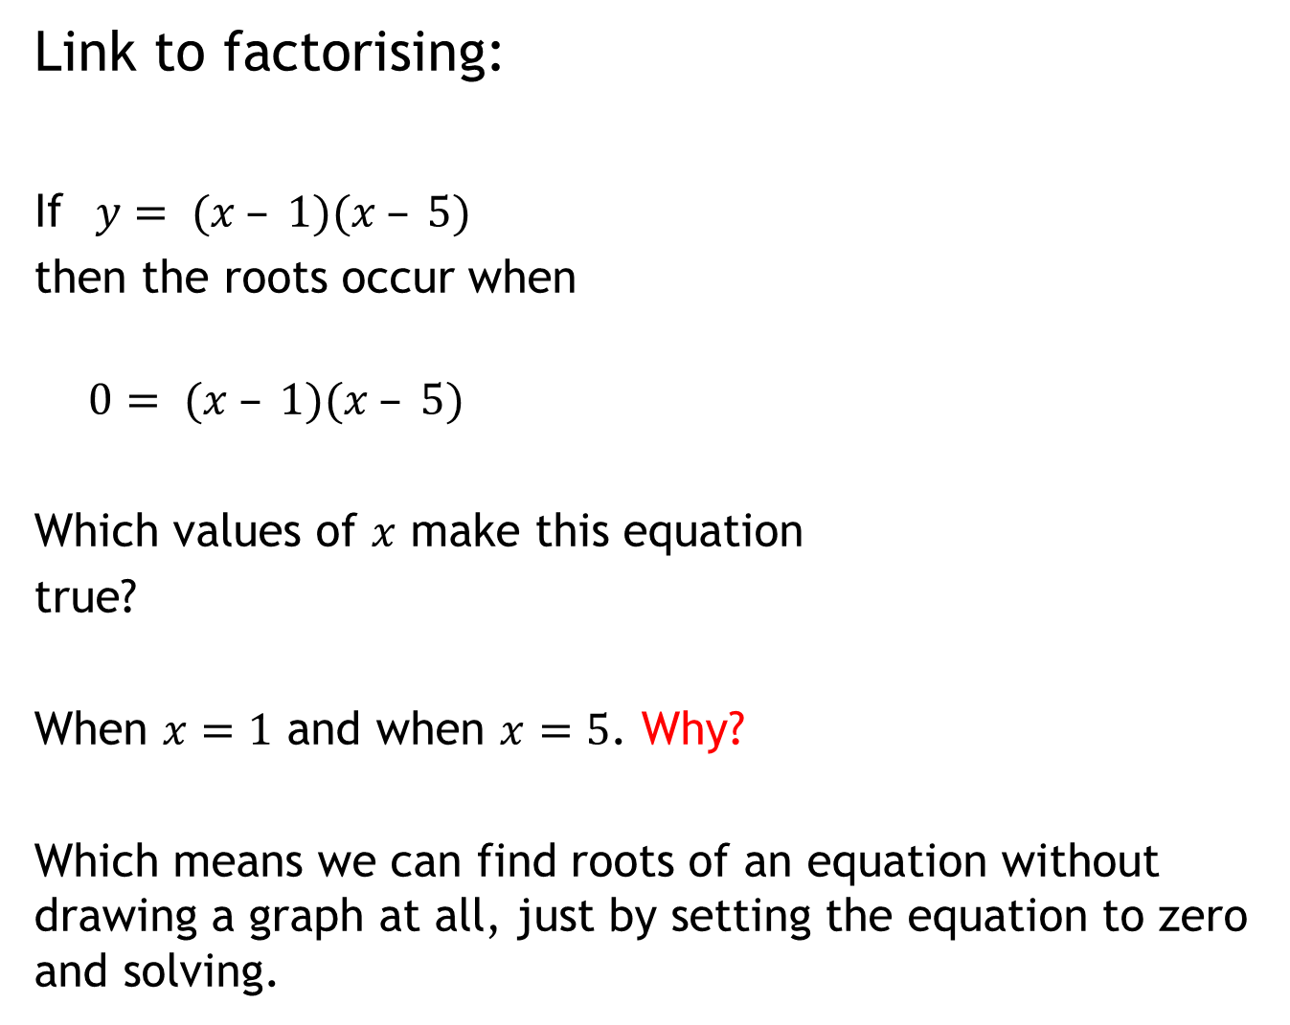
Link to factorising:
If$y= (x – 1)(x – 5)$
then the roots occur when
$$0= (x – 1)(x – 5)$$
Which values of $x$ make this equation
true?
When $x=1$ and when $x=5$. Why?
Which means we can find roots of an equation without drawing a graph at all, just by setting the equation to zero and solving.

Slide 9
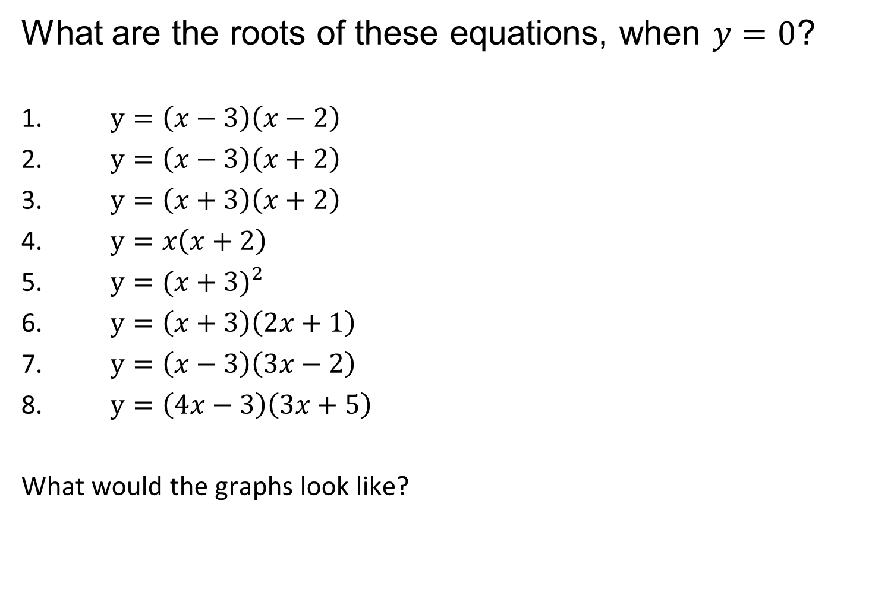
What are the roots of these equations, when $y=0$?
1. $y=\left(x−3\right)\left(x−2\right)$
2. $y=\left(x−3\right)\left(x+2\right)$
3. $y=\left(x+3\right)\left(x+2\right)$
4. $y=x\left(x+2\right)$
5. $y={(x+3)}^{2}$
6. $y=\left(x+3\right)\left(2x+1\right)$
7. $y=\left(x−3\right)\left(3x−2\right)$
8. $y=\left(4x−3\right)\left(3x+5\right)$
What would the graphs look like?

Slide 10
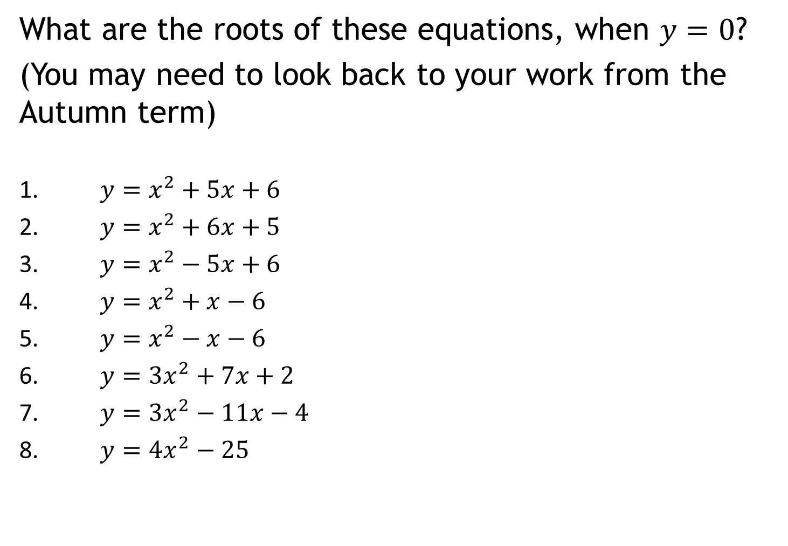
What are the roots of these equations, when $y=0$?
(You may need to look back to your work from the Autumn term)
1. $y=x^{2}+5x+6$
2. ${y=x}^{2}+6x+5$
3. ${y=x}^{2}−5x+6$
4. ${y=x}^{2}+x−6$
5. ${y=x}^{2}−x−6$
6. ${y=3x}^{2}+7x+2$
7. ${y=3x}^{2}−11x−4$
8. ${y=4x}^{2}−25$

