Slide 1
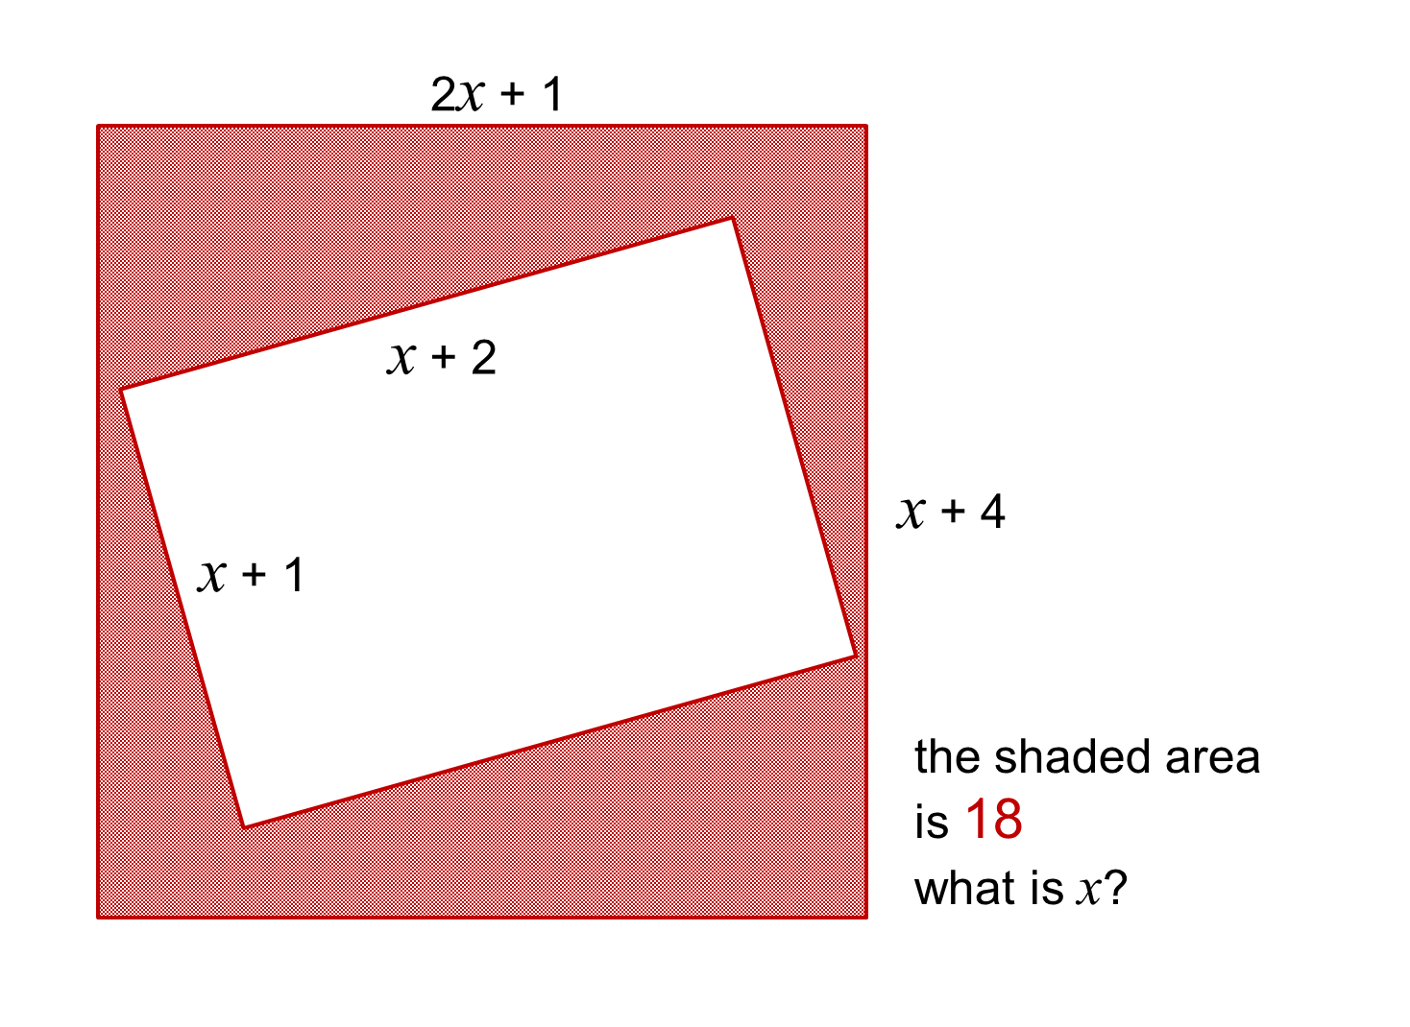
Notes:
All positive values

Slide 2
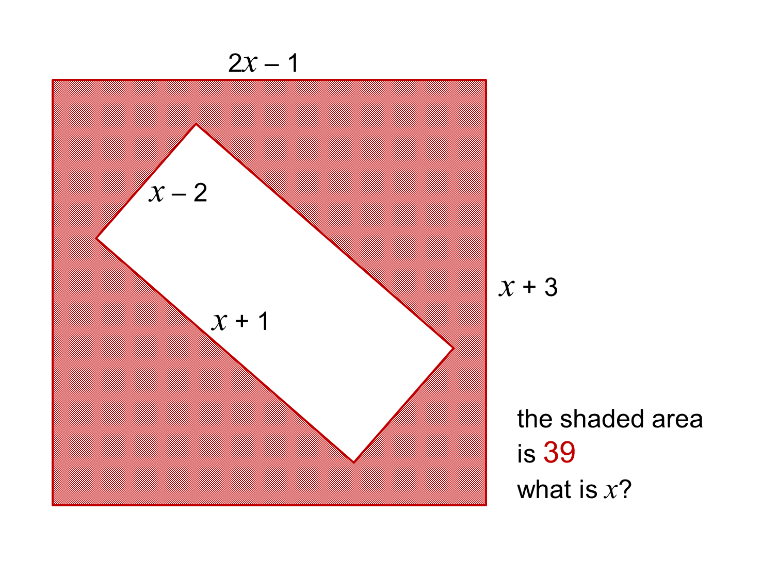
Notes:
Includes negative values that may cause problems in the algebraic manipulation

Slide 3
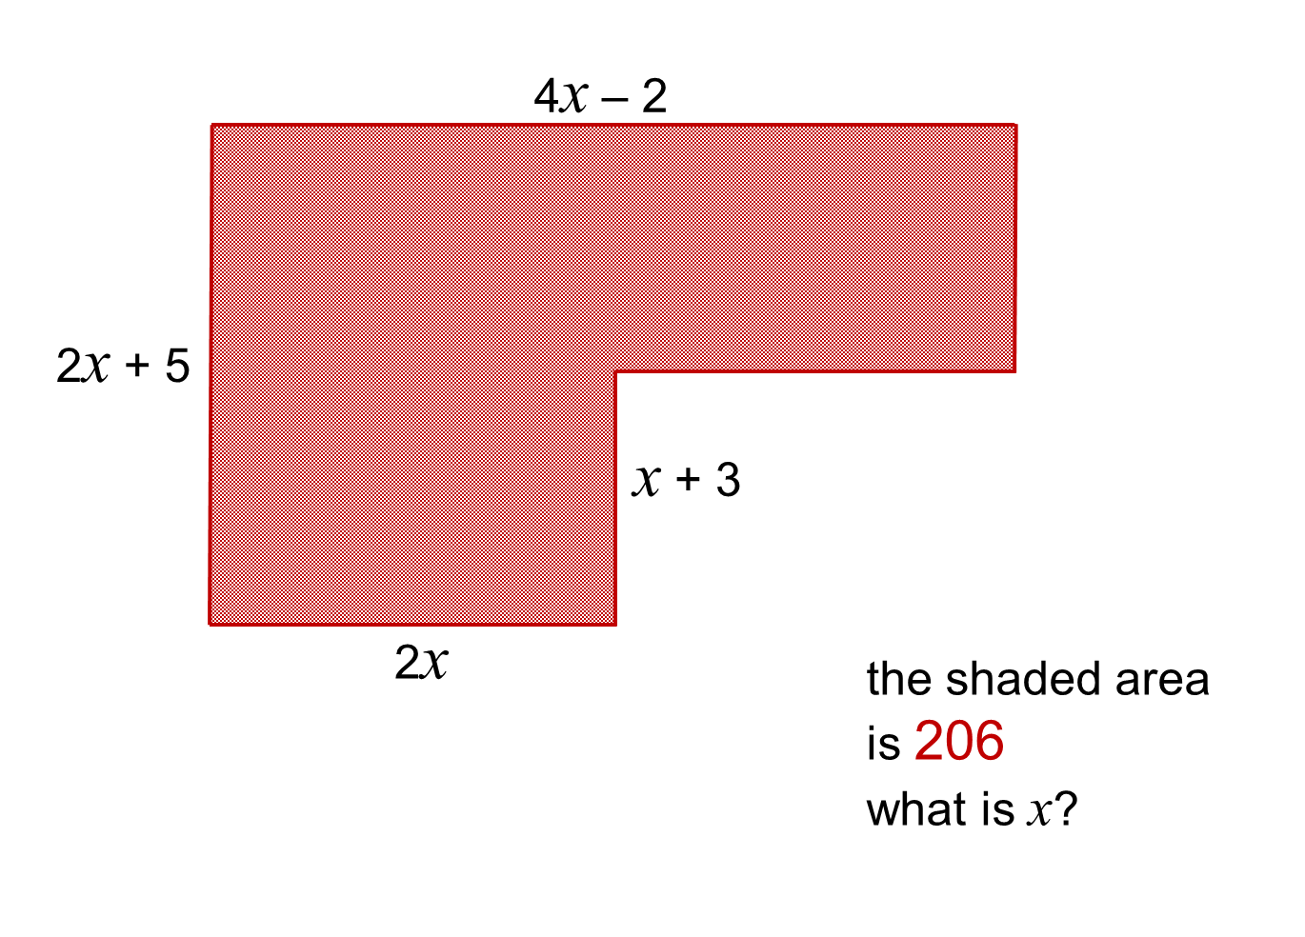
Notes:
There is more than one way to form this quadratic. It would be good to compare the different approaches. This results in a quadratic equation where the coefficient of x^2 >1. However, a factor of 6 may be removed to make it easier to solve.

