Slide 1
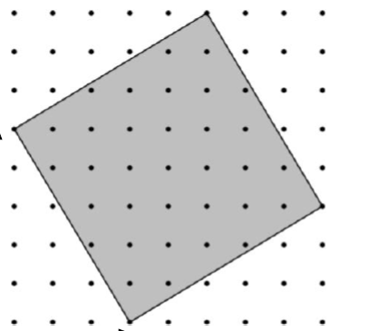
The dots on the grid are all one unit apart.
This square can be described as a ‘3 by 5’ square.
Why do you think that is?

Slide 2
Tilted Squares

Slide 3
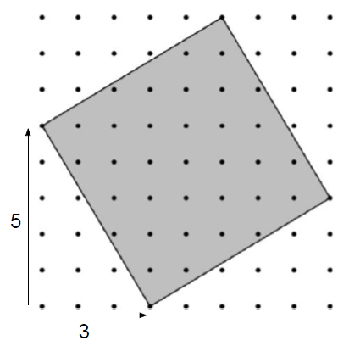
The first number in the description always represents the horizontal tilt of the square.
On your wallets …
Draw a ‘3 by 4’ square

Slide 4
The first number in the description always represents the horizontal tilt of the square.
On your wallets …
Draw a ‘2 by 3’ square

Slide 5
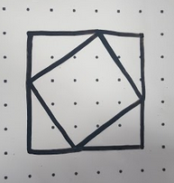
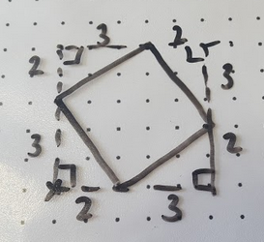
How did you do it?
How can you tell if it is accurate?
How do these diagrams help?

Slide 6
In your pairs …
Can you find the area of your ‘2 by 3’ square.
Show all your reasoning.

Slide 7
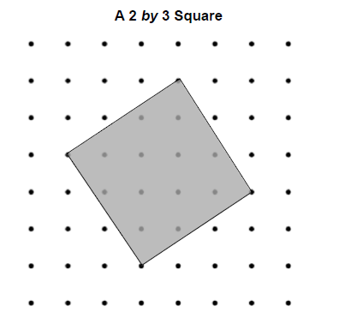

Slide 8
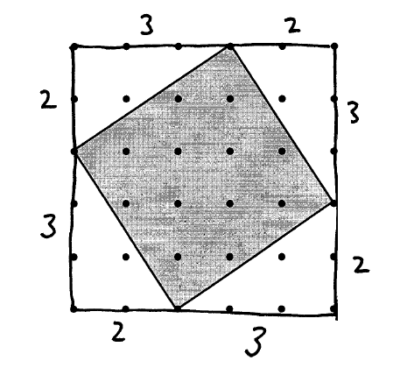
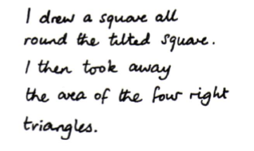
Jason’s Method
Discuss Jason’s method in your pairs.
Do you agree?
Notes:
Try to elicit these methods from your students – If you don’t have any methods, use these to provoke discussion. Labour the point of multiple solution methods

Slide 9
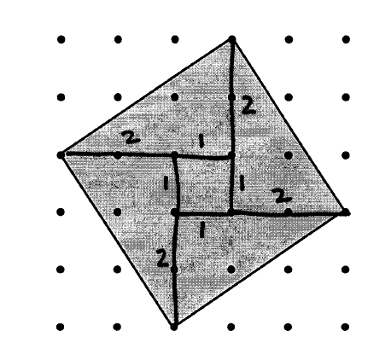
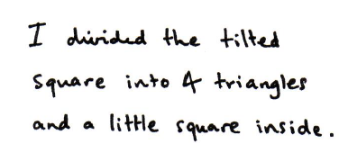
Kate’s Method
Discuss Kate’s method in your pairs.
Do you agree?
Notes:
Try to elicit these methods from your students – If you don’t have any methods, use these to provoke discussion. Labour the point of multiple solution methods

Slide 10
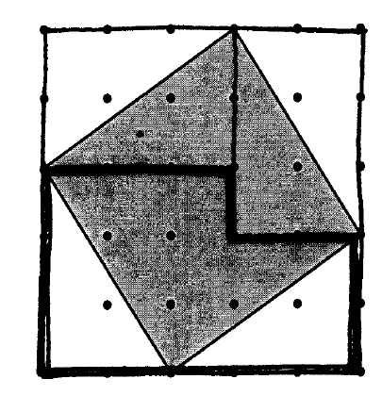
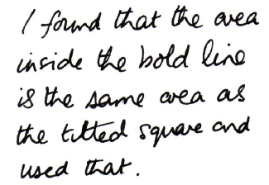
Simon’s Method
Discuss Simon’s method in your pairs.
Do you agree?
Notes:
Try to elicit these methods from your students – If you don’t have any methods, use these to provoke discussion. Labour the point of multiple solution methods

Slide 11
In pairs, try to find an efficient way to calculate the areas of tilted squares.
Draw different squares and use one or more of the methods to find the area of the tilted square
Which different areas can you make by drawing squares on a grid?
Notes:
Don’t spend too long on this, it isn’t intended to be an investigation it’s just practice to allow students to get to grips with the method!

Slide 12
Is there anything that you notice?
Tilted Square Size | Area
2 by 3 | 13 units²
Notes:
It does NOT matter if students do not recognise Pythagoras here – the intention is that they’re just practicing the method of finding areas in order to be confident for the next slide.

Slide 13

Notes:
Plastic wallet

Slide 14
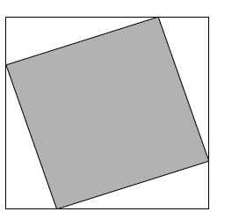
a
b
a
b
Use what you have learned from the tilted squares problem to find the area of this shaded square

Slide 15
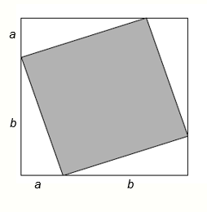
Using Jason’s method:
Area of outside square = (a + b) x (a + b)
= (a + b)(a + b)
= a² + 2ab + b²
Area of outside square
a² + 2ab + b²

Slide 16
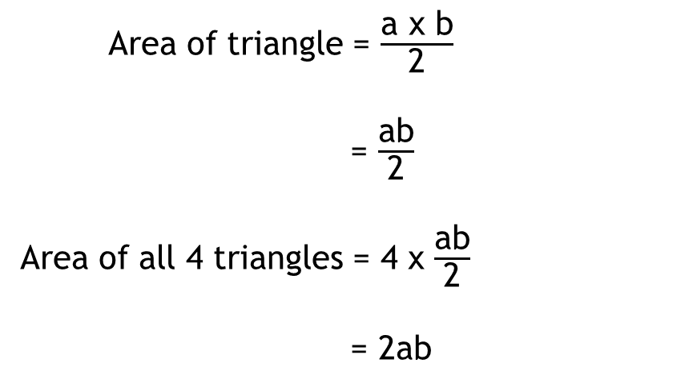
Using Jason’s method:
Area of triangle = $\frac{\text{a} \text{x} \text{b}}{\text{2}}$
= $\frac{\text{ab}}{\text{2}}$
Area of all 4 triangles = 4 x $\frac{\text{ab}}{\text{2}}$
= 2ab
Area of outside square
a² + 2ab + b²
Area of all triangles
2ab

Slide 17
Using Jason’s method:
Area of shaded square = a² + 2ab + b² - 2ab
Area of shaded square = a² + b²
What could we call the length of the shaded square?
Area of outside square
a² + 2ab + b²
Area of all triangles
2ab

Slide 18
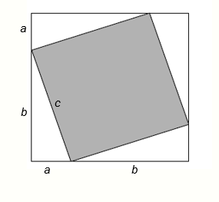
Using Jason’s method:
Area of shaded square = c x c
= c²
Area of outside square
a² + 2ab + b²
Area of inside square
c²
Area of all triangles
2ab

Slide 19
Using Jason’s method:
Therefore:
c² = a² + b²
Area of outside square
a² + 2ab + b²
Area of inside square
c²
Area of all triangles
2ab

Slide 20
c² = a² + b²
This is known as Pythagoras’ Theorem
Next lesson we will be doing more to help us understand why it works

Slide 21
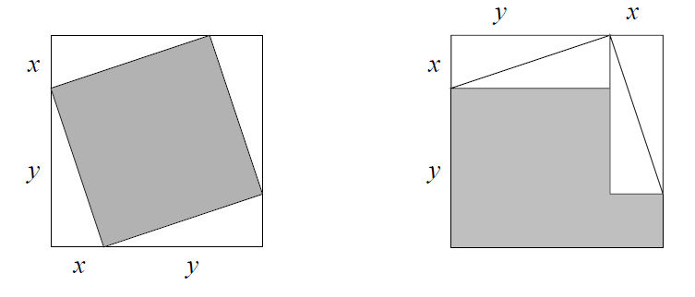
Challenge:
Prove that the 2 shaded areas are the same size
Show all of your reasoning

