Slide 1
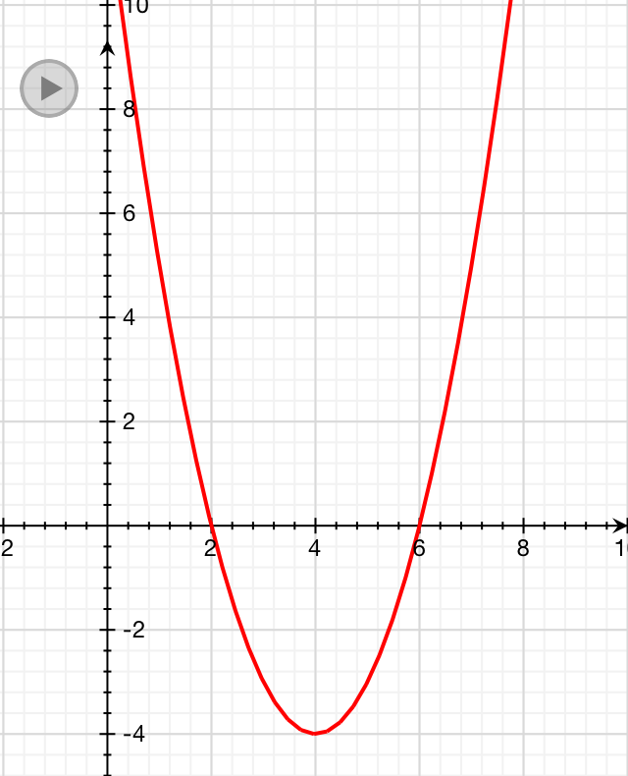
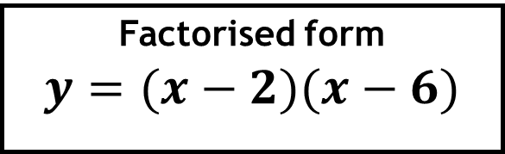
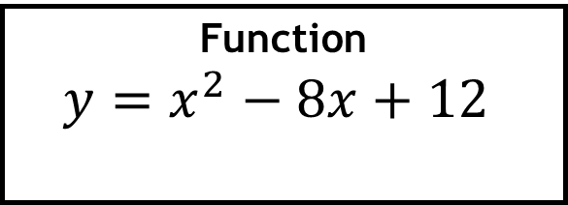
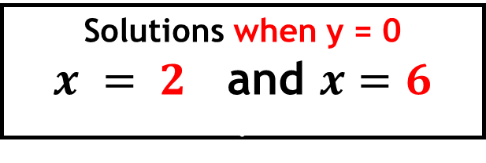
Example:
Function
$y=x^{2}−8x+12$.
Factorised form
$$y=(x−2)(x−6)$$
Solutions when y = 0
$x = 2$and $x=6$ .

Slide 2
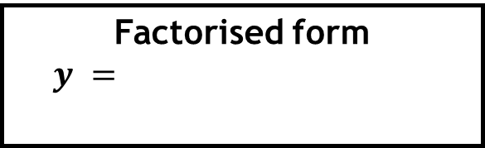
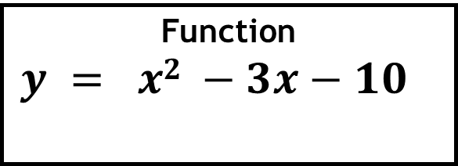
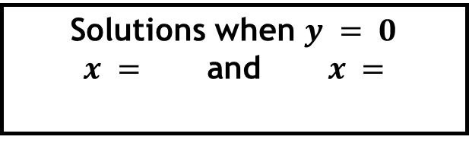
Function
$y = x2 −3x−10$ .
Factorised form
$y =$.
Solutions when $y = 0$
$x =$ and $x =$.

Slide 3
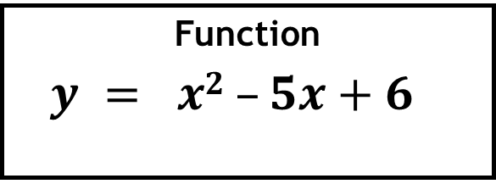
Function
$y = x2 –5x+6$ .
Factorised form
$y =$.
Solutions when $y = 0$
$x =$ and $x =$.

Slide 4
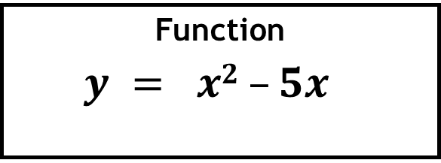
Function
$y = x2 –5x$ .
Factorised form
$y =$.
Solutions when $y = 0$
$x =$ and $x =$.

Slide 5
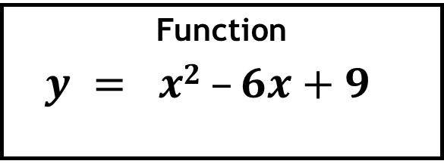
Function
$y = x2 –6x+9$ .
Factorised form
$y =$.
Solutions when $y = 0$
$x =$ and $x =$.

Slide 6
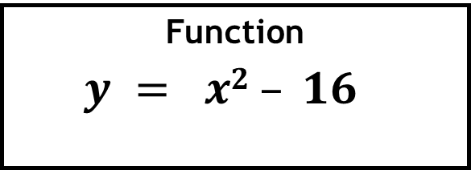
Function
$y = x2 – 16$ .
Factorised form
$y =$.
Solutions when $y = 0$
$x =$ and $x =$.

Slide 7
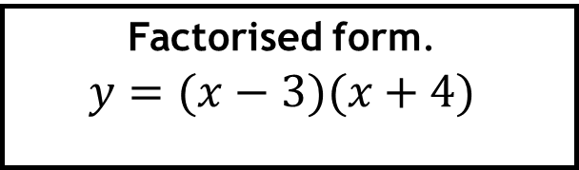
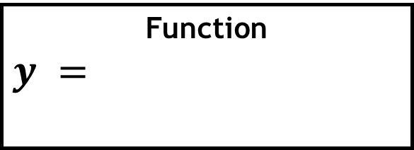
Function
$y =$.
Factorised form.
$$y=(x−3)(x+4)$$
Solutions when $y = 0$
$x =$ and $x =$.

Slide 8
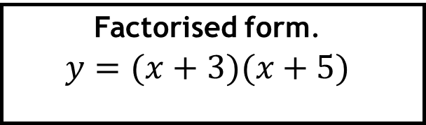
Function
$y =$.
Factorised form.
$$y=(x+3)(x+5)$$
Solutions when $y = 0$
$x =$ and $x =$.

Slide 9
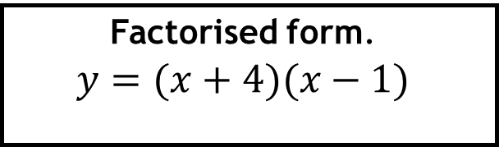
Function
$y =$.
Factorised form.
$$y=(x+4)(x−1)$$
Solutions when $y = 0$
$x =$ and $x =$.

Slide 10
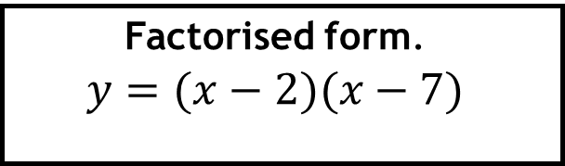
Function
$y =$.
Factorised form.
$$y=(x−2)(x−7)$$
Solutions when $y = 0$
$x =$ and $x =$.

Slide 11
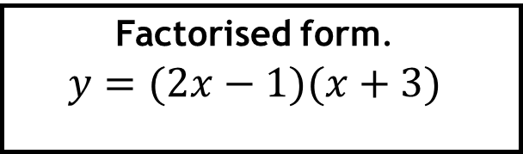
Function
$y =$.
Factorised form.
$$y=(2x−1)(x+3)$$
Solutions when $y = 0$
$x =$ and $x =$.

Slide 12
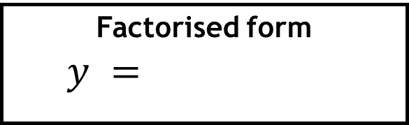
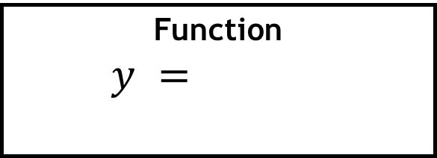
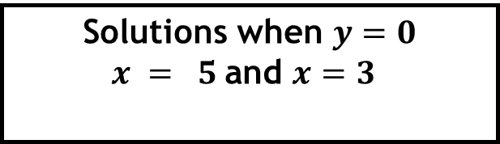
Function
$y =$.
Factorised form
$y =$…………….
Solutions when $y=0$
$x = 5$and $x=3$.

Slide 13
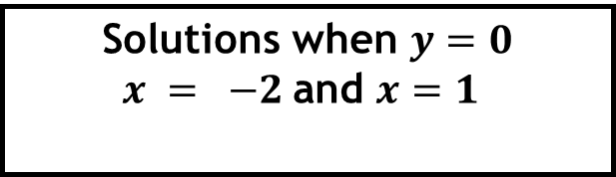
Function
$y =$.
Factorised form
$y =$…………….
Solutions when $y=0$
$x = −2$and $x=1$.

Slide 14
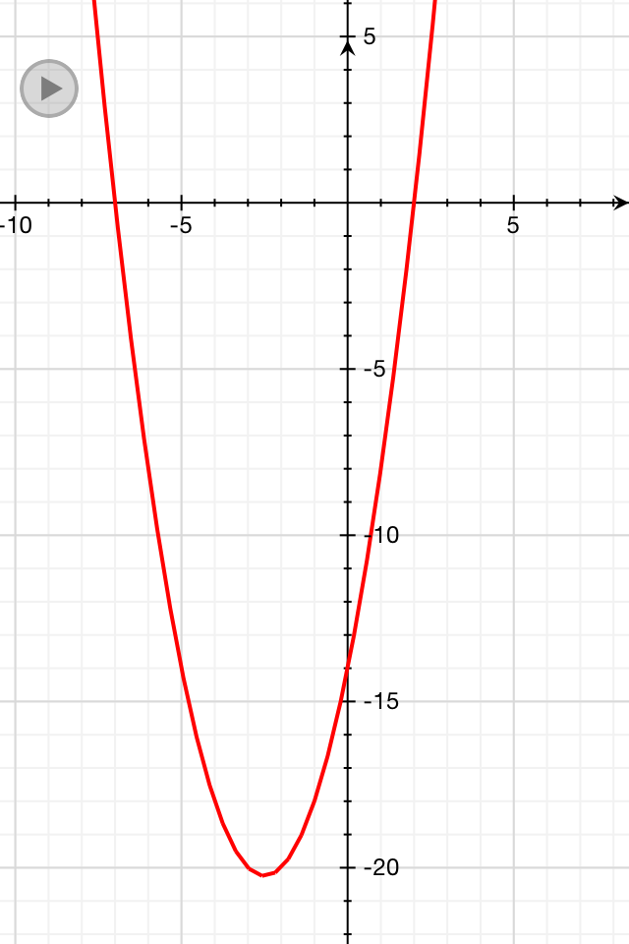
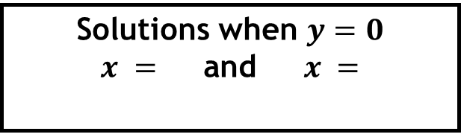
Function
$y =$.
Factorised form
$y =$…………….
Solutions when $y=0$
$x =$ and $x =$ .

Slide 15
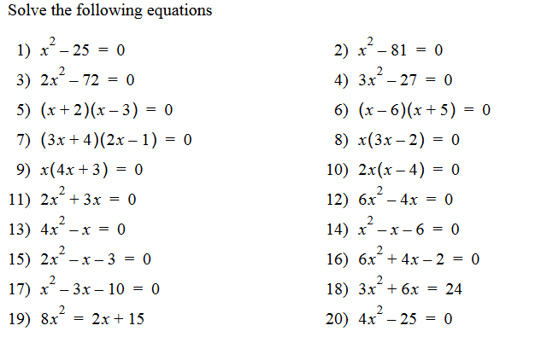

Slide 16
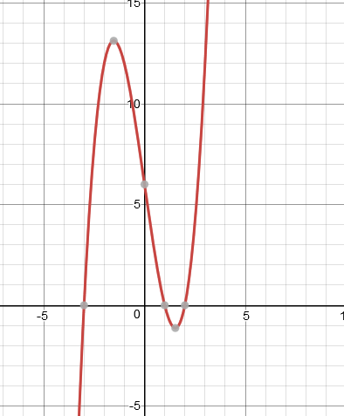
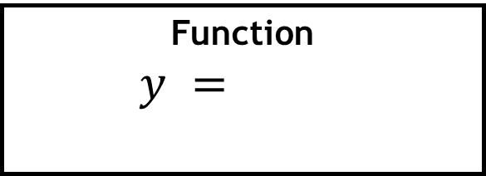
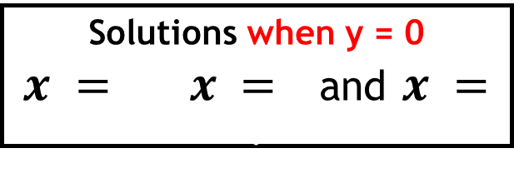
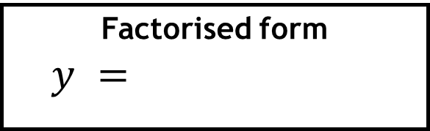
Function
$y =$.
Factorised form
$y =$…………….
Solutions when y = 0
$x = x =$and $x =$ .

