Slide 1
Recap…
Answer the questions below about the straight line
How would you describe what the line looks like?
What is the gradient?
What is its y-intercept?
Write down any coordinate on the line.
Write down any coordinate not on the line.
y = 3x - 2

Slide 2
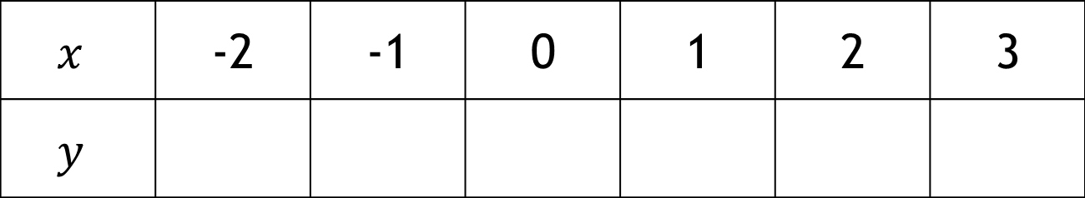
Recap…
How did we find coordinates of points on the line?
y = 3x - 2
$$x$$ | -2 | -1 | 0 | 1 | 2 | 3
$$y$$

Slide 3
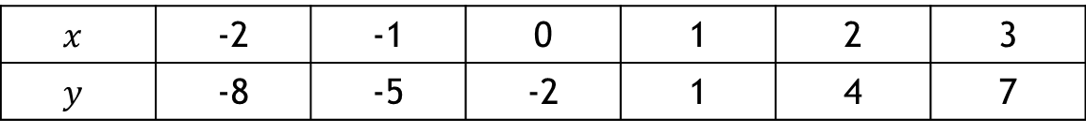
Plotting the graph
$$x$$ | -2 | -1 | 0 | 1 | 2 | 3
$$y$$ | -8 | -5 | -2 | 1 | 4 | 7
(-2,-8)
(-1,-5)
( 0,-2)
( 1, 1)
( 2, 4)
( 3, 7)

Slide 4
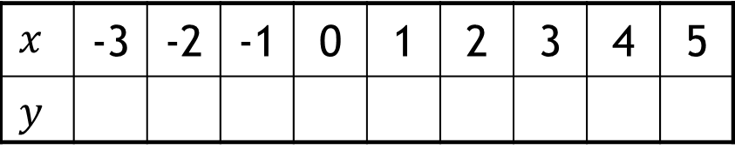

What is different about this equation?
$$y = x^{2}−2x−8$$
$$x$$ | -3 | -2 | -1 | 0 | 1 | 2 | 3 | 4 | 5
$$y$$
7
0
-5
-8
-9
-8
-5
0
7
Some people start with zero and then the positive integers when filling in the table.
Why might this be the case?
What do you notice about the coordinates?

Slide 5
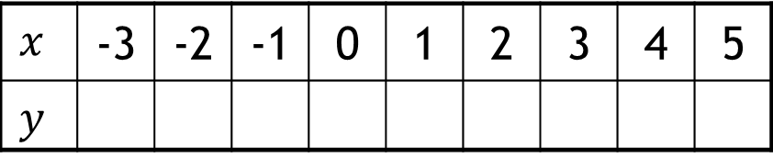
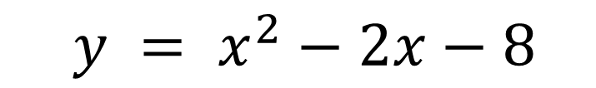
8
y
7
Example 1
6
5
4
$y = x^{2}−2x−8$
3
2
1
$$x$$ | -3 | -2 | -1 | 0 | 1 | 2 | 3 | 4 | 5
$$y$$
-3
-2
-1
0
1
2
3
4
5
-1
-2
-3
-4
-5
-6
-7
-8
-9

Slide 6
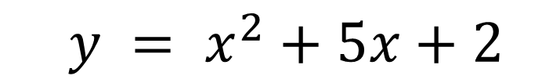
y
8
Example 2
7
6
5
$y = x^{2}+5x+2$
4
3
2
$$x$$ | -3 | -2 | -1 | 0 | 1 | 2 | 3 | 4 | 5
$$y$$
1
-6
-5
-4
-2
-1
0
1
x
-3
2
-1
-2
-3
-4
Make sure the curve does not have a flat bottom.
-5
-6
-7
-8

Slide 7
On your whiteboards…
Write down a quadratic equation.
and another…
and another…

Slide 8

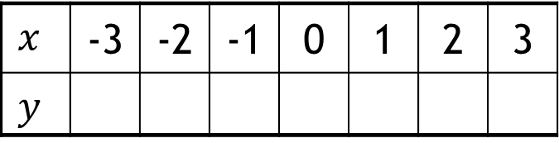

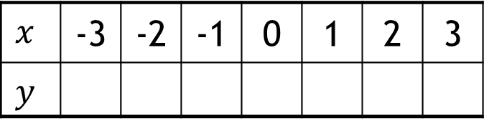
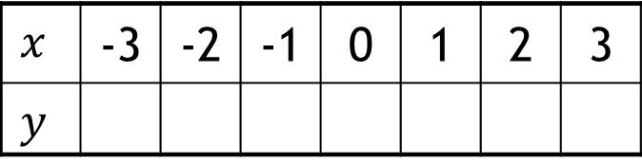

In your books
Title: Plotting quadratic curves
$$y = x2 + 2x + 1$$
$$x$$ | -3 | -2 | -1 | 0 | 1 | 2 | 3
$$y$$
For each table:
Complete the table of values
Draw a set of axes that will fit the coordinates.
Choose your scale carefully.
Plot the coordinates and join them with a smooth curve.
$$y = x2 + x$$
$$x$$ | -3 | -2 | -1 | 0 | 1 | 2 | 3
$$y$$
$$y = 2x2 + x − 3$$
$$x$$ | -3 | -2 | -1 | 0 | 1 | 2 | 3
$$y$$

Slide 9
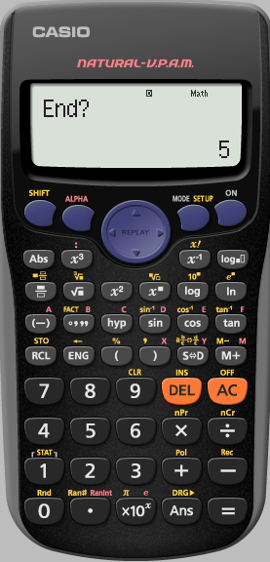
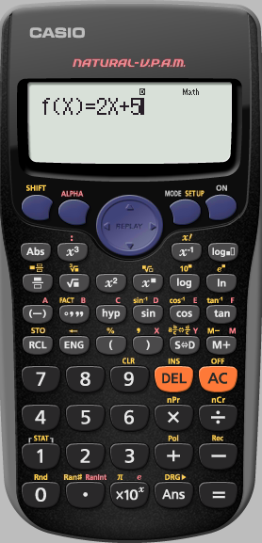
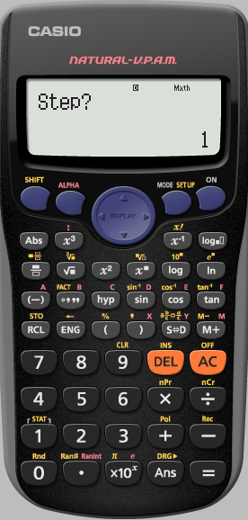
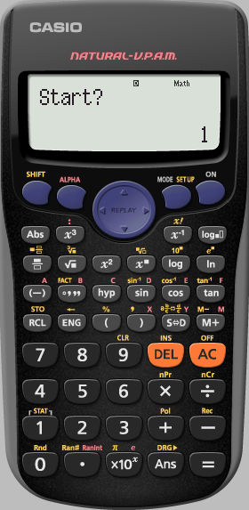
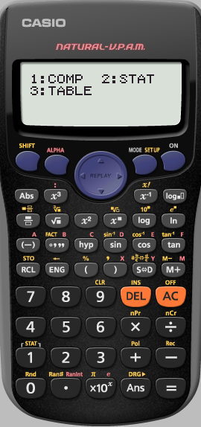



Check using your calculator
To draw a graph of $y = x 2+ 2x +1$
1) Complete a table of values:
Goes up in 1’s
$$x$$
–3
–2
–1
0
1
2
3
$$y$$
4
1
0
1
4
9
16
Type in 3
Type in -3
Now use you calculator to check your answers.
Notes:
This slide summarizes the steps required to plot a graph using a table of values.

Slide 10

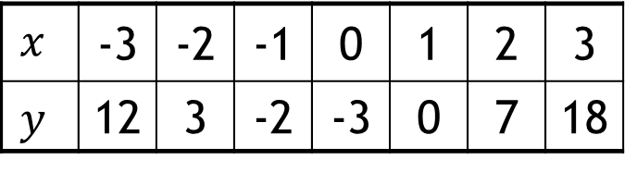

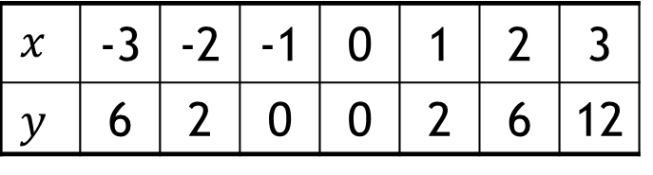
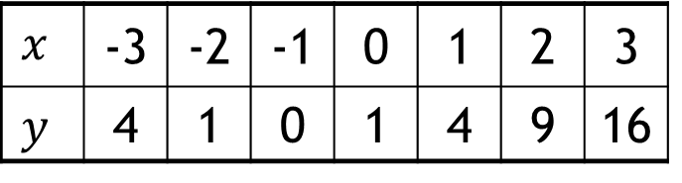

Answers
$$y = x2 + 2x + 1$$
$$x$$ | -3 | -2 | -1 | 0 | 1 | 2 | 3
$$y$$ | 4 | 1 | 0 | 1 | 4 | 9 | 16
$$y = x2 + x$$
$$x$$ | -3 | -2 | -1 | 0 | 1 | 2 | 3
$$y$$ | 6 | 2 | 0 | 0 | 2 | 6 | 12
$$y = 2x2 + x − 3$$
$$x$$ | -3 | -2 | -1 | 0 | 1 | 2 | 3
$$y$$ | 12 | 3 | -2 | -3 | 0 | 7 | 18
Who got different answers to these?

Slide 11
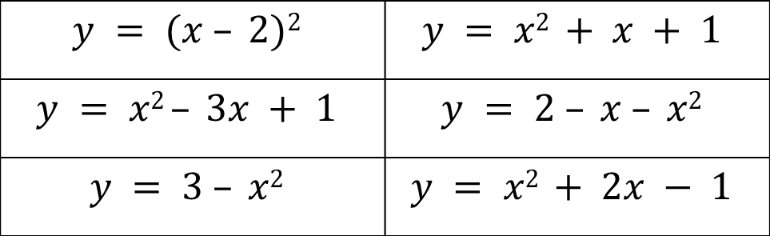
There are six quadratic graphs on the sheet.
Using what we have done today, match each parabola to
one of the equations below.
You will be asked to explain how you know, so write
something at the side of each graph.
$$y = (x – 2)2$$ | $$y = x2 + x + 1$$
$$y = x2 – 3x + 1$$ | $$y = 2 – x – x2$$
$$y = 3 – x2$$ | $$y = x2 + 2x − 1$$
Notes:
Students should look at the x-coordinates on the graphs and substitute them into each equation to see which ones match

Slide 12
8
y
7
Example 1
6
5
4
$y = x^{2}−2x−8$
3
2
1
$$x$$ | -3 | -2 | -1 | 0 | 1 | 2 | 3 | 4 | 5
$$y$$
-3
-2
-1
0
1
2
3
4
5
-1
-2
-3
-4
-5
-6
-7
-8
-9

Slide 13
y
8
Example 2
7
6
5
$y = x^{2}+5x+2$
4
3
2
$$x$$ | -3 | -2 | -1 | 0 | 1 | 2 | 3 | 4 | 5
$$y$$
1
-6
-5
-4
-2
-1
0
1
x
-3
2
-1
-2
-3
-4
-5
-6
-7
-8

