Slide 1
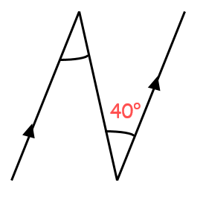
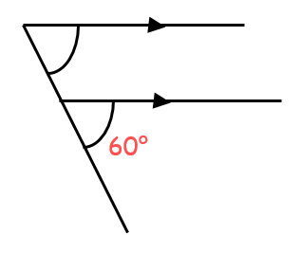
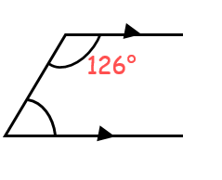
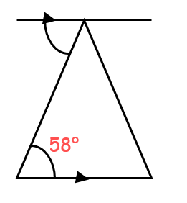
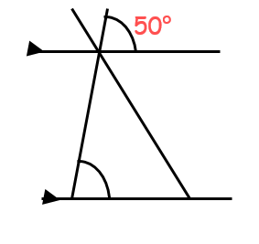
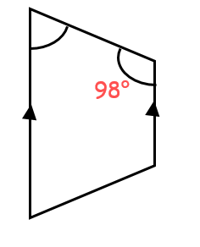












True or False
b$°$
a$°$
c$°$
Angle a = 140$°$
Angle b = 60$°$
Angle c = 126$°$
d$°$
f$°$
e$°$
Angle d = 58$°$
Angle e = 130$°$
Angle f = 98$°$
Challenge: Which parallel lines rule has been applied in each case?

Slide 2


True or False
b$°$
a$°$
c$°$
Angle a = 140$°$
Angle b = 60$°$
Angle c = 126$°$
d$°$
f$°$
e$°$
Angle d = 58$°$
Angle e = 130$°$
Angle f = 98$°$
Challenge: Which parallel lines rule has been applied in each case?

Slide 3


True or False
b$°$
a$°$
c$°$
Angle a = 140$°$
Angle b = 60$°$
Angle c = 126$°$
d$°$
f$°$
e$°$
Angle d = 58$°$
Angle e = 130$°$
Angle f = 98$°$
Challenge: Which parallel lines rule has been applied in each case?

Slide 4

True or False
b$°$
a$°$
c$°$
Angle a = 140$°$
Angle b = 60$°$
Angle c = 126$°$
d$°$
f$°$
e$°$
Angle d = 58$°$
Angle e = 130$°$
Angle f = 98$°$
Challenge: Which parallel lines rule has been applied in each case?

Slide 5

True or False
b$°$
a$°$
c$°$
Angle a = 140$°$
Angle b = 60$°$
Angle c = 126$°$
d$°$
f$°$
e$°$
Angle d = 58$°$
Angle e = 130$°$
Angle f = 98$°$
Challenge: Which parallel lines rule has been applied in each case?

Slide 6

True or False
b$°$
a$°$
c$°$
Angle a = 140$°$
Angle b = 60$°$
Angle c = 126$°$
d$°$
f$°$
e$°$
Angle d = 58$°$
Angle e = 130$°$
Angle f = 98$°$
Challenge: Which parallel lines rule has been applied in each case?

Slide 7

True or False
b$°$
a$°$
c$°$
Angle a = 140$°$
Angle b = 60$°$
Angle c = 126$°$
d$°$
f$°$
e$°$
Angle d = 58$°$
Angle e = 130$°$
Angle f = 98$°$
Challenge: Which parallel lines rule has been applied in each case?

Slide 8
On your whiteboards, show me …
A pair of parallel lines
and
A pair alternate angles that are 38°

Slide 9
On your whiteboards, show me …
A pair of parallel lines
and
A pair of corresponding angles that are 54°

Slide 10
On your whiteboards, show me …
A pair of parallel lines
and
A pair of interior angles, one of which is 63°

Slide 11
On your whiteboards, show me …
A pair of parallel lines
and
A pair of alternate angles that are 72°

Slide 12
On your whiteboards, show me …
A pair of parallel lines
and
Any pair of angles
Make sure you label the parallel lines rule that you have used

Slide 13
The diagram below shows an isosceles triangle inside a rectangle
Can you find a pair of parallel lines in the diagram?
A
B
C
F
E
D

Slide 14
The diagram below shows an isosceles triangle inside a rectangle
How many pairs of alternate angles can you find?
A
B
C
F
E
D

Slide 15
The diagram below shows an isosceles triangle inside a rectangle
How many pairs of corresponding angles can you find?
A
B
C
F
E
D

Slide 16
The diagram below shows an isosceles triangle inside a rectangle
How many pairs of interior angles can you find?
A
B
C
F
E
D

Slide 17
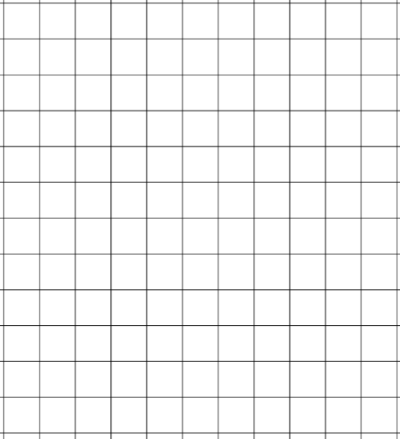
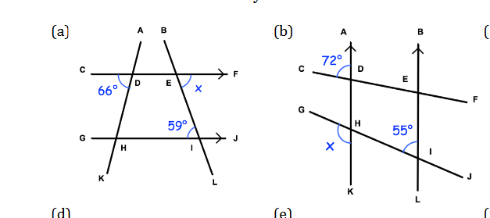
Your turn …
Find the missing angles stating the angle rules you have used each time

Slide 18
Your turn …
Find the missing angles stating the angle rules you have used each time

Slide 19
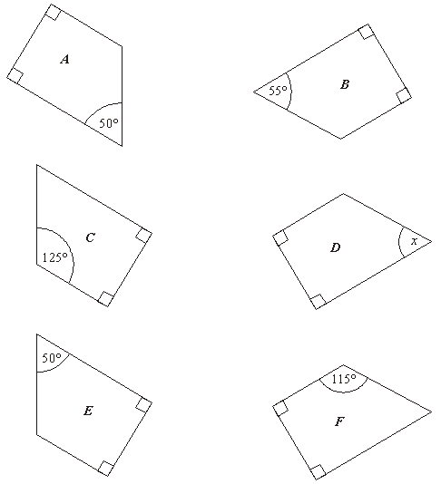
Rebecca has three rectangular sheets of paper.
She cuts each sheet into two pieces.
She now has the six pieces, A to F, shown below:
Notes:
Print out for students to see/cut out

Slide 20
Rebecca has three rectangular sheets of paper.
She cuts each sheet into two pieces.
She now has the six pieces, A to F, shown below.
Which piece is part of the same rectangle as A?
Which piece is part of the same rectangle as B?
Calculate the size of angle x on piece D

Slide 21
Rebecca has three rectangular sheets of paper. She cuts each sheet into two pieces.
She now has the six pieces, A to F, shown below.
Which piece is part of the same rectangle as A?
Discuss

Slide 22
Rebecca has three rectangular sheets of paper. She cuts each sheet into two pieces.
She now has the six pieces, A to F, shown below.
Which piece is part of the same rectangle as B?
Discuss

Slide 23
Rebecca has three rectangular sheets of paper. She cuts each sheet into two pieces.
She now has the six pieces, A to F, shown below.
Calculate the size of angle x on piece D
Discuss

Slide 24
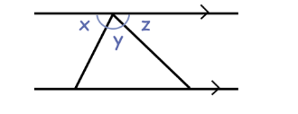
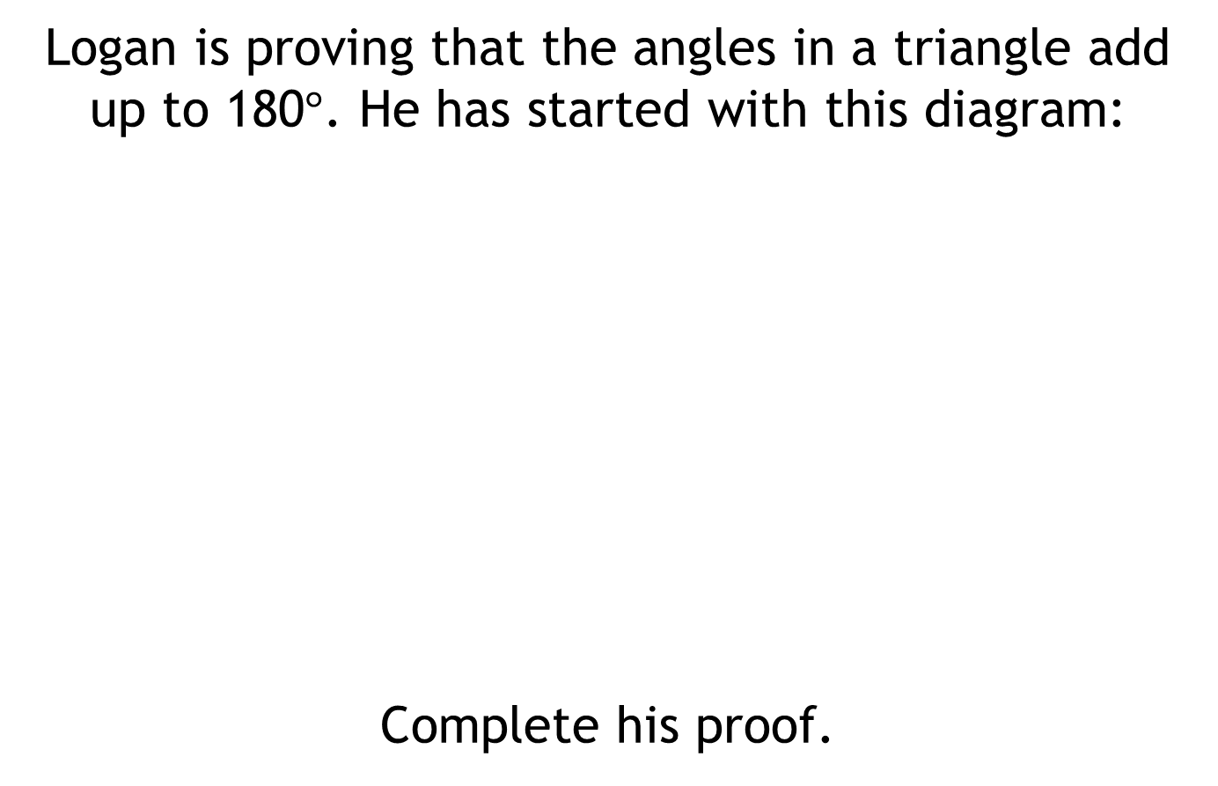
Challenge Problem:
Logan is proving that the angles in a triangle add up to 180$°$. He has started with this diagram:
Complete his proof.

Slide 25
Resources

Slide 26
Your turn …
Find the missing angles stating the angle rules you have used each time

Slide 27
Your turn …
Find the missing angles stating the angle rules you have used each time

Slide 28
Rebecca has three rectangular sheets of paper. She cuts each sheet into two pieces.
She now has the six pieces, A to F, shown below.
Notes:
Weaker students may physically need to cut these out to see the link

