Slide 1
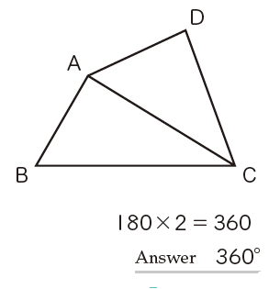
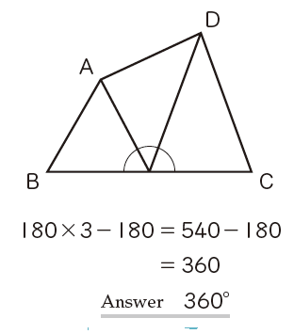
Recap:
The sum of interior angles in any quadrilateral is 360º.
Here are two ways of showing that to be the case:

Slide 2
On your whiteboards, complete the explanation for the first method below:
First, split quadrilateral ABCD into two triangles with diagonal AC. Since the sum of the three angles of a triangle is 180º…

Slide 3
Now look at the second method and complete the sentence on your whiteboards.
First, split quadrilateral ABCD into three triangles with lines joining A and D to the midpoint of BC. Since there are three triangles, multiply 180 by three. 180 must then be subtracted from the total because …

Slide 4
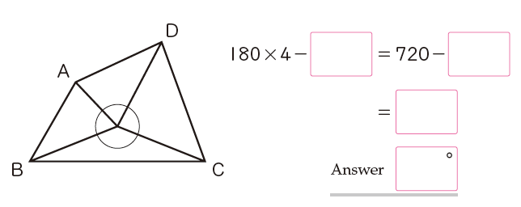
Here is a third way of finding the sum of interior angles in a quadrilateral.
Complete the working out on your whiteboards.

Slide 5
Summary.
The sum of interior angles of a quadrilateral can be found by splitting the shape into triangles.
The angle sum of a quadrilateral is always 360º

Slide 6
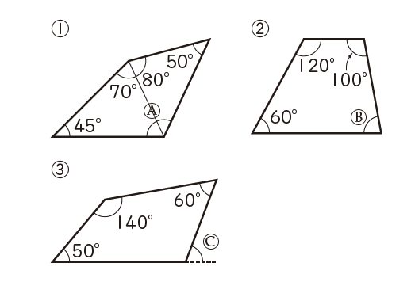
Use the fact that the angle sum of a quadrilateral is 360º to find the angles A, B and C

Slide 7
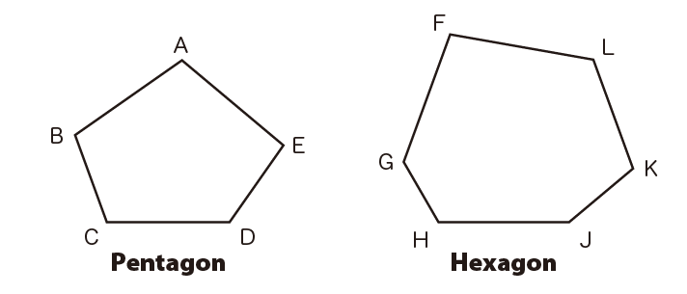
Find the angle sum of a pentagon and hexagon by splitting into triangles (or triangles and quadrilaterals).
Find at least two ways of splitting each shape.

Slide 8

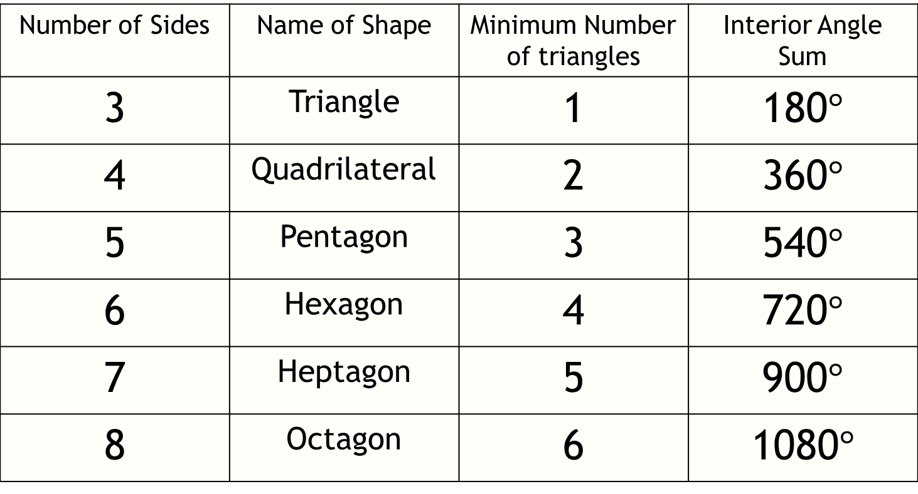
Fill in the table below by splitting each of the shapes into triangles using this method:
Number of Sides | Name of Shape | Minimum Number of triangles | Interior Angle Sum
3 | Triangle | 1 | 180$°$
4 | Quadrilateral | 2 | 360$°$
5 | Pentagon | 3 | 540$°$
6 | Hexagon | 4 | 720$°$
7 | Heptagon | 5 | 900$°$
8 | Octagon | 6 | 1080$°$

Slide 9
Use the results in your table to find the interior angle sum of a dodecagon (12-sided shape).
Number of Sides | Name of Shape | Minimum Number of triangles | Interior Angle Sum
3 | Triangle | 1 | 180$°$
4 | Quadrilateral | 2 | 360$°$
5 | Pentagon | 3 | 540$°$
6 | Hexagon | 4 | 720$°$
7 | Heptagon | 5 | 900$°$
8 | Octagon | 6 | 1080$°$

Slide 10
Use the results in your table to find the interior angle sum of an icosagon (20-sided shape).
Number of Sides | Name of Shape | Minimum Number of triangles | Interior Angle Sum
3 | Triangle | 1 | 180$°$
4 | Quadrilateral | 2 | 360$°$
5 | Pentagon | 3 | 540$°$
6 | Hexagon | 4 | 720$°$
7 | Heptagon | 5 | 900$°$
8 | Octagon | 6 | 1080$°$

Slide 11
Use the results in your table to find the interior angle sum of an n-agon (n-sided shape).
Number of Sides | Name of Shape | Minimum Number of triangles | Interior Angle Sum
3 | Triangle | 1 | 180$°$
4 | Quadrilateral | 2 | 360$°$
5 | Pentagon | 3 | 540$°$
6 | Hexagon | 4 | 720$°$
7 | Heptagon | 5 | 900$°$
8 | Octagon | 6 | 1080$°$

Slide 12

Sum of interior angles n-sided polygon = $180(n−2)$
Use this formula to find the sum of interior angles of a 14 sided shape
Interior angle sum = 180(n - 2)
Interior angle sum = 180(14 - 2)
Interior angle sum = 180(12)
Interior angle sum = 2160$°$
Notes:
12

Slide 13
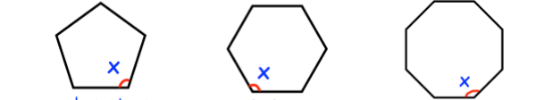
Using what we have learnt today, how could you find the size of one of the interior angles in:
A regular pentagon
A regular hexagon
A regular octagon
If the shape is regular then all of the sides are the same size and all of the angles are the same size
How does this help?

Slide 14
Using what we have learnt today, how could you find the size of one of the interior angles in:
A regular pentagon
A regular hexagon
A regular octagon
If we know the interior angle sum, and the number of equal angles then we can simply divide the sum by the number of angles

Slide 15



Using what we have learnt today, how could you find the size of one of the interior angles in:
A regular pentagon
A regular hexagon
A regular octagon
540 $÷$ 5 = 108$°$
720 $÷$ 6 = 120$°$
900 $÷$ 8 = 112.5$°$

Slide 16
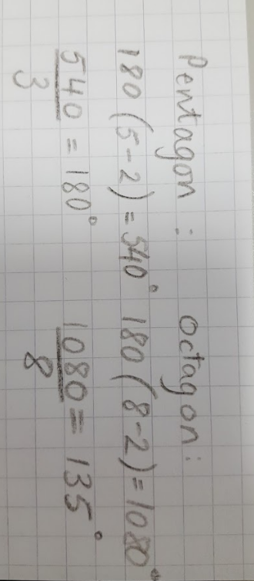
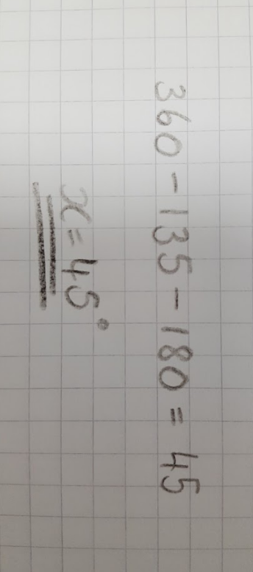
The diagram shows a regular pentagon and a regular decagon.
Annabel is trying to find the size of angle x.
x°
Do you agree with her solution?

