Slide 1
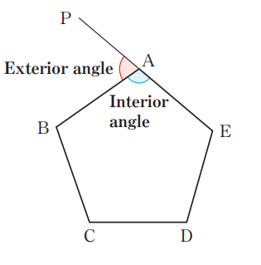
Today we will learn about exterior angles of polygons.
Definition:
The exterior angle is the angle between a side of a polygon and an adjacent side extended outward.

Slide 2
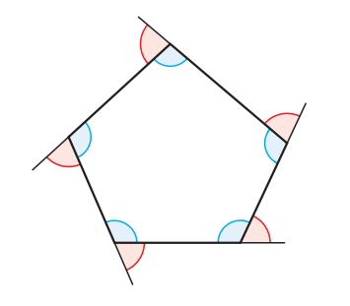
We will use what we learnt last lesson about the sum of interior angles to help us find the exterior angle of this pentagon.

Slide 3
The blue angles are the interior angles and the pink are the exterior angles.

Slide 4
What is the angle sum of this pink and blue angle? How do you know?

Slide 5
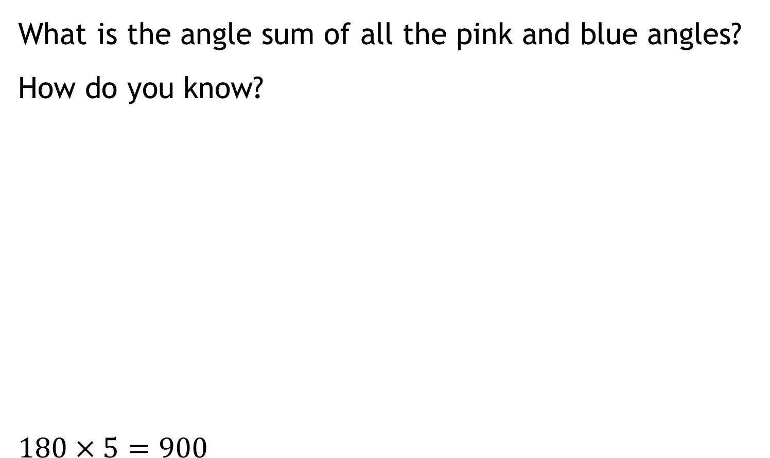
What is the angle sum of all the pink and blue angles? How do you know?
$$180×5=900$$

Slide 6
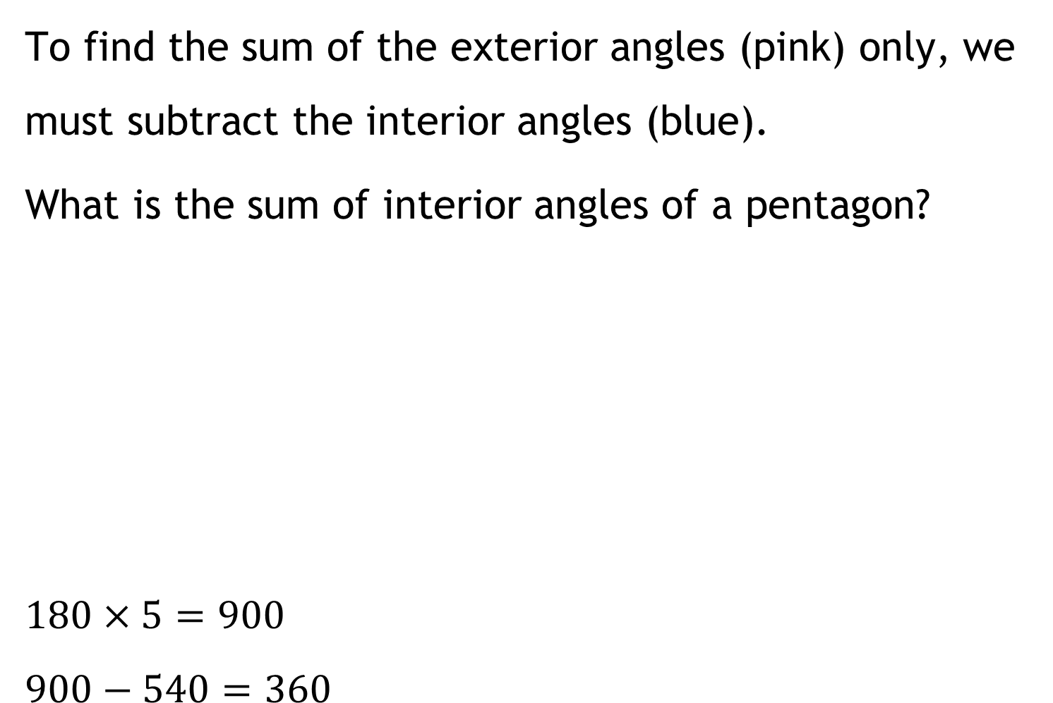
To find the sum of the exterior angles (pink) only, we must subtract the interior angles (blue).
What is the sum of interior angles of a pentagon?
$$180×5=900$$
$$900−540=360$$

Slide 7
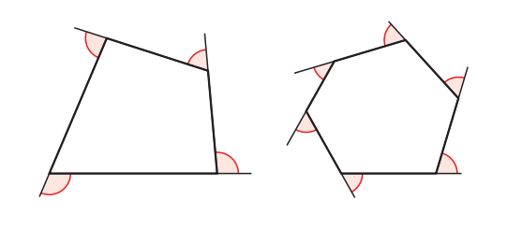
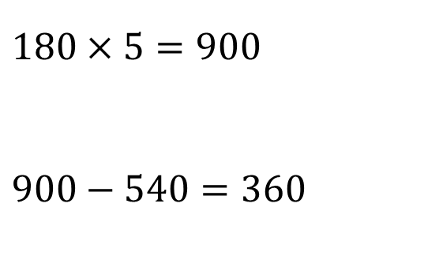
The sum of exterior angles for a pentagon is 360º
$$180×5=900$$
$$900−540=360$$
Where does the 180 come from? Why is it multiplied by 5?
Why is 540 subtracted?
Use the same method to find the sum of exterior angles of a quadrilateral and hexagon.

Slide 8
The sum of exterior angles for a pentagon is 360º
$$180×5=900$$
$$900−540=360$$
Where does the 180 come from? Why is it multiplied by 5?
Why is 540 subtracted?
Challenge:
Predict the sum of exterior angles for an n-agon.
Verify your answer using the same method as above.

Slide 9
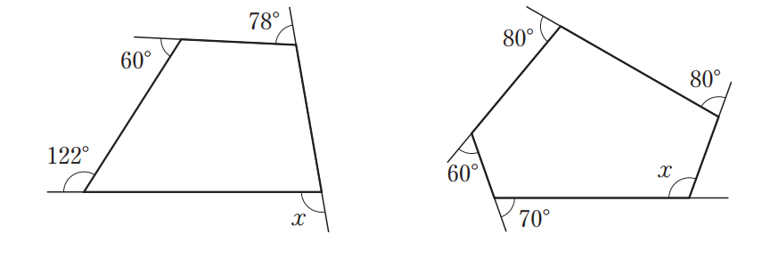
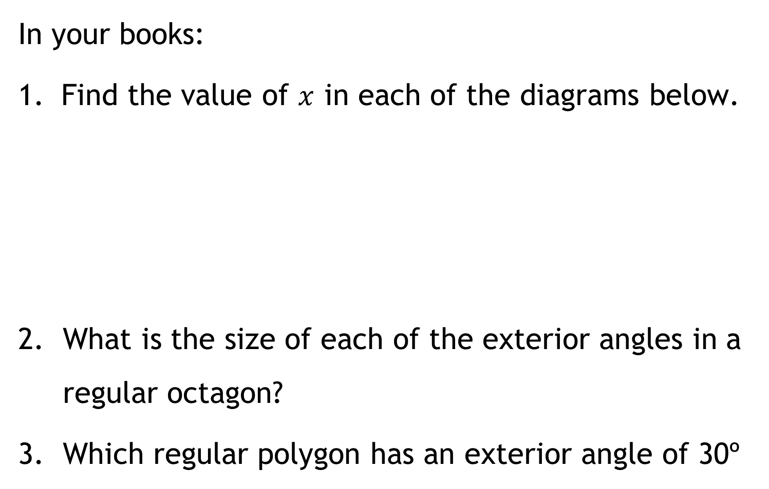
In your books:
Find the value of $x$ in each of the diagrams below.
2. What is the size of each of the exterior angles in a regular octagon?
3. Which regular polygon has an exterior angle of 30º

