Slide 1
Evaluating Conditions for Congruency

Slide 2
Finding Congruent Triangles
On your sheets, draw triangles that satisfy the conditions for each triangle.
You should do this on your own.
You may refer to your work from the last two lessons in your books.

Slide 3
Triangle 1
One angle of 30° and another angle of 40°.
Triangle 2
One right angle and one side is 4 cm long.
Triangle 3
One side is 6cm long and it has angles of 50° and 30°.

Slide 4
Finding Congruent Triangles
Sam says:
I have drawn a triangle.
It has one angle of 30° and another angle of 40°.
Jermaine, you draw a triangle with the same two properties.
Jermaine says:
My triangle will be congruent to yours, because all triangles that have those two properties must be congruent.
Is Jermaine correct to say that all triangles with these two properties must be congruent?
Write your answer at the bottom of the sheet.

Slide 5
Finding Congruent Triangles
Chloe says:
I have drawn a triangle.
It has one right angle and one side is 4 cm long.
Natalie, you draw a triangle with the same two properties.
Natalie says:
My triangle will be congruent to yours, because all triangles that have those two properties must be congruent.
Is Natalie correct to say that all triangles with these two properties must be congruent?
Write your answer at the bottom of the sheet.

Slide 6
Finding Congruent Triangles
Ahmed says:
I have drawn a triangle.
One side is 6cm long and it has angles of 50° and 30°. Cameron, you draw a triangle with the same two properties.
Cameron says:
My triangle will be congruent to yours, because all triangles that have those three properties must be congruent.
Is Cameron correct to say that all triangles with these two properties must be congruent?
Write your answer at the bottom of the sheet.

Slide 7
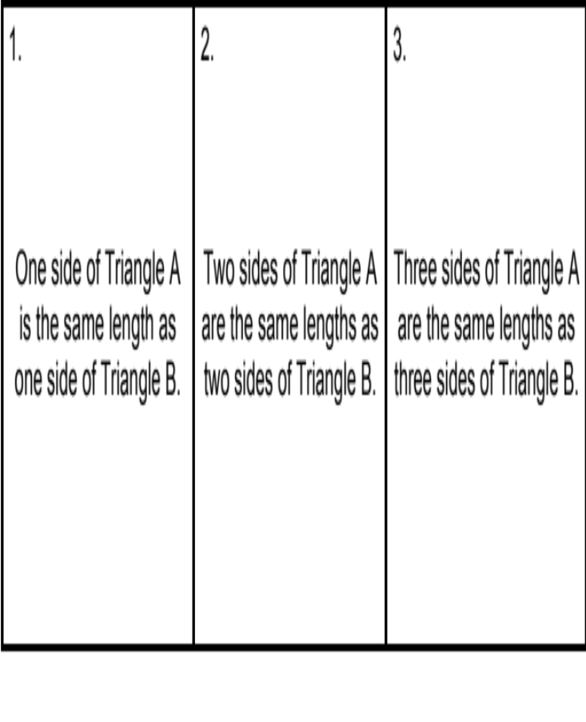
On your whiteboard, draw two triangles, Triangle A and Triangle B.
Make one side of Triangle A the same length as one side of Triangle B.
Make up some side lengths and angles on your example so they are congruent.
Make up some side lengths and angles on your example so they are not congruent.

Slide 8
Comparing answers:
Must Triangle A be congruent to Triangle B?
Is it possible that they are not congruent?
In this case, the triangles can be congruent but do not have to be congruent.

Slide 9
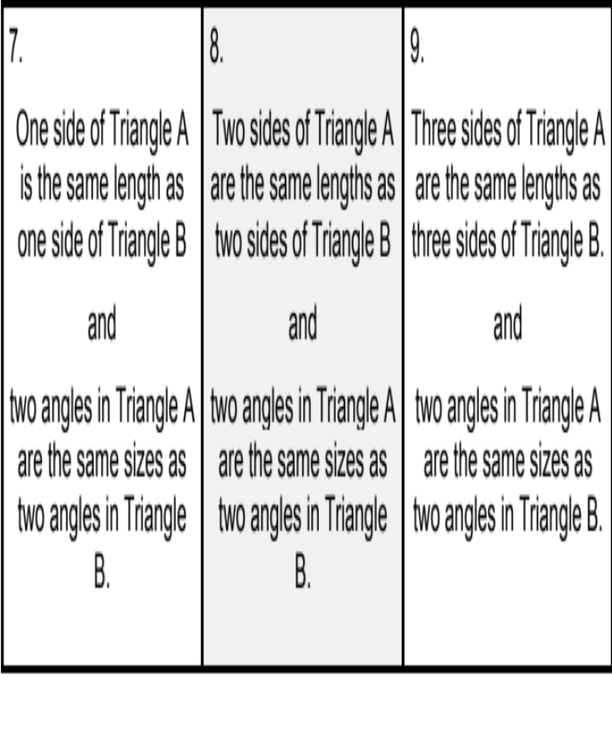
Now draw a pair of triangles with these properties.
Is there a way to draw them so they are not congruent?

Slide 10
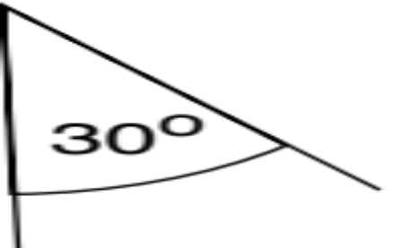
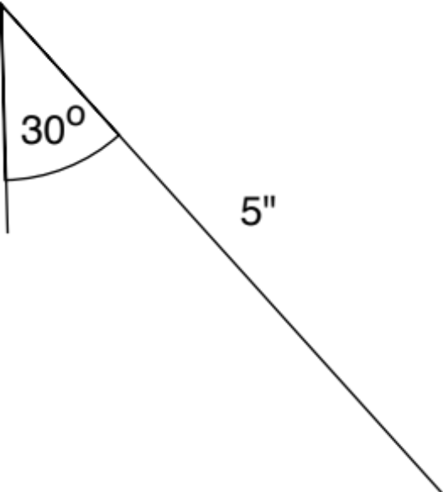
Question 7: Constructing Non-Congruent Triangles
Suppose I choose angles 30°, 40° and a side 5 cm long.
Is there a way to make two triangles with these properties so they are not congruent?

Slide 11
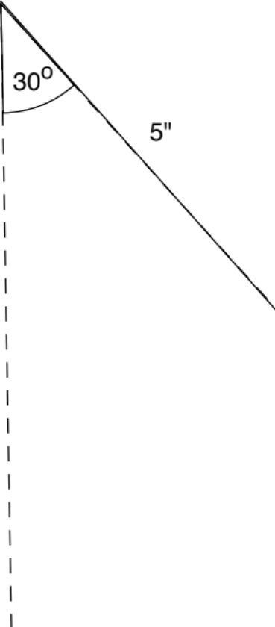

Question 7: Constructing Non-Congruent Triangles
Where could I construct the 40° angle?
P-10

Slide 12
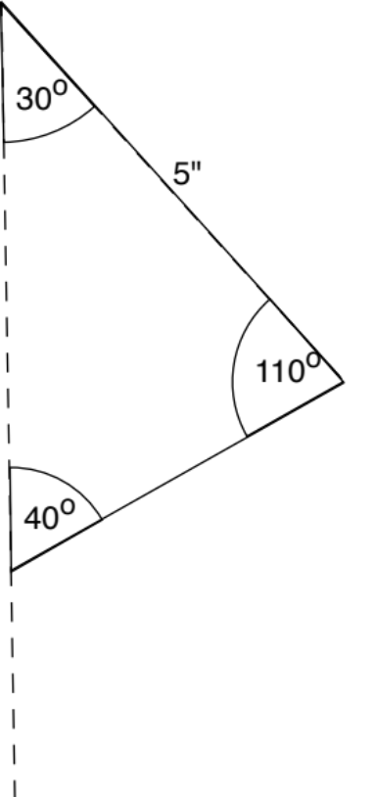
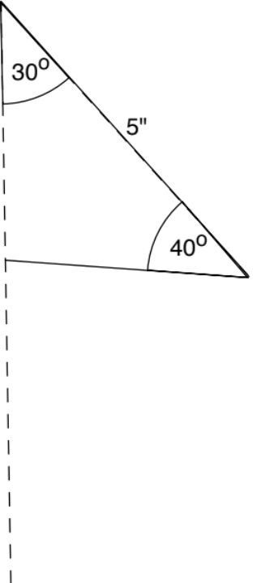
Question 7: Constructing Non-Congruent Triangles
Triangle 1
Triangle 2
P-11
11

Slide 13
Must the Two Triangles be Congruent?
1. One side of Triangle A is the same length as one side of Triangle B. | 2. Two sides of Triangle A are the same lengths as two sides of Triangle B. | 3. Three sides of Triangle A are the same lengths as three sides of Triangle B.
4. One side of Triangle A is the same length as one side of Triangle B and one angle in Triangle A is the same size as one angle in Triangle B. | 5. Two sides of Triangle A are the same lengths as two sides of Triangle B and one angle in Triangle A is the same size as one angle in Triangle B. | 6. Three sides of Triangle A are the same lengths as three sides of Triangle B and one angle in Triangle A is the same size as one angle in Triangle B.
7. One side of Triangle A is the same length as one side of Triangle B and two angles in Triangle A are the same sizes as two angles in Triangle B. | 8. Two sides of Triangle A are the same lengths as two sides of Triangle B and two angles in Triangle A are the same sizes as two angles in Triangle B. | 9. Three sides of Triangle A are the same lengths as three sides of Triangle B and two angles in Triangle A are the same sizes as two angles in Triangle B.

Slide 14
Must the Two Triangles be Congruent?
For each question:
Draw examples of pairs of triangles A and B that have the properties stated for each question.
Decide whether the two triangles must be congruent. Record your decision at the bottom of the question box.
If you decide that the triangles do not have to be congruent, draw examples and explain why.
If you decide that the triangles must be congruent, try to write a convincing proof.
Make sure to include question 5 in your work, as the whole-class will discuss this statement.

Slide 15
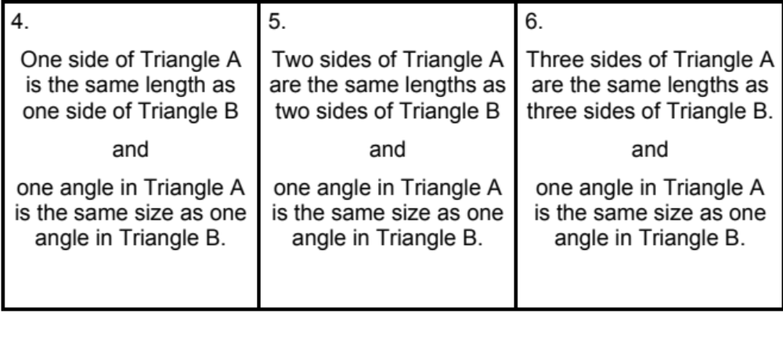
Must the Two Triangles be Congruent?
Were you able to draw triangles that weren’t congruent?

Slide 16
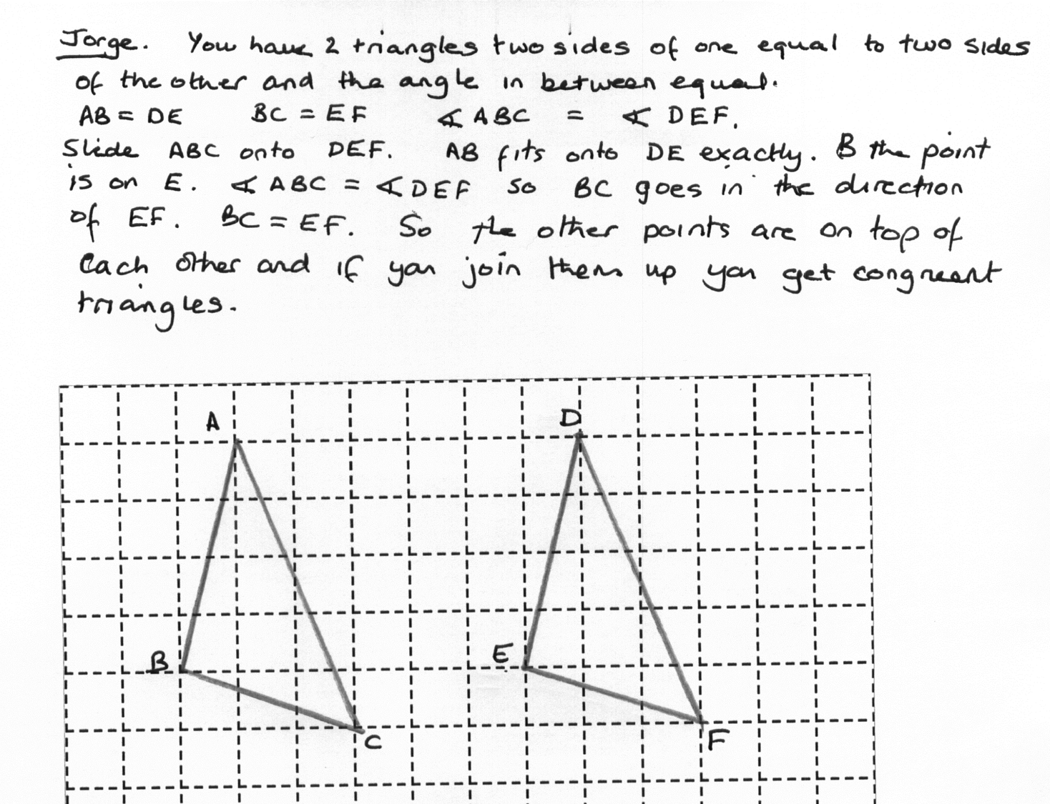
Jorge’s Proof

