Slide 1
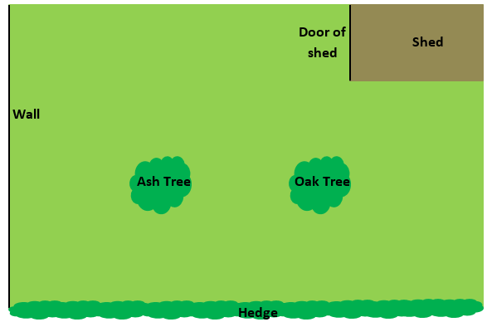
John is standing at the point marked with a red cross.
He wants to walk so that he is always the same distance away from the hedge and the wall.
Where should John walk?
X

Slide 2
John is standing at the point marked with a red cross.
He wants to walk so that he is always the same distance away from the hedge and the wall.
How do you know he is exactly half way between the wall and the hedge?
X

Slide 3
John is standing at the point marked with a cross.
He wants to walk so that he is always the same distance away from the hedge and the wall.
What would be the same if the path had been drawn perfectly?
X

Slide 4
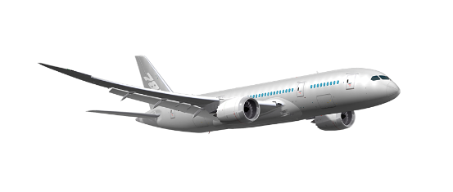
The ideal flight path for the plane to land is midway between the maximum and minimum angle of descent.
What path should the plane take?
Maximum angle of descent
Minimum angle of descent

Slide 5
Maximum angle of descent
Minimum angle of descent
To draw the path accurately we can use a construction known as an angle bisector.
What do you think the word bisector means?
bisect: to split into two equal parts

Slide 6
Please use exemplar sheet for students to complete the missing gaps and complete a worked example

Slide 7
When constructing an angle bisector
every point on the path drawn is equidistant
from one side as it is from the other.
The angle has been perfectly cut in half.

Slide 8
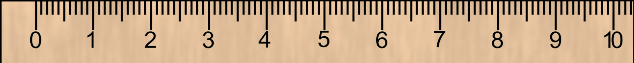
Constructing an angle bisector
Q
P
R

Slide 9
Constructing an angle bisector
Q
P
R
Measure both angles. Are they the same?

Slide 10
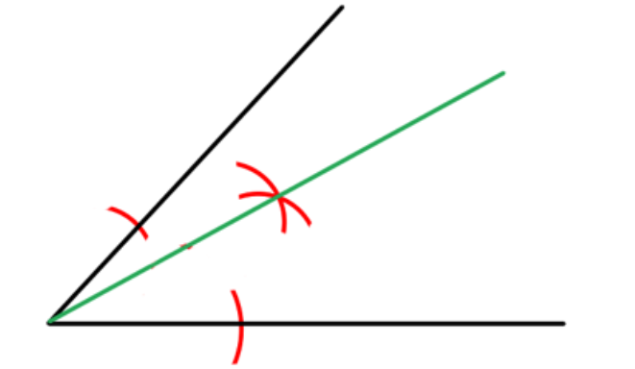
Jane has attempted to construct an angle bisector of the following angle.
How can we tell if Jane is correct or not?

Slide 11
Jane has attempted to construct an angle bisector of the following angle.
Discuss: Where has Jane gone wrong?

Slide 12
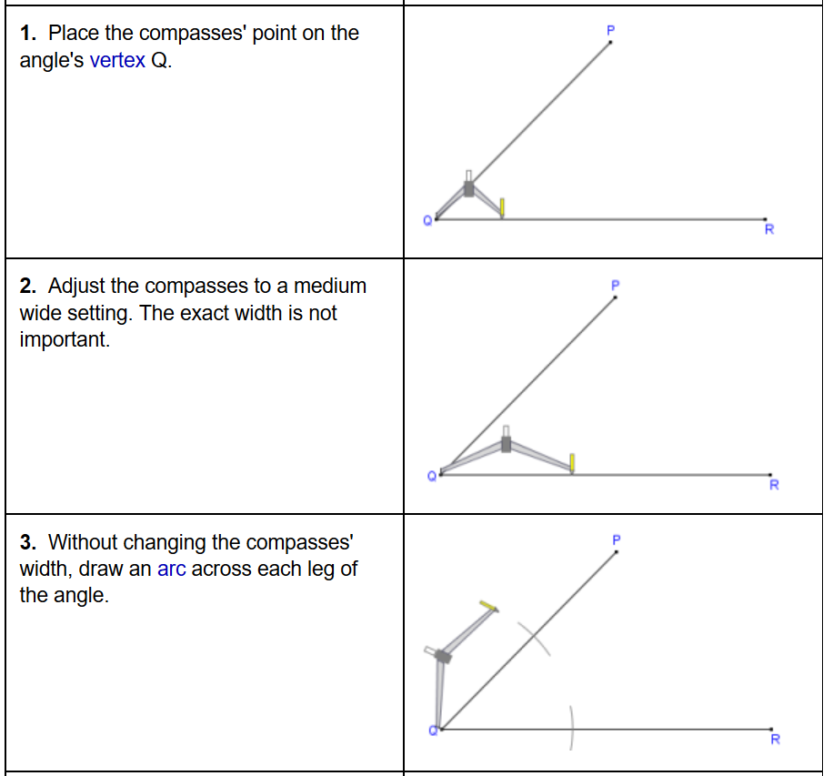
Constructing an angle bisector
Why do you think the exact width is not important?

Slide 13
Constructing an angle bisector

Slide 14
Constructing an angle bisector
Why do you think the compass width must remain the same?

Slide 15
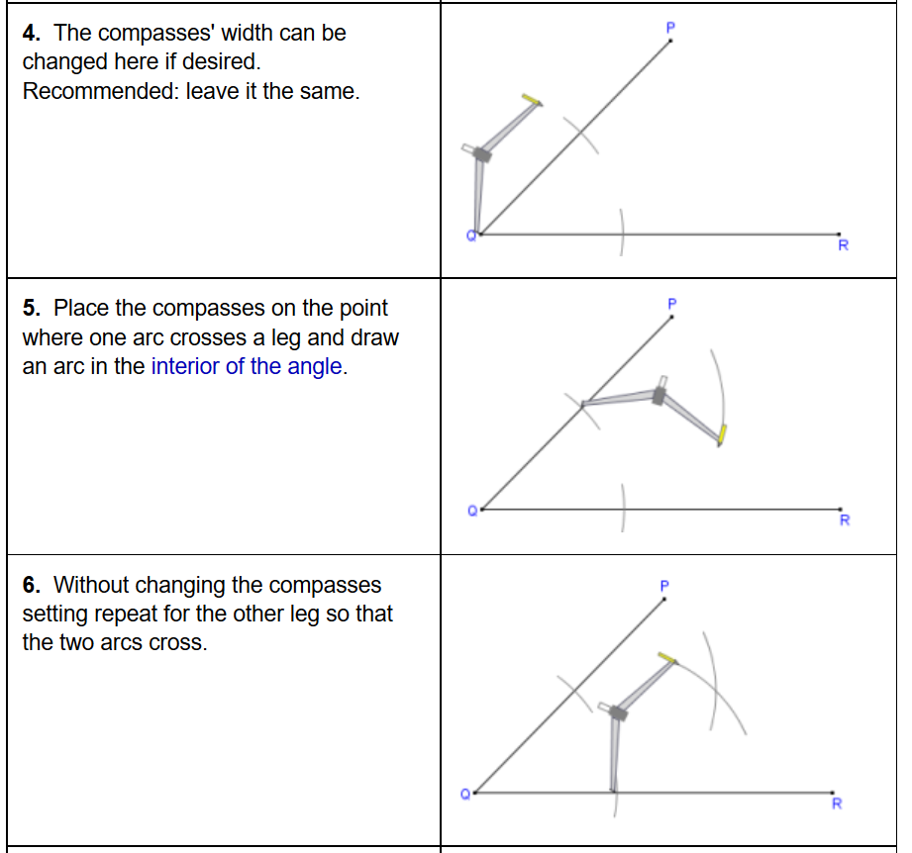
Why do you think the compass width can change at this point?
Why would it be sensible to keep it the same?

Slide 16
Why do you think the compass width must remain the same?

Slide 17
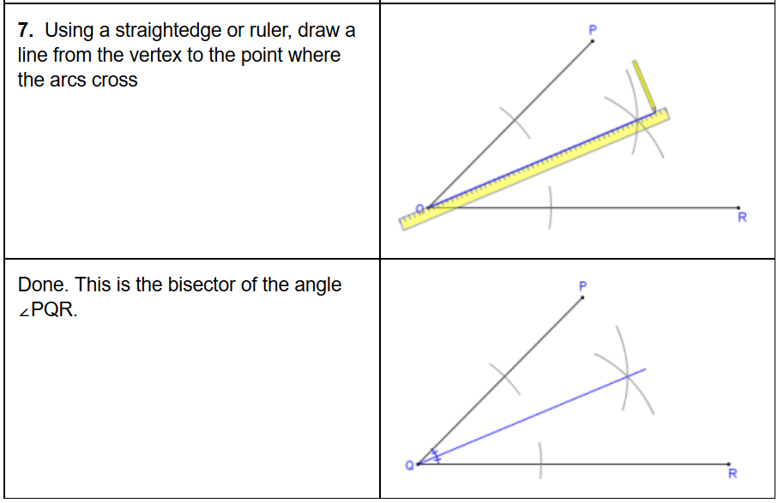

Slide 18
Angle Bisector
Bisect each of the angles on the worksheet.
You must leave in your construction lines

Slide 19
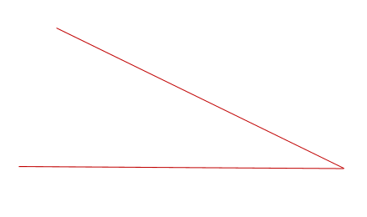
Construct an angle bisector on the following:

Slide 20
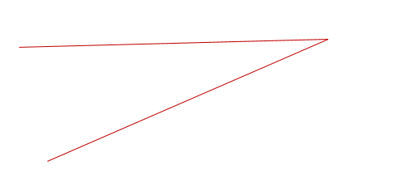
Construct an angle bisector on the following:

Slide 21
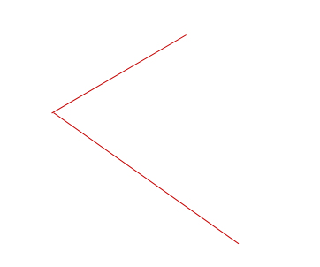
Construct an angle bisector on the following:

Slide 22
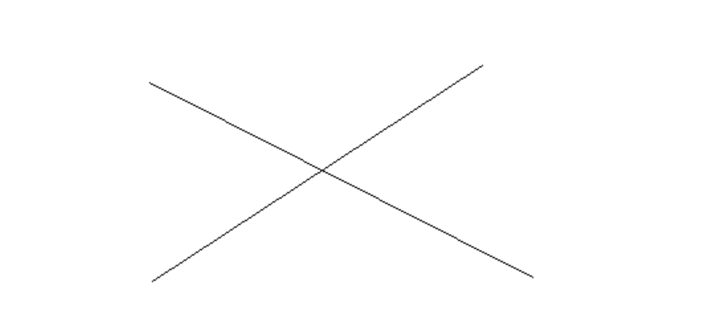
Challenge Problem:
Bisect all 4 angles using the fewest arcs and lines.
(Record: 4 arcs, 2 lines)

Slide 23
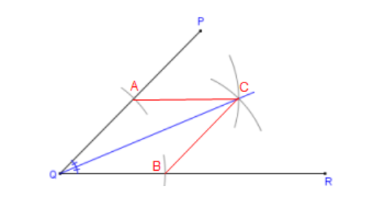
Can you use the diagram below to describe how the construction works?
This construction works by effectively creating two congruent triangles.
The image is the final drawing above with the red lines added and points A,B,C labelled.

Slide 24
Challenge Problem:
Draw a triangle and construct the angle bisector of each corner
You should find that the bisectors intersect at a single point inside the triangle!
Now using the point of intersection as centre, draw the largest possible circle that does not leave the triangle
You should find that the circle touches all three sides of the triangle
This works with any triangle…
Can you explain why this happens?!

