Slide 1
Today we will learn how to accurately construct regular polygons inside circles
Watch the following demonstration of how to construct an equilateral triangle.

Slide 2
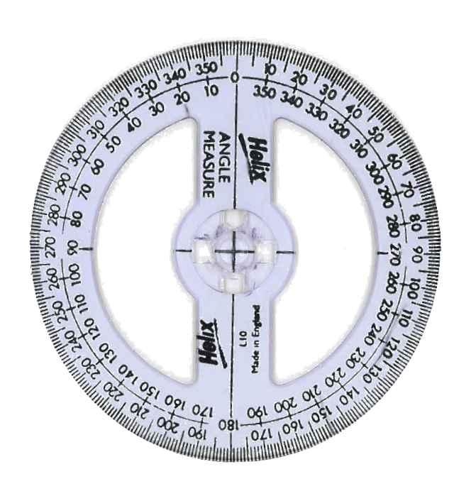
Constructing Regular Polygons

Slide 3
Constructing Regular Polygons
X

Slide 4

Constructing Regular Polygons
X
360 ÷ 3 = 120º

Slide 5
Constructing Regular Polygons

Slide 6
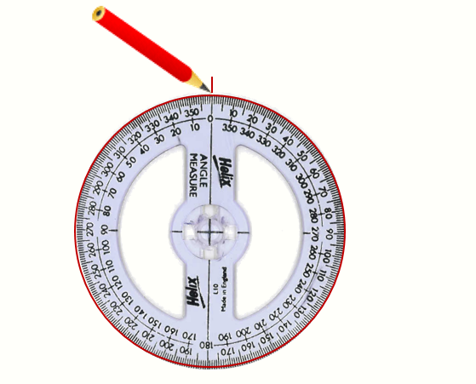

Constructing Regular Polygons
Make a mark at the centre of the circle, then mark 0$°.$
This is where you will start

Slide 7
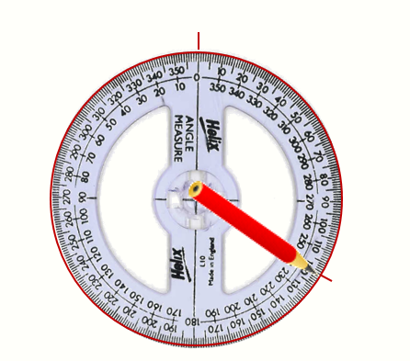
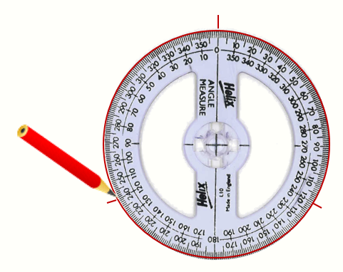

Constructing Regular Polygons
Make more marks every $x$ degrees. In this case $x$ is 120 degrees.

Slide 8
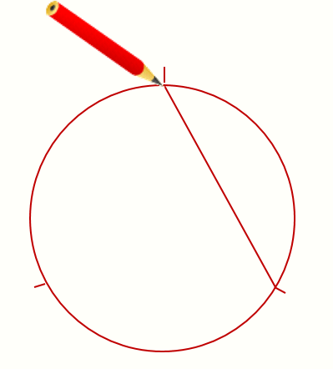
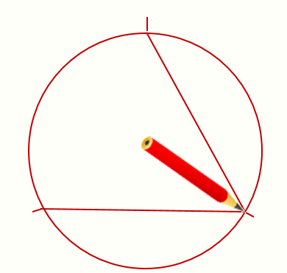
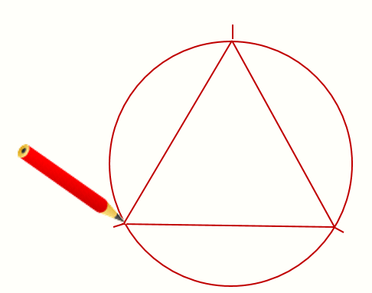
Constructing Regular Polygons
Join up the marked points with line segments to make a polygon

Slide 10

Use the same method to accurately construct the following regular polygons inside circles …
Square
Hexagon
Pentagon
Octagon
Nonagon
Decagon

Slide 11
Challenge:
Dodecagon

Slide 12
Discuss:
Why didn’t we attempt to construct a heptagon?
Which other polygons would be difficult to construct?

Slide 13
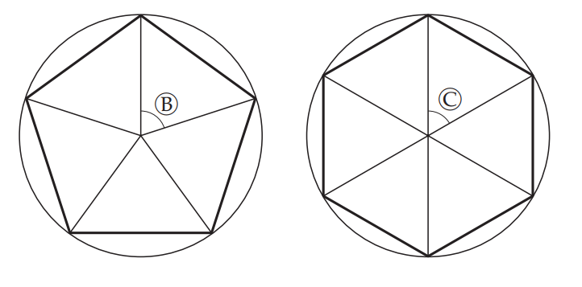
If you draw lines from the centre of the circle to each vertex of the pentagon and hexagon you will have split the shapes into congruent triangles.
What is the size of angle B and angle C in the diagrams above?
How do you know?

Slide 14
The triangles in both shapes are isosceles. How do we know that without measuring the lengths of the sides?
As each vertex is on the circumference of the circle, the lines from the centre are all radii.
This means they are all the same length.

Slide 15
Now that we know the size of angles B and C, we can find the other angles labelled with the blue and red dots.
On your whiteboards, show how you find the red and blue angles.

