Slide 1
Rally Coach Recap
Partner A solves their first problem.
Partner B watches and listens. Then checks, coaches and critiques the answer.
Partner B solves their first problem.
Partner A watches and listens. Then checks, coaches and critiques answer.
This is repeated until each person has answered all their questions.

Slide 2
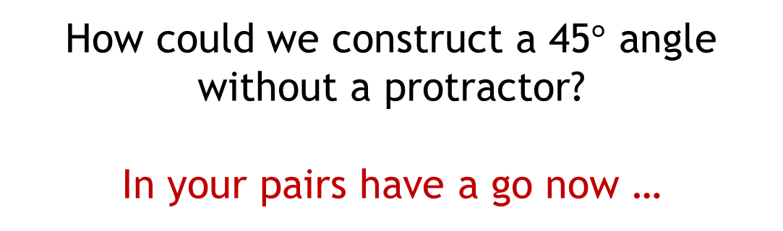
How could we construct a 45$°$ angle without a protractor?
In your pairs have a go now …

Slide 3
Think back …
How could we draw an equilateral triangle using a compass and ruler?

Slide 4
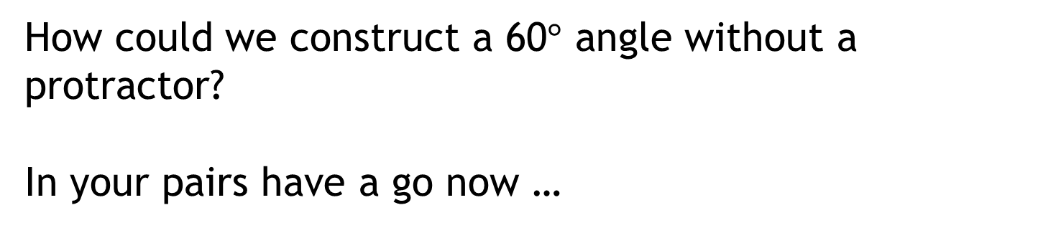
How could we construct a 60$°$ angle without a protractor?
In your pairs have a go now …
http://www.mathopenref.com/constangle60.html

Slide 5
What about a 30̊ angle?
What do you know that could help you?
http://www.mathopenref.com/constangle30.html

Slide 6
Crazy Constructions
Follow the instructions as carefully as you can to try and create a pattern.
You must not rub out your construction lines!

Slide 7
