Slide 1
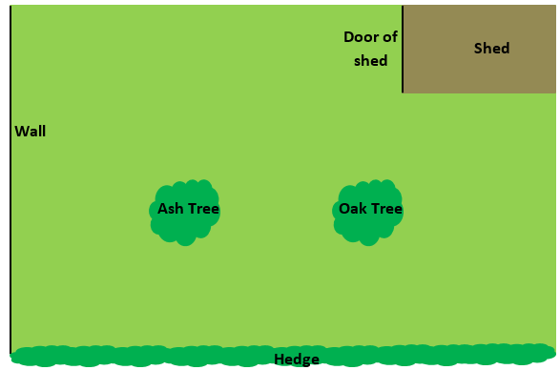
John is now standing at the point marked with a red cross.
He wants to walk the shortest possible distance to the hedge.
Where should John walk?
X

Slide 2
Why wouldn’t John walk this way to the hedge?
X

Slide 3
How can we guarantee that we have drawn the shortest possible distance?
X

Slide 4
The shortest possible route makes a right angle with the hedge
X

Slide 5
This type of construction is referred as a perpendicular from a point.

Slide 6
When constructing a perpendicular from a point
the new path is the
shortest possible distance
from the point to the line

Slide 7
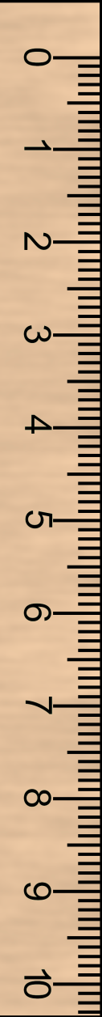
Constructing a Perpendicular from a Point
M
P
Q

Slide 8
Constructing a perpendicular from a point
How can we show that the new line is the shortest possible distance from the point M to the line PQ?
M
P
Q

Slide 9
Constructing a perpendicular from a point
M
P
Q
Measure it!

Slide 10
Constructing a Perpendicular from a Point
M
P
Q

Slide 11
Constructing a Perpendicular from a Point
M
P
Q
Would this line be shorter?

Slide 12
Constructing a Perpendicular from a Point
M
P
Q
Why not?

Slide 13
The Perpendicular From a Point
Construct the perpendicular from each of the given points on the worksheet.
Complete your constructions on the worksheet
Leave in your construction lines

Slide 14
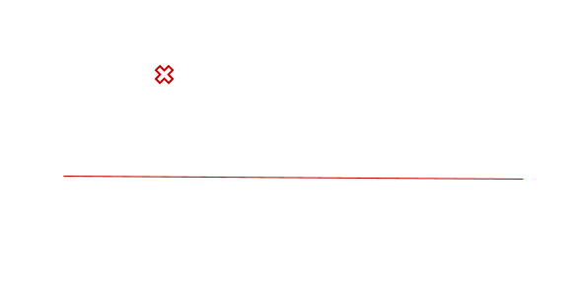
Construct a perpendicular from a point on the following:

Slide 15
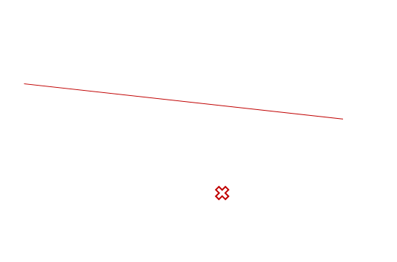
Construct a perpendicular from a point on the following:

Slide 16
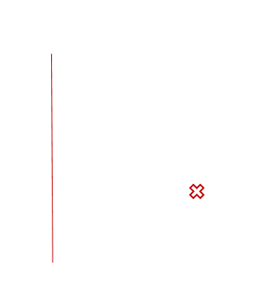
Construct a perpendicular from a point on the following:

Slide 17
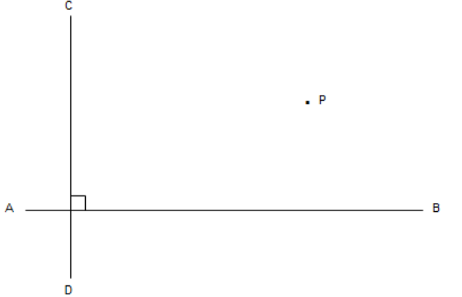
Challenge:
Construct a line perpendicular to AB that passes through P
Construct a line perpendicular to CD that passes through P
What is the name of the resulting quadrilateral?
Measure its side lengths with a ruler and calculate its area and perimeter

