Slide 1
Think back to last lesson:
If the arrowed lines are parallel, show me a pair of angles that are the same size.
c°
d°
b°
a°
g°
h°
f°
e°

Slide 2
Angle a = angle e.
These are called corresponding angles. Can you see why?
c°
d°
c°
d°
b°
a°
b°
a°
g°
h°
g°
h°
f°
e°
f°
e°

Slide 3
Angle b and angle f are also corresponding.
Can you find any other pairs of corresponding angles?
c°
d°
c°
d°
b°
a°
b°
a°
g°
h°
g°
h°
f°
e°
f°
e°

Slide 4
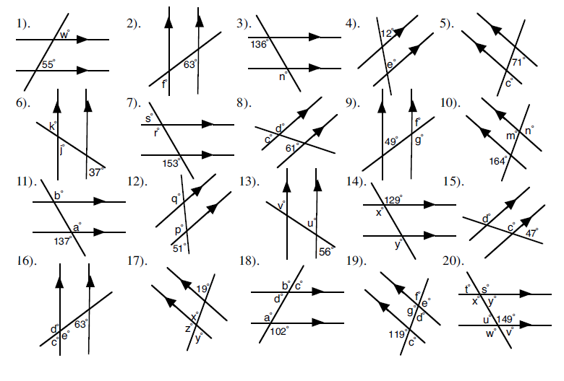
Title: Corresponding angles.
Find the values of the missing letters in the diagrams. Where there is more than one letter to find, find them in alphabetical order.
Give a reason for your answers.

Slide 5
Title: Corresponding angles.
Find the values of the missing letters in the diagrams. Where there is more than one letter to find, find them in alphabetical order.
Give a reason for your answers.

Slide 6
Angle a = angle g and angle b = angle h.
Can you see why?
c°
d°
c°
b°
d°
a°
b°
a°
g°
h°
g°
f°
h°
e°
f°
e°

Slide 7
These pairs of angles are called alternate angles.
Why do you think they are called that?
c°
d°
c°
b°
d°
a°
b°
a°
g°
h°
g°
f°
h°
e°
f°
e°

Slide 8
Can you write down the other two pairs of alternate angles?
c°
d°
c°
b°
d°
a°
b°
a°
g°
h°
g°
f°
h°
e°
f°
e°

Slide 9
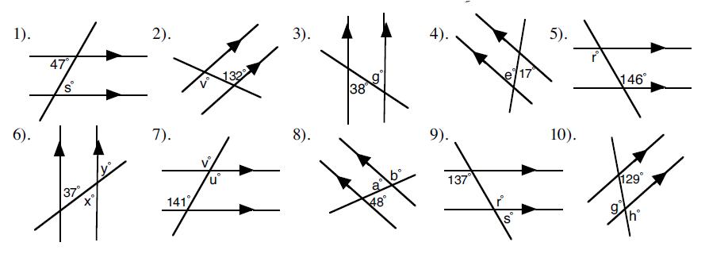
Title: Alternate angles.
Find the values of the missing letters in the diagrams. Where there is more than one letter to find, find them in alphabetical order.
Give a reason for your answers.

Slide 10
What can you say about the relationship between angles a and h?
c°
d°
b°
a°
Angles a and h are called interior angles (sometimes co-interior)
a + h = 180º
Angles that have a sum of 180º are said to be supplementary.
Can you find the other pair of interior angles?
g°
h°
f°
e°

Slide 11
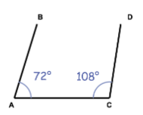
Are the lines AB and CD parallel?
Explain your answer

Slide 12
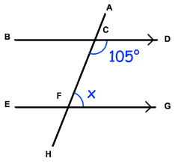
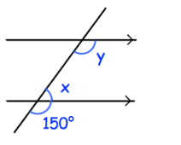

Find the value of the missing angles
1)
2)

Slide 13
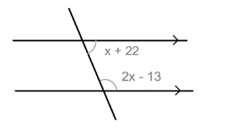
Challenge:
By forming an equation, find the value of x

Slide 14
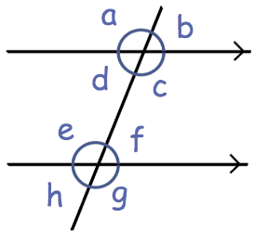
To finish …
Which angle is corresponding to angle c?
(b) Which angle is alternate to angle d?
(c) Which angle is corresponding to angle h?
(d) Which angle is vertically opposite to angle a?
(e) Which angle is alternate to angle e?
(f) Which angle is co-interior with angle c?
(g) Which angle is vertically opposite to angle h?
(h) Which angle is co-interior with angle e?
(i) Which angle is corresponding to angle a?
(j) Which angle is vertically opposite to angle g?

