Slide 1
Welcome to Emmanuel
Please take a seat using the following rules(!)
At least one member of staff from each of the four Trust academies must be on each table.
No two people seated next to each other can work at the same Academy.
Introduce yourselves around the table.
Phones away please…

Slide 2
Deepening Understanding
In each of the 5 sessions this year, we will concentrate on the five different aspects of the 5 big ideas for deepening understanding, through the lens of one of the topics or units of work that we all teach.
Today we will look at Coherence through the topic of quadratics.
We will think about how we can work collaboratively on the key aspects of teaching for deeper understanding and begin work on a support for teachers’ planning.

Slide 3
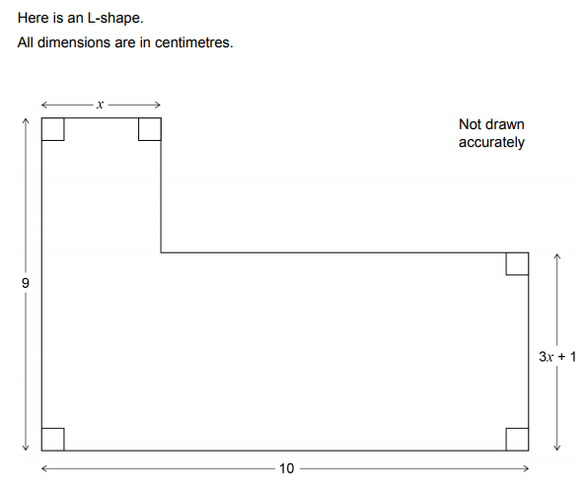

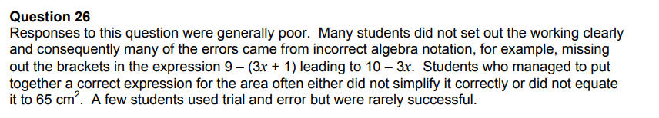
How did students fare in the quadratics questions in this year’s exams?

Slide 4
Deepening Understanding
Representation
& Structure
Access
Mathematical Thinking
Chains of Reasoning
Fluency
Number Facts
Variation
Procedural
Conceptual
Table Facts
Pattern
Making Connections
Making Connections
Making Connections
Making Connections
Coherence
Small connected steps are easier to take

Slide 5
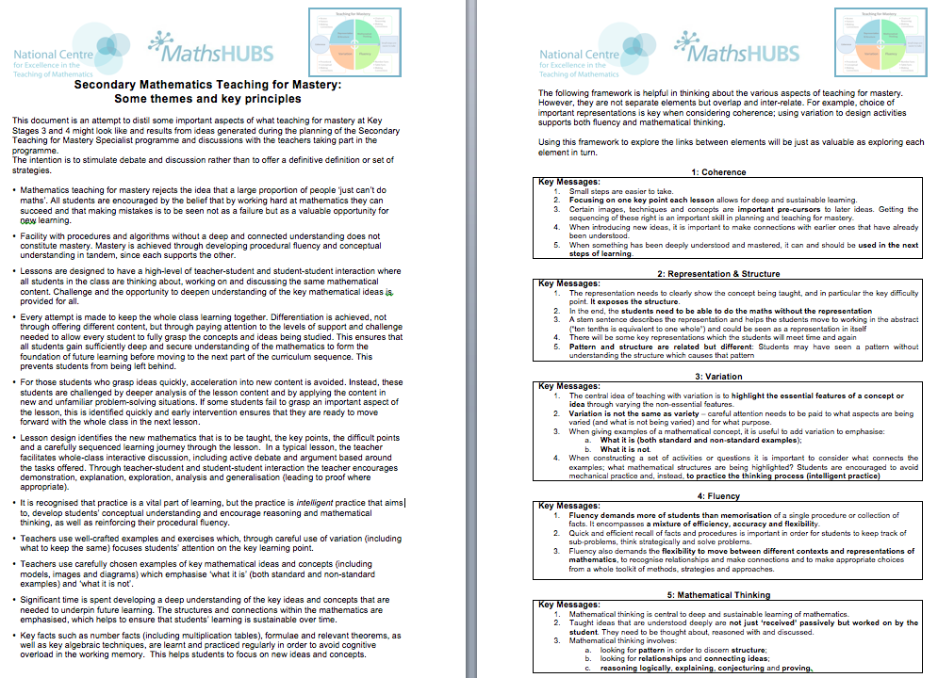

Slide 6
Plan a unit of work incorporating the big ideas:
Coherence
Focussing on one key point each lesson allows for deep and sustainable learning

Slide 7
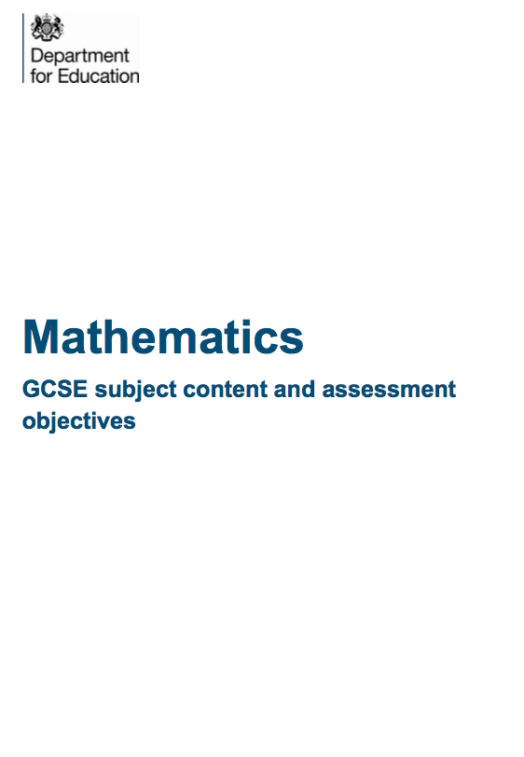

Slide 8
Algebra
Algebra: Notation, vocabulary and manipulation 4
Simplify and manipulate algebraic expressions (including those involving surds
and algebraic fractions) by:
- factorising quadratic expressions of the form x² + bx + c, including the difference
of two squares; factorising quadratic expressions of the form ax² + bx + c
How can this very broad statement be broken down into key ideas when planning a scheme?

Slide 9
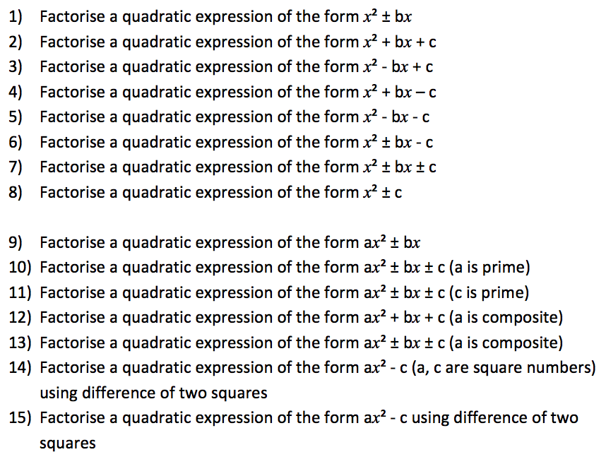

Slide 10
For each of the key points:
Standard questions
Non-standard questions
What it’s not – difficulty points, misconceptions and common errors
Context/links to other areas
Standard variation
Positive variation
Conceptual Variation
Non-standard variation
Negative variation

Slide 11
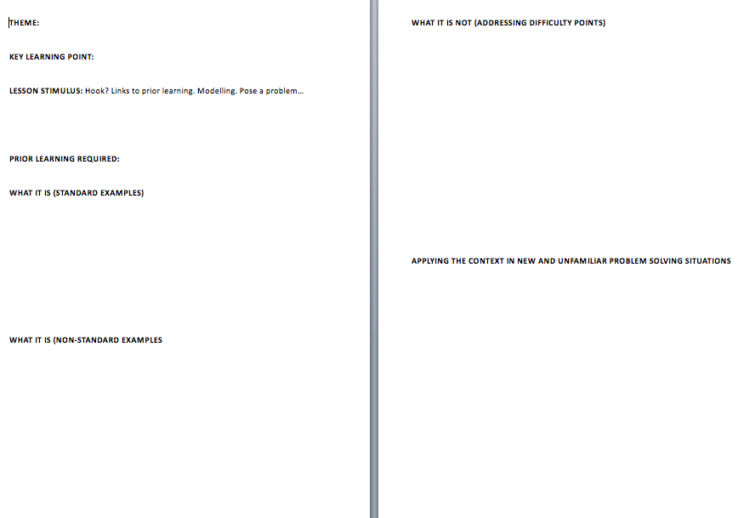

Slide 12
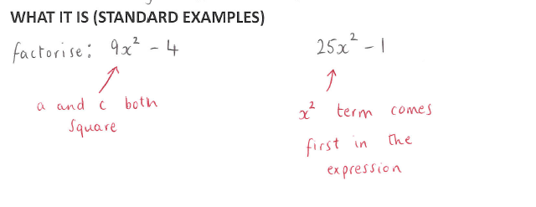
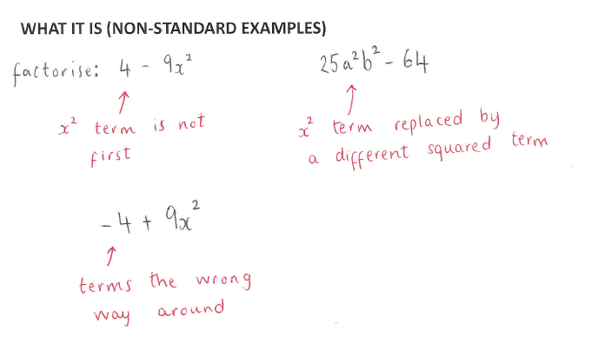

Slide 13
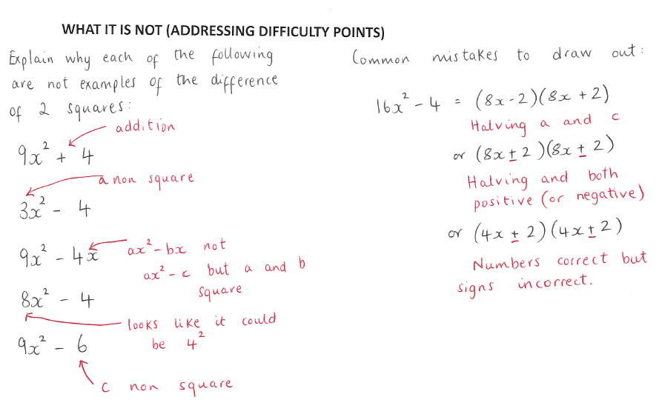

Slide 14
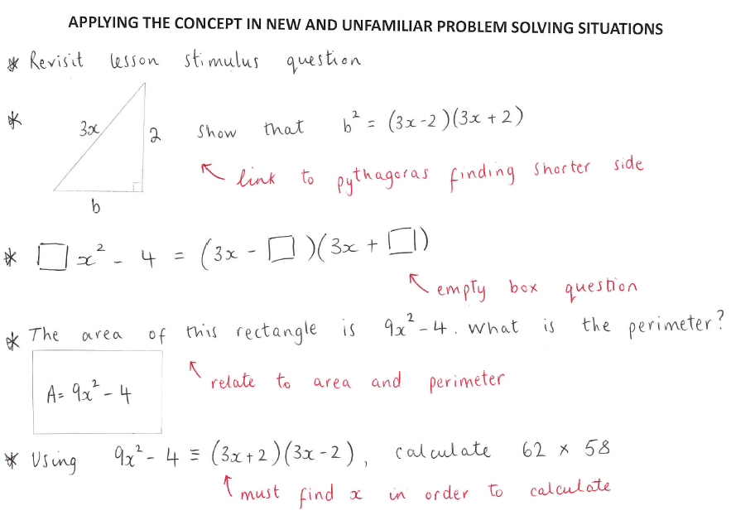

Slide 15
Deepening Understanding
Representation
& Structure
Access
Mathematical Thinking
Chains of Reasoning
Fluency
Number Facts
Variation
Procedural
Conceptual
Table Facts
Pattern
Making Connections
Making Connections
Making Connections
Making Connections
Coherence
Small connected steps are easier to take

Slide 16
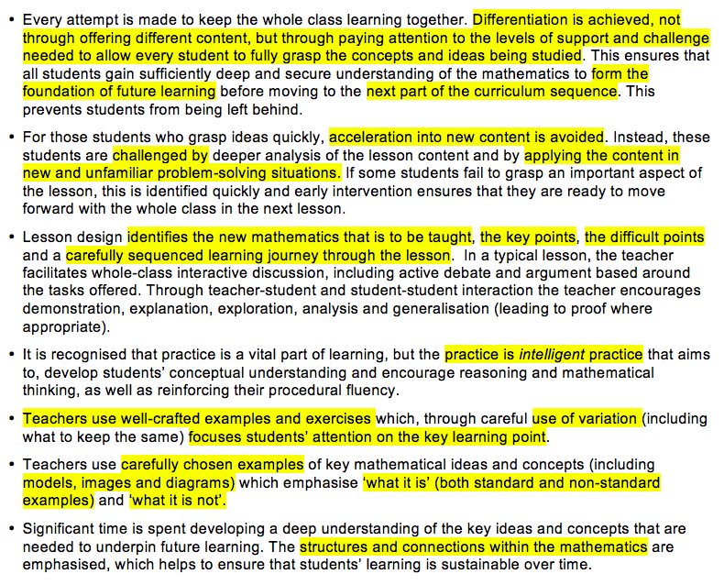

Slide 17

Bluecoat Wollaton Academy
Faculty of Mathematics
Numeracy Plan 2017/18
Faculty of Mathematics Where everyone counts

Slide 18
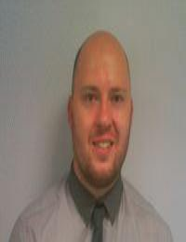
Faculty of Mathematics Where everyone counts

Slide 19
SCHEDULE
AUTUMN 2
Design a Numeracy Champion 3rd November
Fibonacci Day 23rd November
ChristMATHS 18th December
SPRING 1
UKMT Intermediate Challenge (Year 9-11) 1st February
NSPCC Number Day 2nd February
SPRING 2
Pi day 14th March
SUMMER 1
UKMT Junior Maths Challenge 26th April
SUMMER 2
Maths & MFL Trip to France 9th July

Slide 20
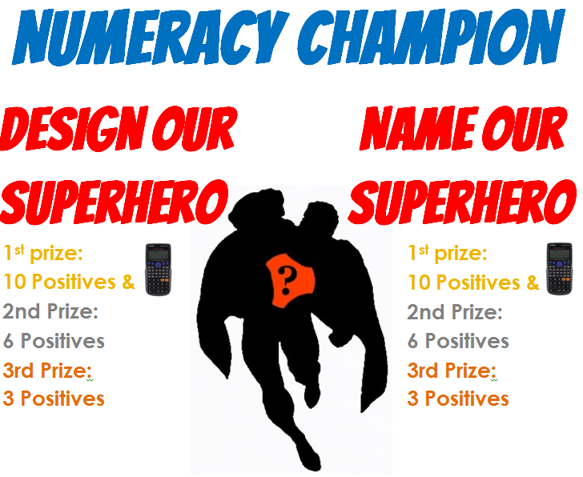

Slide 21
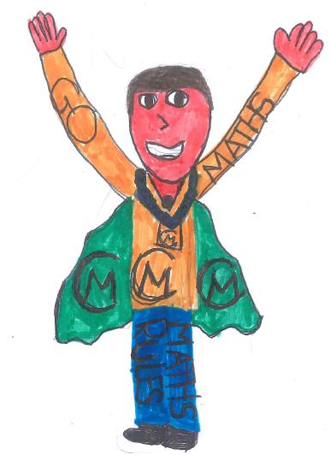
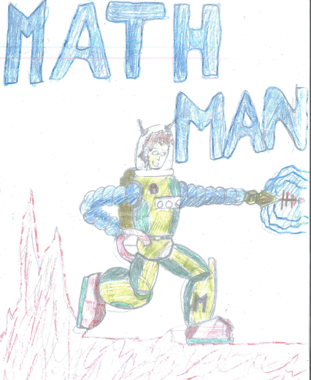
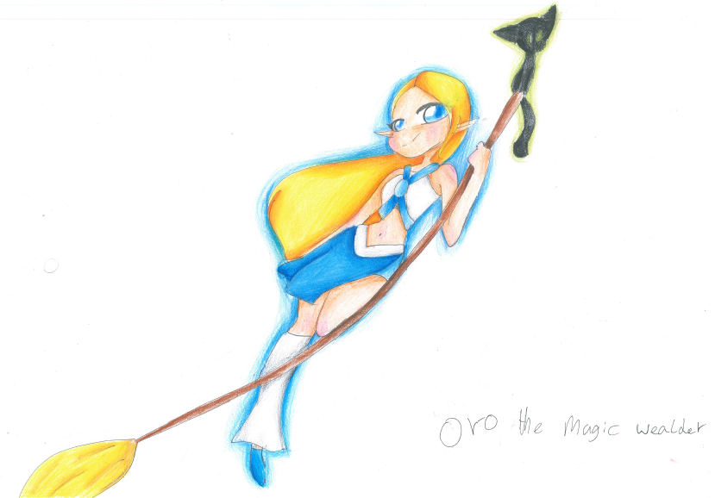
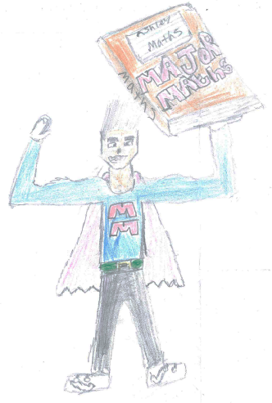
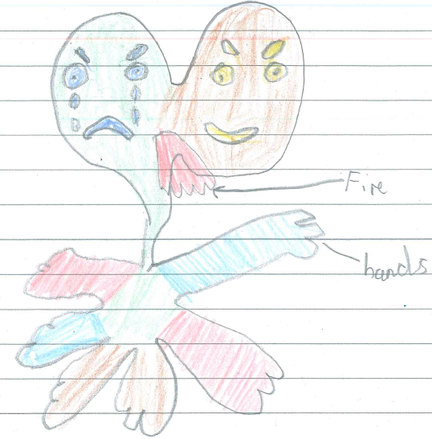
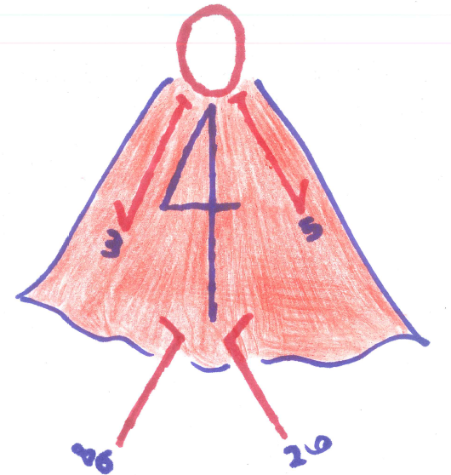
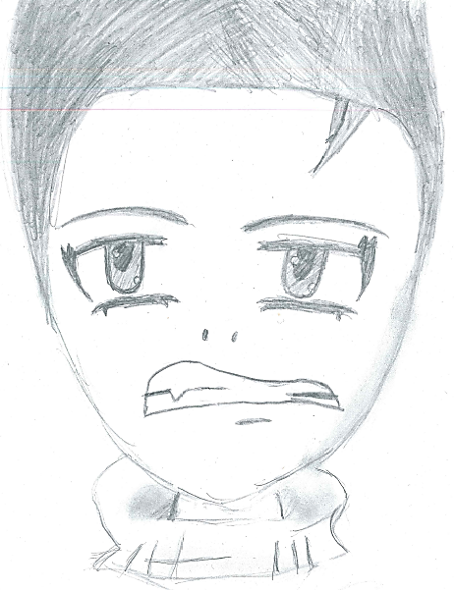
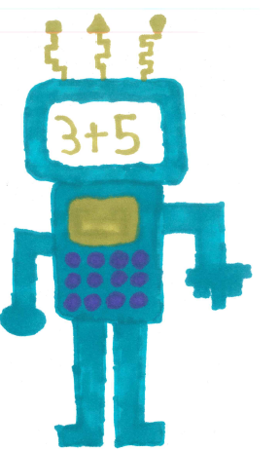
We asked you for a new….
Numeracy Champion
And you delivered! Here are the highlights…

Slide 22
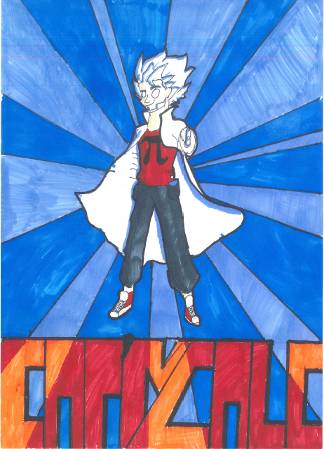

Peithok, Year 8

Slide 23

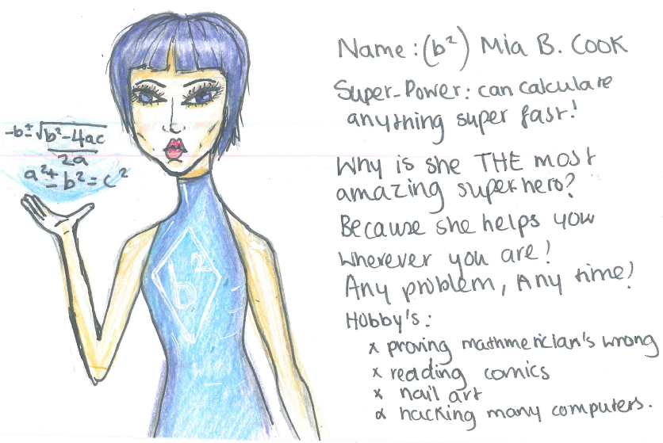
Ani, Year 9

Slide 24


Slide 25

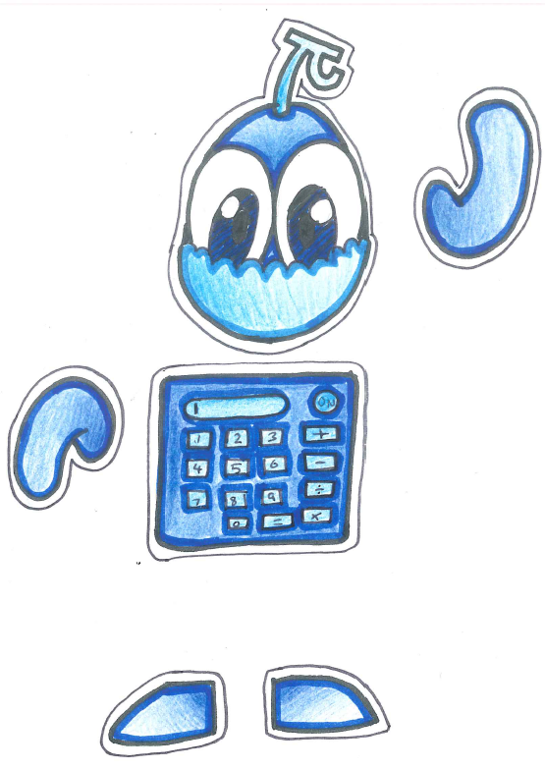
James, Year 10

Slide 26
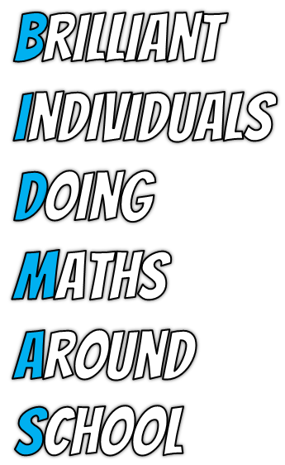

Slide 27

Today we will have our very first…
Fibonacci Day 2017
Intro & Period 1
Period 2
Period 3
Period 4
Faculty of Mathematics Where everyone counts

Slide 28
Today we will have our very first…
Fibonacci
Day
2017
Period 1
Faculty of Mathematics Where everyone counts

Slide 29
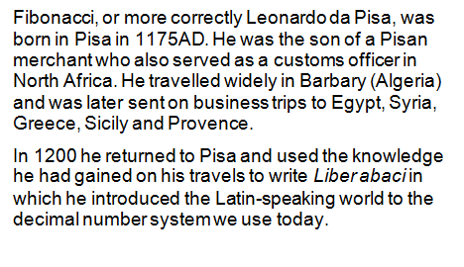
Fibonacci Day 2017 Period 1
Faculty of Mathematics Where everyone counts

Slide 30
Fibonacci Day 2017 Period 1
Previously, you may have come across the Fibonacci sequence.
Can you write down the first 10 Fibonacci numbers?
1, 1, 2, 3, 5, 8, 13, 21, 34, 55, …
How is it different to other sequences you’ve come across?
Why can’t you find the nth term of this sequence using methods you’ve been taught previously?
(There is an nth term, Google it!)
Faculty of Mathematics Where everyone counts

Slide 31
Fibonacci Day 2017 Period 1
There is another series quite similar to the Fibonacci series that often occurs when working with the Fibonacci series. Edouard Lucas (1842-1891) (who gave the name "Fibonacci Numbers" to the series written about by Leonardo of Pisa) studied this second series of numbers: 2, 1, 3, … called the Lucas numbers in his honour.
Show me the first 10 numbers in this sequence…
2, 1, 3, 4, 7, 11, 18, 29, 47, 76, …
Faculty of Mathematics Where everyone counts

Slide 32
Fibonacci Day 2017 Period 1
Why is the
23rd November
Fibonacci Day?
Faculty of Mathematics Where everyone counts

Slide 33
Fibonacci Day 2017 Period 1
In the American format of month before day,
23rd November = 11/23
The first 4 terms of the Fibonacci Sequence!
Faculty of Mathematics Where everyone counts

Slide 34
Period
2
Faculty of Mathematics Where everyone counts

Slide 35
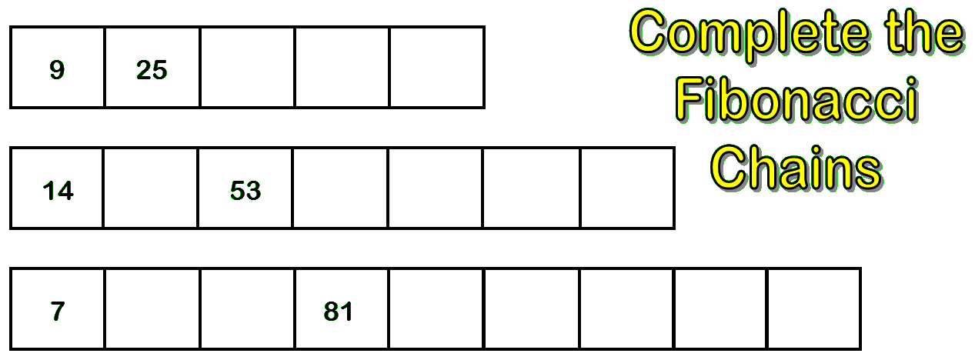
Fibonacci Day 2017 Period 2
The Fibonacci sequence is a series of numbers where the next number is found by adding the two numbers before it.
Can you complete these Fibonacci sequences?
53 – 14 = 39
81 – 7 = 74
74 ÷ 2 = 37
34
59
93
39
92
145
237
382
37
44
125
206
331
537
868
Faculty of Mathematics Where everyone counts

Slide 36
Period
3
Faculty of Mathematics Where everyone counts

Slide 37
Fibonacci Day 2017 Period 3
Today, it’s good to tell a fib!
Faculty of Mathematics Where everyone counts

Slide 38
Fibonacci Day 2017 Period 3
A Fibonacci poem (or Fib) is a multiple-line verse based on the Fibonacci sequence so that the number of syllables in each line equals the total number of syllables in the preceding two lines.
The Fibonacci sequence begins with either zero or one, followed by one, and proceeds based on the rule that each number (called a Fibonacci number ) is equal to the sum of the preceding two numbers.
Faculty of Mathematics Where everyone counts

Slide 39
Fibonacci Day 2017 Period 3
Here's an example:
1 What
1 is
2 a Fib?
3 A poem
5 mathematical
8 Syllables are arranged in lines
13 according to Fibonacci's sequence of numbers:
21 One, one, two, three, five, eight, thirteen,
twenty-one, thirty-four, fifty-five and so on.
Faculty of Mathematics Where everyone counts

Slide 40
Fibonacci Day 2017 Period 3
Because the lines have ever-increasing syllables, the composition of long Fibonacci poems is very challenging. As a result, most have only six or seven lines. The last syllable in each line may rhyme with the last syllable in one or more other lines, although rhyme is not a requirement.
Fibs have become popular among geeks as well as literati. According to some enthusiasts, this new poetic structure has the capacity to spark communication among mathematicians, physicists, chemists, biologists and poets, despite the gulfs that often seem to prevail between their disciplines in other respects.
Faculty of Mathematics Where everyone counts

Slide 41
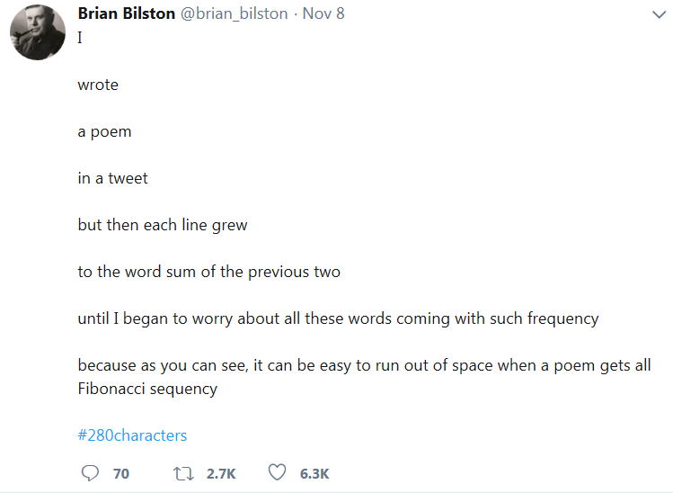
This fib is slightly different – can you work out how?
This time, it’s the number of words that follow the Fibonacci sequence, rather than the number of syllables!
Faculty of Mathematics Where everyone counts

Slide 42
Period
4
Faculty of Mathematics Where everyone counts

Slide 43
Fibonacci Day 2017 Period 4
Video
Faculty of Mathematics Where everyone counts

Slide 44
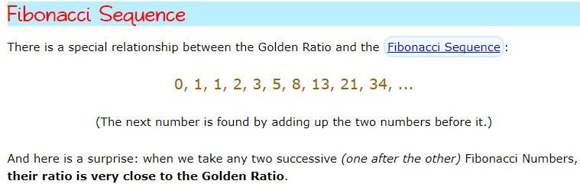
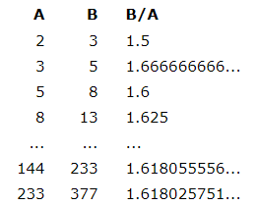
Dividing consecutive numbers in the Fibonacci sequence gets us closer to the golden ratio, the further into the sequence we go.
Faculty of Mathematics Where everyone counts

Slide 45
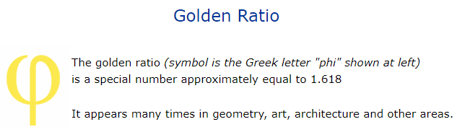
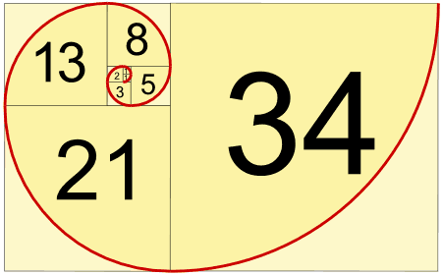
Faculty of Mathematics Where everyone counts

Slide 46
ChristMATHS Monday 18th December
Week-long tutor time competition – “The Days of ChristMATHS” – a daily Christmas Maths challenge, with a prize awarded to one student in each year group at the end of the week.
BIDMAS Day activities for every lesson, similar to Fibonacci Day.
Christmas Murder Mystery Competition
Lesson-time: design Mathematical Christmas decorations to hang at home.

Slide 47
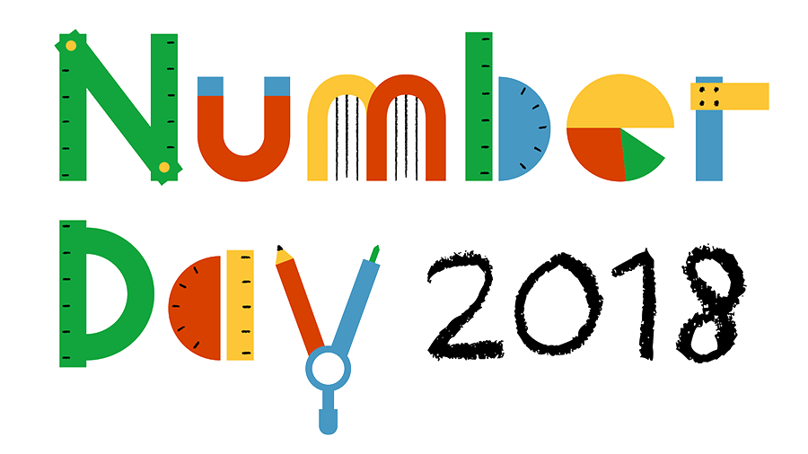
Friday 2nd February
NSPCC provide everything you need to make your Number Day a success. Our activities and resources can be used in class or by the whole school. digital resources you can use in class fundraising tips and ideas to help pupils and teachers raise money maths activities for children of all ages printed posters to promote your event access to teacher resources to keep children safe from harm, supporting your school's safeguarding.

Slide 48

Wednesday 14th March
Competitions and activities using the resources
shared at http://www.piday.org/
Similar to Fibonacci Day…
BIDMAS Day PowerPoint presentation to be
shared at the start of every lesson throughout the day
  Slide 1 – What is Pi and why is it special? (video)
  Slide 2 – Pi in Nature (videos)
  Slide 3 – Calculating circumference and arc length
  Slide 4 – Calculating area (differentiated)
  Slide 5 – Pi and other irrational numbers
Competition for who can remember the most digits of Pi – prizes to be awarded in each year group.

Slide 49
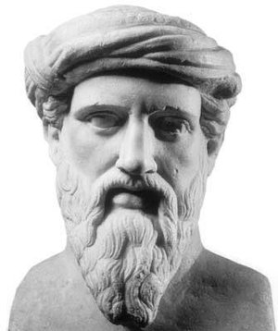
Famous Mathematicians Hunt
Posters about 20 famous mathematicians hidden around the school.
Students collect information about these Mathematicians by filling in missing key information on entry form.
Name: |  | Form:
Who? |  | When? | What?
 | Pythagoras |  | Best known for discovering the Pythagorean Theorem which states that states that the square of the hypotenuse (the side opposite the right angle) is equal to the sum of the squares of the other two sides.

Slide 50

Junior Mathematical Challenge
Thursday 1 February 2018
Top 30 or so students from each year group based on ability and results.
Intermediate Mathematical Challenge
Thursday 26 April 2018
Top set in each year group

Slide 51

Year 7
Numeracy Ninjas is a free Key Stage 3 numeracy intervention designed to fill gaps in students’ basic mental calculation strategies and also to empower them with the numeracy skills and fluency required to fully access GCSE Maths concepts when they move to Key Stage 4 study.
Furthermore, through growth mindsets and the promotion of regular practice, we want to ensure students’ perception of maths is positive and one in which they take pride and enjoyment.
Completed twice a week in Maths lessons, 10-15 mins at the start of lessons.
Awards half-termly for Grand Masters – highest achievers & most improved.
www.numeracyninjas.org

Slide 52

Year 8
Mental Arithmetic is a highly differentiated series of graded workbooks proven to raise children's attainment in maths. Based on ability, rather than age, each book practises the four basic number operations, challenging children to do more complex problems involving logical thinking and to apply knowledge introduced previously.
Completed twice a week in Maths lessons, 5-10 minutes at the start of lessons.

Slide 53
Maths Trip to France 2018
Maths & MFL trip to Paris, France
July 2018

Slide 54
Cross-Curricular Links
In Maths… posters highlighting the use of Maths in other subjects
In other subject classrooms… posters highlighting the Maths skills needed in these lessons

