Slide 1
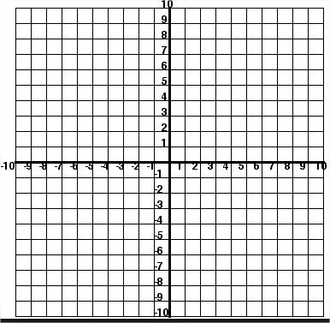
Are these lines parallel?

Slide 2
How could we describe these lines?

Slide 3
Are they perpendicular?
They look perpendicular, but how can we be certain?
We can compare their gradients…
Notes:
Do this as a class so students understand how

Slide 4
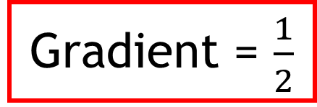
Find the gradient of each line
1
2
Gradient = $\frac{1}{2}$
2
Gradient = -2
1
Notes:
Students to do these on their own

Slide 5
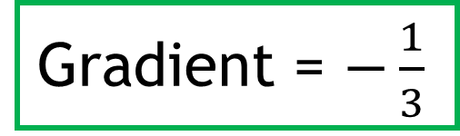
Find the gradient of each line
Gradient = 3
1
3
3
Gradient = $−\frac{1}{3}$
1
Notes:
Students to do these on their own

Slide 6
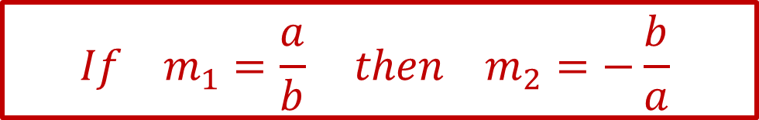
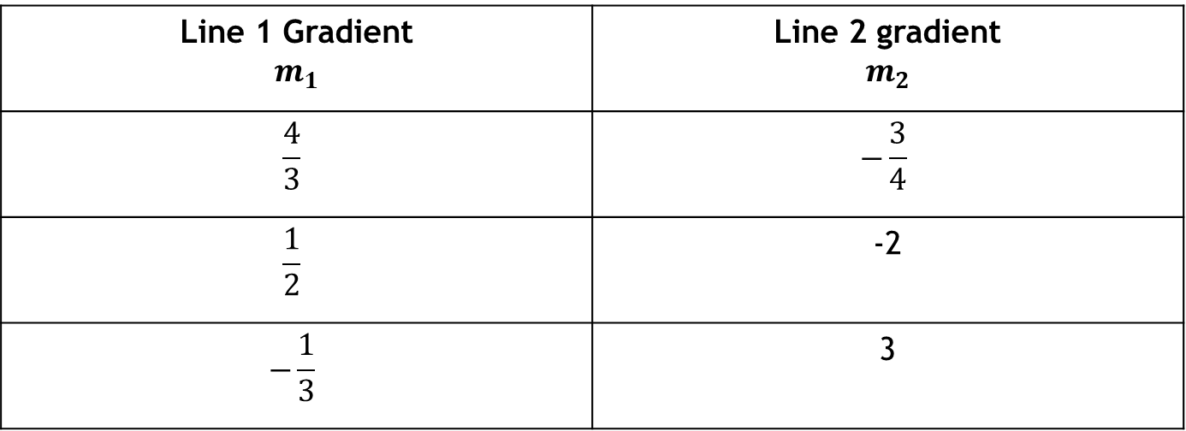
Are they perpendicular?
 | -2
 | 3
Compare the gradients …
What do you notice?

Slide 7
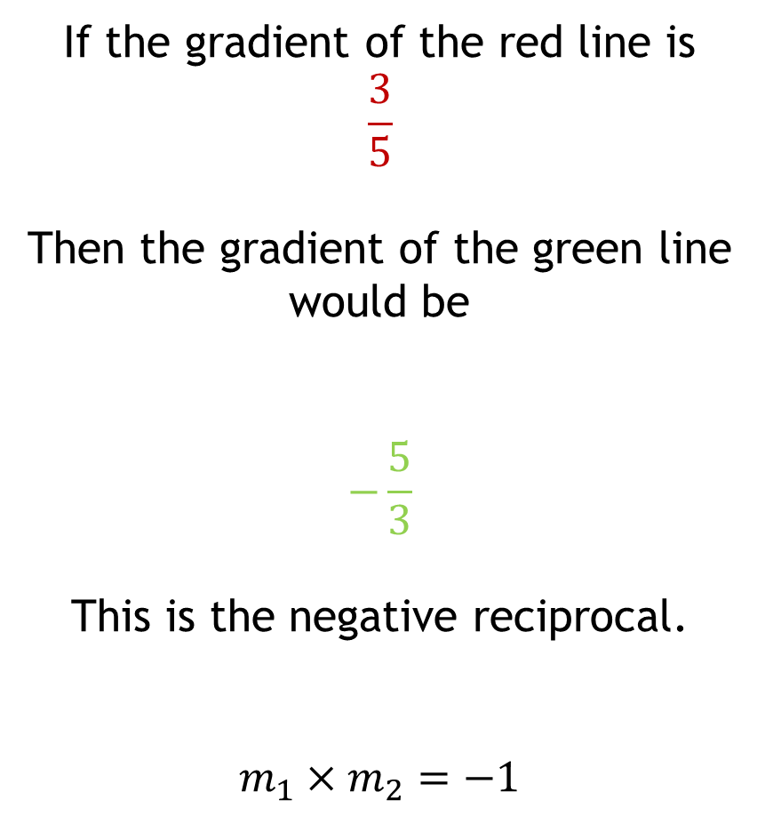
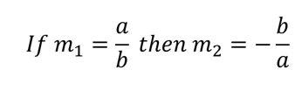
Perpendicular Lines
Gradient = m₁
Gradient = m₂

Slide 8

Perpendicular Lines
Perpendicular lines meet at right angles
The product of the gradients of perpendicular lines is always -1.
The gradients are the
negative reciprocal of each other
Gradient = m₁
Gradient = m₂

Slide 9

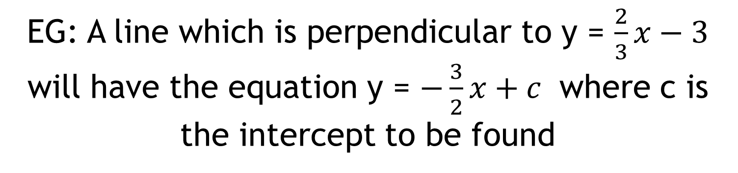
Fill in the blanks
The gradient of a perpendicular line is the negative reciprocal of the other
This means that when the equations are in the form y = mx + c
-1

Slide 10
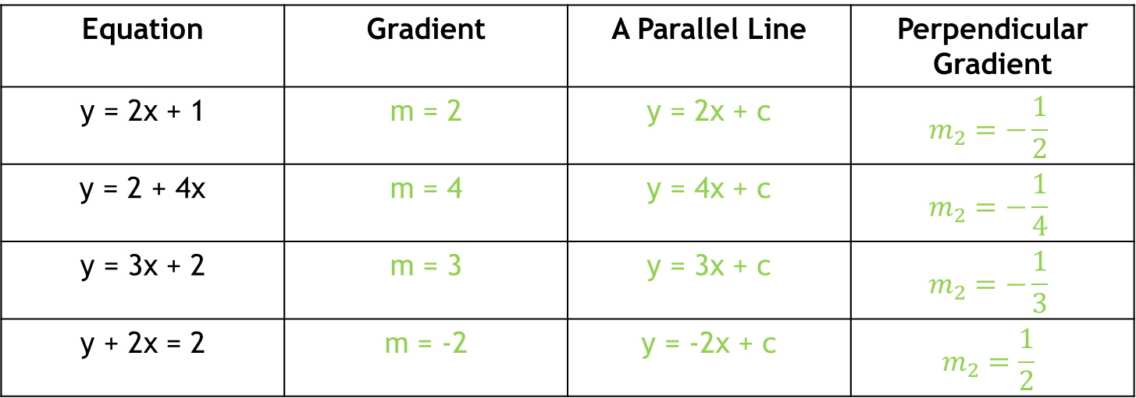
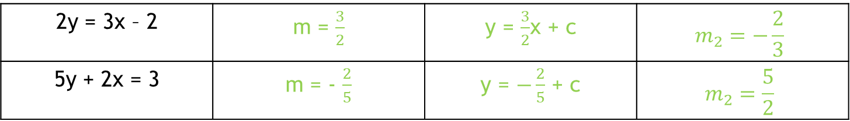
In your books:
Write an equation of a line that is parallel to these
Equation | Gradient | A Parallel Line | Perpendicular Gradient
y = 2x + 1 | m = 2 | y = 2x + c
y = 2 + 4x | m = 4 | y = 4x + c
y = 3x + 2 | m = 3 | y = 3x + c
y + 2x = 2 | m = -2 | y = -2x + c
Challenge:
2y = 3x – 2
5y + 2x = 3

Slide 11
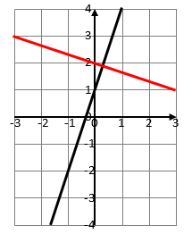
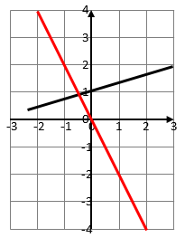
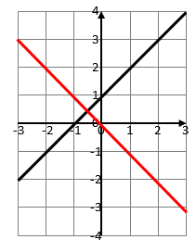
By comparing gradients state whether the following pairs of lines are perpendicular.

Slide 12
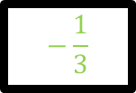
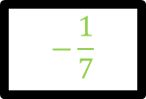
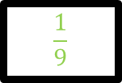
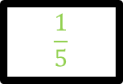
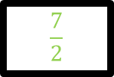


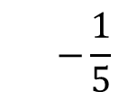
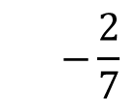
Fill in the gaps with the negative reciprocal
3
x
=
-1
7
x
=
-1
-9
x
=
-1
-5
x
=
-1
$$−\frac{1}{5}$$
x
5
=
-1
$$−\frac{2}{7}$$
x
=
-1
x
=
-1

Slide 13
Consider the following line that has a gradient of 4:
y
y₁
x
On your whiteboards:
Give me an equation of a line that would be perpendicular to this line
and another …

Slide 14
Consider the following line that has a gradient of 4:
y
y₁
x
Discuss:
How many lines are there that are perpendicular to this one?

Slide 15
Consider the following line that has a gradient of 4:
y
y₁
x
Discuss:
How could I change my question so that there was only one correct equation?
What other information would you need?

Slide 16
There are an infinite number of lines that are perpendicular to the one I have drawn …
We do not have enough information to be able to determine which particular line it is.
y
y₁
x
?
?
To do this we must have a coordinate on the new line as well.
?

Slide 17
Find the equation of the line that is perpendicular to
y = 3x + 2
and that passes through the point (0, -1)
Discuss:
What new information do we have in this question?

Slide 18
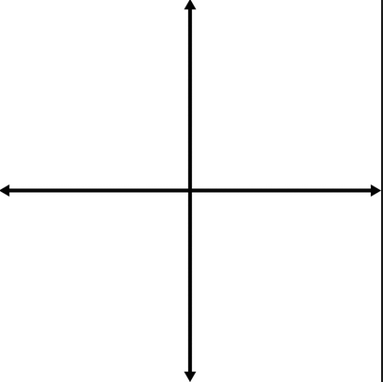
Find the equation of the line that is perpendicular to
y = 3x + 2
and that passes through the point (0, -1)
How can we find the gradient of the new line?
What will the y-intercept of the new line be?
What is the equation of the new line?

Slide 19
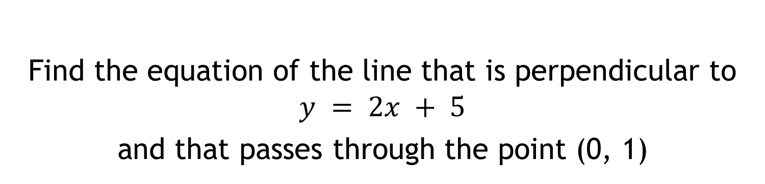
On your whiteboards…
Find the equation of the line that is perpendicular to
$$y = 2x + 5$$
and that passes through the point (0, 1)
m =
c =
Equation
Notes:
Print this slide for students to attempt

Slide 20
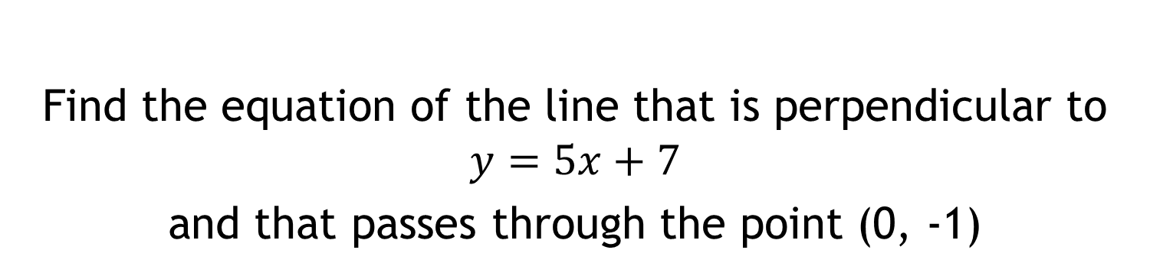
In your books…
Find the equation of the line that is perpendicular to
$$y=5x+7$$
and that passes through the point (0, -1)
m =
c =
Equation
Notes:
Print this slide for students to attempt

