Slide 1
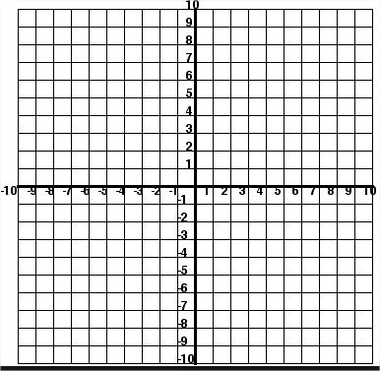
Recap –
Draw the graph for the line y = 3x -3
x | -2 | -1 | 0 | 1 | 2
y
State three coordinates that lie on the line but will not fit on your grid.
How do you know that they will lie on the line?

Slide 2
Starter –
Draw the graph for the line y = 3x -3
x | -2 | -1 | 0 | 1 | 2
y | -9 | -6 | -3 | 0 | 3

Slide 3
Log on to the laptops and…
Go to www.desmos.com/calculator
Use the website to investigate the questions in your booklet.
Try to write your answers in full using the mathematical terminology below:
Parallel gradient coordinate perpendicular y-intercept

Slide 4
Challenge:
Delete all your graphs and points.
Type in the following:
y = x {-2 < x < 2}
A line segment will appear.
The information in curly brackets tells you how to restrict the values of x that are used to draw the line.
Your challenge is to use what you now know about straight line graphs to crate a picture using only straight lines.

Slide 5
In summary …
What is y = mx + c?
How does the line change as m changes?
How does the line change as c changes?

