Slide 1
Are the lines the same?
Do these two cards describe the same straight line?
How can you tell?
Line A passes through (0, 2) and (6, 10) | Line B passes through (6, 10) and (10, 16)

Slide 2
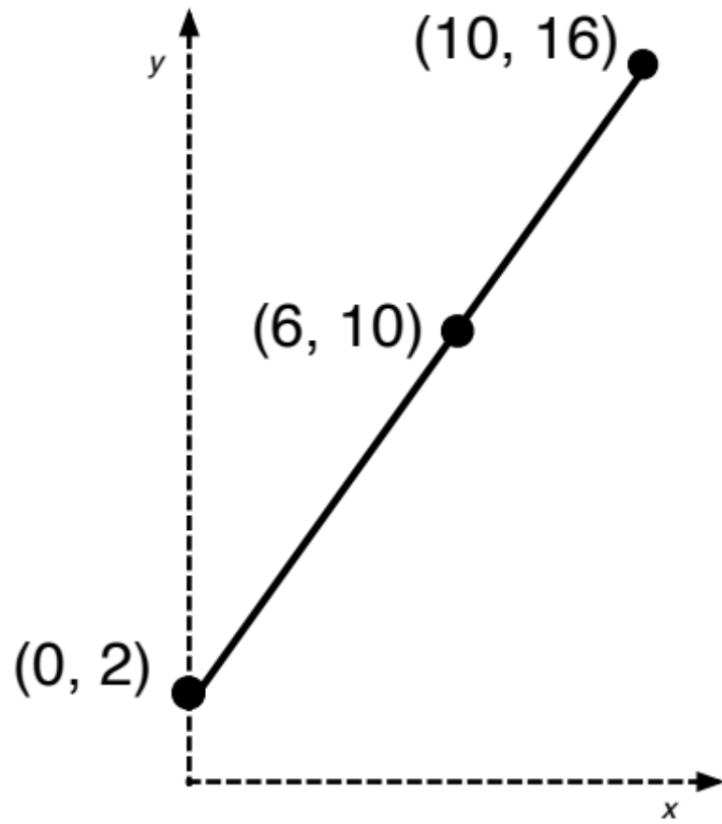
Let’s plot them!
Are the lines the same?
If we plot the points they look like they might be the same straight line ….
But looks can be deceptive.
How can we be sure?

Slide 3
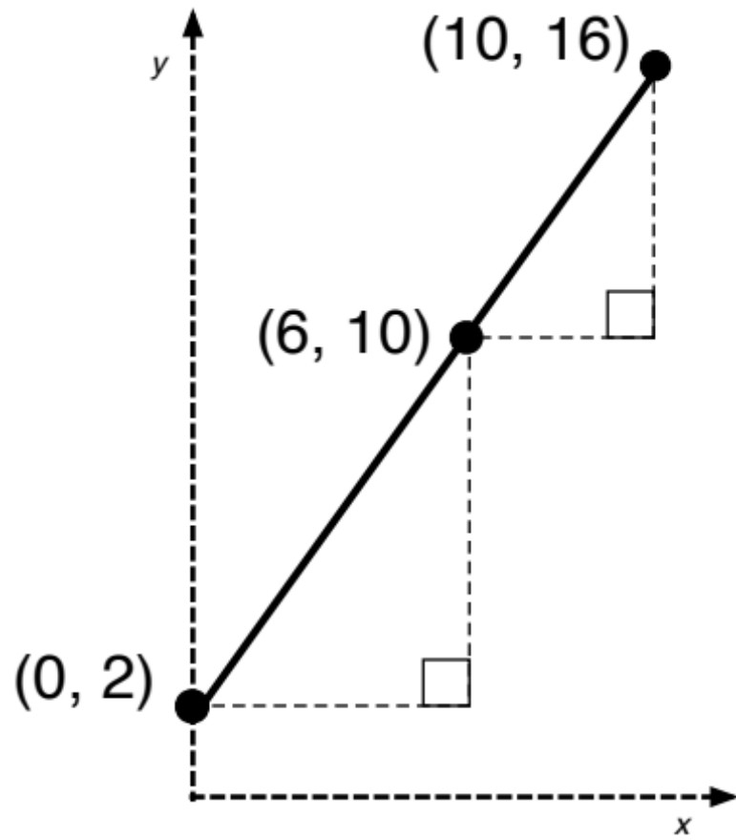
Let’s plot them!
Are the lines the same?
Here are some construction lines that might help you decide.

Slide 4
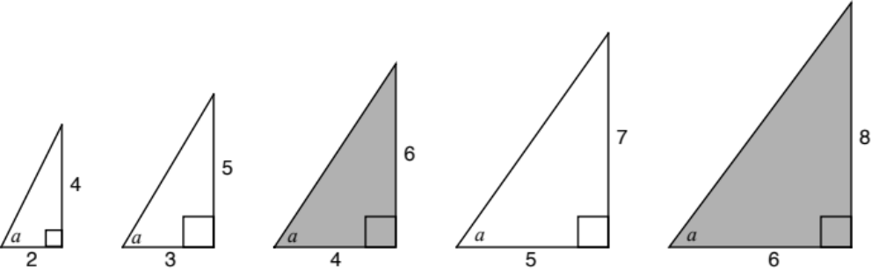
Are these triangles similar?
Are the lines the same?
Are the angles marked “a” all equal?

Slide 5
Working Together
Are the lines the same?
Look for pairs of cards that describe the same line.
Some of the cards have information missing. You will need to work out the missing information once you have matched the card.
Before writing anything down, describe your reasoning to your partner. Your partner must challenge your explanation if they disagree, or describe it in their own words if they agree.
Once agreed, glue the pair of cards onto the poster and write your reasoning in pencil next to it.
Work together until all the cards are placed.

Slide 6
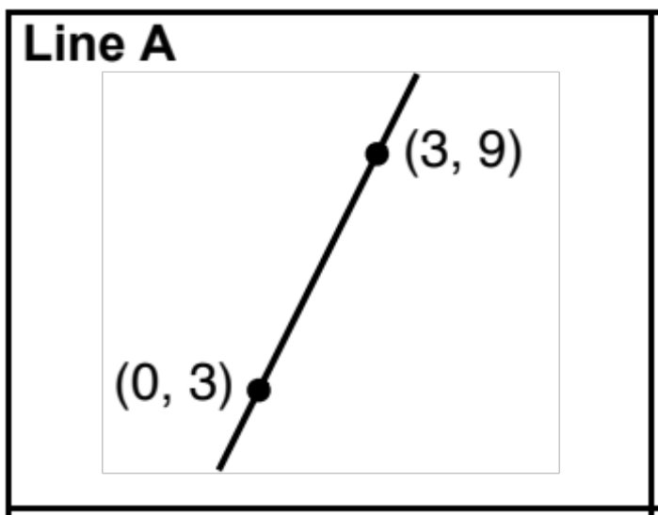
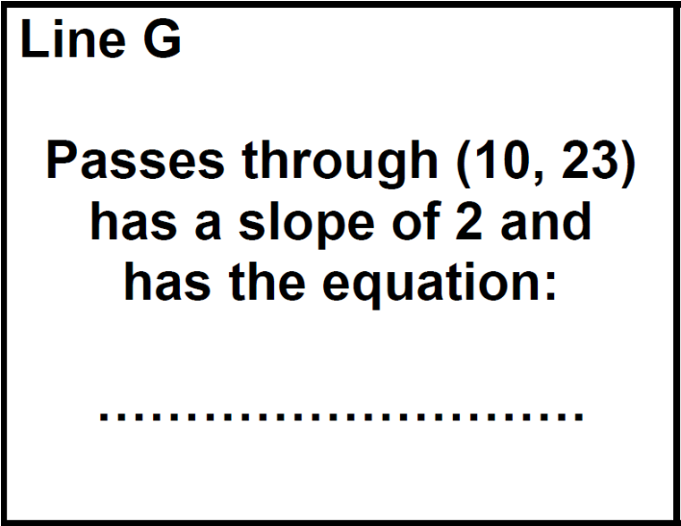
Cards A and G
Are the lines the same?
How can we tell that these are the same line?

Slide 7
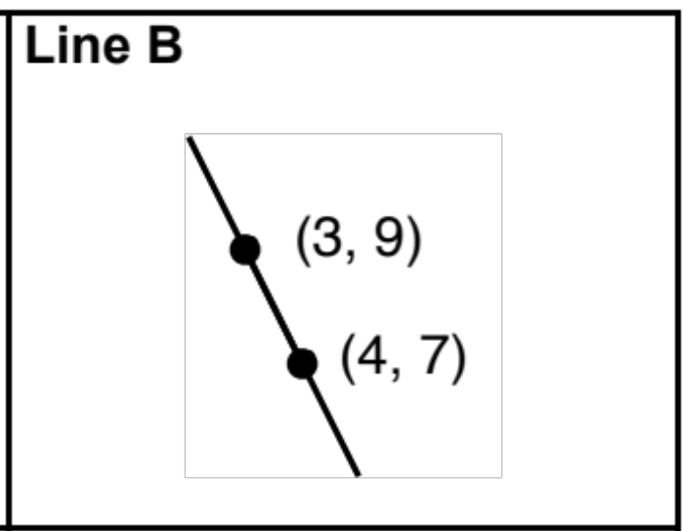
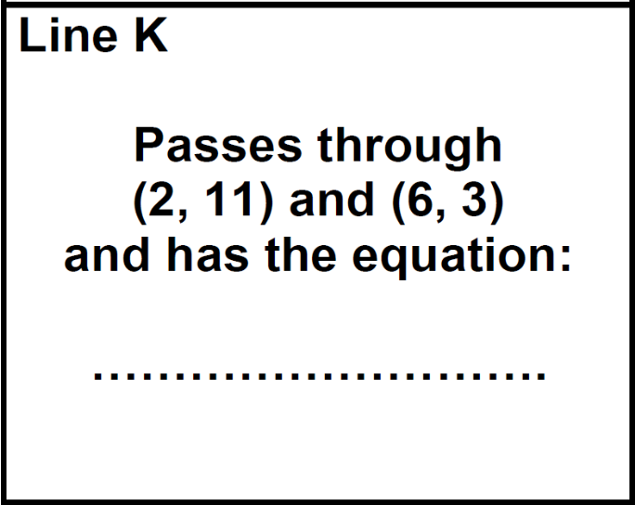
Cards B and K
Are the lines the same?
How can we tell that these are the same line?

Slide 8
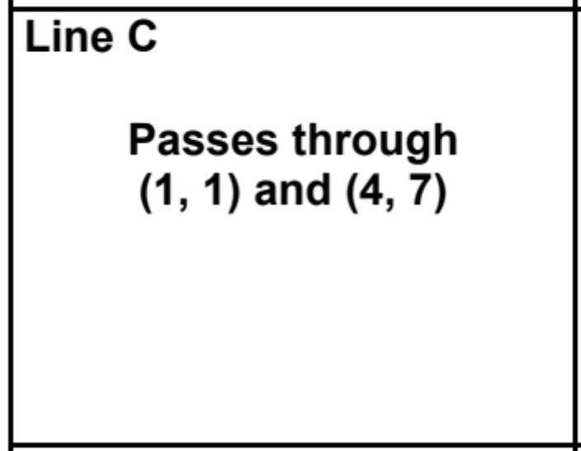
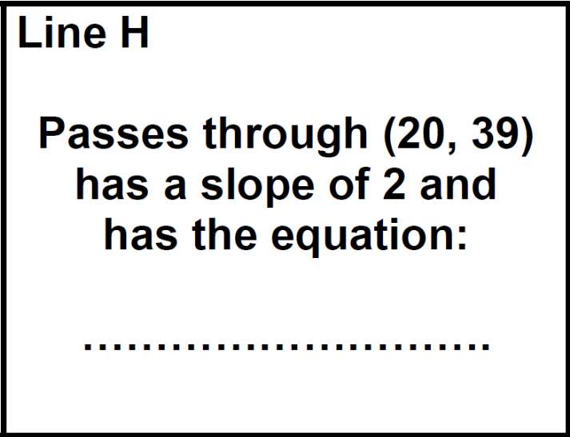
Cards C and H
How can we tell that these are the same line?

Slide 9
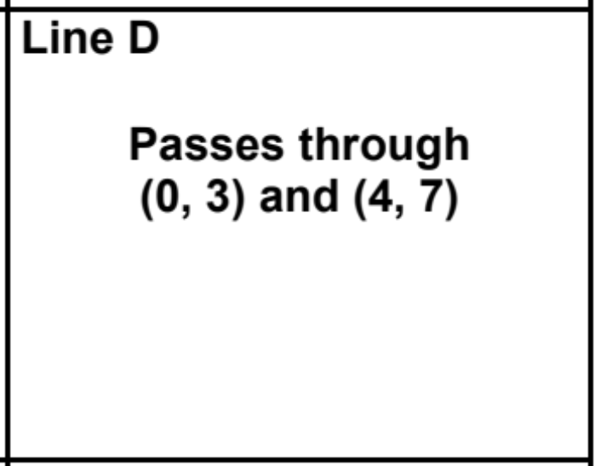
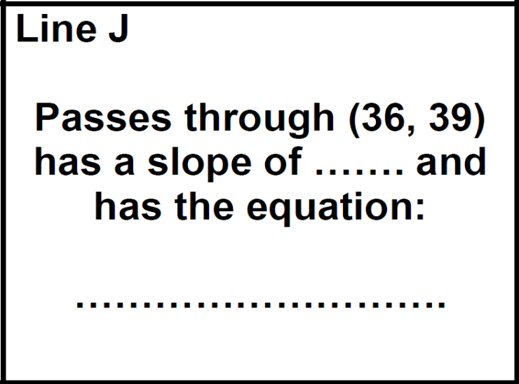
Cards D and J
Are the lines the same?
How can we tell that these are the same line?

Slide 10
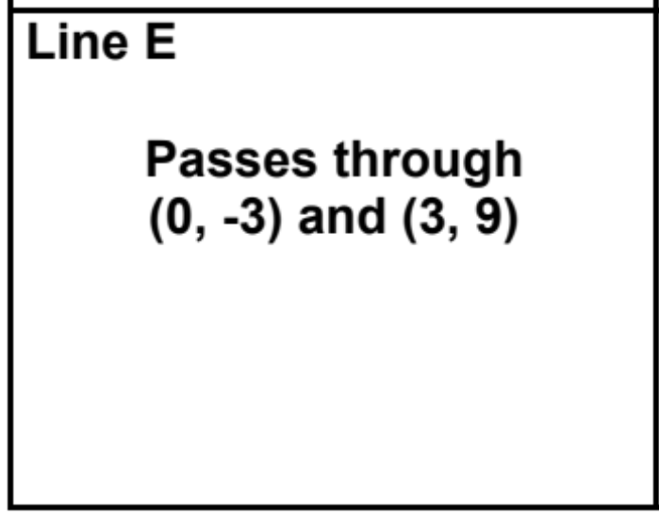
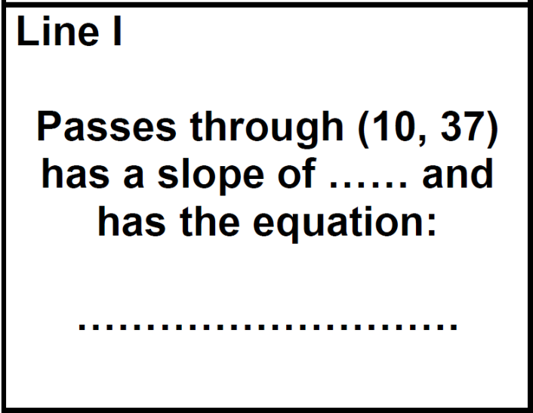
Cards E and I
Are the lines the same?
How can we tell that these are the same line?

Slide 11
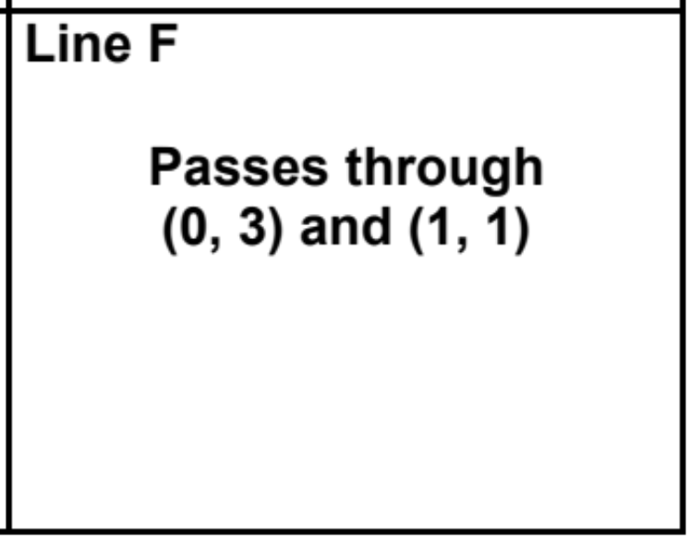
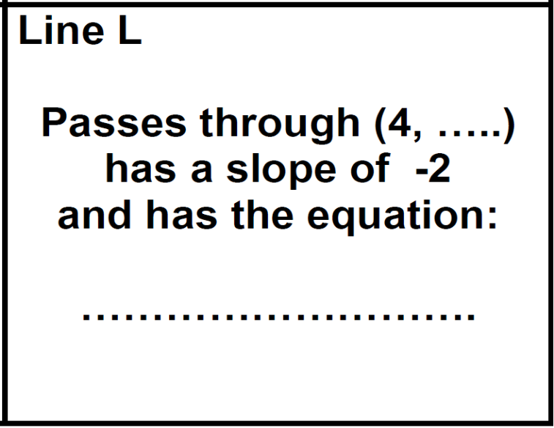
Cards F and L
Are the lines the same?
L doesn’t have enough information to define a line.
If they are the same line, what must this information be?

