Slide 1
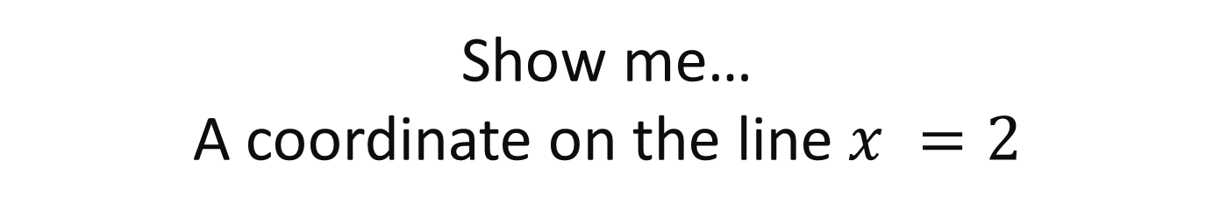
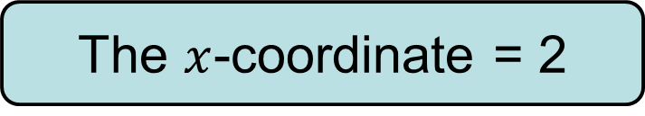
Show me…
A coordinate on the line $x =2$
Remember what that equation means…
The $x$-coordinate = 2

Slide 2
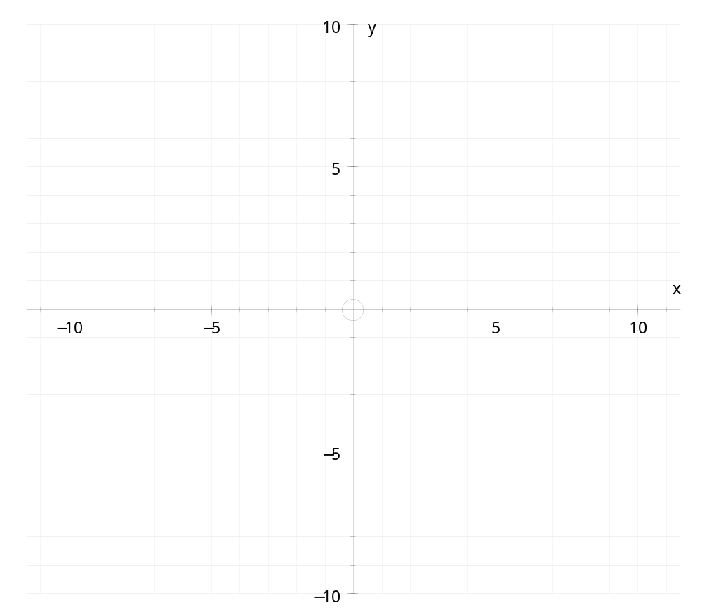

Draw the line $x =2$on your grids

Slide 3
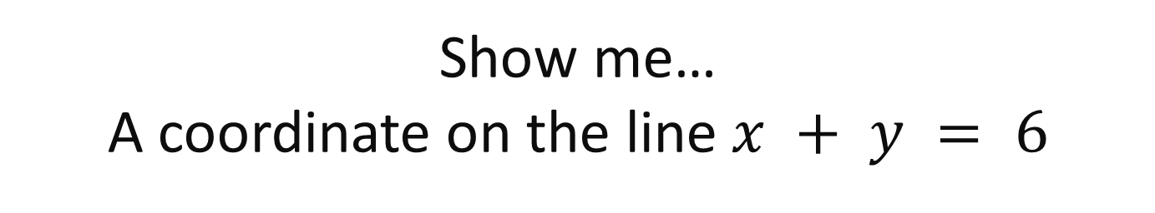
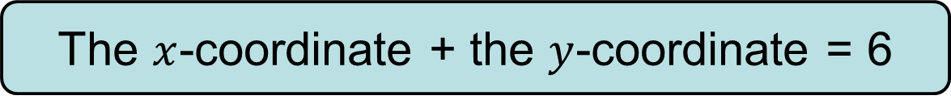
Show me…
A coordinate on the line $x + y = 6$
What do you think it means?
The $x$-coordinate + the $y$-coordinate = 6

Slide 4
Show me…
A coordinate on the line $x + y = 6$
What do you think it means?
The $x$-coordinate + the $y$-coordinate = 6

Slide 5
Show me…
A coordinate on the line $x + y = 6$
Choose three coordinates from around the room and plot them on your grid.

Slide 6
Show me…
A coordinate on the line $x + y = 6$

Slide 7
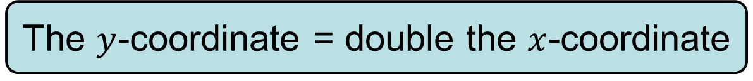
Show me…
A coordinate on the line y = 2x
What do you think it means?
The $y$-coordinate = double the $x$-coordinate

Slide 8
Show me…
A coordinate on the line y = 2x
Choose three coordinates from around the room and plot them on your grid.

Slide 9
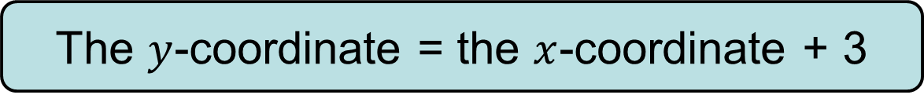
Show me…
A coordinate on the line y = x + 3
What do you think this equation means?
The $y$-coordinate = the $x$-coordinate + 3

Slide 10
Show me…
A coordinate on the line y = x + 3
Choose three coordinates from around the room and plot them on your grid.

Slide 11
Show me…
A coordinate on the line y = 2x + 3
Choose three of your own coordinates and plot them on the grid.

Slide 12
2
Show me another coordinate on the line
( 4 , 10)
is a coordinate on the line
y = 2x + ?

Slide 13
12
Show me another coordinate on the line
( ? , 24)
is a coordinate on the line
y = 2x

Slide 14
18
Show me another coordinate on the line
( 17 , 35)
is a coordinate on the line
y = x + ?

Slide 15
23
Show me another coordinate on the line
( 8 , ?)
is a coordinate on the line
y = 3x - 1

Slide 16
10
Show me another coordinate on the line
( ? , 7)
is a coordinate on the line
y = x - 3

Slide 17
1
Show me another coordinate on the line
( ? , ½ )
is a coordinate on the line
2y = x

Slide 18
3
Show me another coordinate on the line
( 4 , 12 )
is a coordinate on the line
y = ?x

Slide 19
13
Show me another coordinate on the line
( 14 , 1 )
Is a coordinate on the line
y = x - ?

Slide 20
11
Show me another coordinate on the line
( 3 , ? )
Is a coordinate on the line
y = 2x + 5

Slide 21
8
Show me another coordinate on the line
( 3 , 24 )
Is a coordinate on the line
y = ?x

Slide 22
Plotting graphs of linear functions
Instead of just picking random coordinates to draw a line, we can find coordinates that obey the function by constructing a table of values.
Suppose we want to plot points that obey the function
y = 2x + 5
We can use a table as follows.
Substitute the values of x to find the value of y.
x
–3
–2
–1
0
1
2
3
y
–1
1
3
5
7
9
11
(–3, –1)
(–2, 1)
(–1, 3)
(0, 5)
(1, 7)
(2, 9)
(3, 11)
Notes:
Explain that when we construct a table of values, the value of y depends on the value of x. That means that we choose the values for x and substitute them into the equation to get the corresponding value for y.
The minimum number of points needed to draw a straight line is two, however, it is best to plot several points to ensure that no mistakes have been made.
The points given by the table can then be plotted to give the graph of the required function.

Slide 23
Plotting graphs of linear functions
For example,
y
to draw a graph of y = 2x + 5:
1) Complete a table of values:
x
–3
–2
–1
0
1
2
3
y = 2x + 5
y
–1
1
3
5
7
9
11
2) Plot the points on a coordinate grid.
3) Draw a line through the points.
x
4) Label the line.
5) Check that other points on the line fit the rule.
Notes:
This slide summarizes the steps required to plot a graph using a table of values.

Slide 24
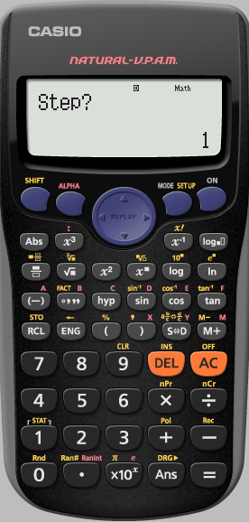
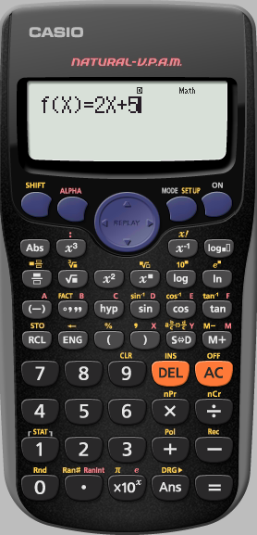
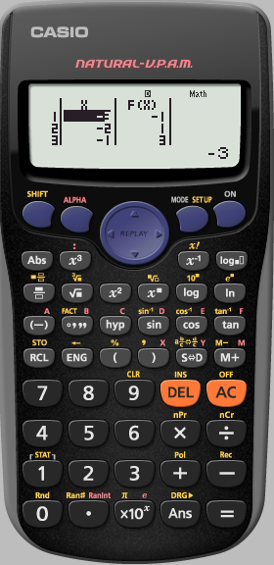
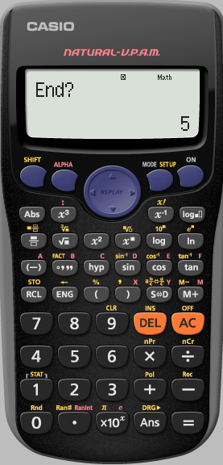
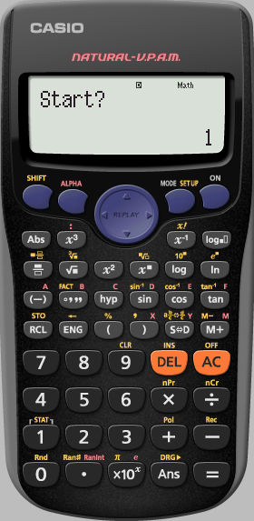
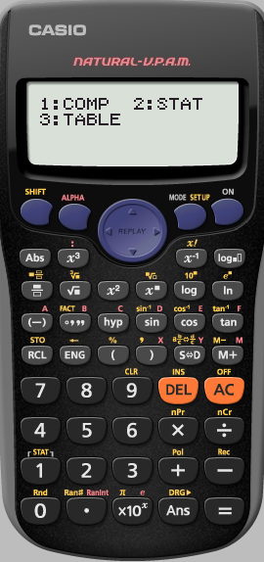
Using a calculator
To draw a graph of y = 2x + 5:
1) Complete a table of values:
Goes up in 1’s
x
–3
–2
–1
0
1
2
3
y
–1
1
3
5
7
9
11
Type in 3
Type in -3
Notes:
This slide summarizes the steps required to plot a graph using a table of values.

Slide 25
Question 1:
Draw a set of axes from -3 to 3 on the x-axis, and from -5 to 10 on the y axis.
Fill in the table without a calculator for each equation
Check your answers are correct using the table function on the calculator.
Draw a graph for each equation on the same set of axes.
x
–3
–2
–1
0
1
2
3
y = 2x + 1
y = 2x + 2
y = 2x + 3
y
x
–3
–2
–1
0
1
2
3
y
x
–3
–2
–1
0
1
2
3
y

Slide 26
Question 2:
Draw a set of axes from -3 to 3 on the x-axis, and from -10 to 10 on the y axis.
Fill in the table without a calculator for each equation
Check your answers are correct using the table function on the calculator.
Draw a graph for each equation on the same set of axes.
x
–3
–2
–1
0
1
2
3
y = x - 1
y = 2x - 1
y = 3x -1
y
x
–3
–2
–1
0
1
2
3
y
x
–3
–2
–1
0
1
2
3
y

Slide 27
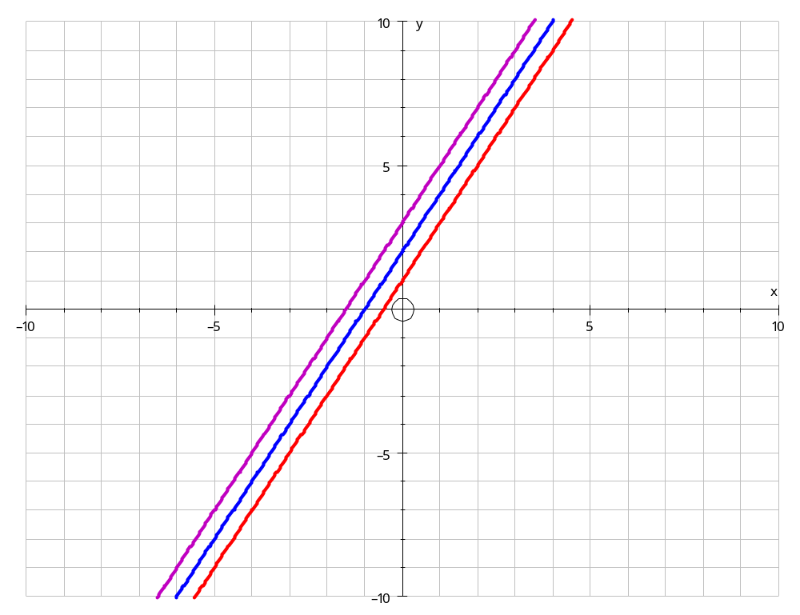
Question 1
The three lines are parallel
On your whiteboards:
Show me an equation of another line that is parallel to these lines.

Slide 28
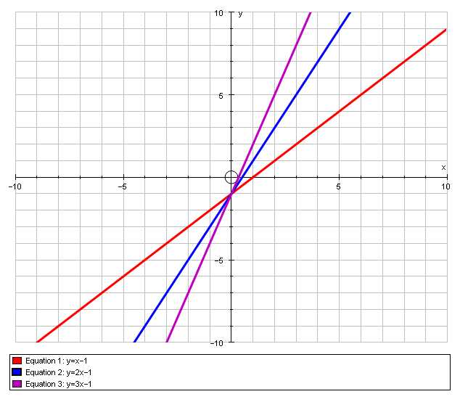
Question 2
The three lines cross at the same point on the y-axis.
They have the same y-intercept
On your whiteboards:
Show me another equation that has the same y-intercept

Slide 29
Question 2
Which equation gives the steepest line?
Can you write down an equation of a steeper line?

Slide 30
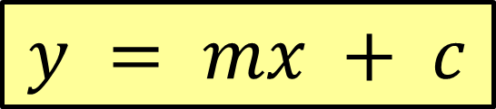
In your books
Title: The equation of a straight line
The general equation of a straight line can be written as:
$$y = mx + c$$
The value of $m$ tells us how steep the line is. This is called the gradient of the line.
The value of $c$ tells us where the line crosses the y-axis.
This is called the y-intercept and it has the coordinate (0, c).
For example, the line y = 3x + 4
has a gradient of 3 and crosses the y-axis at the point (0, 4).

Slide 31
On your whiteboards…
y = 2x + 3
y = -3x + 1
y = 4x - 3
y = -5x - 4
y = 2x + 5
y = 4x + 1
Which of these lines are parallel?

Slide 32
On your whiteboards…
y = 2x + 3
y = -3x + 1
y = 4x - 3
y = -5x - 4
y = 2x + 5
y = 4x + 1
Which of these lines have the same y-intercept

Slide 33
On your whiteboards…
y = 2x + 3
y = -3x + 1
y = 4x - 3
y = -5x - 4
y = 2x + 5
y = 4x + 1
Which line is the steepest?

Slide 34
On your whiteboards…
y = 2x + 3
y = -3x + 1
y = 4x - 3
y = -5x - 4
y = 2x + 5
y = 4x + 1
Which lines slope downwards?

