Slide 1
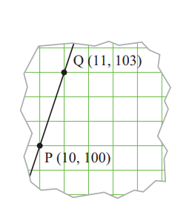
Lesson
Points on a line
The diagram shows a straight line drawn through points P and Q.
P has coordinates (10, 100) and
Q has coordinates (11, 103).
Another point A also lies on the line. Its x-coordinate is 5.
Find the value of its y-coordinate.
Find different ways of getting the answer.

Slide 2
I have joined an evening class to learn Spanish
cooking. The graph we’ve been looking at is about the cost.
Thus 10 lessons would cost me £100, and
11 lessons would cost me £103, etc.
If I tell you how many lessons I’ve attended, what is the rule for working out the cost?”

